Slide 1



AI Image Generation Project
Powered by Stable Diffusion

Slide 2

Learning Objectives
▶ Implement AI image generation with Stable Diffusion.
▶ Optimize models for low VRAM GPUs.
▶ Use Hugging Face and PyTorch effectively.
GOAL: ▶ Create an accessible program for generating images from text prompts on modest hardware or cloud platforms.
GOAL
Source :
www.freepik.com/

Slide 3
Tools and Technology used:
▶ Python
▶ PyTorch with CUDA
▶ Hugging Face Diffusers
▶ Google Colab (T4 GPU)
▶ Matplotlib

Slide 4
Methodology
Model Selection: Chose Stable Diffusion v1.5 for robust text-to-image generation.
Optimization: Applied FP16 precision, attention slicing, and VAE slicing to run on 4GB VRAM GPUs.
Setup: Configured environment with PyTorch, CUDA, and Hugging Face libraries; provided Google Colab option.
Execution: Generated 512x512 images from prompts using StableDiffusionPipeline.
Output: Saved and displayed images with Matplotlib.

Slide 5
Problem Statement:
▶ High-quality image generation requires significant GPU resources.
▶ Complex setup for AI models is challenging for beginners.
▶ Need for an optimized, accessible solution for low-end hardware.

Slide 6
Solution:
▶ Python script (Generate.py) using Stable Diffusion.
▶ Optimized for 4GB VRAM GPUs and Google Colab.
▶ Simple setup with README.md guide.
pipe = StableDiffusionPipeline . from_pretrained ( " runwayml / stable - diffusion -v1 -5", torch_dtype = torch . float16 ). to (" cuda ")
image = pipe ("A man riding a Kawasaki bike ", num_inference_steps =25) . images [0]

Slide 7
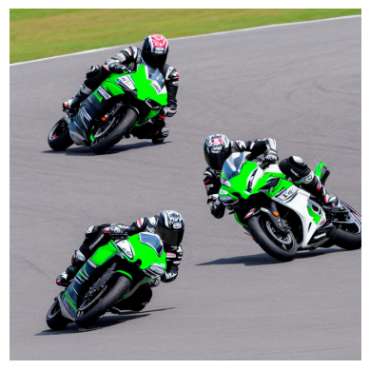
Screenshot of Output:
Connection
▶ Output: 512x512 image (optimized_image.png).
▶ Example: "A man riding a Kawasaki bike on a race track“.

Slide 8
Conclusion:
▶ Accessible AI image generation with Stable Diffusion.
▶ Runs on low VRAM GPUs and cloud platforms.
▶ Future: Support newer models, enhance prompts.

