Slide 1



Crop and Fertilizer Recommendation System using Machine Learning

Slide 2

Learning Objectives
Understand the importance of crop and fertilizer recommendation systems in agriculture.
Learn how to preprocess agricultural datasets for machine learning models.
Explore various features and their distributions in the dataset.
Implement machine learning algorithms to predict the best crops and fertilizers.
Evaluate the performance of the machine learning models.
Develop a user-friendly function to recommend crops and fertilizers based on input conditions.
GOAL
Source :
www.freepik.com/

Slide 3
Tools and Technology used
Python: Programming language used for data manipulation and machine learning model implementation.
Pandas: Library for data manipulation and analysis.
NumPy: Library for numerical computations.
Matplotlib: Library for data visualization.
Seaborn: Library for statistical data visualization.
Scikit-learn: Machine learning library for model building and evaluation.
VS Code: Interactive environment for writing and running code.

Slide 4
Methodology
1. Data Collection:
- Collected crop and fertilizer datasets from reliable sources.
2. Data Preprocessing:
- Handled missing values and duplicates.
- Encoded categorical variables.
- Scaled numerical features for better model performance.
3. Exploratory Data Analysis (EDA):
- Visualized data distributions and relationships using histograms, scatter plots, and heatmaps.
- Identified patterns and correlations in the data.
4. Feature Selection:
- Selected relevant features for model training based on EDA insights.

Slide 5
Methodology
5. Model Training:
- Split data into training and testing sets.
- Trained Decision Tree Classifier models for crop and fertilizer recommendations.
6. Model Evaluation:
- Evaluated model performance using accuracy scores on test data.
- Fine-tuned models to improve accuracy.
7. Prediction Function:
- Developed functions to predict the best crop and fertilizer based on input conditions.
8. Deployment:
- Deployed the models in a Jupyter Notebook for interactive predictions.

Slide 6
Problem Statement:
The goal of this project is to develop a machine learning-based recommendation system for crops and fertilizers. The system aims to assist farmers in making informed decisions about the best crops to grow and the most suitable fertilizers to use based on various environmental and soil conditions. By leveraging data analysis and predictive modeling, the project seeks to enhance agricultural productivity and sustainability.

Slide 7
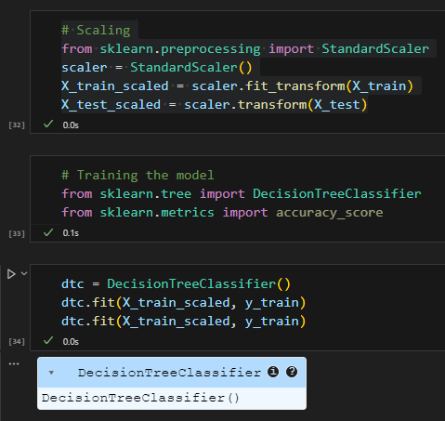
Solution:
The solution involves developing two machine learning-based recommendation systems: one for crop recommendation and another for fertilizer recommendation.
1. Crop Recommendation System:

Slide 8
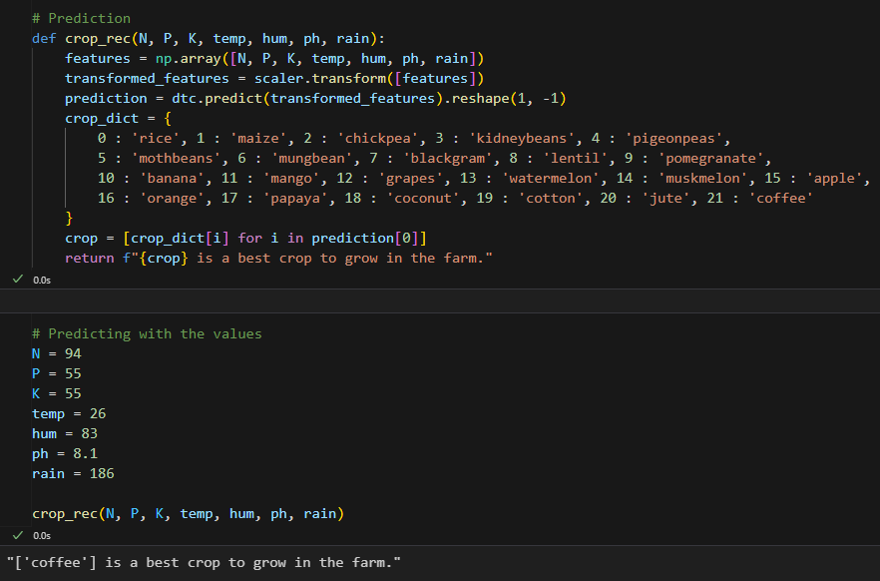
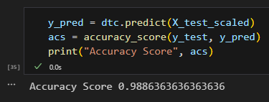
Screenshot of Output:

Slide 9
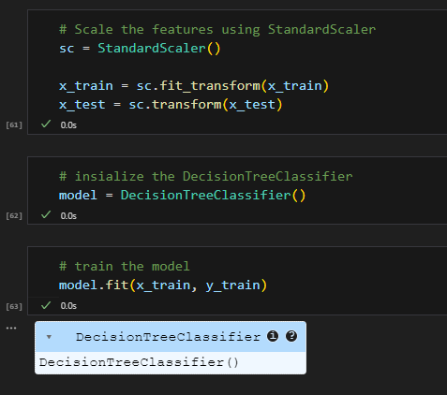
Solution:
2. Fertilizer Recommendation System

Slide 10
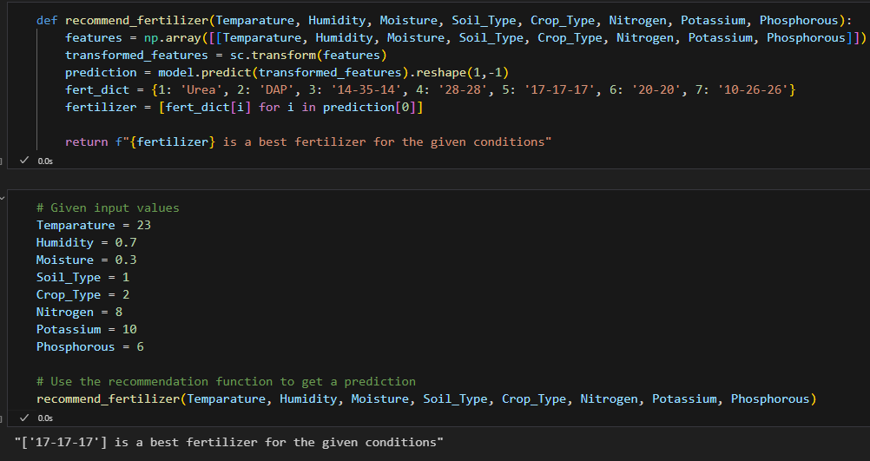
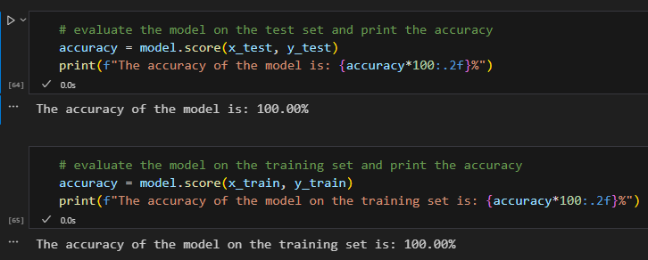
Screenshot of Output:

Slide 11
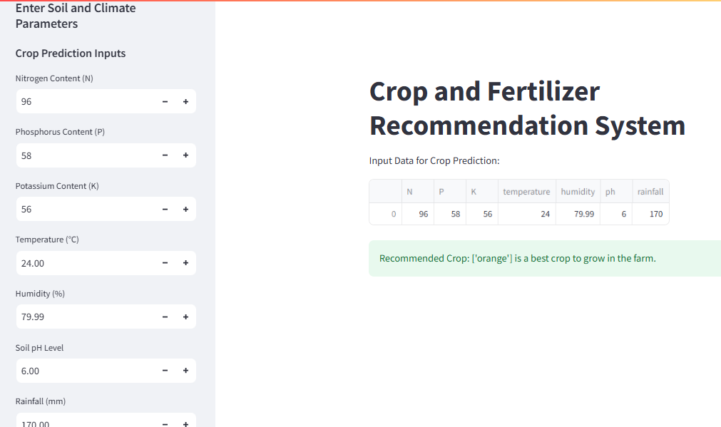
Screenshot of Streamlit Application:

Slide 12
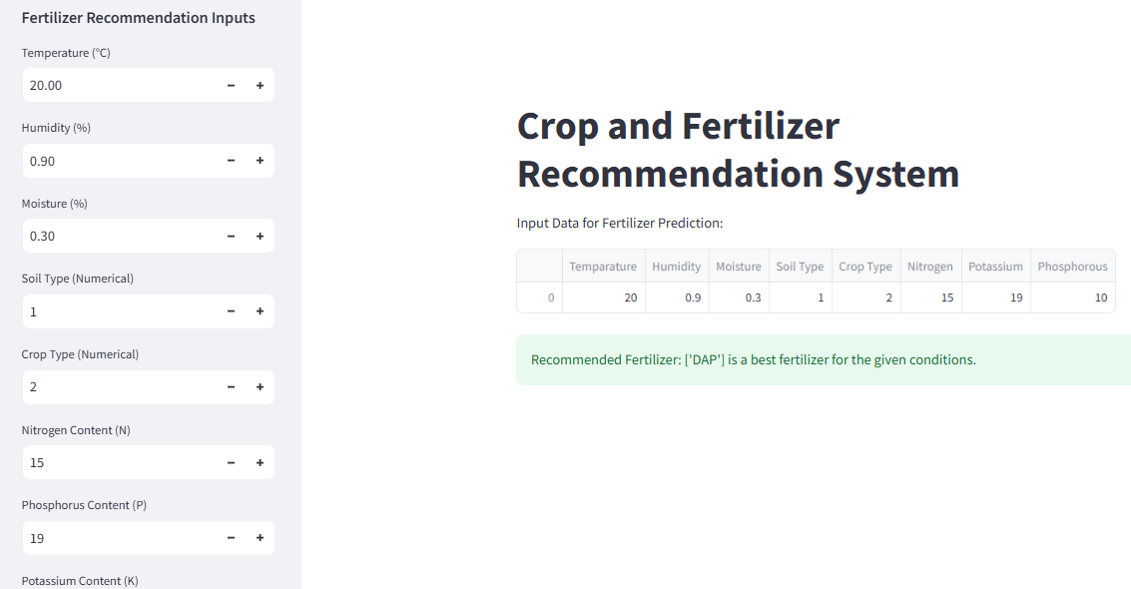
Screenshot of Streamlit Application:

Slide 13
Conclusion:
The development of the Crop Recommendation System and Fertilizer Recommendation System using machine learning has shown promising results in assisting farmers with their agricultural decisions.
1. Crop Recommendation System:
- Achieved high accuracy in predicting the best crop to grow based on environmental and soil conditions.
- Utilized a Decision Tree Classifier for model training and prediction.
2. Fertilizer Recommendation System:
- Successfully recommended the most suitable fertilizer based on soil type, crop type, and other relevant features.
- Employed a Decision Tree Classifier to achieve accurate predictions.
Both systems aim to enhance agricultural productivity and sustainability by providing data-driven recommendations, ultimately benefiting farmers and contributing to more efficient farming practices.
THANK YOU

