Slide 1

CAREER COMPASS USING SUPERVISED MACHINE LEARNING
CS5610
ADVANCED R FOR DATA SCIENCE
Team Members:
Lahari Potharaju
Tanuja Neelapu
Nikhil Sairam Adari

Slide 2
CONTENTS:
Introduction
Objectives
Tools & Libraries
Data Description
Design and Overview Methods
Machine Learning Models
Shiny App Structure& Features
Machine Learning Models& Accuracy
Project Challenges
Demo
Conclusion

Slide 3
Introduction:
We are starting a project to build a career guidance system using data analysis and machine learning to uncover factors influencing career growth.
The initial phase will focus on collecting, cleaning, and analyzing historical career data to identify patterns and trends.
We will develop an R Shiny web application to provide personalized career insights and recommendations to users.
The goal is to create an accessible, data-driven tool that helps individuals make well-informed decisions about their career progression.

Slide 4
Objectives:
Our goal is to combine insights from data analysis with practical career advice, helping professionals make better decisions about their career paths.
Analyze historical career data to identify key factors that drive career advancement.
Develop machine learning models, like Random Forest, to predict career progression.
Provide personalized, actionable career guidance through an easy-to-use R Shiny web application.

Slide 5
Tools & Libraries
R + Shiny: For interactive web app.
Machine Learning: randomForest, glm, svm (e1071)
Data Manipulation: dplyr, readr
Visualization: ggplot2, plotly, corrplot
Tables & UI: DT, shinythemes, shinyWidgets
Metrics: MLmetrics (F1 Score, Accuracy)

Slide 6
Data Description:
The data set captures detailed information on professional career paths and skill sets.
The key variables include:
We collected the data from Kaggle.
There are 11 attributes and 1251 observations in the data file “linkedin.csv”.
Upon cleaning the data, we will use category, experience, position, clean_skills to determine the outstanding resume for the required category.

Slide 7
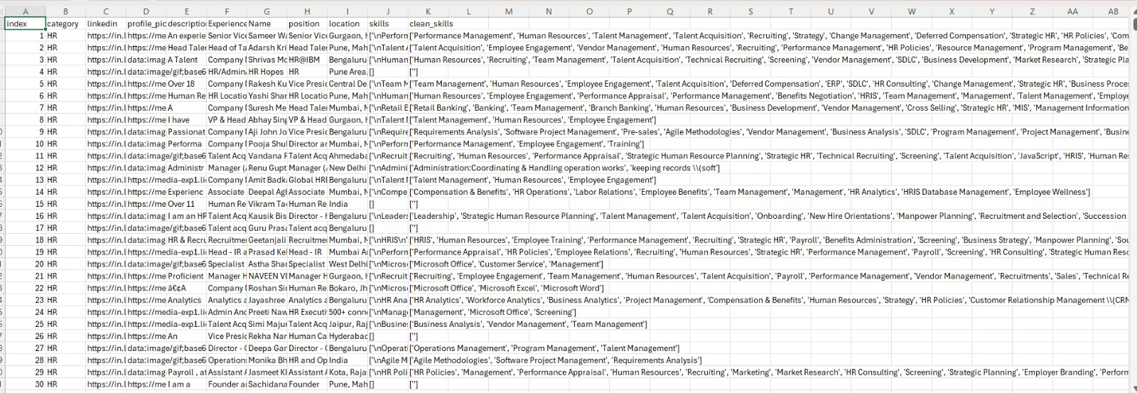

Slide 8
Design And Overview Methods:
Data Gathering and Preparation:
Collect relevant career data (e.g., experience, skills, job titles).
Clean and transform data to ensure consistency and usability.
Exploratory Data Analysis (EDA):
Perform statistical summaries to understand distributions.
Use visualizations (e.g., histograms, scatter plots) to spot patterns or outliers.
Feature Engineering:
Derive new variables (e.g., skill categories, skill counts).
Select and rank features based on correlation or importance metrics.

Slide 9
Model Building
Train a Random Forest classifier to predict career advancement.
Split data into training and testing sets for reliable evaluation.
Model Evaluation
Assess performance using Accuracy, Precision, Recall, and F1 Score.
Tune hyperparameters to improve model results.
Application Development (R Shiny)
Build an interactive web app for inputting user data and viewing predictions.
Integrate visualizations (ggplot2, plotly) and generate personalized reports.

Slide 10
Machine Learning Models
Random Forest:
Many Trees: Random Forest uses many decision trees to make better predictions.
Random Choices: It picks random data and features to build each tree, making the model stronger.
Better Results: It gives accurate results and works well even if some data is missing.

Slide 11
Machine Learning Models
Logistic Regression:
Predicts Yes or No: Logistic Regression is used to predict two outcomes like pass/fail or spam/not spam.
Uses Probabilities: It gives a result between 0 and 1, which tells how likely something is to happen.
Draws a Curve: Instead of a straight line, it draws an S-shaped curve to separate the two outcomes.

Slide 12
Machine Learning Models
SVM:
Draws a Line: SVM finds the best line (or curve) that separates two groups of data.
Focuses on Borders: It looks for the points closest to the line to decide the best position.
Works Well with Complex Data: It can handle cases where the data is not easily separated with a straight line.

Slide 13
Shiny App Structure & Features
Home Tab: Users can enter basic details such as name, age, education level, and preferred industry.
Predict Tab: Allows users to input experience and skillset; displays visual outputs based on career prediction results.
About Tab: Explains the purpose of the application and includes a feedback form for user suggestions and inquiries.

Slide 14
Machine Learning Models& Accuracy
Random Forest: Accuracy 73.6%, F1 Score 0.735
Logistic Regression: Accuracy 80%, F1 Score 0.80
SVM (Linear): Accuracy 80%, F1 Score 0.80
Chosen Model
Logistic Regression was chosen due to its simplicity, interpretability, and reliable predictive accuracy, making it an ideal candidate for deployment within the Shiny web application framework.

Slide 15
Project Challenges and Our Approach to Solving Them
Lack of Structured Data: No direct dataset linking skills and experience to career progression, so we manually analyzed public LinkedIn profiles to identify real-world career trends.
Synthetic Dataset Creation: Used insights from LinkedIn analysis to build a realistic synthetic dataset reflecting career advancement patterns.
Model Selection Challenge: Evaluated Random Forest, Logistic Regression, and SVM using accuracy and F1 score; selected Logistic Regression for its balance between performance and interpretability.
User-Friendly Design: Built an interactive Shiny app with sliders and dropdowns to make it accessible for users from non-technical backgrounds.

Slide 16
Demo

Slide 17
Conclusion
Career Compass successfully demonstrates how machine learning can guide professional growth by combining data analysis with user-friendly web interfaces. It offers professionals a data-driven glimpse into their career future, promoting informed decision-making and skill development.

Slide 18
THANK YOU

