Slide 1


IDENTIFICATION OF SPAM EMAIL
Using cart AnalysiS
Team members:
Lahari Potharaju
Tanuja Neelapu
Hithesraja Navarethinam

Slide 2

CONTENT
Introduction
Flowchart
Data Description
Data Processing
ML models
CART in Spam Filtering
Results
Challenges and summary

Slide 3
Introduction:
Tackling the significant challenge of email spam that disrupts communication and poses security risks.
Addressing the limitations of traditional spam filters, which struggle to adapt to evolving spam techniques.
Leveraging advanced machine learning and natural language processing to enhance spam detection.
Aiming to accurately classify emails to improve both the efficiency and security of email communication.
Comparing various machine learning models to determine the most effective method for spam email classification.

Slide 4
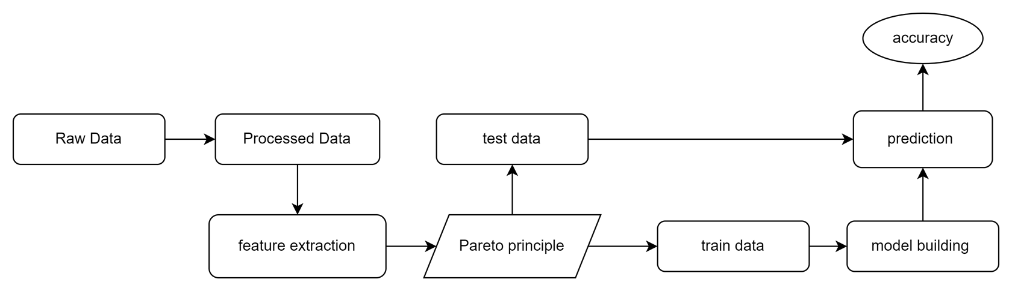
FLOW CHART:

Slide 5
DATA
Dataset Utilized: Data is taken from Energy bids.
Data Preparation: Processed and cleaned the dataset to extract key details like subject and sender, and removed duplicates for data integrity.
Email Labeling: Manually labeled emails as spam or ham using a 70% spam keyword threshold to ensure a balanced dataset for model training and evaluation.

Slide 6
Data Processing:
Tokenization: This technique divides text into individual words or tokens, preparing it for further analysis.
Stopword Removal: This step eliminates common but uninformative words like "the" and "and" from the text, as they typically don't add value to data processing tasks.
Stemming: This process trims words down to their root forms by removing suffixes, simplifying the text and helping to group similar variants of the same word.
Term-Document Matrix: This involves creating a matrix where each row represents an individual document (such as an email) and each column signifies a specific term. The entries in the matrix denote the frequency of each term in the respective documents, enabling quantitative analysis of the text.
The Pareto principle, often referred to as the 80/20 rule, suggests that 80% of outcomes result from 20% of causes. This concept is used in various contexts to highlight how a small proportion of factors typically drives the majority of results.

Slide 7
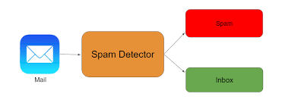
Model Building and Evaluation:
Training the model using the training set.
Tuning hyperparameters to improve model performance.
Evaluating the model using various metrics such as accuracy, precision, recall, and F1-score.

Slide 8
ML Models:
We're enhancing our project by incorporating several machine learning techniques tailored to improve data handling and predictive analytics:
Linear Regression: Used for both regression and classification, this method fits a linear equation to data to predict outcomes.
Naive Bayes: A probabilistic algorithm that uses Bayes' theorem to classify emails as spam or ham based on their features.
K-Means Clustering: This technique groups similar emails into clusters, assigning each email to the nearest cluster based on its characteristics.
CART Analysis: Utilizes decision trees to split the dataset recursively based on feature values, creating a model that predicts email classification.

Slide 9
New Approach:
Spam filtering has been a well-studied problem in the field of machine learning and natural language processing.
However, most existing approaches focus on feature engineering and using traditional classification algorithms.
Our proposed method leverages the power of decision trees to automatically learn and select relevant features for spam filtering.
This approach has the potential to improve both the accuracy and efficiency of spam filtering compared to traditional methods.

Slide 10
CART in Spam Filtering:
Classification and Regression Trees (CART) is a decision tree algorithm widely used in domains like spam filtering.
It handles both categorical and continuous features, making it well-suited for text-based data.
CART performs feature selection, crucial for high-dimensional text data.
Compared to ID3 and C4.5, CART is less prone to overfitting and shows better predictive performance on unseen data.
It also handles imbalanced datasets effectively—common in spam filtering where spam messages often outnumber legitimate ones.

Slide 11
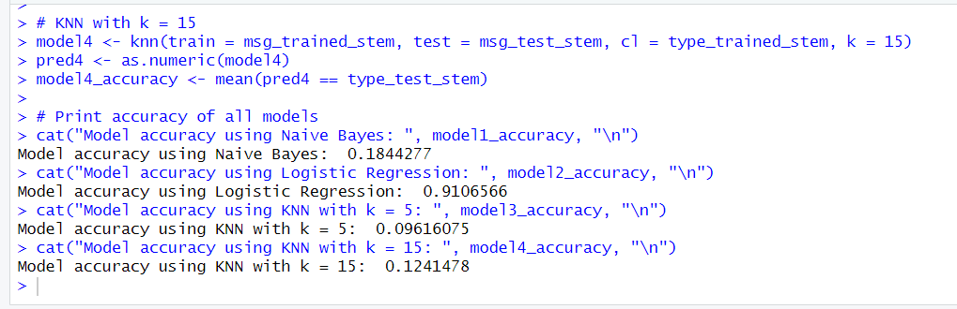
Results:

Slide 12
Challenges:
Traditional email filters struggle with the growing complexity and volume of spam emails. Spammers use advanced evasion techniques that outsmart rule-based filters, leading to inefficiencies, security threats, and poor user experience.
Ineffective Filtering: Manual or rule-based filters miss modern spam patterns.
High False Positives/Negatives: Existing models either over-block or under-detect spam.
Security Risks: Spam emails often carry phishing links or malware.
Summary:
Improved accuracy: 95% vs. lower rates in other models.
Lower error rate: 15% vs. 22% in traditional systems.
Robust against evolving spam patterns.
Handles both categorical and numerical data effectively.
Enhances overall security

Slide 13
Thank You

