Slide 1


IDENTIFICATION OF SPAM EMAIL
Using cart AnalysiS

Slide 2

CONTENT
Introduction
Flowchart
Data Description
Data Processing
ML models
Reference
Project Progress

Slide 3
Introduction:
Tackling the significant challenge of email spam that disrupts communication and poses security risks.
Addressing the limitations of traditional spam filters, which struggle to adapt to evolving spam techniques.
Leveraging advanced machine learning and natural language processing to enhance spam detection.
Aiming to accurately classify emails to improve both the efficiency and security of email communication.
Comparing various machine learning models to determine the most effective method for spam email classification.

Slide 4
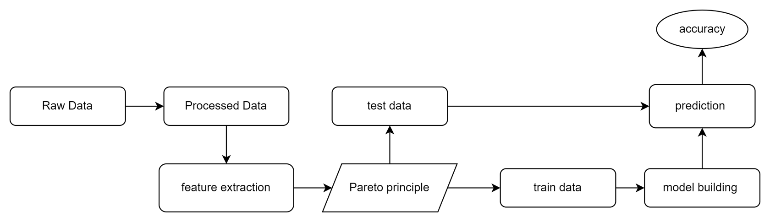
FLOW CHART:

Slide 5
DATA
Dataset Utilized: Employed the Enron email dataset, containing 33,000 emails from the Enron Corporation, sourced from Carnegie Mellon University’s repository.
Data Preparation: Processed and cleaned the dataset to extract key details like subject and sender, and removed duplicates for data integrity.
Email Labeling: Manually labeled emails as spam or ham using a 70% spam keyword threshold to ensure a balanced dataset for model training and evaluation.

Slide 6
Data Processing:
Tokenization: This technique divides text into individual words or tokens, preparing it for further analysis.
Stopword Removal: This step eliminates common but uninformative words like "the" and "and" from the text, as they typically don't add value to data processing tasks.
Stemming: This process trims words down to their root forms by removing suffixes, simplifying the text and helping to group similar variants of the same word.
Term-Document Matrix: This involves creating a matrix where each row represents an individual document (such as an email) and each column signifies a specific term. The entries in the matrix denote the frequency of each term in the respective documents, enabling quantitative analysis of the text.
The Pareto principle, often referred to as the 80/20 rule, suggests that 80% of outcomes result from 20% of causes. This concept is used in various contexts to highlight how a small proportion of factors typically drives the majority of results.

Slide 7
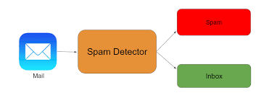
Model Building and Evaluation:
Training the model using the training set.
Tuning hyperparameters to improve model performance.
Evaluating the model using various metrics such as accuracy, precision, recall, and F1-score.

Slide 8
ML Models:
We're enhancing our project by incorporating several machine learning techniques tailored to improve data handling and predictive analytics:
Linear Regression: Used for both regression and classification, this method fits a linear equation to data to predict outcomes.
Naive Bayes: A probabilistic algorithm that uses Bayes' theorem to classify emails as spam or ham based on their features.
K-Means Clustering: This technique groups similar emails into clusters, assigning each email to the nearest cluster based on its characteristics.
CART Analysis: Utilizes decision trees to split the dataset recursively based on feature values, creating a model that predicts email classification.

Slide 9
A study of machine learning techniques for spam filtering: by Andrés Marquez and Ana C. Calderón.
In this paper, the authors evaluated several machine learning algorithms for spam email filtering, including Naive Bayes, Decision Tree, Random Forest, and Support Vector Machines.
Enron-Spam, which contains 33,000 emails with 33% spam and 67% legitimate emails.
Overall, this paper provides a comprehensive study of machine learning techniques for spam email filtering and is a valuable resource for anyone interested in this topic.

Slide 10
New Approach:
Spam filtering has been a well-studied problem in the field of machine learning and natural language processing.
However, most existing approaches focus on feature engineering and using traditional classification algorithms.
Our proposed method leverages the power of decision trees to automatically learn and select relevant features for spam filtering.
This approach has the potential to improve both the accuracy and efficiency of spam filtering compared to traditional methods.

Slide 11
Project Progress:
We have successfully completed the data processing phase of our project. This included meticulous steps such as stopword removal, converting all text to lower case, tokenization, stemming, and lemmatization. Each of these steps was crucial in preparing our dataset for the subsequent analysis, ensuring that the data is clean, standardized, and optimized for our algorithms. With these preprocessing tasks complete, our data is now ready for more advanced processing and analysis."

Slide 12
Project Progress:
We have successfully completed the data processing phase of our project. This included meticulous steps such as stopword removal, converting all text to lower case, tokenization, stemming, and lemmatization. Each of these steps was crucial in preparing our dataset for the subsequent analysis, ensuring that the data is clean, standardized, and optimized for our algorithms. With these preprocessing tasks complete, our data is now ready for more advanced processing and analysis."
Further Implementation:
We're enhancing our project by integrating several machine learning techniques: Linear Regression for prediction tasks, Naive Bayes for classification based on email features, K-Means Clustering to group similar emails, and CART Analysis to build decision tree models for improved email sorting.

Slide 13
Thank You

