Slide 1

DATABASE SYSTEMS ENGINEERING AND DISTRIBUTED BACKEND DEVELOPMENT (25CS1302E)
Y25 · 2026–2027 · Trimester 4 · Section 13 · Team 4
SOLAR ENERGY MANAGEMENT AND
MONITORING SYSTEM
Database Management System Project
Team Members
2520090226 – Lahari Namala
2520090236 – K. Keathana Vikashini
2520090234 – C. Poojitha
1
B.Tech II Year | Dept of CSIT | Database Systems Engineering (25CS1302E) | DBMS Project
Notes:
Introduce the project title and the team.

Slide 2








Abstract
Solar Energy Management and Monitoring System is a DBMS-based full-stack web application
Users add solar panel details and enter daily generated and consumed energy
All data is stored in a SQL database (SQLite)
The system calculates energy balance, expected energy, efficiency, and savings
If efficiency is below 60%, a low-efficiency alert is generated automatically
Results are displayed through the dashboard, reports, and alerts pages
Main Purpose: Avoid manual tracking of solar energy data and provide a simple database-based system to monitor solar panel performance.
2
B.Tech II Year | Dept of CSIT | Database Systems Engineering (25CS1302E) | DBMS Project
Notes:
Read each point: what the system is, what it stores, what it calculates, and what it shows.

Slide 3



Problem Statement
Solar energy users do not have a simple system to track and monitor their solar energy data.
No tracking – generated and consumed energy are not recorded in one place
No calculations – efficiency and savings are not calculated clearly
No alerts – low-performing solar panels go unnoticed
Manual tracking – difficult, time-consuming, error-prone, and leads to poor monitoring
Need: A database-based monitoring system is needed.
3
B.Tech II Year | Dept of CSIT | Database Systems Engineering (25CS1302E) | DBMS Project
Notes:
Explain the main problem, then the four issues it causes.

Slide 4




Motivation
Renewable energy – promotes the use of solar power
Awareness – helps users understand their solar panel performance
Less wastage – reduces energy wastage through monitoring
Cost saving – shows money saved from solar energy
Sustainability – encourages sustainable energy management
Who benefits: Useful for homes, colleges, and small organizations that use solar panels.
4
B.Tech II Year | Dept of CSIT | Database Systems Engineering (25CS1302E) | DBMS Project
Notes:
Why this project matters to society and to users.

Slide 5
Objectives
To store solar panel details in a database
1
To record daily generated and consumed energy
2
To calculate energy balance, expected energy, efficiency, and savings
3
To generate alerts when efficiency is below 60%
4
To display dashboard and reports using SQL queries
5
5
B.Tech II Year | Dept of CSIT | Database Systems Engineering (25CS1302E) | DBMS Project
Notes:
Five objectives. Each one is implemented in a module shown later.

Slide 6


Literature Survey
Solar Monitoring Dashboards [1]
IoT-Based Solar Monitoring [2]
• Features: Show solar generation and usage with graphs
• Limitation: No SQL reports or DBMS concepts
• Features: Collect real-time data using sensors
• Limitation: Needs extra hardware and setup cost
Energy Management Systems [3]
Database Reporting Systems [4]
• Features: Track household electricity usage
• Limitation: No focus on solar efficiency or savings
• Features: Store data and create SQL reports
• Limitation: Not designed for solar energy data
6
B.Tech II Year | Dept of CSIT | Database Systems Engineering (25CS1302E) | DBMS Project
Notes:
Four types of existing systems were studied. For each: what it does and its limitation.

Slide 7




Research Gap
Existing systems monitor solar energy or electricity usage, but none provide one simple DBMS-based solution that combines:
Structured solar panel storage
Savings calculation
Daily energy reading storage
Low-efficiency alert generation
Efficiency calculation
SQL-based reports
Gap: This gap creates the need for a database-driven solar energy management system.
Our Solution: Our project fills this gap with a web system using FastAPI and SQLite.
7
B.Tech II Year | Dept of CSIT | Database Systems Engineering (25CS1302E) | DBMS Project
Notes:
Existing systems each do part of the job. None combines all six features in one simple DBMS solution.

Slide 8
Proposed Methodology
Methodology: DBMS-Based Full Stack Development Methodology
Requirement Collection – user details, panel details, generated and consumed energy, cost per unit, alerts
Database Integration – backend stores and fetches data from the SQLite database
1
5
Database Design – SQL tables with primary keys and foreign keys
Energy Calculation Algorithm – calculates balance, expected energy, efficiency, and savings
2
6
Frontend Design – Home, Dashboard, Solar Panels, Energy Readings, Reports, Alerts, Maintenance, Users pages
Testing With Sample Data – tested with sample users, panels, readings, and alerts
3
7
Backend API Development – REST APIs created using FastAPI
Dashboard and Report Generation – final results shown through dashboard, reports, and alerts
4
8
8
B.Tech II Year | Dept of CSIT | Database Systems Engineering (25CS1302E) | DBMS Project
Notes:
DBMS-Based Full Stack Development Methodology: eight steps from requirements to the final dashboard.

Slide 9
Algorithm
Title: Solar Energy Monitoring and Alert Generation Algorithm
Type: Rule-Based Energy Calculation and Alert Generation
1
Start
7
Calculate expected energy
2
User logs into the system
8
Calculate efficiency percentage
3
User adds solar panel details
9
Calculate savings
4
User enters daily generated energy and consumed energy
10
If efficiency is below 60%, generate alert
5
Store data in SQL database
11
Display dashboard, reports, and alerts
6
Calculate energy balance
12
Stop
9
B.Tech II Year | Dept of CSIT | Database Systems Engineering (25CS1302E) | DBMS Project
Notes:
Name and type of the algorithm, then its twelve steps in order.

Slide 10
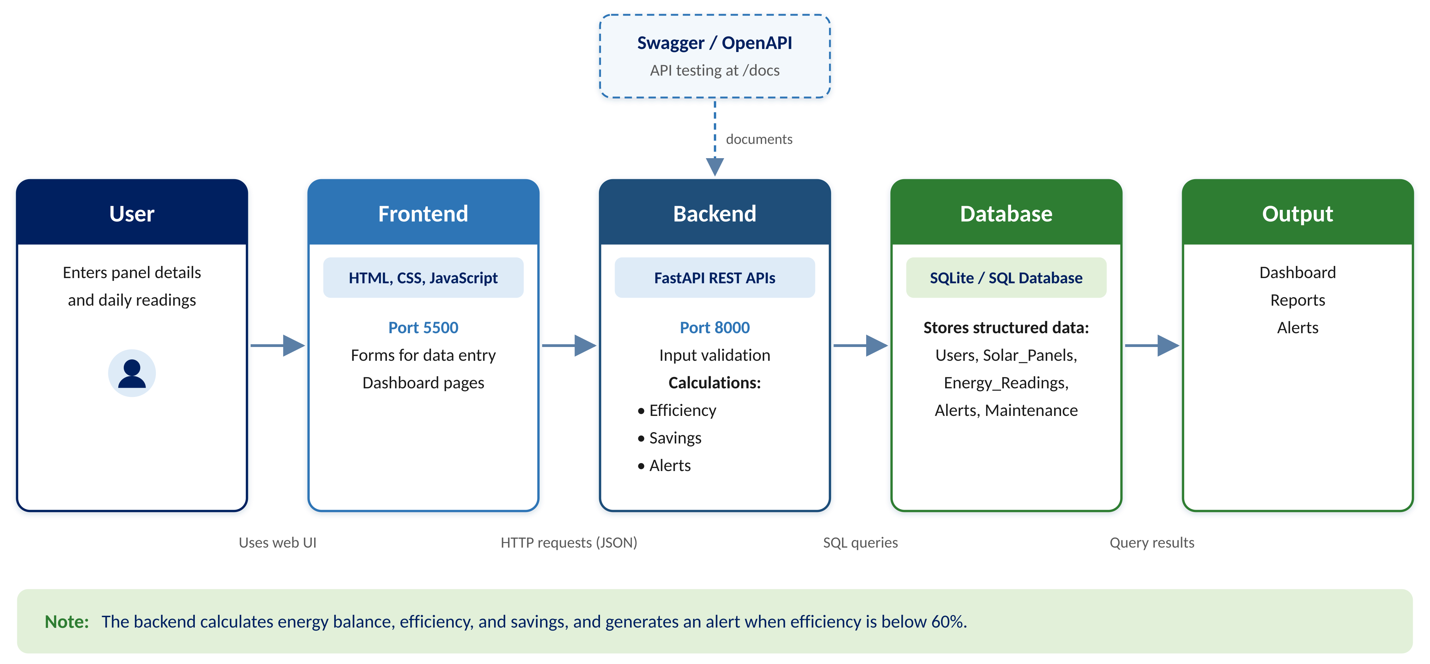



System Architecture
Frontend · Port 5500
HTML, CSS, JS pages; common.js sends API requests
Backend · Port 8000
FastAPI validates input, calculates, runs SQL
Database · No port
SQLite file backend/solar.db stores all tables
10
B.Tech II Year | Dept of CSIT | Database Systems Engineering (25CS1302E) | DBMS Project
Notes:
Follow the arrows: user → frontend (5500) → FastAPI backend (8000) → SQLite → output.

Slide 11







Technologies Used
HTML – Frontend – page structure
Python – Backend – logic and calculations
CSS – Frontend – styling and layout
SQLite – Database – stores project data
JavaScript – Frontend – API calls and dynamic display
Swagger / OpenAPI – Backend testing – tests API endpoints
FastAPI – Backend – REST API development
VS Code – Development – code writing and running
11
B.Tech II Year | Dept of CSIT | Database Systems Engineering (25CS1302E) | DBMS Project
Notes:
For each technology: where it is used and why.

Slide 12
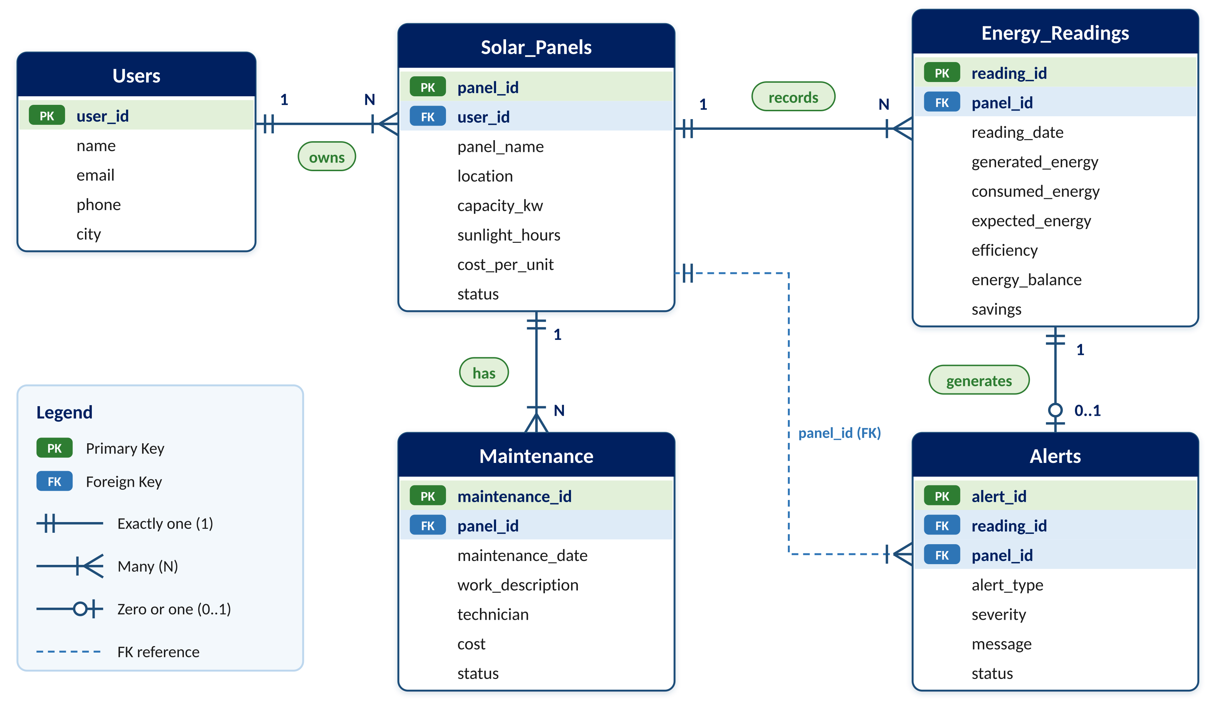
Database Design
Tables and Purpose
users – user / admin details
solar_panels – solar panel details
energy_readings – daily generated and consumed energy
alerts – low-efficiency alerts
maintenance – service / repair details
Relationships
One user → many solar panels
One solar panel → many energy readings
Stored at: backend/solar.db
Tables from: backend/schema.sql
Created automatically when the backend starts
One energy reading → zero or one alert
One solar panel → many maintenance records
12
B.Tech II Year | Dept of CSIT | Database Systems Engineering (25CS1302E) | DBMS Project
Notes:
Five tables, four relationships, and where the database file is stored.

Slide 13



Dataset / Input Details
Inputs Entered by the User
Sample Data Used
Users – name, email, phone, city
Rooftop Array A – 5 kW × 5.5 h = 27.5 kWh/day, ₹7/unit
Garage Panel B – 3 kW × 5.5 h = 16.5 kWh/day, ₹7/unit
Solar Panels – owner, panel name, location, capacity (kW), sunlight hours, cost per unit, status
Farm Array C – 10 kW × 6 h = 60 kWh/day, ₹6.5/unit
Energy Readings – panel, date, generated energy (kWh), consumed energy (kWh)
2 users and 3 solar panels
Maintenance – panel, work description, date, technician, cost, status
42 daily readings (30 Aug – 28 Sept 2026)
7 low-efficiency alerts, 2 maintenance records
13
B.Tech II Year | Dept of CSIT | Database Systems Engineering (25CS1302E) | DBMS Project
Notes:
What the user enters in each form, and the sample data used for testing.

Slide 14
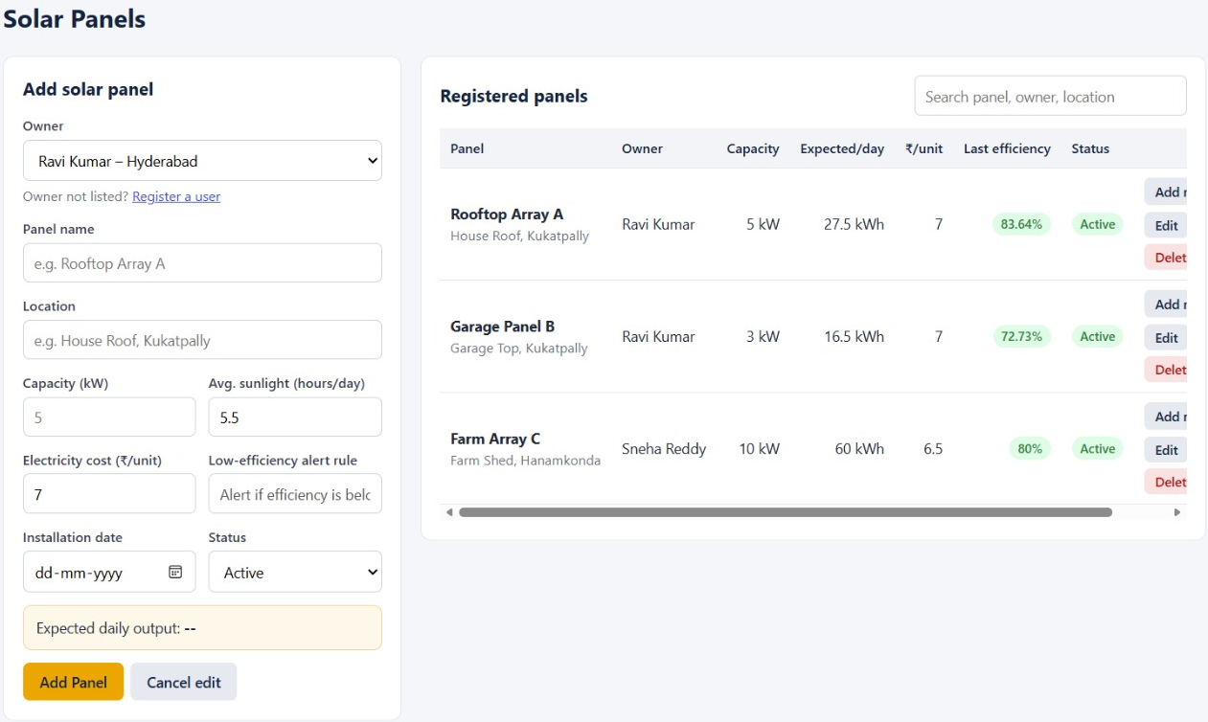

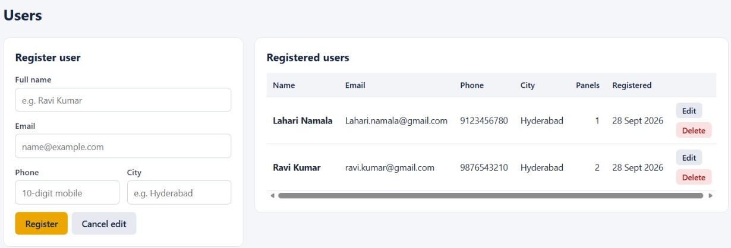
Implementation – Module 1: User & Solar Panel
User Module – stores user details (name, email, phone, city)
Solar Panel Module – stores panel name, location, capacity, sunlight hours, cost per unit
Relationship – each panel is linked to its owner using user_id (foreign key)
DBMS – tables, primary key, foreign key, constraints, INSERT / UPDATE / DELETE / SELECT
Solar Panels page
Code files
• database.py – connects to SQLite, creates solar.db
• schema.sql – creates all database tables
• models.py – validates input data using Pydantic
Users page
14
B.Tech II Year | Dept of CSIT | Database Systems Engineering (25CS1302E) | DBMS Project
Notes:
User Module and Solar Panel Module: the base data of the system.

Slide 15
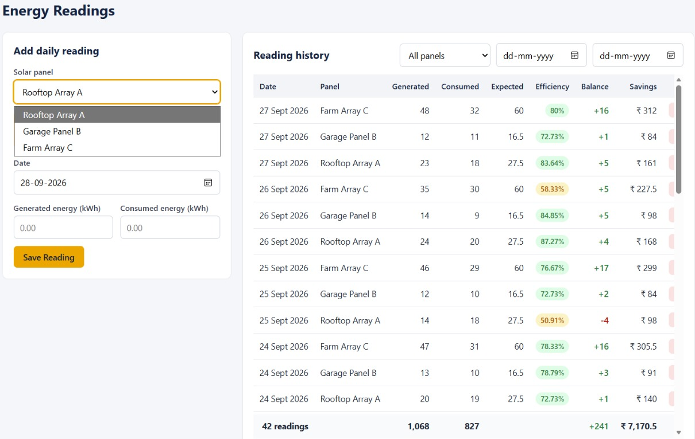



Implementation – Module 2: Energy & Calculation
Energy Reading Module – stores daily generated and consumed energy
Energy Balance = Energy Generated − Energy Consumed
Expected Energy = Panel Capacity × Sunlight Hours
Efficiency (%) = Actual Energy Generated ÷ Expected Energy × 100
Savings = Energy Generated × Cost per Unit
Alert Rule: if Efficiency < 60%, generate Low-Efficiency Alert
Energy Readings page
Example: Farm Array C → 35 ÷ 60 × 100 = 58.33% (< 60%) → alert
Code files
• algorithm.py – contains calculation functions
• add-reading.html – page to enter generated and consumed energy
15
B.Tech II Year | Dept of CSIT | Database Systems Engineering (25CS1302E) | DBMS Project
Notes:
Energy Reading Module plus the calculation formulas.

Slide 16
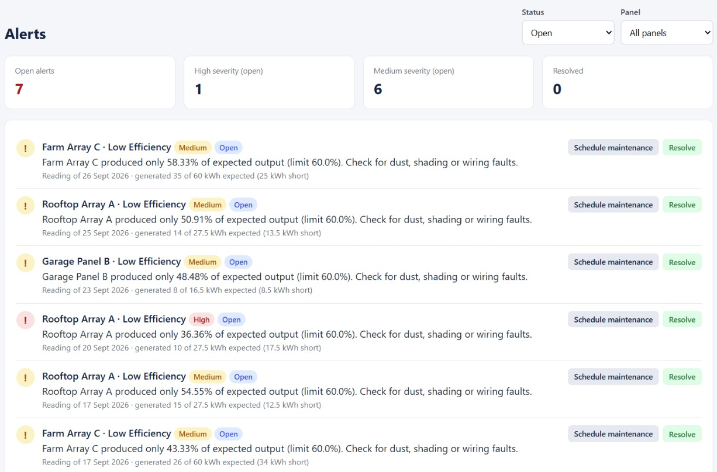

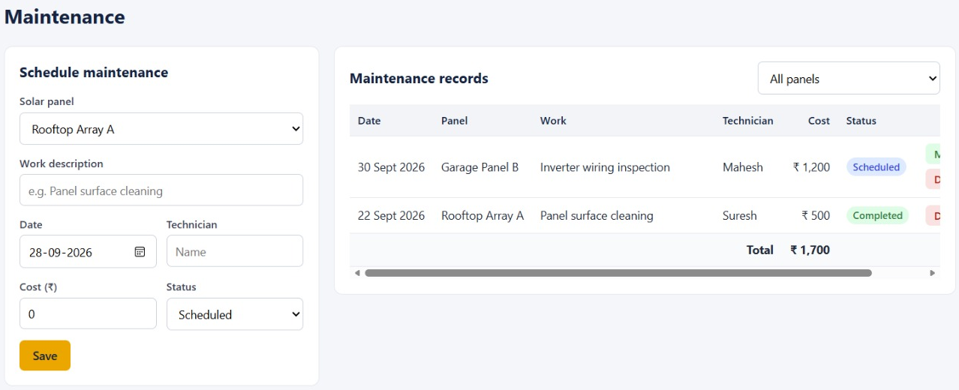
Implementation – Module 3: Reports & Alerts
Dashboard Module – displays summary values
Reports Module – daily, monthly, panel-wise, user-wise reports
Alerts Module – shows low-efficiency alerts (efficiency < 60%)
Maintenance Module – stores service or repair records
DBMS – SQL queries, joins, SUM / AVG, GROUP BY
Alerts page
Code files
• main.py – FastAPI routes and SQL queries
• reports.html – daily, monthly, panel-wise, user-wise reports
• common.js – connects frontend to backend using API URL
Maintenance page
16
B.Tech II Year | Dept of CSIT | Database Systems Engineering (25CS1302E) | DBMS Project
Notes:
Dashboard, Reports, Alerts, and Maintenance modules: the outputs of the system.

Slide 17




DBMS Concepts Used
Tables – users, solar_panels, energy_readings, alerts, maintenance
SQL Queries – INSERT readings, UPDATE alert status, DELETE panels, SELECT data
Primary Keys – user_id, panel_id, reading_id, alert_id, maintenance_id
Joins – panels with users (owner); readings with panels (reports)
Foreign Keys – user_id in solar_panels; panel_id in readings, alerts, maintenance
Reports – daily, monthly, panel-wise, user-wise reports page
Constraints – keys and required fields defined in schema.sql
Aggregations – SUM and AVG for totals and average efficiency
17
B.Tech II Year | Dept of CSIT | Database Systems Engineering (25CS1302E) | DBMS Project
Notes:
Each DBMS concept and where it appears in our project.

Slide 18


Experimental Setup
Ports and URLs
Port 5500 · Frontend website – http://127.0.0.1:5500/index.html
Port 8000 · Backend FastAPI server – http://127.0.0.1:8000
Port 8000/docs · Swagger API docs – http://127.0.0.1:8000/docs (test every API)
No port · SQLite database – local file backend/solar.db, created automatically when the backend starts
Environment
Development tool – VS Code
Table structure – backend/schema.sql
Browser – Chrome / Edge
Test data – 2 users, 3 panels, 42 readings
18
B.Tech II Year | Dept of CSIT | Database Systems Engineering (25CS1302E) | DBMS Project
Notes:
Tools, port numbers, URLs, and where the database file is stored.

Slide 19
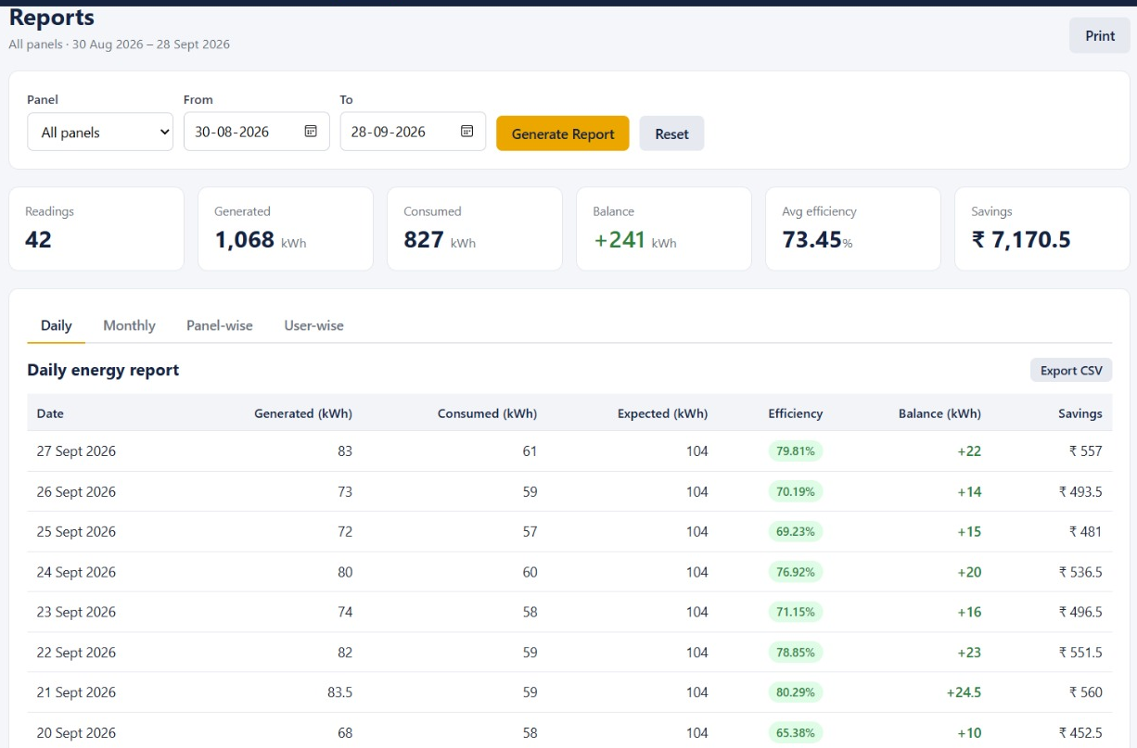
Results
Report period: 30 Aug – 28 Sept 2026 · 42 readings · 3 panels
Total Energy Generated
Total Energy Consumed
1,068 kWh
827 kWh
Energy Balance
Average Efficiency
+241 kWh
73.45 %
Reports page (source of results)
Total Savings
Alerts Generated
₹7,170.5
7
The system stores data, calculates values, generates alerts, and displays reports correctly.
19
B.Tech II Year | Dept of CSIT | Database Systems Engineering (25CS1302E) | DBMS Project
Notes:
Totals from the Reports page for 30 Aug – 28 Sept 2026 (42 readings, 3 panels).

Slide 20
Performance Evaluation
1
✔ Formula Accuracy – Farm Array C: 35 ÷ 60 × 100 = 58.33%, same as the app
2
✔ Database Accuracy – 42 readings, 3 panels, 2 users stored and retrieved correctly
3
✔ API Accuracy – frontend (5500) fetches data from backend (8000); status shows Connected
4
✔ Alert Accuracy – all 7 alerts are below 60% (lowest 36.36%)
5
✔ Report Accuracy – 1,068 − 827 = +241 kWh matches the report balance
6
✔ Dashboard Accuracy – savings ₹7,170.5 is the same on the home page and reports
20
B.Tech II Year | Dept of CSIT | Database Systems Engineering (25CS1302E) | DBMS Project
Notes:
Each check compares system output with manual calculation or stored records. All passed.

Slide 21
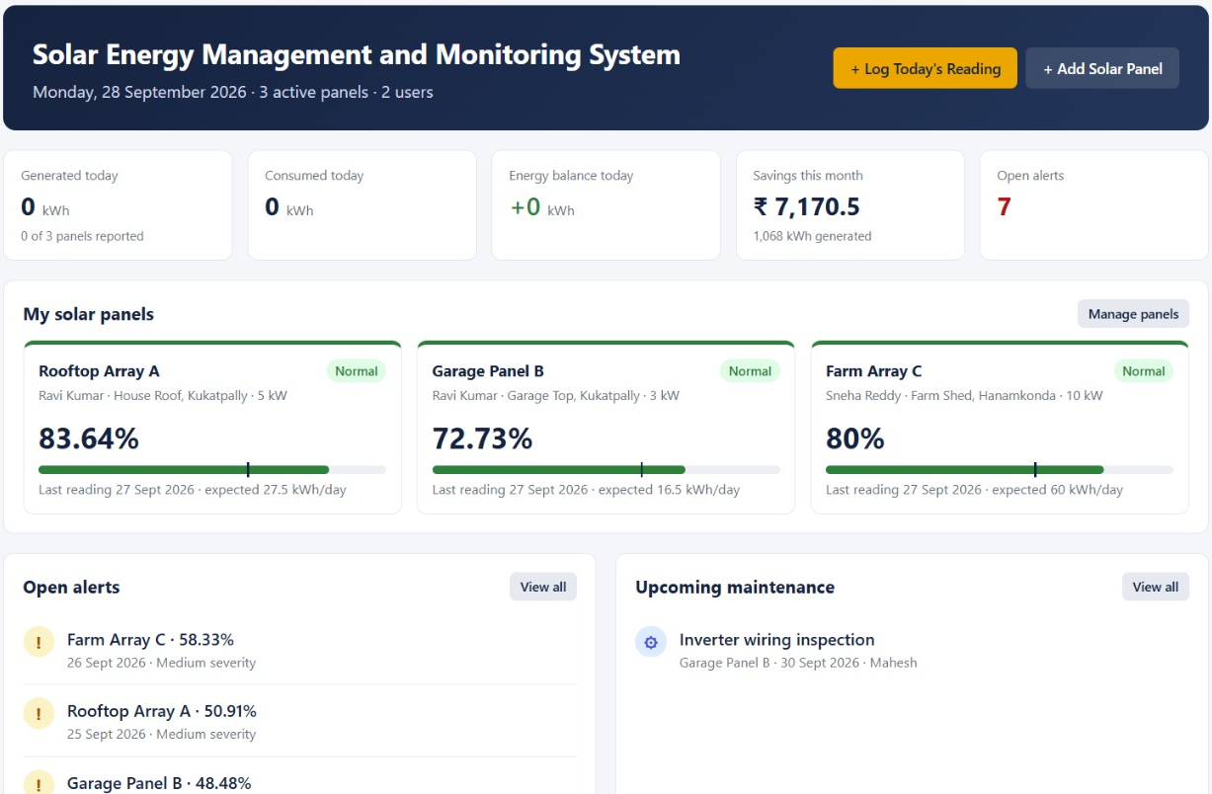
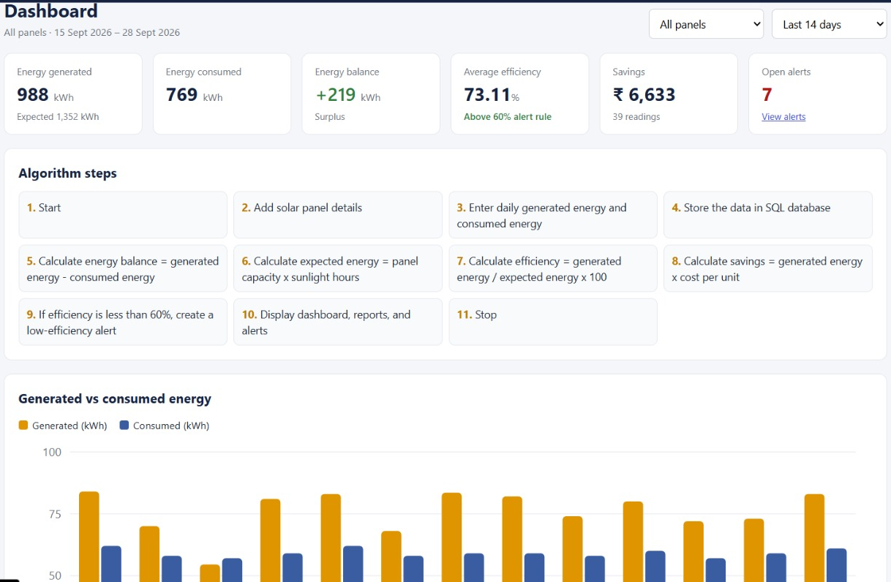

Screenshots / Working Demo
Home page · 127.0.0.1:5500/index.html
Dashboard page · algorithm steps and chart
1
User opens frontend website
2
Enters panel or reading details
3
JavaScript sends request to FastAPI
4
Backend validates input
5
Stores data in SQLite
6
Algorithm calculates values
7
Alert if efficiency < 60%
8
Frontend shows dashboard, reports, alerts
21
B.Tech II Year | Dept of CSIT | Database Systems Engineering (25CS1302E) | DBMS Project
Notes:
Show the home and dashboard pages, then explain the eight-step working flow.

Slide 22
Comparison with Existing System
Existing / Manual System
Proposed System
✘ Data kept in notebooks or loose spreadsheets
✔ Data stored in SQL tables with keys
✘ Energy calculated by hand
✔ Balance and expected energy calculated automatically
✘ Efficiency rarely tracked
✔ Efficiency calculated for every reading
✘ Savings roughly estimated
✔ Savings = generated × cost per unit
✘ No low-efficiency alerts
✔ Automatic alert when efficiency < 60%
✘ Reports prepared manually
✔ Daily, monthly, panel-wise, user-wise reports
✘ No DBMS integration
✔ Tables, keys, joins, SQL queries
22
B.Tech II Year | Dept of CSIT | Database Systems Engineering (25CS1302E) | DBMS Project
Notes:
Left: manual / existing way. Right: our system for the same point.

Slide 23

Challenges & Solutions
1
Frontend–backend connection
API calls from frontend (5500) to FastAPI backend (8000) using common.js
2
Database integration
SQLite tables with keys and relationships (schema.sql)
3
Input validation
Pydantic models in models.py
4
Formula validation
checked calculations with sample data
5
Alert generation
rule applied: efficiency below 60%
6
Report generation
SQL queries with joins, SUM, AVG on stored records
23
B.Tech II Year | Dept of CSIT | Database Systems Engineering (25CS1302E) | DBMS Project
Notes:
For each challenge, the solution we used.

Slide 24







Future Work
IoT Sensors – automatic real-time readings
Email / SMS Alerts – instant alert notifications
Cloud Deployment – online access using Docker
Role-Based Login – separate admin and user access
Mobile App – mobile application support
PDF Export – download reports as PDF
Advanced Analytics – energy prediction
24
B.Tech II Year | Dept of CSIT | Database Systems Engineering (25CS1302E) | DBMS Project
Notes:
Planned improvements beyond the current system.

Slide 25



CO Mapping
CO1 – tables, schema, SQL queries, joins, reports
CO2 – SQL chosen because solar data is structured (fixed fields and related tables)
CO3 – FastAPI REST APIs, validation (Pydantic), Swagger docs at /docs
CO4 – backend modules: users, panels, readings, alerts, reports, maintenance
CO5 – architecture can be divided into services: User, Energy, Report, Alert
CO6 – full-stack integration: frontend (5500), backend (8000), SQLite database
25
B.Tech II Year | Dept of CSIT | Database Systems Engineering (25CS1302E) | DBMS Project
Notes:
How each course outcome is covered in the project.

Slide 26
Conclusion
Solar Energy Management and Monitoring System is a DBMS-based full-stack web application
Frontend: HTML, CSS, JavaScript · Backend: FastAPI · Database: SQLite (backend/solar.db)
Stores solar panel details and daily energy readings
Calculates energy balance, expected energy, efficiency, and savings
Creates a low-efficiency alert when efficiency is below 60%
Dashboard and reports use SQL queries, joins, and aggregate functions
Covers database design, SQL operations, backend APIs, frontend integration, reports, and alerts
26
B.Tech II Year | Dept of CSIT | Database Systems Engineering (25CS1302E) | DBMS Project
Notes:
Our project is a DBMS-based full-stack web application. Frontend: HTML, CSS, JavaScript. Backend: FastAPI. SQLite database stored as backend/solar.db. Users add panels and daily readings; the backend stores data and calculates balance, expected energy, efficiency, and savings; efficiency below 60% creates an alert. Dashboard and reports use SQL queries, joins, and aggregate functions.

Slide 27
References
[1]
S. R. Madeti, S. N. Singh, “Monitoring system for photovoltaic plants: A review,” Renewable and Sustainable Energy Reviews, vol. 67, 2017.
[2]
A. S. Spanias, “Solar energy management as an Internet of Things (IoT) application,” IEEE IISA Conference, 2017.
[3]
M. Beaudin, H. Zareipour, “Home energy management systems: A review of modelling and complexity,” Renewable and Sustainable Energy Reviews, vol. 45, 2015.
[4]
A. Silberschatz, H. F. Korth, S. Sudarshan, Database System Concepts, 7th ed., McGraw-Hill, 2019.
[5]
SQLite Documentation – sqlite.org/docs.html
[6]
FastAPI Documentation – fastapi.tiangolo.com
27
B.Tech II Year | Dept of CSIT | Database Systems Engineering (25CS1302E) | DBMS Project
Notes:
Sources used for the literature survey, DBMS concepts, and tools.

