Slide 1

DATABASE SYSTEMS ENGINEERING AND DISTRIBUTED BACKEND DEVELOPMENT (25CS1302E)
Y25 · 2026–2027 · Trimester 4 · Section 13 · Team 4
SOLAR ENERGY MANAGEMENT AND
MONITORING SYSTEM
Review-3
Subject: Database Management System Project
Team Members
2520090226 – Lahari Namala
2520090236 – K. Keathana Vikashini
2520090234 – C. Poojitha
1
B.Tech II Year | Dept of CSIT | Database Systems Engineering (25CS1302E) | Project Review
Notes:
Introduce the project and say this is Review-3: methodology, algorithm, formulas, database design, and working screens.

Slide 2

Proposed Methodology (1/2)
Methodology: DBMS-Based Full Stack Development Methodology
DBMS concept
1
Requirement Collection
Data requirements
User details, panel details, generated and consumed energy, efficiency, savings, alerts
2
Database Design using ER Diagram
ER model, PK & FK
Tables: users, solar_panels, energy_readings, alerts, maintenance, reports; identify PKs, FKs, and relationships
3
Frontend Page Design
Data entry forms
Home, Login/Register, Dashboard, Solar Panel Details, Energy Entry, Reports, Alerts
4
Backend API Development
CRUD operations
APIs to insert, update, fetch, and delete project data
2
B.Tech II Year | Dept of CSIT | Database Systems Engineering (25CS1302E) | Project Review
Notes:
Explain each step in one or two lines. The green tag shows the DBMS concept used in that step.

Slide 3
Proposed Methodology (2/2)
Methodology: DBMS-Based Full Stack Development Methodology
DBMS concept
5
Database Integration
SQL INSERT & SELECT
Connect backend APIs with the SQL database to store and retrieve data
6
Energy Calculation Algorithm
Derived attributes
Calculate energy balance, expected energy, efficiency, and savings
7
Testing with Sample Data
Data validation
Test database records, formulas, API responses, reports, and alerts
8
Dashboard and Report Generation
SUM, AVG, GROUP BY
Display calculated values, reports, and alerts on the dashboard
3
B.Tech II Year | Dept of CSIT | Database Systems Engineering (25CS1302E) | Project Review
Notes:
Steps 5 to 8: connect to the database, apply formulas, test with sample data, and show reports.

Slide 4
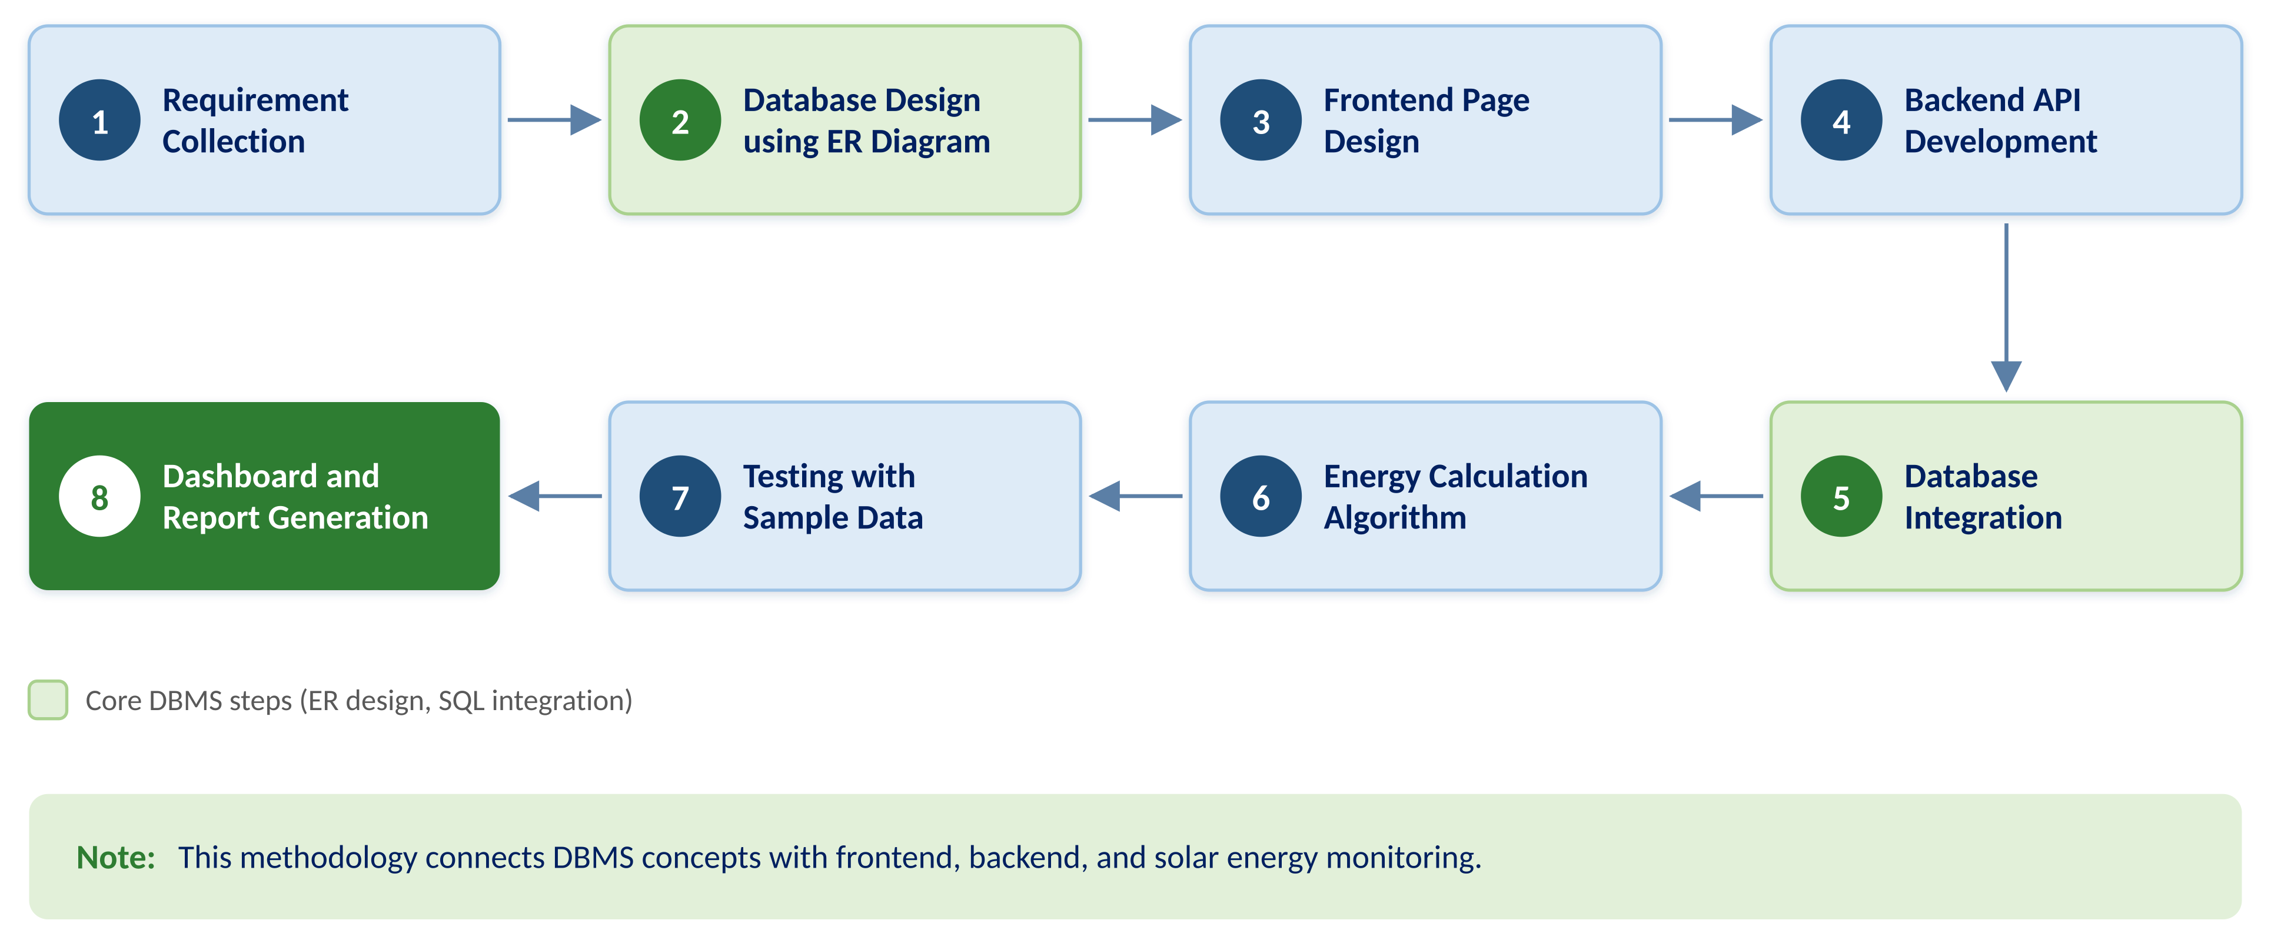
Methodology Flow Diagram
4
B.Tech II Year | Dept of CSIT | Database Systems Engineering (25CS1302E) | Project Review
Notes:
Follow the numbers: top row left to right, then bottom row right to left. Green boxes are the core DBMS steps.

Slide 5
Algorithm
Title: Solar Energy Monitoring and Alert Generation Algorithm
Type: Rule-Based Calculation and Alert Generation
1
Start
8
Efficiency (%) = Actual Energy Generated ÷ Expected Energy × 100
2
User logs into the system
9
Savings = Energy Generated × Cost per Unit
3
Add panel details: name, location, capacity, sunlight hours, cost per unit
10
Check efficiency value
4
Enter daily generated energy and consumed energy
11
If efficiency < 60%, generate low-efficiency alert
5
Store panel and reading data in SQL database
12
If efficiency ≥ 60%, mark panel status as normal
6
Energy Balance = Energy Generated − Energy Consumed
13
Display dashboard, reports, and alerts
7
Expected Energy = Panel Capacity × Sunlight Hours
14
Stop
5
B.Tech II Year | Dept of CSIT | Database Systems Engineering (25CS1302E) | Project Review
Notes:
Say the algorithm name and type. Steps 6 to 9 are calculations; steps 10 to 12 are the alert rule.

Slide 6


Important Formulas
Energy Balance
Expected Energy
Example from Our App
Energy Generated − Energy Consumed
Panel Capacity × Sunlight Hours
Farm Array C · 26 Sept · 10 kW · 6 h · ₹6.5
Energy Balance
35 − 30 = +5 kWh
Efficiency (%)
Savings
Expected Energy
10 × 6 = 60 kWh
Actual Energy Generated ÷ Expected Energy × 100
Energy Generated × Cost per Unit
Efficiency
35 ÷ 60 × 100 = 58.33%
Alert Rule
If Efficiency < 60%, generate Low-Efficiency Alert
Savings
35 × ₹6.5 = ₹227.5
Result
58.33% < 60% → Alert
DBMS / CO link: Calculated values are stored in the energy_readings table.
6
B.Tech II Year | Dept of CSIT | Database Systems Engineering (25CS1302E) | Project Review
Notes:
Explain each formula, then use the Farm Array C reading from 26 Sept to show how the alert is created.

Slide 7
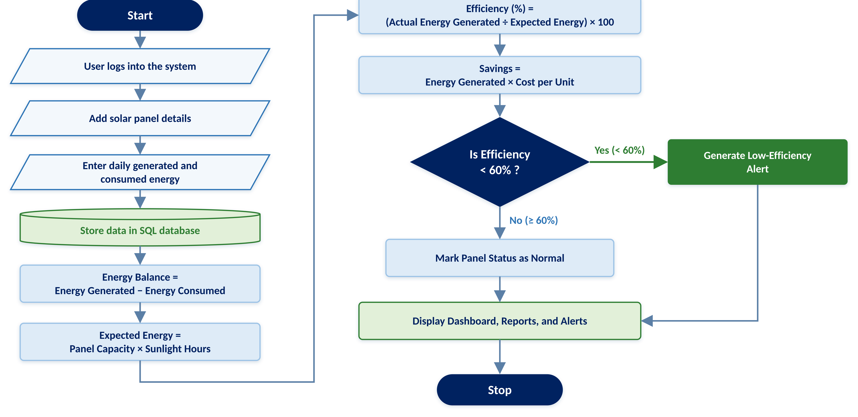
Algorithm Flowchart
7
B.Tech II Year | Dept of CSIT | Database Systems Engineering (25CS1302E) | Project Review
Notes:
Left column top to bottom, then the right column. The diamond is the 60% check.

Slide 8
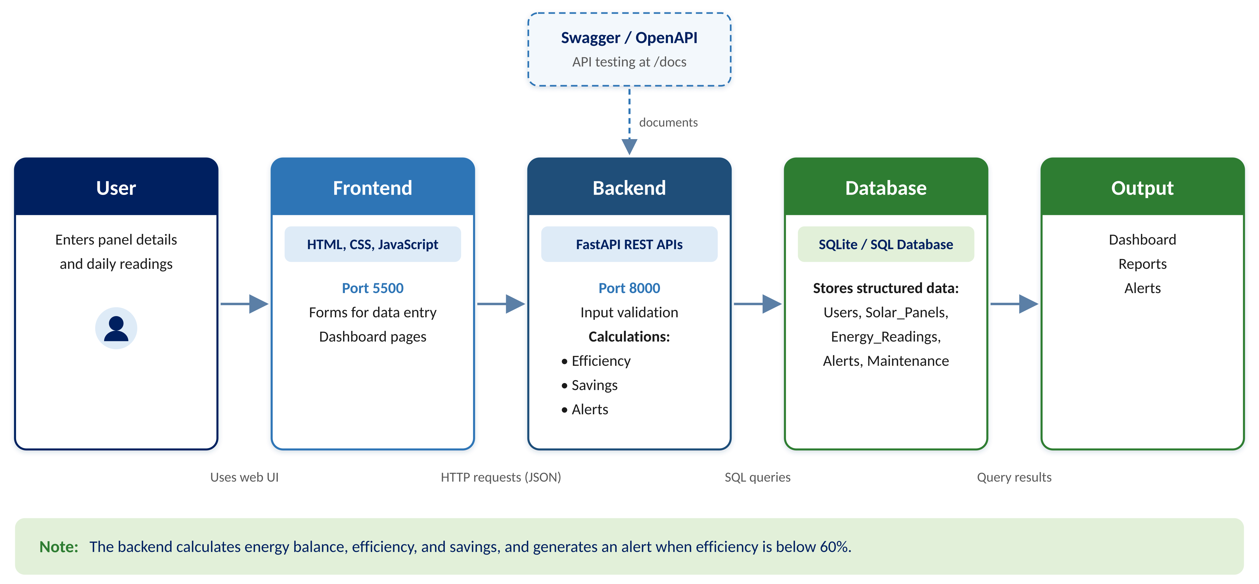
System Architecture
8
B.Tech II Year | Dept of CSIT | Database Systems Engineering (25CS1302E) | Project Review
Notes:
Frontend on port 5500, backend on port 8000, SQLite stores all tables. Swagger at /docs tests the APIs.

Slide 9
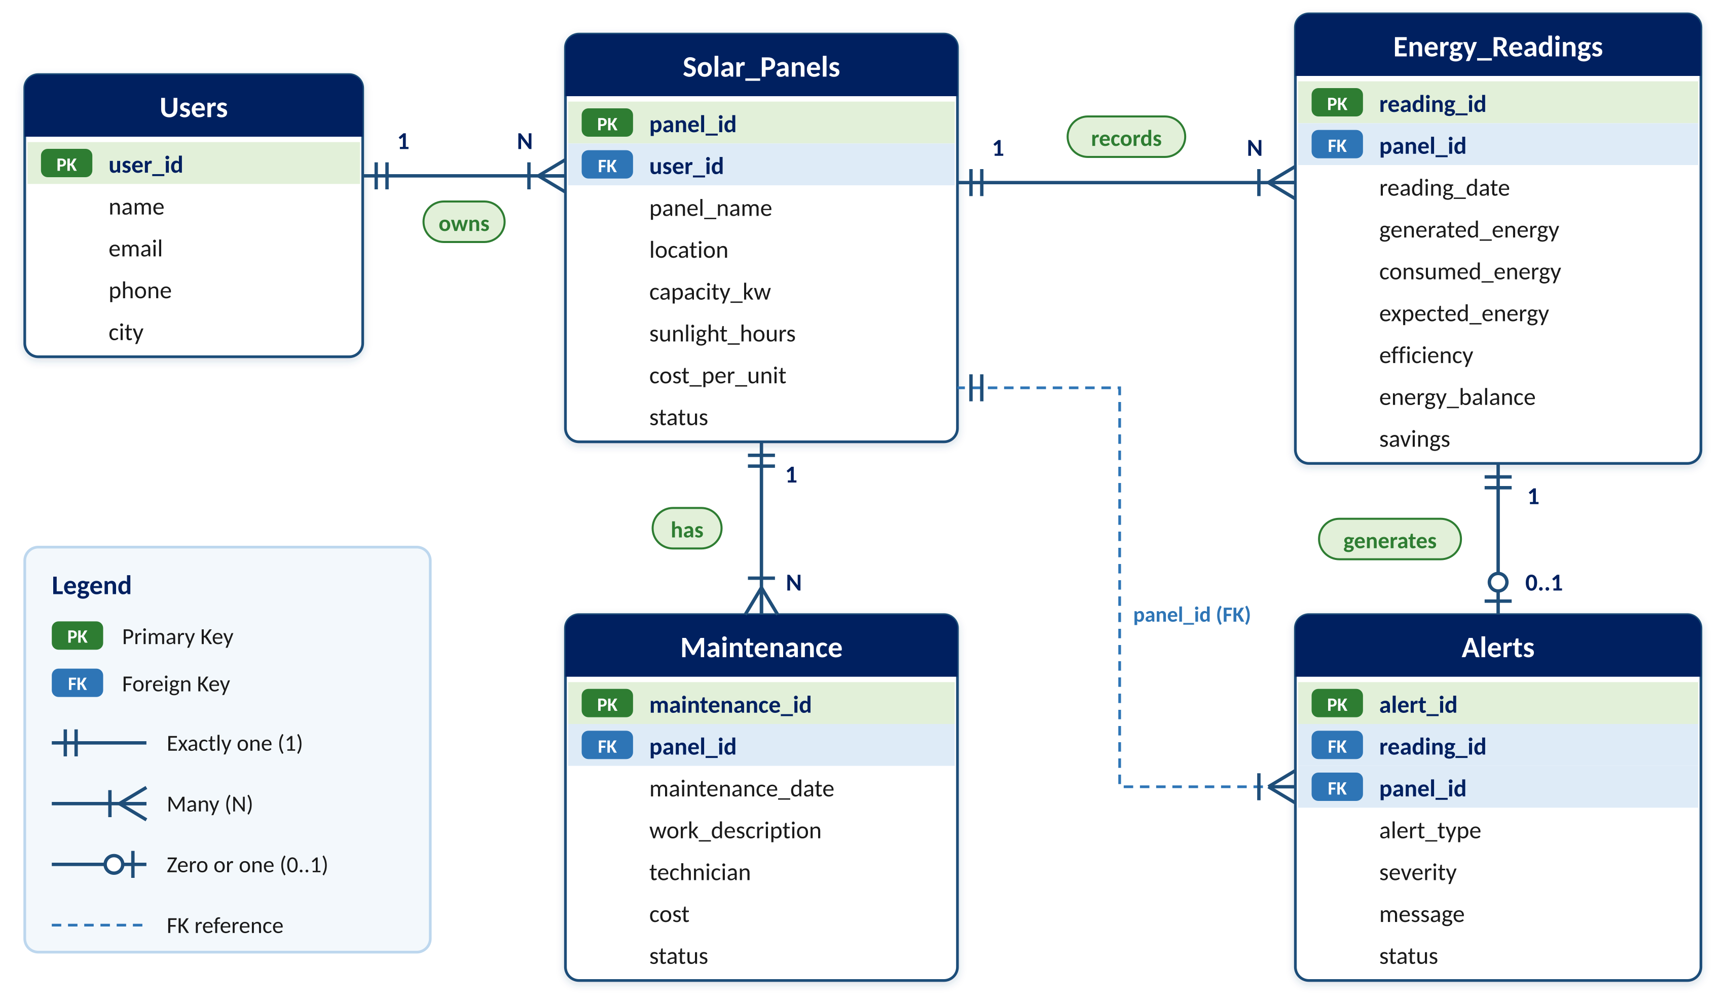
Database Design / ER Diagram
Relationships
1 : N
User → Solar Panels
1 : N
Solar Panel → Energy Readings
1 : 0..1
Energy Reading → Alert
1 : N
Solar Panel → Maintenance
9
B.Tech II Year | Dept of CSIT | Database Systems Engineering (25CS1302E) | Project Review
Notes:
Five tables, each with a primary key. Child tables link to parents through foreign keys.

Slide 10
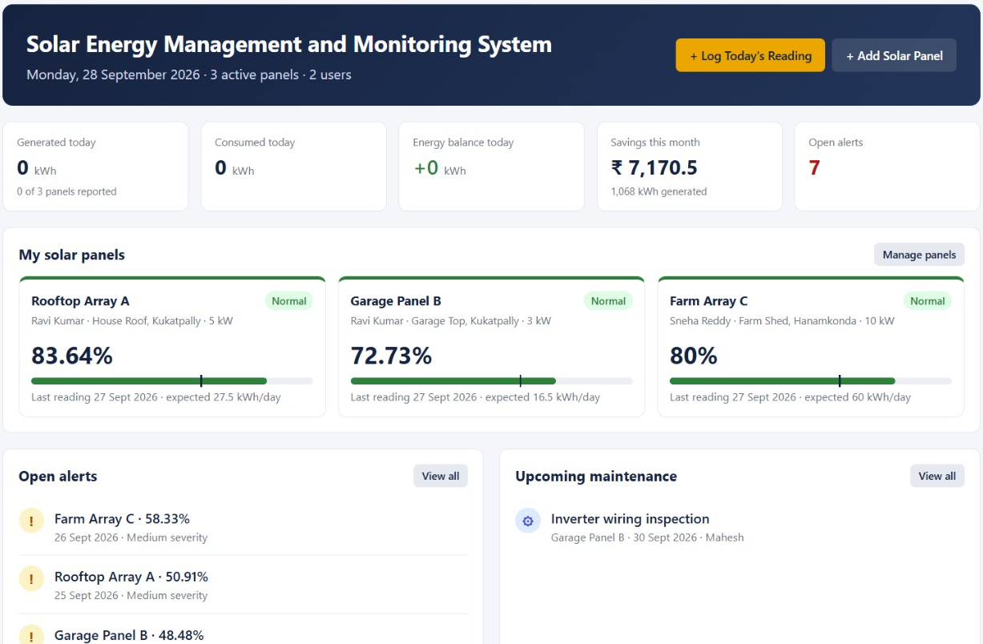
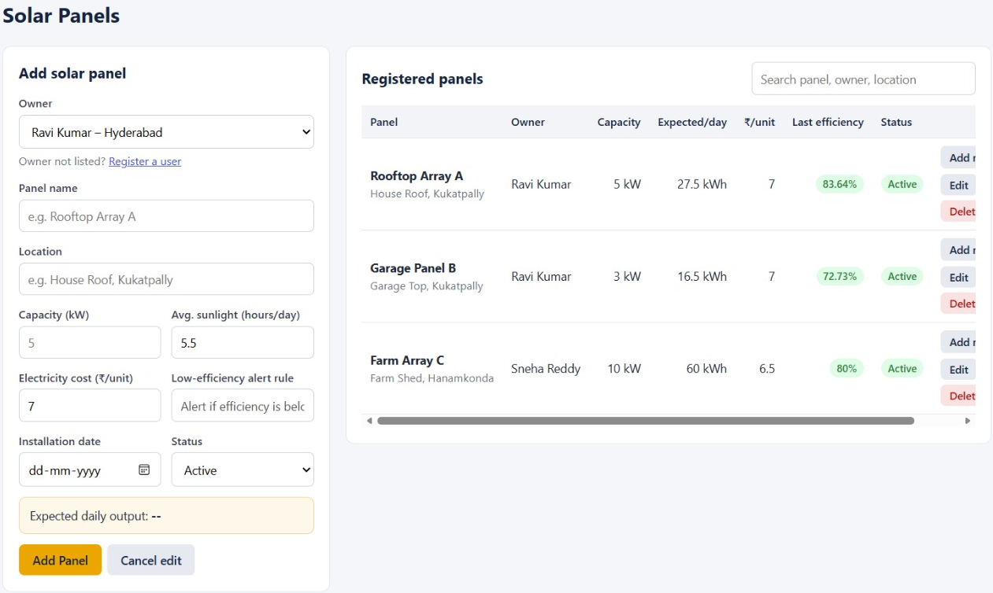
Project Screens (1/3)
Solar Panels · INSERT, UPDATE, DELETE
Home Dashboard · SELECT with SUM
10
B.Tech II Year | Dept of CSIT | Database Systems Engineering (25CS1302E) | Project Review
Notes:
Home shows today's totals, panel efficiency, open alerts, and maintenance. Solar Panels page adds panels; expected/day = capacity × sunlight hours.

Slide 11
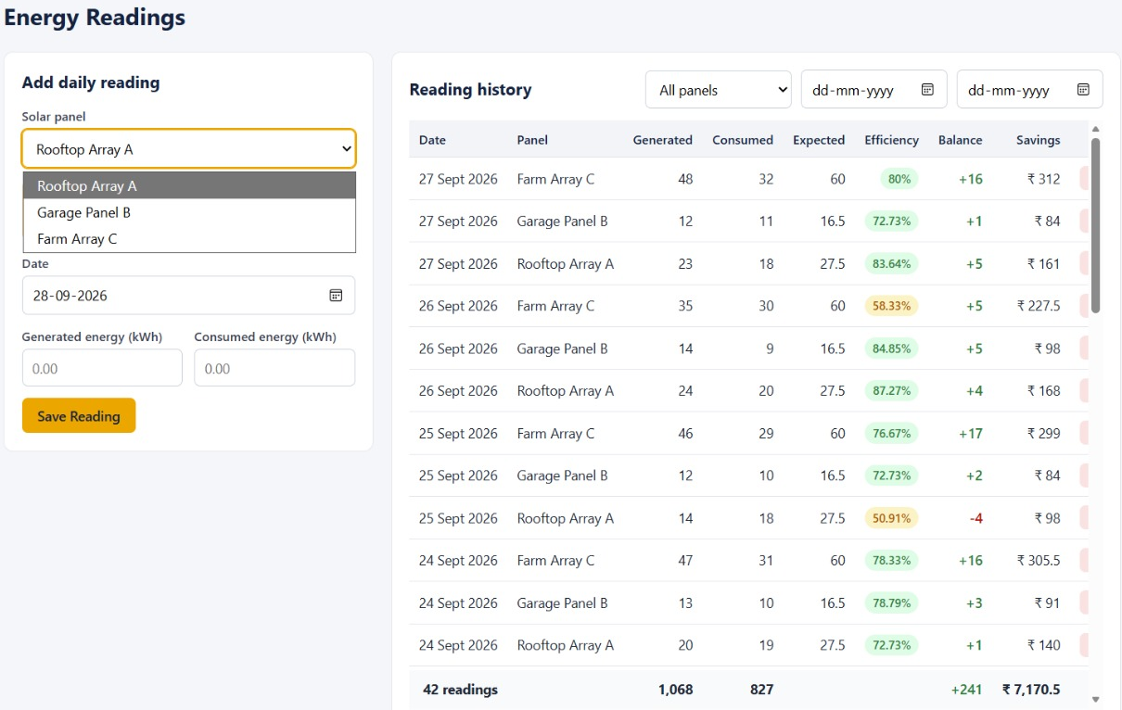
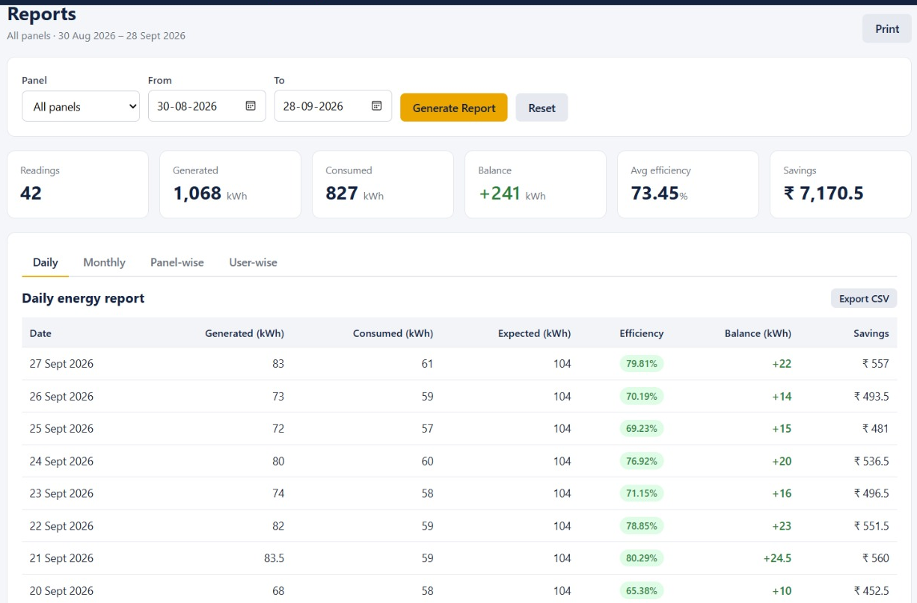
Project Screens (2/3)
Energy Readings · INSERT + SELECT
Reports · SUM, AVG, GROUP BY
11
B.Tech II Year | Dept of CSIT | Database Systems Engineering (25CS1302E) | Project Review
Notes:
Energy Readings stores daily data and shows efficiency, balance, and savings. Reports give daily, monthly, panel-wise, and user-wise totals.

Slide 12
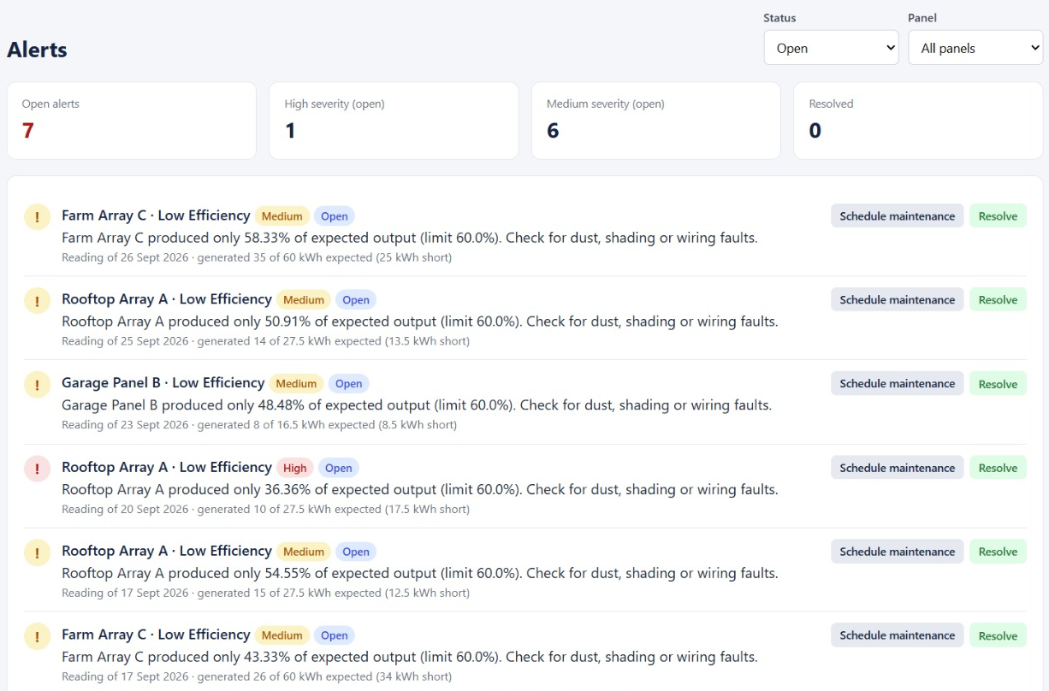
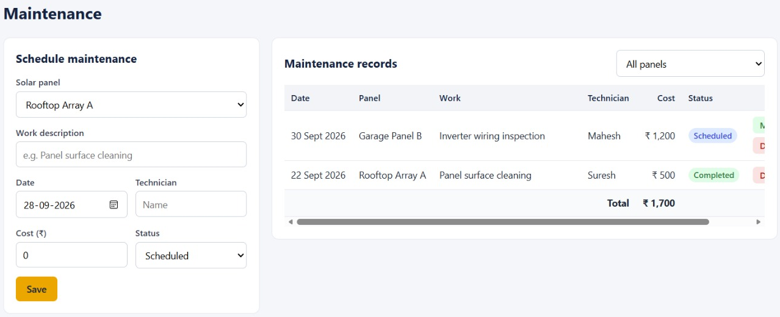
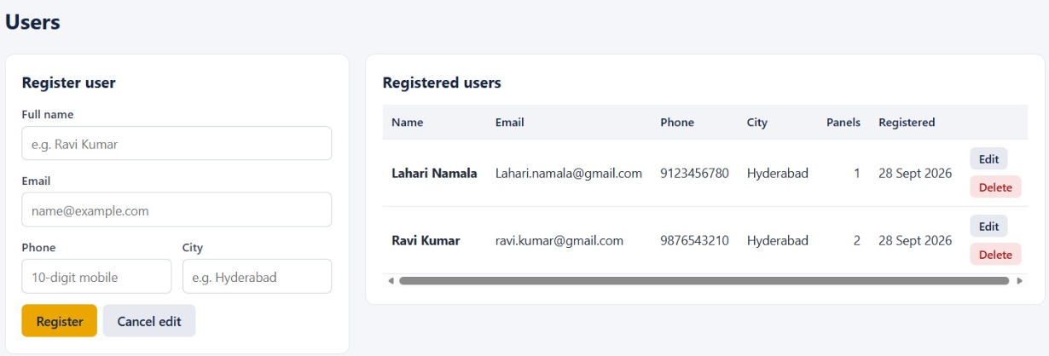
Project Screens (3/3)
Maintenance · INSERT + SUM(cost)
Alerts · UPDATE status
Users · JOIN + COUNT
12
B.Tech II Year | Dept of CSIT | Database Systems Engineering (25CS1302E) | Project Review
Notes:
Alerts come from the 60% rule. Maintenance records are linked to panels; Users page shows panel count per user.

Slide 13



Dissemination and Accessibility
Dissemination
Accessibility
How the project output is shared or displayed to users
How easily users can access and use the system
1
Dashboard Page
Generated, consumed, balance, savings, efficiency, alerts
1
Web-Based Interface
Access the system through a browser
Reports Page
Daily, monthly, panel-wise, and user-wise reports
2
Simple Navigation
Dashboard, Solar Panels, Energy Readings, Reports, Alerts
2
3
Easy Data Entry
Simple forms for panel details and daily readings
3
Alerts Page
Low-efficiency alerts when efficiency is below 60%
4
Clear Output
Balance, efficiency, savings, and alerts shown clearly
Charts and Tables
Energy data in easy-to-understand tables and charts
4
Local System Access
Frontend on port 5500, backend on port 8000
5
5
API Documentation
Backend APIs checked using Swagger / OpenAPI
Future Accessibility
Online deployment using Docker or cloud hosting
6
This makes the project easy to demonstrate, easy to understand, and accessible for users and faculty during review.
13
B.Tech II Year | Dept of CSIT | Database Systems Engineering (25CS1302E) | Project Review
Notes:
Dissemination is how our output is shared and displayed. Accessibility is how easily users can reach and use the system. End with the final point at the bottom.

