Slide 1

DATABASE SYSTEMS ENGINEERING AND DISTRIBUTED BACKEND DEVELOPMENT (25CS1302E)
Y25 · 2026–2027 · Trimester 4 · Section 13 · Team 4
SOLAR ENERGY MANAGEMENT AND
MONITORING SYSTEM
Database Management System Project
Team Members
2520090226 – Lahari Namala
2520090236 – K. Keathana Vikashini
2520090234 – C. Poojitha
1
B.Tech II Year | Dept of CSIT | Database Systems Engineering (25CS1302E) | DBMS Project
Notes:
Introduce the project title and the team.

Slide 2





Abstract and Objectives
Abstract
Objectives
A database-based web application to manage and monitor solar energy
Store solar panel details in a database
1
Stores solar panel details and daily energy readings in a SQL database
Record daily generated and consumed energy
2
Calculates energy balance, efficiency, and savings automatically
Calculate balance, efficiency, and savings
3
Generate alerts when efficiency is low
Generates low-efficiency alerts and shows dashboard and reports
4
Display dashboard and reports using SQL queries
5
2
B.Tech II Year | Dept of CSIT | Database Systems Engineering (25CS1302E) | DBMS Project
Notes:
Abstract: a database-based web system for solar data. Then read the five objectives.

Slide 3






Problem Statement and Motivation
Solar energy users do not have a simple system to track generated energy, consumed energy, efficiency, savings, and low-performance alerts. Manual tracking is difficult and leads to poor monitoring.
Problems Faced
Motivation
No single place to store solar data
Promotes renewable energy usage
Manual records cause errors and delays
Helps users understand solar performance
Low panel performance goes unnoticed
Reduces energy wastage and supports cost saving
No clear view of savings
Encourages sustainable energy management
3
B.Tech II Year | Dept of CSIT | Database Systems Engineering (25CS1302E) | DBMS Project
Notes:
Problem: no simple way to track solar data; manual tracking is hard. Motivation: renewable energy and savings.

Slide 4

Literature Survey and Research Gap
Existing System | Main Features | Limitation
Solar Monitoring Dashboards [1] | Show generation and usage graphs | No SQL reports or DBMS concepts
IoT-Based Solar Monitoring [2] | Real-time data from sensors | Needs extra hardware and cost
Energy Management Systems [3] | Track household electricity usage | No solar efficiency or savings focus
Database Reporting Systems [4] | Store data and create SQL reports | Not designed for solar data
Research Gap
Existing systems do not provide one simple DBMS-based solution that combines structured panel storage, daily reading storage, efficiency and savings calculation, low-efficiency alerts, and SQL reports.
Our project fills this gap with a database-driven web system.
4
B.Tech II Year | Dept of CSIT | Database Systems Engineering (25CS1302E) | DBMS Project
Notes:
Four types of existing systems were studied. None combines SQL storage, calculations, alerts, and reports simply.

Slide 5
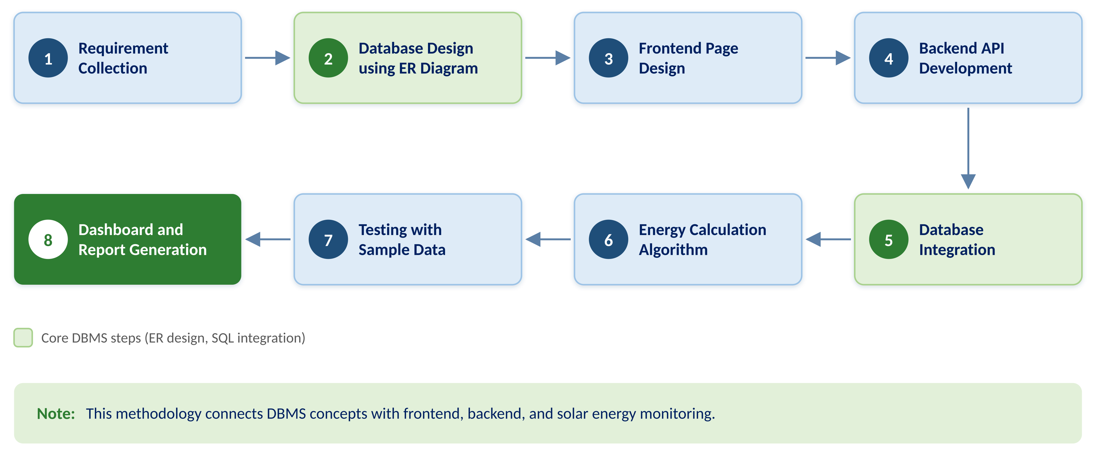
Proposed Methodology
5
B.Tech II Year | Dept of CSIT | Database Systems Engineering (25CS1302E) | DBMS Project
Notes:
DBMS-Based Full Stack Development Methodology in eight steps. Green boxes are the core database steps.

Slide 6
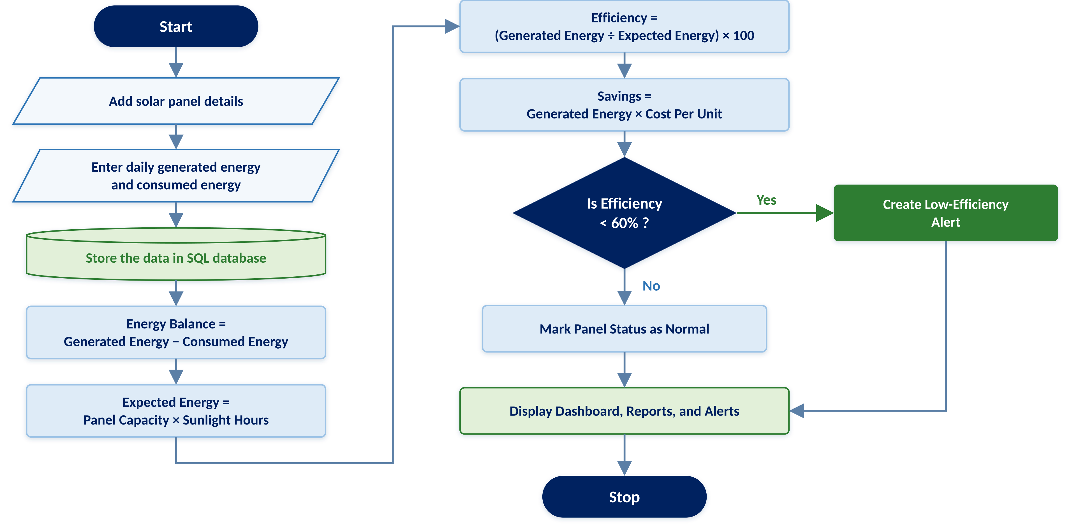
Algorithm: Monitoring and Alert Generation
6
B.Tech II Year | Dept of CSIT | Database Systems Engineering (25CS1302E) | DBMS Project
Notes:
Rule-based algorithm. Input readings, store in SQL, calculate four values, then apply the 60% alert rule.

Slide 7
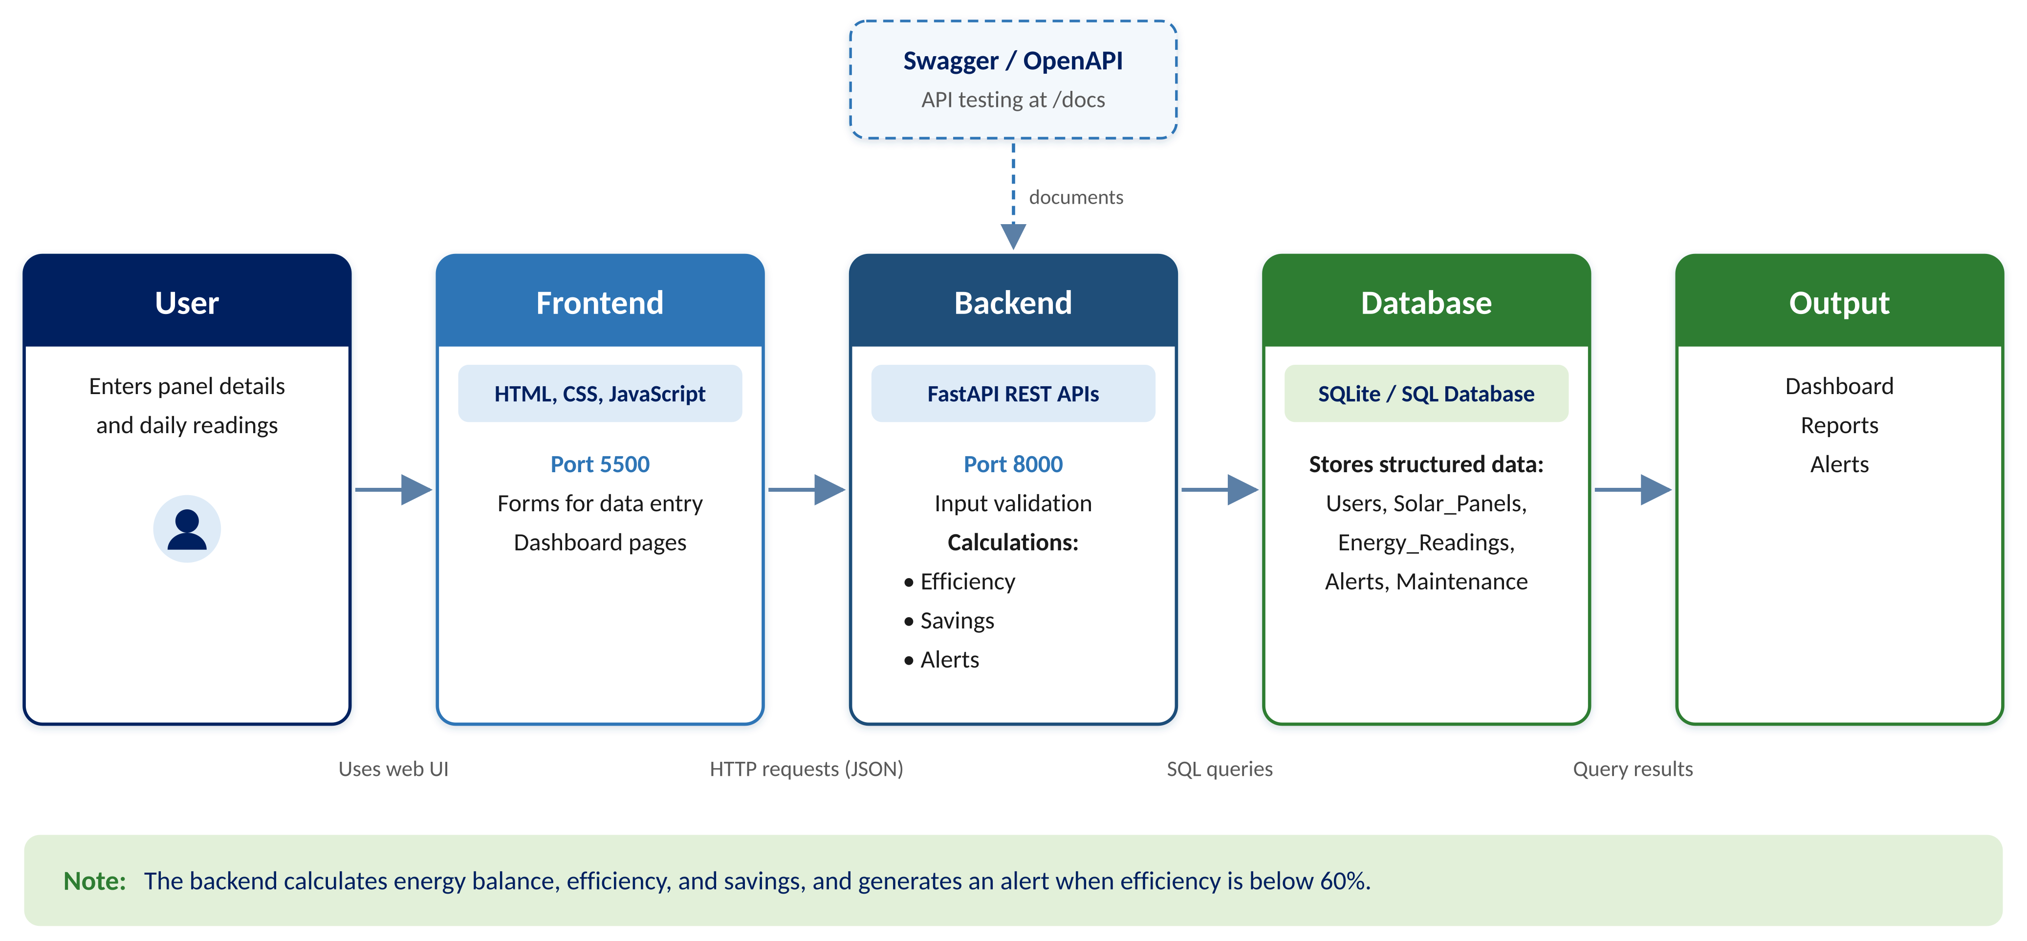
System Architecture
7
B.Tech II Year | Dept of CSIT | Database Systems Engineering (25CS1302E) | DBMS Project
Notes:
User uses the frontend (port 5500). The frontend calls FastAPI (port 8000), which runs SQL on SQLite. Swagger at /docs documents the APIs.

Slide 8







Technologies Used and Experimental Setup
Frontend
HTML, CSS, JavaScript
Backend
Python FastAPI
Database
SQLite (SQL)
API Docs
Swagger / OpenAPI
Dev Tool
VS Code
Browser
Chrome / Edge
Frontend Port
5500
Backend Port
8000
Component | Port | URL | Usage
Frontend (web pages) | 5500 | http://127.0.0.1:5500/index.html | Open the app in the browser
Backend API (FastAPI) | 8000 | http://127.0.0.1:8000 | Frontend sends API requests; backend runs SQL
Swagger / OpenAPI Docs | 8000 | http://127.0.0.1:8000/docs | View and test every API
Database (SQLite) | — | Local database file | Accessed only by the backend
8
B.Tech II Year | Dept of CSIT | Database Systems Engineering (25CS1302E) | DBMS Project
Notes:
Open the frontend at 127.0.0.1:5500/index.html. The backend runs at 127.0.0.1:8000 and Swagger docs at 127.0.0.1:8000/docs.

Slide 9
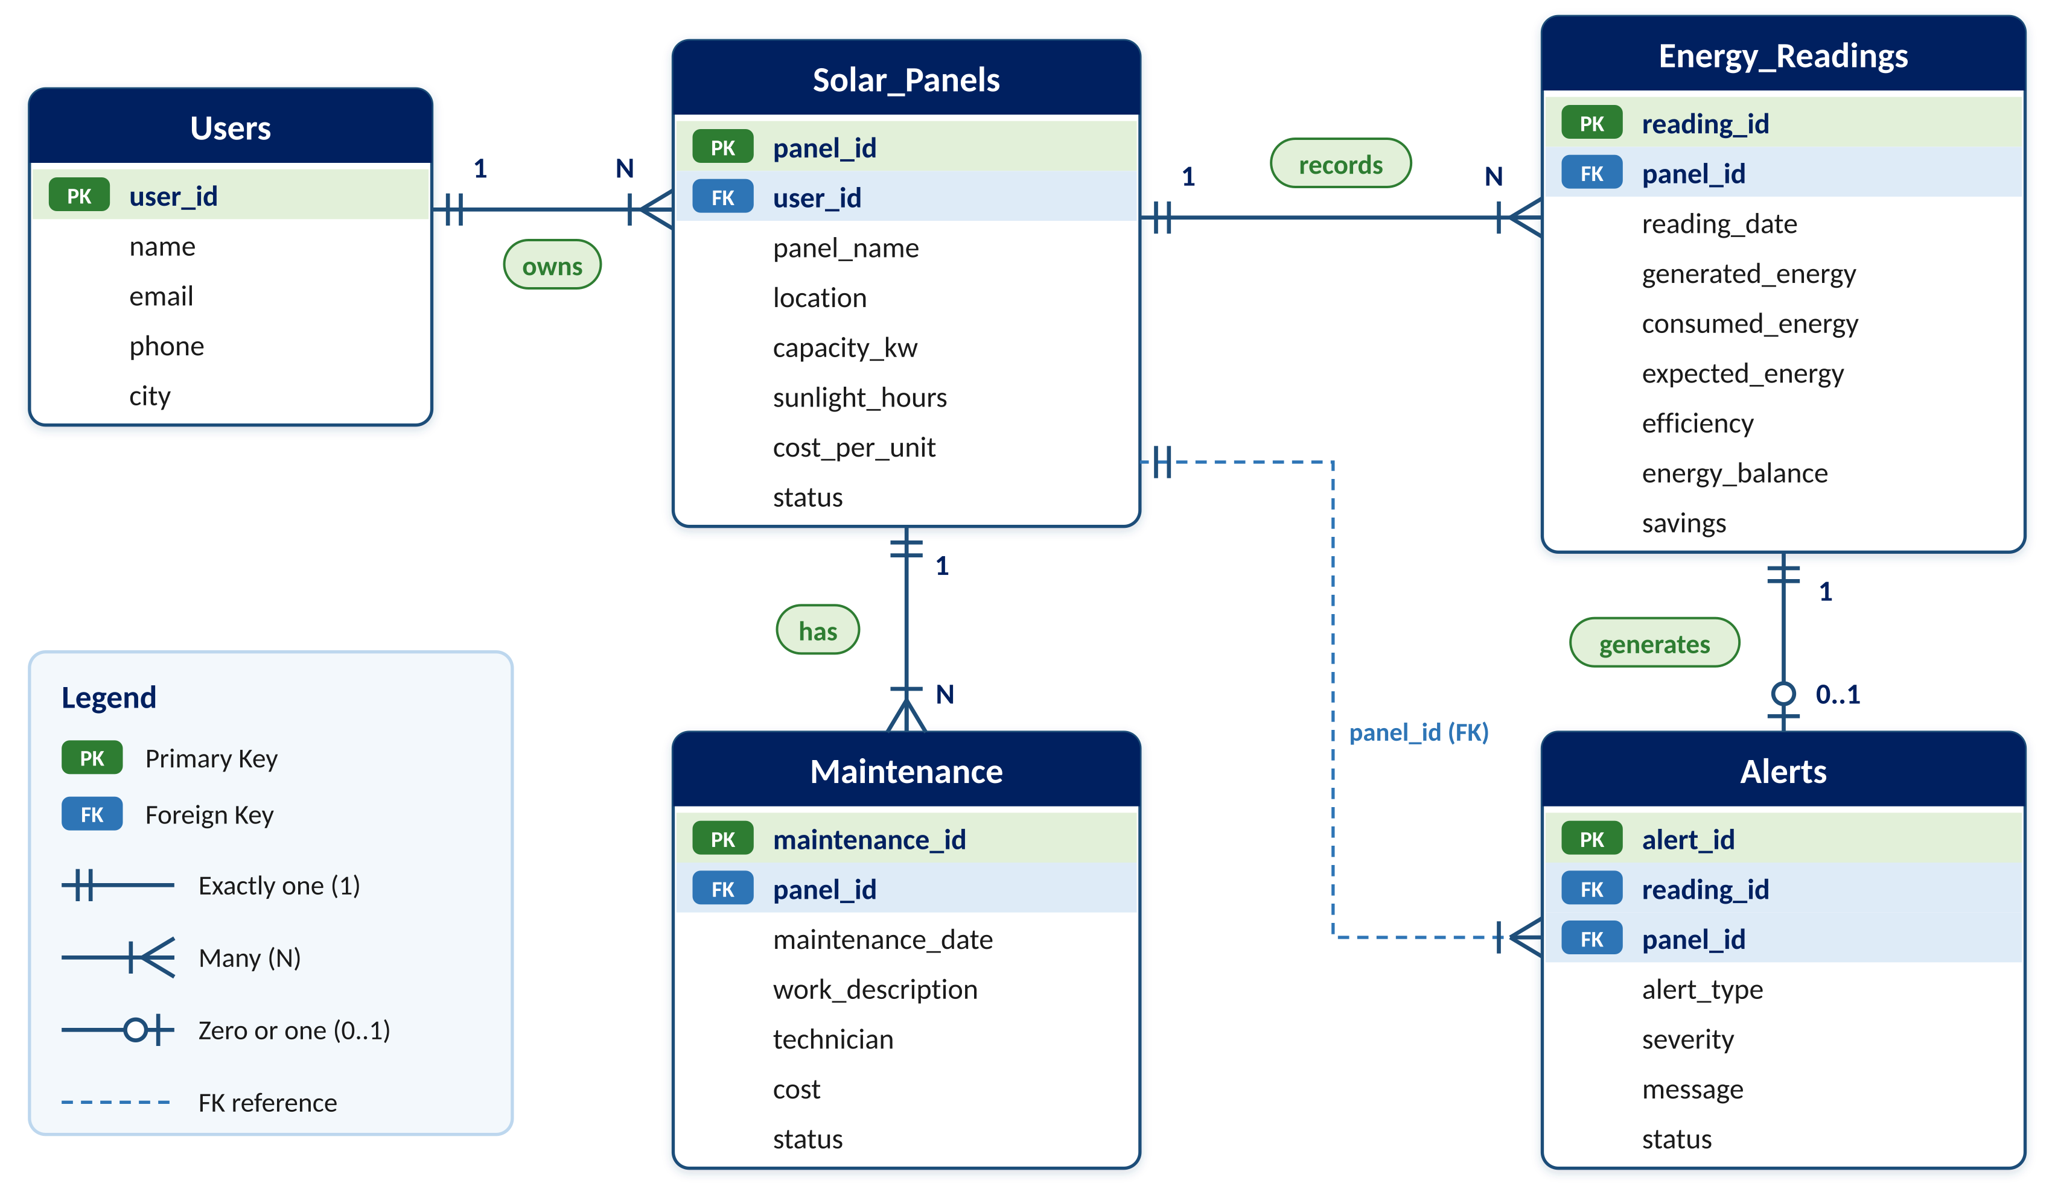
Database Design (ER Diagram)
Relationships
1 : N
User → Solar Panels
1 : N
Solar Panel → Energy Readings
1 : 0..1
Energy Reading → Alert
1 : N
Solar Panel → Maintenance
9
B.Tech II Year | Dept of CSIT | Database Systems Engineering (25CS1302E) | DBMS Project
Notes:
Five tables. Each has a primary key; child tables link to parents through foreign keys.

Slide 10



Dataset / Input Details
Input Forms
Sample Dataset
Users
Panel | kW | Sun h | ₹/unit | Exp. kWh
Rooftop Array A | 5 | 5.5 | ₹7 | 27.5
Garage Panel B | 3 | 5.5 | ₹7 | 16.5
Farm Array C | 10 | 6 | ₹6.5 | 60
name, email, phone, city
Solar Panels
owner, panel name, location, capacity (kW), sunlight hours/day, cost per unit (₹), installation date, status
Energy Readings
2
3
42
7
panel, date, generated energy (kWh), consumed energy (kWh)
Users
Panels
Readings
Alerts
Maintenance
Period: 30 Aug – 28 Sept 2026
Why SQL, not NoSQL: fixed structured fields and linked tables need keys and joins
panel, work description, date, technician, cost (₹), status
10
B.Tech II Year | Dept of CSIT | Database Systems Engineering (25CS1302E) | DBMS Project
Notes:
Inputs come from four forms. The sample dataset has 2 users, 3 panels, and 42 daily readings.

Slide 11
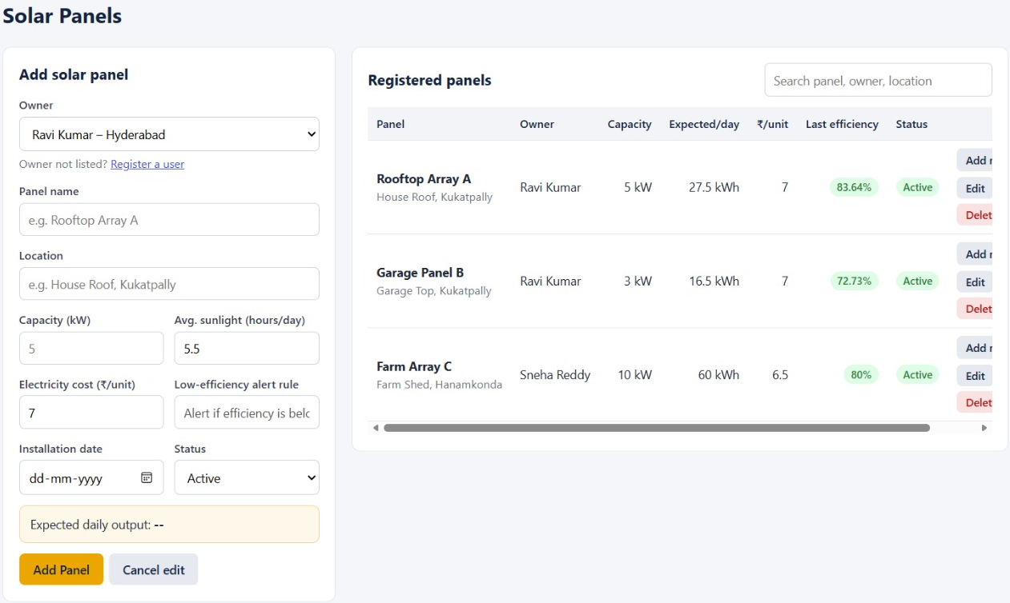



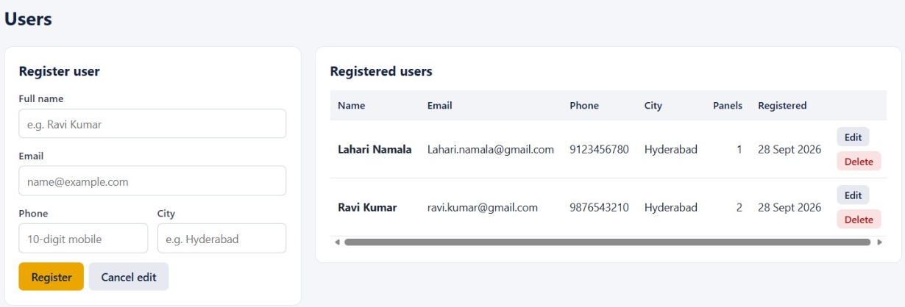
Module 1: User & Solar Panel Management
User details stored in the users table
Panel details stored in the solar_panels table
Panel name, location, capacity, sunlight hours, cost per unit, status
Each panel linked to its owner using user_id (FK)
Solar Panels page
Add, edit, and delete users and panels
DBMS concepts:
Tables
Primary Keys
Foreign Keys
INSERT
UPDATE
DELETE
SELECT
Users page
11
B.Tech II Year | Dept of CSIT | Database Systems Engineering (25CS1302E) | DBMS Project
Notes:
Users and panels are the base data. Every panel belongs to one user through the user_id foreign key.

Slide 12
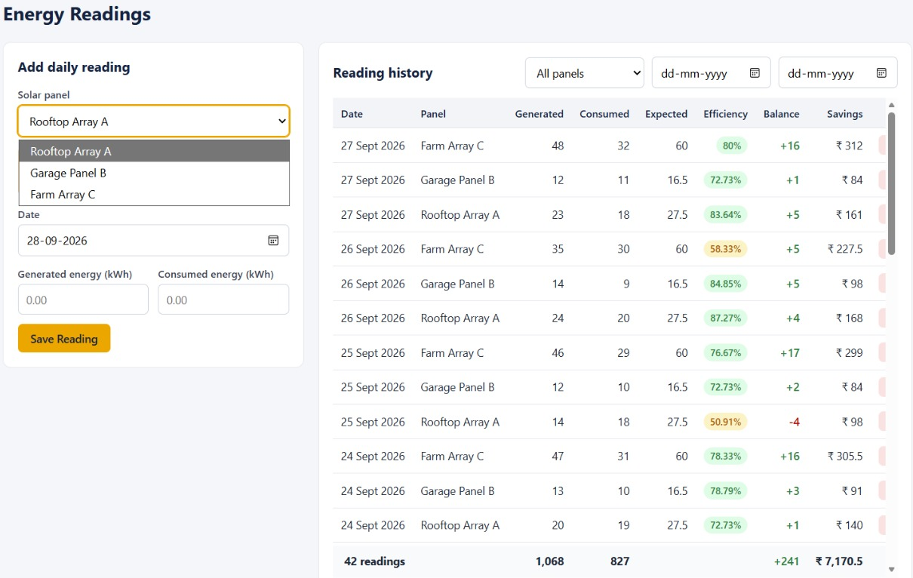
Module 2: Energy Reading & Calculation
User enters daily generated and consumed energy
Stored in the energy_readings table
Backend calculates the values below automatically
Energy Balance
Expected Energy
Energy Generated − Energy Consumed
Panel Capacity × Sunlight Hours
Energy Readings page
Efficiency (%)
Savings
Actual Generated ÷ Expected × 100
Energy Generated × Cost per Unit
Example: Farm Array C → 35 ÷ 60 × 100 = 58.33%, savings 35 × ₹6.5 = ₹227.5
12
B.Tech II Year | Dept of CSIT | Database Systems Engineering (25CS1302E) | DBMS Project
Notes:
User enters generated and consumed energy. The backend calculates four values and stores them in energy_readings.

Slide 13
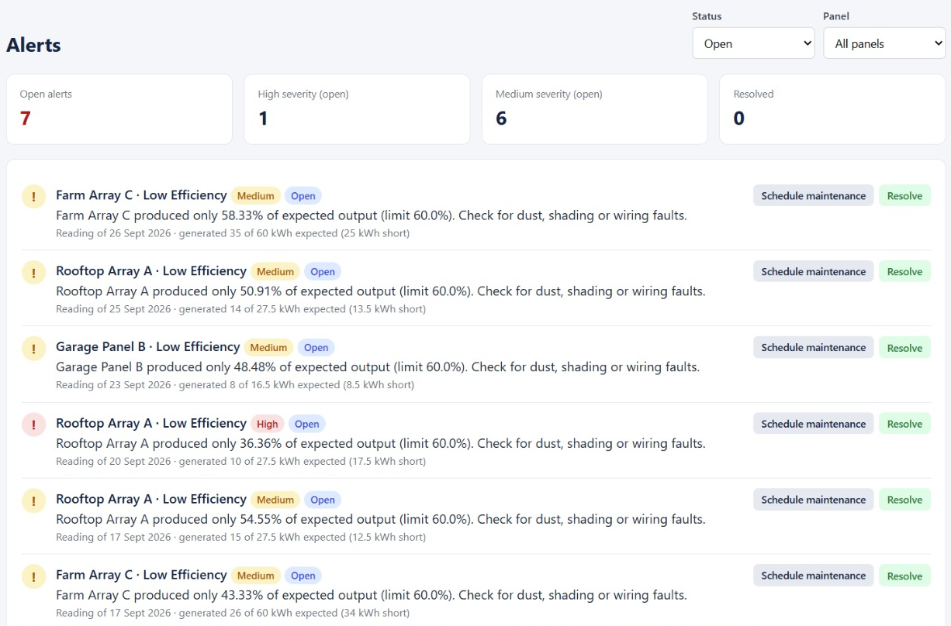


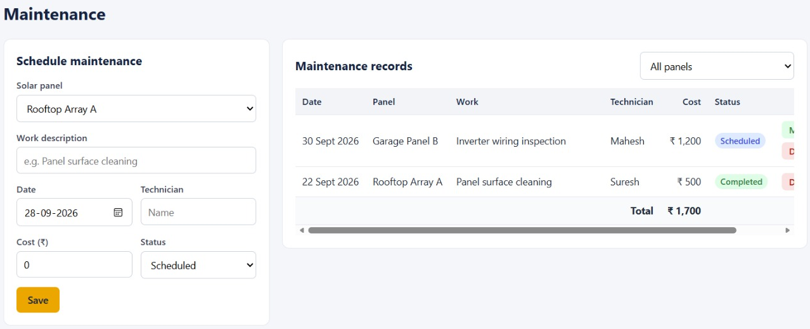

Module 3: Dashboard, Reports & Alerts
Dashboard: generated, consumed, balance, efficiency, savings, alerts
Reports: daily, monthly, panel-wise, user-wise
Alerts page shows low-efficiency alerts with severity
Alert can be resolved or used to schedule maintenance
Alerts page
Alert Rule
If efficiency < 60% → low-efficiency alert
DBMS concepts:
SQL Queries
Joins
SUM / AVG
GROUP BY
Maintenance page
13
B.Tech II Year | Dept of CSIT | Database Systems Engineering (25CS1302E) | DBMS Project
Notes:
Dashboard and reports use SQL aggregate queries with joins. Alerts use the 60% rule; an alert can lead to a maintenance record.

Slide 14
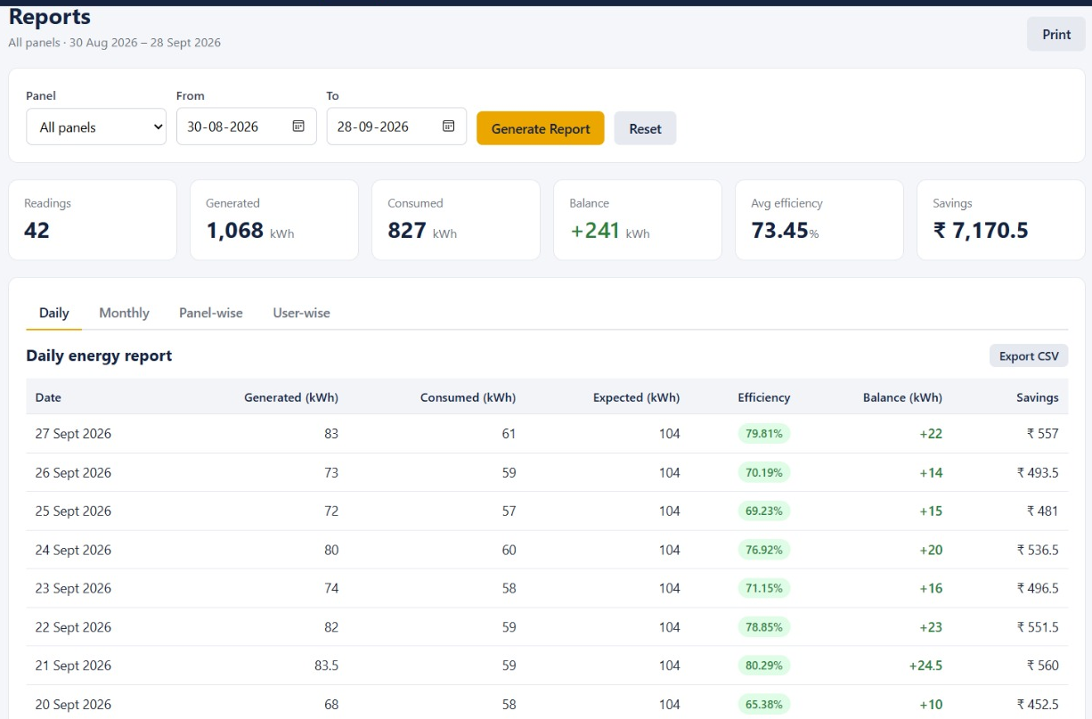
Results
Report period: 30 Aug – 28 Sept 2026 · 42 readings · 3 panels
Total Energy Generated
Total Energy Consumed
1,068 kWh
827 kWh
Energy Balance
Average Efficiency
+241 kWh
73.45 %
Reports page (source of results)
Total Savings
Alerts Generated
₹7,170.5
7 open
The system stores data, calculates values, generates alerts, and displays reports correctly.
14
B.Tech II Year | Dept of CSIT | Database Systems Engineering (25CS1302E) | DBMS Project
Notes:
Totals from the Reports page, 30 Aug – 28 Sept 2026: 42 readings from 3 panels.

Slide 15
Performance Evaluation
Check | What Was Tested | Evidence from Our App | Result
Formula Accuracy | Values match the formulas | Farm Array C: 35 ÷ 60 × 100 = 58.33% (same as app) | ✔ Pass
Database Accuracy | Data stored and retrieved correctly | 42 readings, 3 panels, 2 users | ✔ Pass
API Accuracy | Frontend (5500) fetches from backend (8000) | All pages load data; status shows Connected | ✔ Pass
Alert Accuracy | Alert only when efficiency < 60% | All 7 alerts below 60% (lowest 36.36%) | ✔ Pass
Report Accuracy | Reports built from SQL data | 1,068 − 827 = +241 kWh matches report | ✔ Pass
Dashboard Accuracy | Dashboard matches database | Savings ₹7,170.5 same on home page and reports | ✔ Pass
15
B.Tech II Year | Dept of CSIT | Database Systems Engineering (25CS1302E) | DBMS Project
Notes:
Each check compares system output with a manual calculation or the stored records.

Slide 16
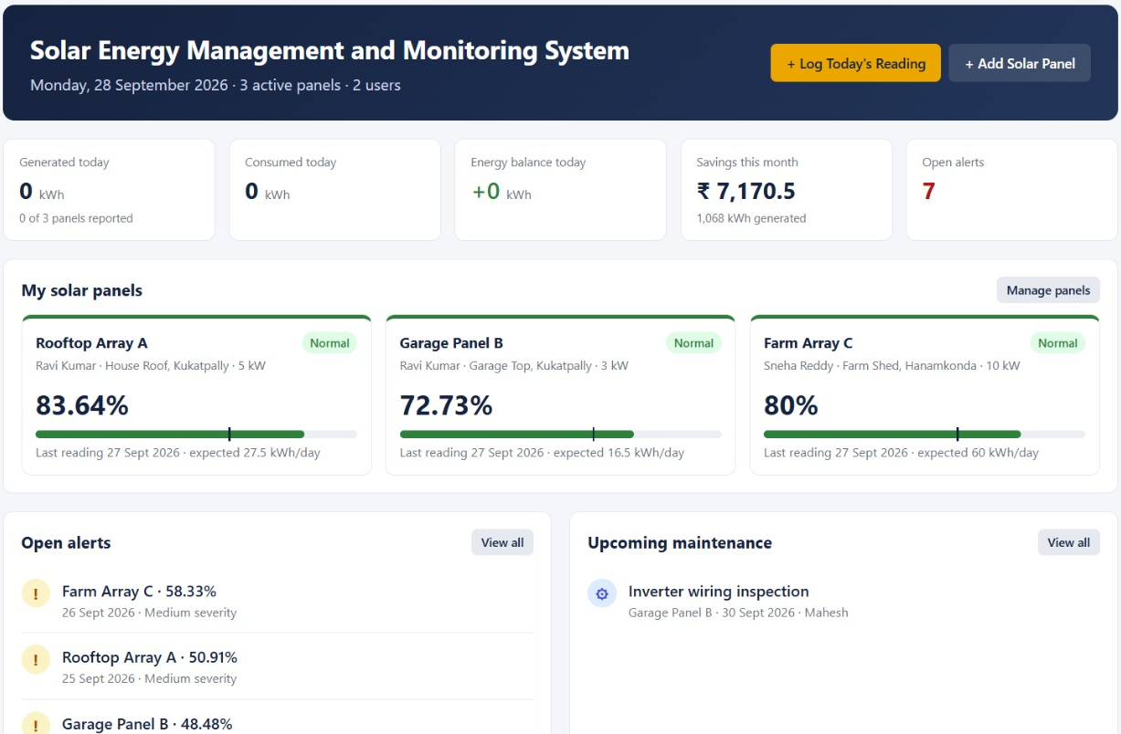
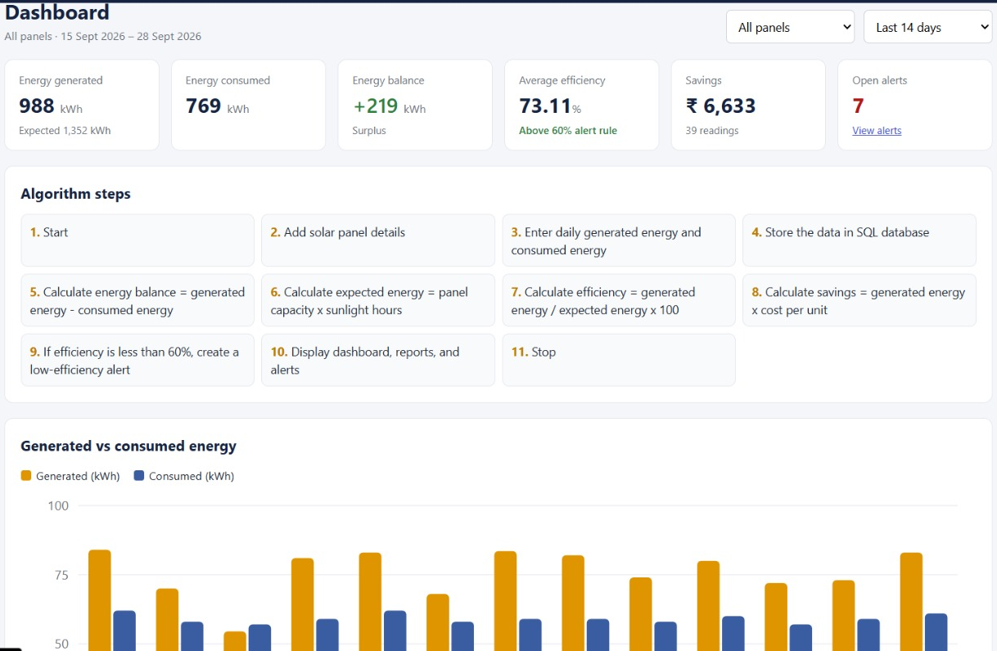

Screenshots / Working Demo
Home page · 127.0.0.1:5500/index.html
Dashboard page · last 14 days, algorithm steps, chart
1
Add panel
2
Enter reading
3
Auto calculation
4
Alert / Report
16
B.Tech II Year | Dept of CSIT | Database Systems Engineering (25CS1302E) | DBMS Project
Notes:
Home page shows today's summary and panel cards. Dashboard page shows the last 14 days, the algorithm steps, and the generated vs consumed chart.

Slide 17
Comparison with Existing System
Feature | Existing / Manual System | Proposed System
Data storage | Paper notes or loose spreadsheets | ✔ SQL tables with primary and foreign keys
Energy calculation | Calculated by hand | ✔ Automatic balance and expected energy
Efficiency tracking | Rarely tracked | ✔ Calculated for every reading
Savings calculation | Rough manual estimate | ✔ Energy generated × cost per unit
Low-efficiency alerts | Not available | ✔ Automatic when efficiency < 60%
Reports | Prepared manually | ✔ Daily, monthly, panel-wise, user-wise
Ease of use | Time-consuming | ✔ Simple web forms and dashboard
DBMS integration | None | ✔ Tables, keys, joins, SQL queries
17
B.Tech II Year | Dept of CSIT | Database Systems Engineering (25CS1302E) | DBMS Project
Notes:
Manual systems need hand-written records and calculations. Our system does it automatically from the database.

Slide 18







Challenges, Solutions and Future Work
Challenge | Solution
Frontend–backend connection | API calls from frontend (5500) to FastAPI (8000)
Database integration | SQL tables with keys and relationships
Formula validation | Checked with sample data
Alert generation | Rule: efficiency below 60%
Report generation | SQL queries on stored records
UI clarity | Simple dashboard, tables, and chart
Future Work
IoT sensors for real-time readings
Cloud deployment (Docker)
Mobile application
Energy prediction analytics
Email / SMS alert notifications
Role-based login (admin / user)
PDF report export
18
B.Tech II Year | Dept of CSIT | Database Systems Engineering (25CS1302E) | DBMS Project
Notes:
Left: how each challenge was solved. Right: planned improvements.

Slide 19
CO Mapping
CO | Mapping in the Project | Shown in
CO1 | Database tables, normalized schema, SQL queries, joins, reports | Slides 9, 11–14
CO2 | SQL vs NoSQL: SQL selected because solar data is structured | Slides 9, 10
CO3 | FastAPI REST APIs, validation, Swagger / OpenAPI docs (port 8000, /docs) | Slides 7, 8
CO4 | Backend modules: users, panels, readings, alerts, reports, maintenance | Slides 11–13
CO5 | Architecture divisible into User, Energy, Report, and Alert services | Slide 7
CO6 | Full-stack integration: frontend (5500) + backend (8000) + SQLite; Docker for future deployment | Slides 8, 16
19
B.Tech II Year | Dept of CSIT | Database Systems Engineering (25CS1302E) | DBMS Project
Notes:
Explain how each course outcome is covered by a part of our project.

Slide 20

Conclusion and References
Conclusion
References
DBMS-based web application for solar energy management
[1] S. R. Madeti, S. N. Singh, “Monitoring system for photovoltaic plants: A review,” Renewable and Sustainable Energy Reviews, vol. 67, 2017.
[2] A. S. Spanias, “Solar energy management as an IoT application,” IEEE IISA, 2017.
[3] M. Beaudin, H. Zareipour, “Home energy management systems: A review,” Renewable and Sustainable Energy Reviews, vol. 45, 2015.
[4] A. Silberschatz, H. F. Korth, S. Sudarshan, Database System Concepts, 7th ed., McGraw-Hill, 2019.
[5] SQLite Documentation, sqlite.org/docs.html.
[6] FastAPI Documentation, fastapi.tiangolo.com.
Stores panel data and daily energy readings in SQLite
Calculates efficiency and savings; generates alerts below 60%
Dashboard and reports built from SQL queries
Shows database design, keys, joins, REST APIs, and full-stack integration
20
B.Tech II Year | Dept of CSIT | Database Systems Engineering (25CS1302E) | DBMS Project
Notes:
Summarise what the project achieved, then mention the references.

