Slide 1

DATABASE SYSTEMS ENGINEERING AND DISTRIBUTED BACKEND DEVELOPMENT (25CS1302E)
Y25 · 2026–2027 · Trimester 4 · Section 13 · Team 4
SOLAR ENERGY MANAGEMENT AND
MONITORING SYSTEM
Review-4
Subject: Database Management System Project
Team Members
2520090226 – Lahari Namala
2520090236 – K. Keathana Vikashini
2520090234 – C. Poojitha
1
B.Tech II Year | Dept of CSIT | Database Systems Engineering (25CS1302E) | Project Review
Notes:
Introduce the project and say this is the final review (Review-4).

Slide 2







Review-4 Rubric Requirements
Accuracy of Results
Final values and verification checks
Slides 7, 8
Technical Competence
Three modules, database, APIs, setup
Slides 3–6
Innovative and Sustainable Features
Automatic efficiency, savings, alerts
Slide 11
Utility to Society
Benefits for homes, colleges, organizations
Slide 12
Presentation Skills
Working screens, tables, clear comparison
Slides 9, 10, 13
Review-4 proves the final project is completed, tested, and working with frontend, backend, database, algorithm, reports, and alerts.
2
B.Tech II Year | Dept of CSIT | Database Systems Engineering (25CS1302E) | Project Review
Notes:
Read the five rubric points and show where each one is covered.

Slide 3
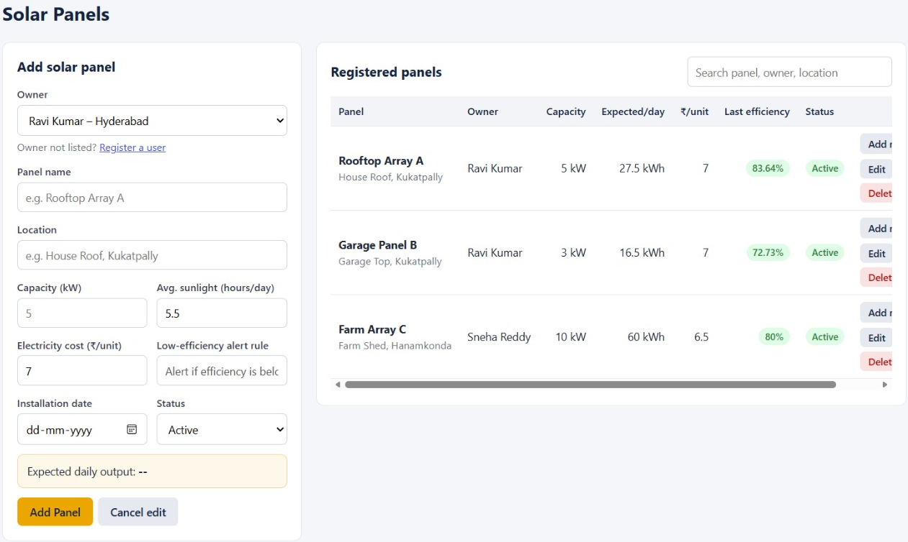




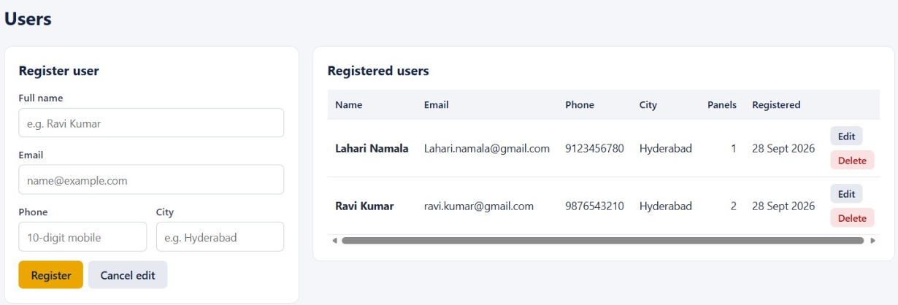
Module 1: User & Solar Panel Management
User details are stored in the users table
Solar panel details are stored in the solar_panels table
Panel name, location, capacity, sunlight hours, cost per unit, status
Manages basic solar panel information
Solar Panels page
Each panel is linked to its owner using user_id (FK)
DBMS concepts:
Tables
Primary Keys
Foreign Keys
INSERT
UPDATE
DELETE
SELECT
Users page
3
B.Tech II Year | Dept of CSIT | Database Systems Engineering (25CS1302E) | Project Review
Notes:
Users and panels are the base data. Every panel belongs to one user through the user_id foreign key.

Slide 4
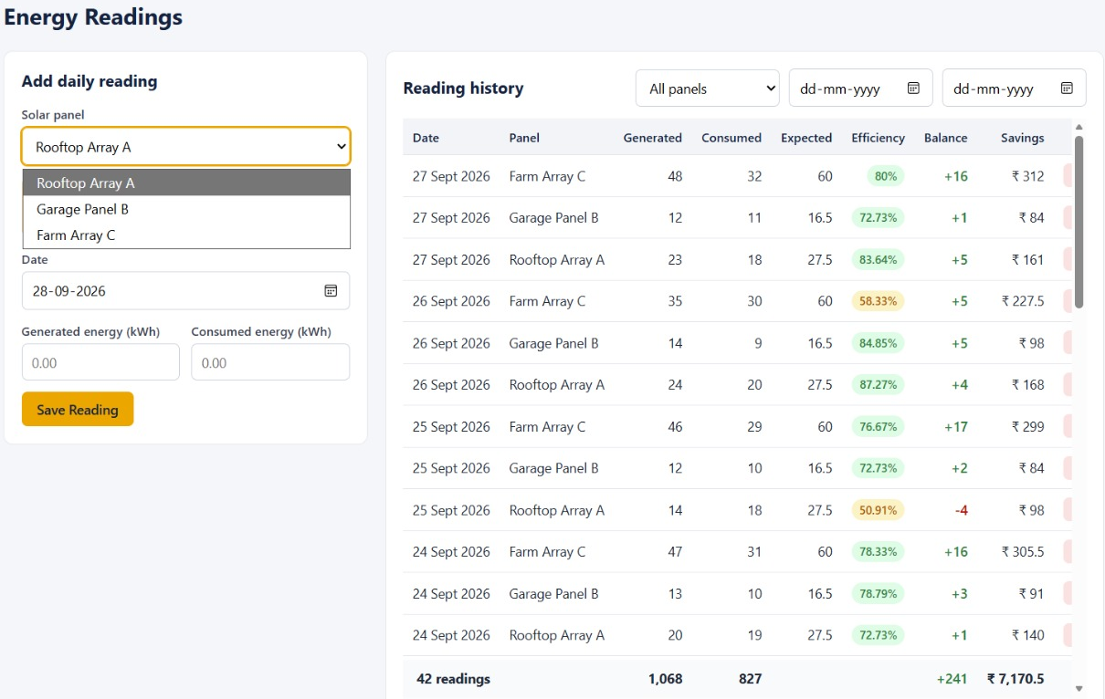



Module 2: Energy Reading & Calculation
User enters daily generated and consumed energy
Data is stored in the energy_readings table
System calculates balance, expected energy, efficiency, savings
Energy Balance
Expected Energy
Energy Generated − Energy Consumed
Panel Capacity × Sunlight Hours
Energy Readings page
Efficiency (%)
Savings
Actual Generated ÷ Expected × 100
Energy Generated × Cost per Unit
4
B.Tech II Year | Dept of CSIT | Database Systems Engineering (25CS1302E) | Project Review
Notes:
The user enters generated and consumed energy. The backend calculates the four values and stores them in energy_readings.

Slide 5
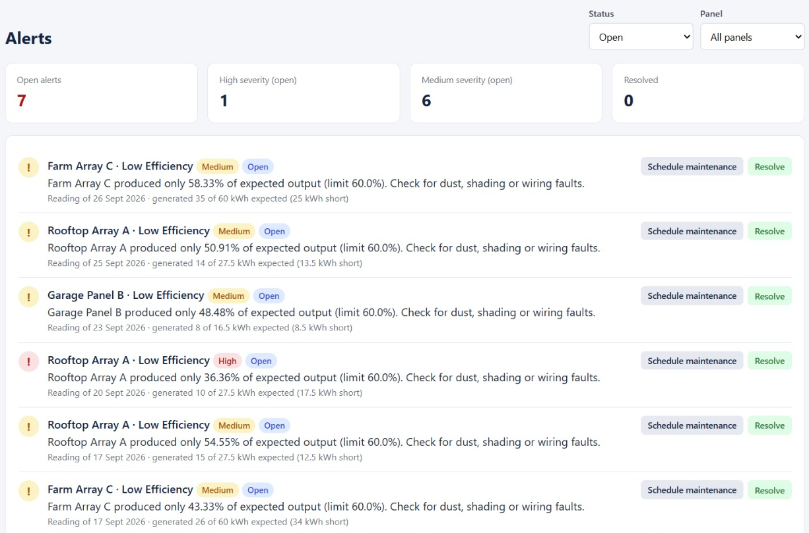




Module 3: Dashboard, Reports & Alerts
Dashboard: generated, consumed, balance, efficiency, savings, alerts
Reports: daily, monthly, panel-wise, and user-wise
Alerts page displays low-efficiency alerts
Alert Rule
If efficiency < 60%, a low-efficiency alert is generated
Alerts page
DBMS concepts:
SQL Queries
Joins
Reports
Data Retrieval
5
B.Tech II Year | Dept of CSIT | Database Systems Engineering (25CS1302E) | Project Review
Notes:
Explain the three output pages and the 60% alert rule. Reports use SQL queries with joins.

Slide 6







Experimental Setup
Development Tool
VS Code
Frontend
HTML, CSS, JavaScript
Backend
Python FastAPI
Database
SQLite / SQL Database
Frontend Port
5500
Backend Port
8000
API Documentation
Swagger / OpenAPI
Browser
Chrome / Edge
Component | Port | URL
Frontend (web pages) | 5500 | http://127.0.0.1:5500/index.html
Backend API (FastAPI) | 8000 | http://127.0.0.1:8000
Swagger / OpenAPI Docs | 8000 | http://127.0.0.1:8000/docs
Database (SQLite) | — | Local database file, accessed by the backend
6
B.Tech II Year | Dept of CSIT | Database Systems Engineering (25CS1302E) | Project Review
Notes:
List the tools. Open the frontend at 127.0.0.1:5500/index.html; the backend API runs at 127.0.0.1:8000 and Swagger docs at 127.0.0.1:8000/docs.

Slide 7
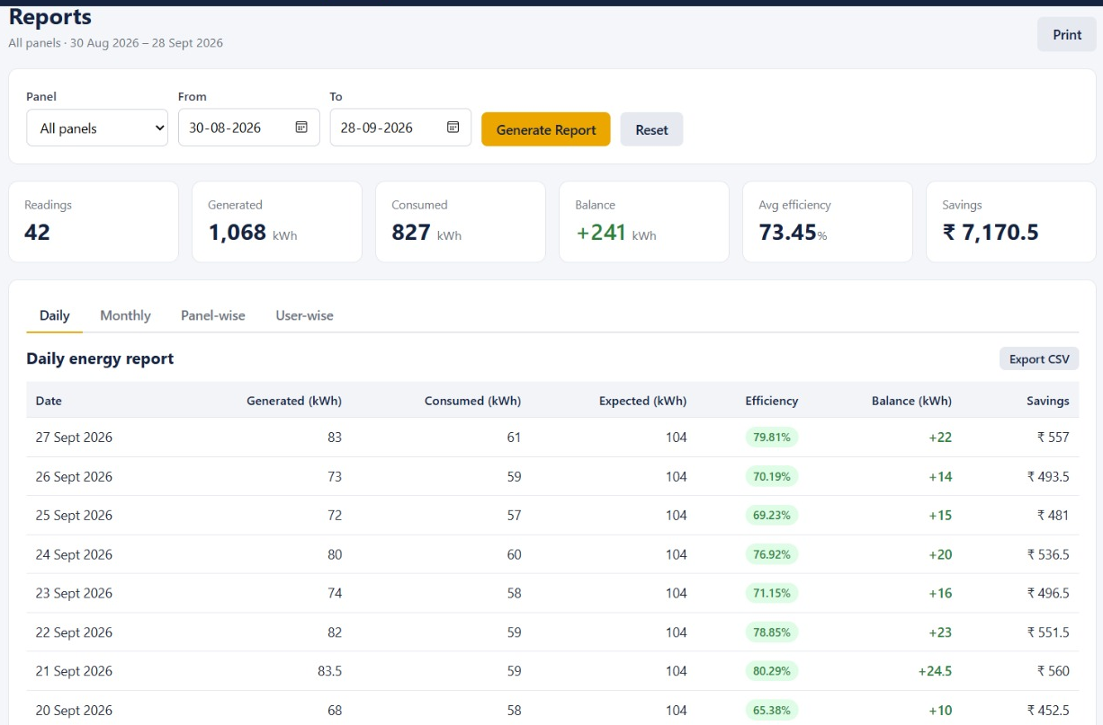
Results
Report period: 30 Aug – 28 Sept 2026 · 42 readings · 3 panels
Total Energy Generated
Total Energy Consumed
1,068 kWh
827 kWh
Energy Balance
Average Efficiency
+241 kWh
73.45 %
Reports page (source of results)
Total Savings
Alerts Generated
₹7,170.5
7 open
Stores input data, performs calculations, generates alerts, and displays reports successfully.
7
B.Tech II Year | Dept of CSIT | Database Systems Engineering (25CS1302E) | Project Review
Notes:
These are the real totals from our Reports page for 30 Aug to 28 Sept 2026: 42 readings from 3 panels.

Slide 8
Performance Evaluation
Check | What Was Tested | Evidence from Our App | Result
Formula Accuracy | Calculated values match expected formulas | Farm Array C: 35 ÷ 60 × 100 = 58.33% (matches app) | ✔ Pass
Database Accuracy | User, panel, reading, alert data stored correctly | 42 readings, 3 panels, 2 users stored and retrieved | ✔ Pass
API Accuracy | Frontend fetches data from backend | All pages load data; status shows Connected | ✔ Pass
Alert Accuracy | Alert generated when efficiency < 60% | All 7 alerts are below 60% (lowest 36.36%) | ✔ Pass
Report Accuracy | Reports built from stored SQL data | 1,068 − 827 = +241 kWh matches report balance | ✔ Pass
Dashboard Accuracy | Dashboard values match database records | Savings ₹7,170.5 same on dashboard and reports | ✔ Pass
8
B.Tech II Year | Dept of CSIT | Database Systems Engineering (25CS1302E) | Project Review
Notes:
Each check compares the system output with a manual calculation or the stored records.

Slide 9
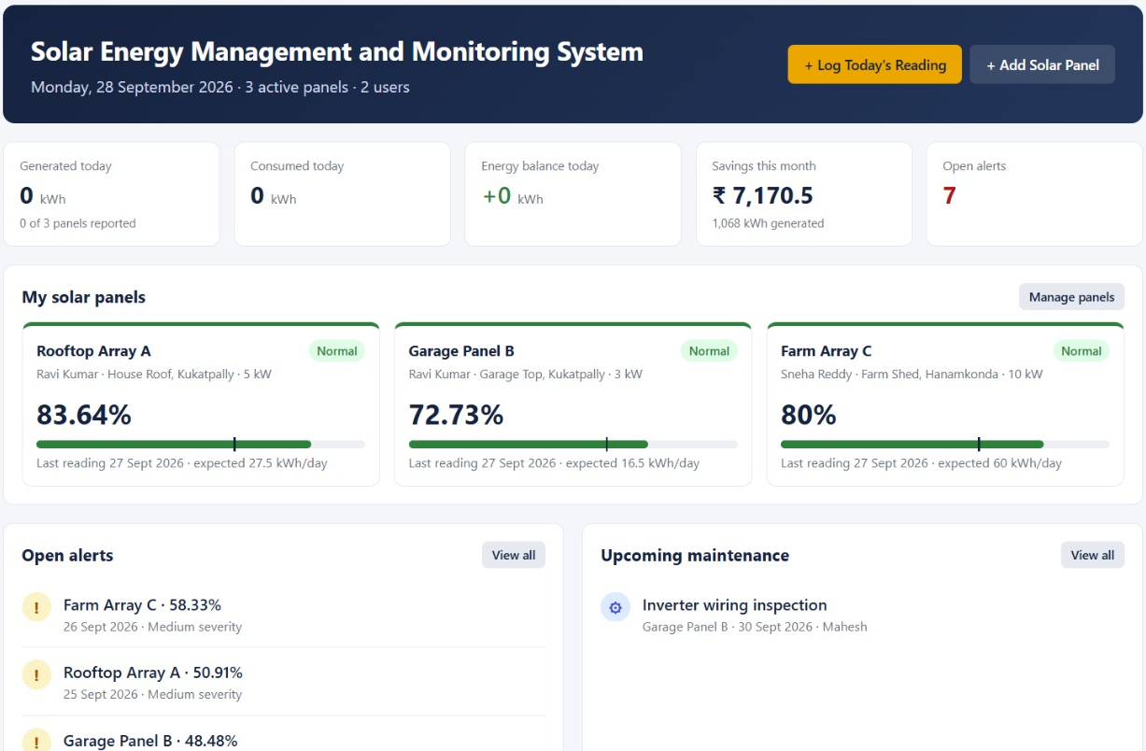
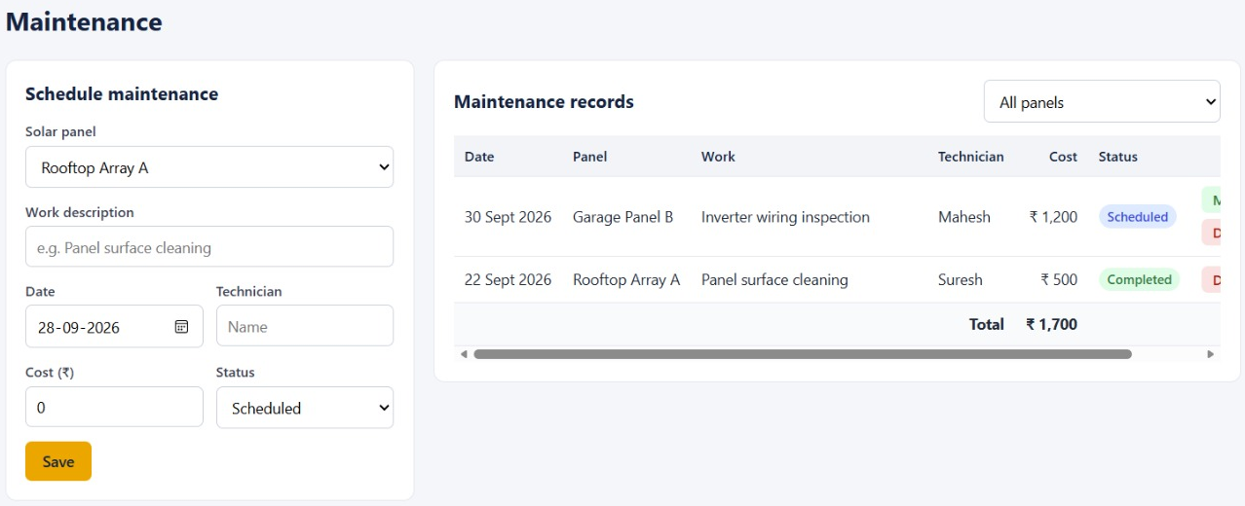
Screenshots / Working Demo
Solar Panels
Energy Readings
Home Page
Reports
Demo Flow
1
Add panel
Users
2
Enter reading
Maintenance
3
Auto calculation
Alerts
4
Alert / Report
9
B.Tech II Year | Dept of CSIT | Database Systems Engineering (25CS1302E) | Project Review
Notes:
Show the working flow: add a panel, enter a reading, see the calculations, alerts, and reports.

Slide 10
Comparison with Existing System
Feature | Existing / Manual System | Proposed System
Data storage | Paper notes or loose spreadsheets | ✔ SQL tables with primary and foreign keys
Energy calculation | Calculated by hand | ✔ Automatic balance and expected energy
Efficiency tracking | Rarely tracked | ✔ Calculated for every reading
Savings calculation | Rough manual estimate | ✔ Energy generated × cost per unit
Low-efficiency alerts | Not available | ✔ Automatic when efficiency < 60%
Reports | Prepared manually | ✔ Daily, monthly, panel-wise, user-wise
Ease of use | Time-consuming | ✔ Simple web forms and dashboard
DBMS integration | None | ✔ Tables, keys, joins, SQL queries
DBMS / CO link: Existing systems need manual records; ours stores data in a database and calculates automatically.
10
B.Tech II Year | Dept of CSIT | Database Systems Engineering (25CS1302E) | Project Review
Notes:
Manual systems need hand-written records and calculations. Our system does it automatically from the database.

Slide 11




Innovative and Sustainable Features
Innovative Features
Sustainable Features
Database-driven solar energy monitoring
Supports renewable energy monitoring
Automatic efficiency calculation
Can be extended with IoT sensors in future
Low-efficiency alert generation
Promotes sustainable energy usage
Energy savings calculation
Dashboard and report generation
11
B.Tech II Year | Dept of CSIT | Database Systems Engineering (25CS1302E) | Project Review
Notes:
Left: what is new in our system. Right: how it supports sustainability.

Slide 12


Utility to Society
Monitor Energy
Renewable Usage
Less Wastage
Track solar generation and consumption
Encourages use of solar energy
Reduces energy wastage
Find Weak Panels
Cost Savings
Wide Use
Identifies low-performing solar panels
Supports savings through energy tracking
Useful for homes, colleges, small organizations
12
B.Tech II Year | Dept of CSIT | Database Systems Engineering (25CS1302E) | Project Review
Notes:
Explain who benefits and how: monitoring, renewable use, less wastage, finding weak panels, saving money.

Slide 13
Challenges & Solutions
# | Challenge | Solution
1 | Backend and frontend connection | Used API calls between frontend and FastAPI backend
2 | Database integration | Used SQL database tables and relationships
3 | Formula validation | Checked calculations using sample data
4 | Alert generation | Applied rule: efficiency below 60%
5 | Report generation | Used stored database records and SQL queries
6 | UI clarity | Used simple dashboard, tables, and charts
13
B.Tech II Year | Dept of CSIT | Database Systems Engineering (25CS1302E) | Project Review
Notes:
For each challenge, explain how we solved it.

Slide 14






Future Work
IoT Sensors
Cloud Deployment
Mobile App
Advanced Analytics
Automatic real-time readings
Online access
Mobile application support
Energy prediction
Email / SMS Alerts
Role-Based Login
Export Reports
Instant alert notifications
Separate admin and user access
Download reports as PDF / CSV
14
B.Tech II Year | Dept of CSIT | Database Systems Engineering (25CS1302E) | Project Review
Notes:
These are planned improvements beyond the current project.

Slide 15

Conclusion and References
Conclusion
References
A DBMS-based web application for solar energy management
[1] A. Silberschatz, H. F. Korth, S. Sudarshan, Database System Concepts, 7th ed., McGraw-Hill, 2019.
[2] SQLite, “SQL As Understood By SQLite,” sqlite.org/lang.html.
[3] FastAPI Documentation, fastapi.tiangolo.com.
[4] SQLite Documentation, sqlite.org/docs.html; MySQL 8.0 Reference Manual, dev.mysql.com/doc.
[5] S. R. Madeti and S. N. Singh, “Monitoring system for photovoltaic plants: A review,” Renewable and Sustainable Energy Reviews, vol. 67, 2017.
Stores solar panel data and records daily energy readings
Calculates efficiency and savings, and generates alerts
Displays dashboard and reports from SQL data
Demonstrates database design, relationships, API integration, and full-stack implementation
15
B.Tech II Year | Dept of CSIT | Database Systems Engineering (25CS1302E) | Project Review
Notes:
Summarise what the project achieved, then mention the references.

