Slide 1

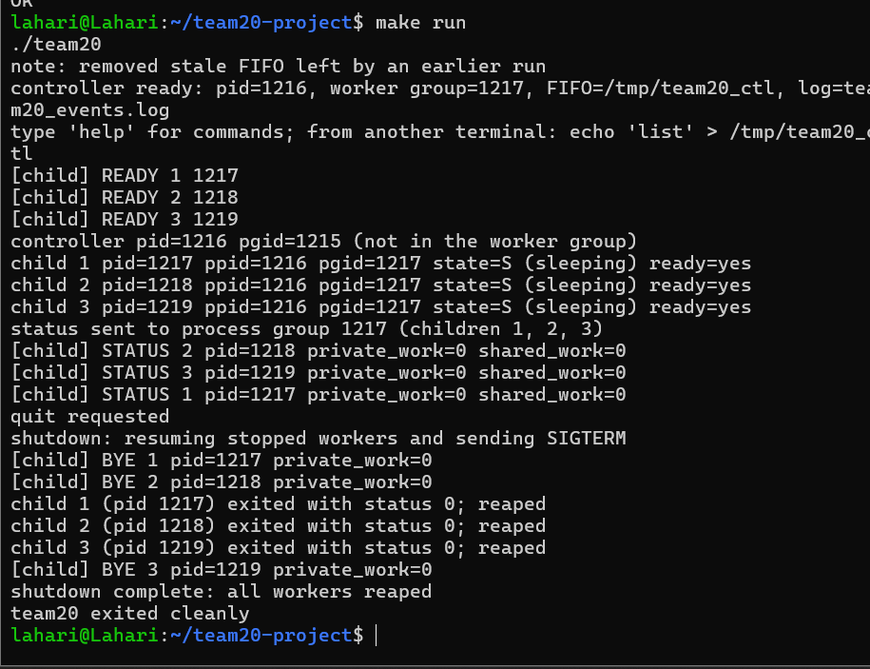
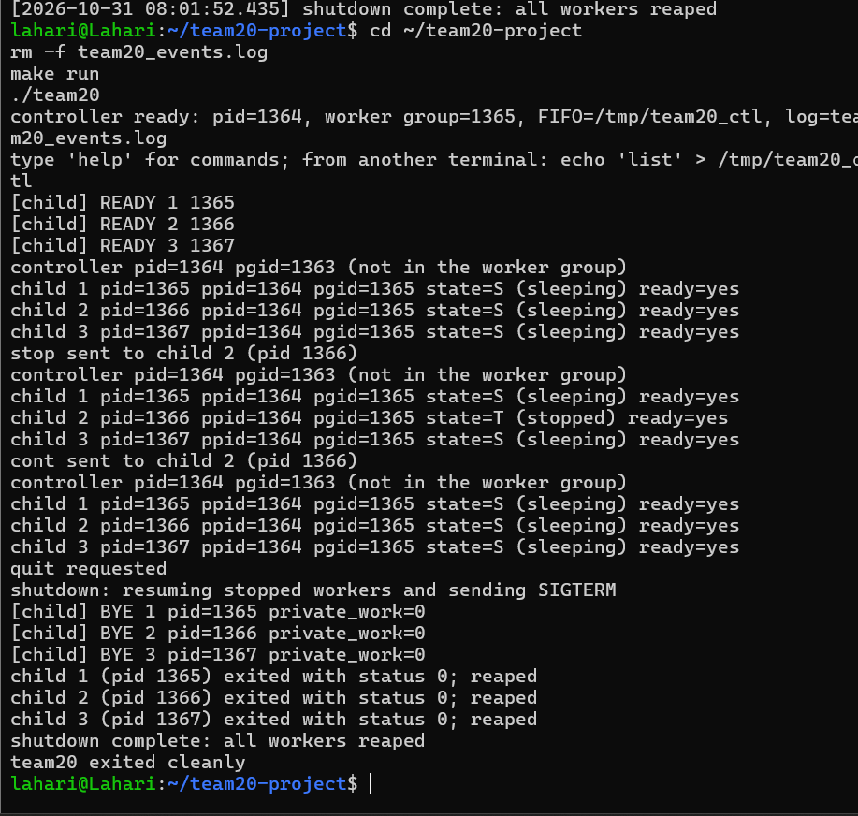
Linux Signal-Based Process Communication and Control System
Team ID: 20 | Section: 13 | Members: Lahari Namala – 2520090226, K. Keathana Vikashini – 2520090236, C. Poojitha – 2520090234, P. Bhagya Sri – 2520080024 | Guide: [to be filled]
Operating Systems and Systems Programming (OSSP) | KLH Bachupally Campus, CSE | PBL 2026–27
Abstract
Tools & Technologies
Problem: a program cannot easily pause, query or stop worker processes, and finished workers can stay as zombies.
Outcome: 13 automated tests pass; stop/continue verified in /proc; clean shutdown with no zombie children.
Programming: C (C11) with GCC; Python 3 unittest for tests.
Platform: Ubuntu Linux on WSL2 (Windows 11).
OS Concepts: processes and process groups, signals, pipes and FIFOs, shared memory, threads and synchronization, /proc, file system.
System Calls / APIs: fork, setpgid, kill, waitpid, sigaction, sigsuspend, ppoll, pipe, mkfifo, mmap, sem_init / sem_wait, pthread_create / pthread_join, stat, readlink.
Tools: GCC, Make, Python unittest, VS Code, GitHub (repository link to be added).
Problem Statement & Objectives
Problem: once worker processes run, a program has no simple way to pause, resume, query or cleanly stop them, and workers that exit without being reaped stay in the process table as zombies.
Objective 1: create three worker processes with fork() and put them in one process group.
Objective 2: control workers one by one or all together with POSIX signals (status, work, stop, cont).
Objective 3: send events from workers to the controller through a pipe; accept commands from a second terminal through a named FIFO; log every event with a timestamp.
Scope: one controller, three workers, one user on Ubuntu / WSL2. Commands: help, list, status, work, stop, cont, board, mem, files, quit. Out of scope: exec()-based workers, real-time signals, zombie/orphan demo mode (future work).
System Workflow / Architecture
Terminal 1
keyboard commands
Terminal 2
echo "cmd" > FIFO
Controller (parent)
ppoll() loop + handle_command()
kill(pid or -pgid, SIG)
SIGUSR1 / SIGUSR2 / SIGSTOP / SIGCONT
Existing vs Proposed System
Worker 1
sigsuspend(), handlers
Worker 2
sigsuspend(), handlers
Worker 3
sigsuspend(), handlers
Aspect | Basic / Existing Approach | Proposed Project
Process handling | Manual or limited process handling | fork() creates three workers in one process group; waitpid() reaps each one.
Communication | No or limited process communication | Pipe for events, named FIFO for commands, signals for control.
Resource handling | Limited file and resource handling | Shared mmap board guarded by a semaphore; log written by a logger thread from a bounded queue.
Error handling | Failures go unnoticed; zombies left behind | Input validation, bounded waits, SIGKILL fallback, stale-FIFO check, instance conflict report.
Key gap | Cannot pause, query or stop workers cleanly | stop / cont / status / board / mem / files commands address this gap.
Workers share one process group (PGID = Worker 1 PID)
Pipe: events to controller
Shared board: mmap + sem
Logger thread: log file
Process, IPC & Resource Design
Controller (parent): forks three workers; PGID = Worker 1 PID.
Pipe: workers to controller; one line per write (under PIPE_BUF).
FIFO /tmp/team20_ctl: second terminal to controller; mode 0600.
Shared board: mmap(MAP_SHARED) created before fork(); sem_t lock; one counter per worker.
Private data: each worker keeps its own work counter (copy-on-write after fork).
Logger thread: bounded queue of 64 messages; mutex + two condition variables; writes team20_events.log.
Feasibility Study
Technical: C with GCC on Ubuntu / WSL2; POSIX and Linux system calls only; no extra libraries.
Economic: open-source tools only; no hardware or hosting cost.
Operational: runs from two terminals (Terminal 2 sends FIFO commands); needs write access to /tmp for the FIFO.
Schedule: milestones: Review 1 proposal, Review 2 prototype, Review 3 final build with tests and logs.
Implementation Screenshots
Results & Testing
Conclusion
Future Scope
13 automated tests pass (make test). Normal: startup, stop/cont, status, work. Boundary: 150-signal burst (signals merge). Invalid: bad and overlong input. Shutdown: quit, SIGTERM, Ctrl+C, stdin EOF.
Controller forks three workers and controls them with signals (single and group), events by pipe, commands by FIFO, shared state by mmap + semaphore, logging by a thread. Covers CO1 system calls, CO2 processes, CO3 signals and IPC, CO4 threads and sync, CO5 memory, CO6 files.
1. exec()-based worker programs.
2. sigqueue() real-time signals so events are not merged; zombie/orphan demo mode.
References: [1] Linux man-pages (fork, kill, sigaction, sigsuspend, ppoll, pipe, mkfifo, mmap, sem_init, pthread_create, /proc) [2] Operating Systems textbook / course material [3] GCC / GNU documentation
QR: GitHub (add link)

