Slide 1
Defective Data Correction(Cold start) of data set and prediction of adobe prices based on classification and regression analysis
Presenters:
Lahari Reddy Muskula (700741333)
Divya Sai Ajay Jasti (700741296)
Vineel Reddy Kunduru (700741502)
Maneesh Reddy Maram (700742207)

Slide 2
ABSTRACT
This project identifies and replaces the missing values with the corresponding mean values in the dataset. This project analyzes the updated dataset by using Gaussian Naive bayes analysis and decision tree analysis, for estimating house price based on area in square feet and number of bedrooms.

Slide 3
MOTIVATION
The current method used to predict the price of house is by checking weather the place is in city or in county area real-estates gets benefits in this scenario.
The proposed strategies are put into practice where gadgets are employed for the automatic identification of house prices that make the procedure cheaper and easier. This increases the accuracy rate and makes it more helpful
Here, in the proposed project we have used a few of the machine learning algorithms to categorize and identify the price of any house.

Slide 4
Project Modules
Classification and Regression Algorithms
Classification: GNB, DTC
Regression: Simple Regression, Bagging Regression, Logistic Regression
Feature Relation Graphs
Predicted Price VS Actual Price comparison plots

Slide 5
Classification and Regression algorithms
Classification Algorithms:
Gaussian Naïve Bayes Classifier
The Bayes hypothesis underpins the Naive Bayes characterisation approach. It's a simple yet effective calculation for demonstrating foresight in controlled learning calculations. The Naive Bayes approach is simple to understand. When we have a large amount of data to focus on, Naive Bayes has a greater precision and speed. There are three sorts of Naive Bayes models: Gaussian, Multinomial, and Bernoulli.
2. Decision Tree Classifier
Decision Trees (DTs) are a non-parametric supervised learning method used for classification and regression. The goal is to create a model that predicts the value of a target variable by learning simple decision rules inferred from the data features. A tree can be seen as a piecewise constant approximation.

Slide 6
Regression Algorithms
Bagging Regression
Bootstrap aggregating, also called bagging , is a machine learning ensemble meta algorithm designed to improve the stability and accuracy of machine learning algorithms used in statistical classification and regression It also reduces variance and helps to avoid overfitting
2. Linear Regression
Linear Regression is the supervised Machine Learning model in which the model finds the best fit linear line between the independent and dependent variable i.e it finds the linear relationship between the dependent and independent variable.

Slide 7
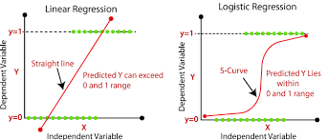
3. Logistic Regression
Logistic regression is an example of supervised learning. It is used to calculate or predict the probability of a binary (yes/no) event occurring.

Slide 8
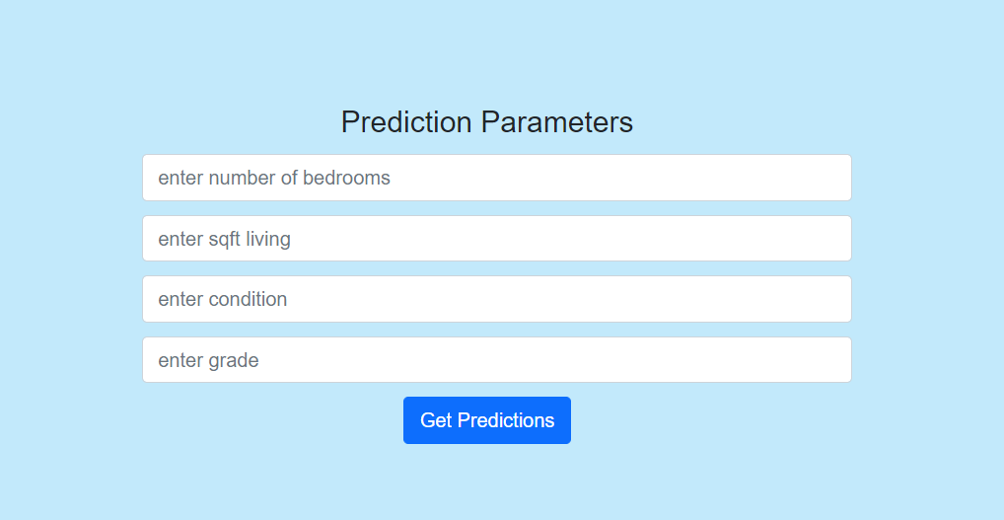
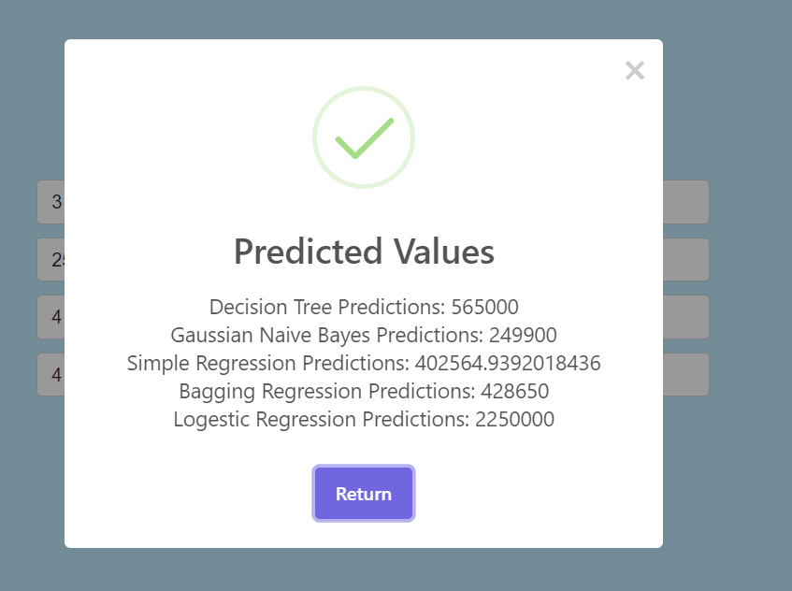

Slide 9
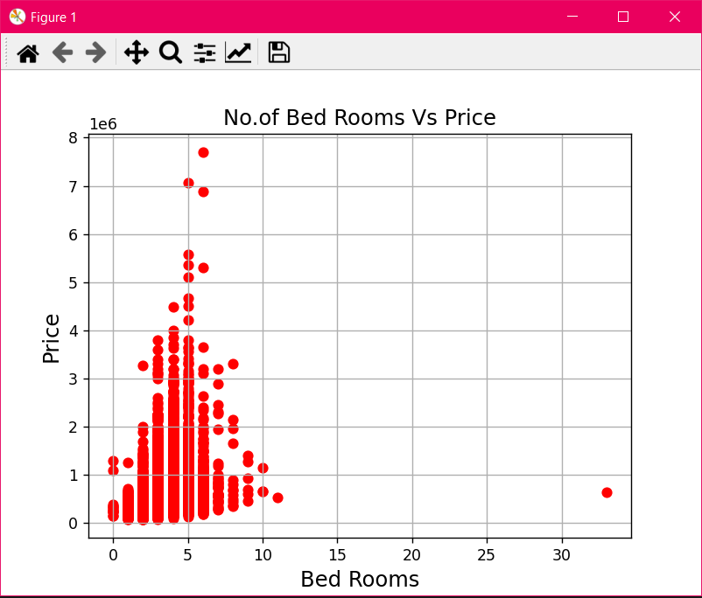
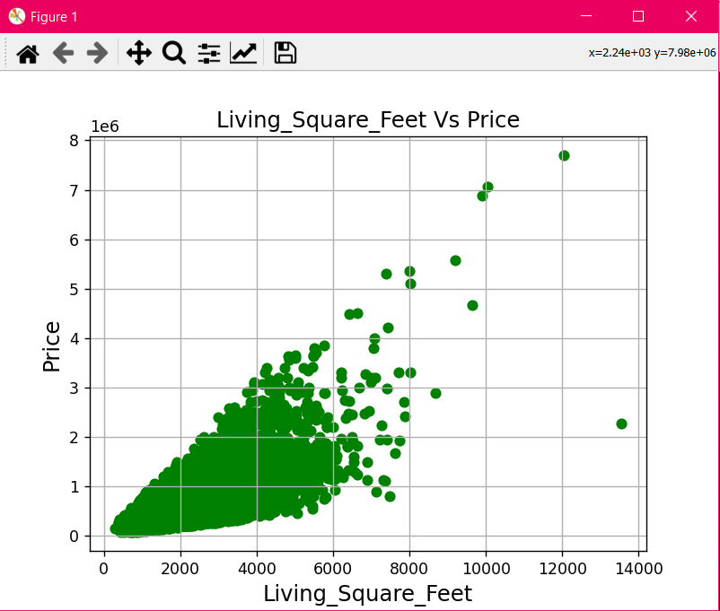
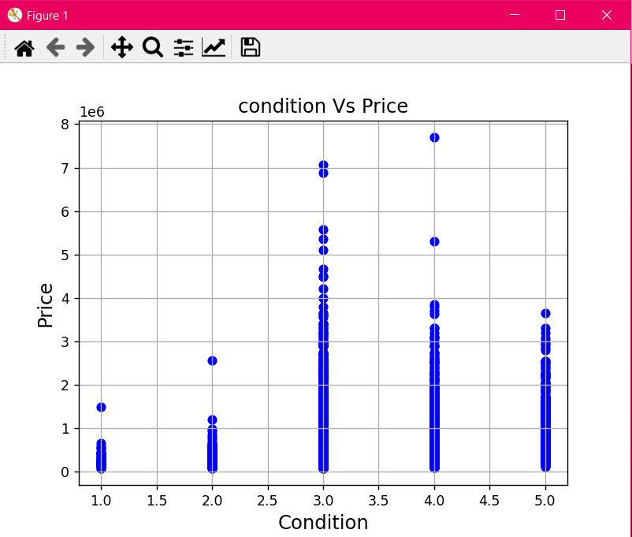
Feature Relation Graphs

Slide 10
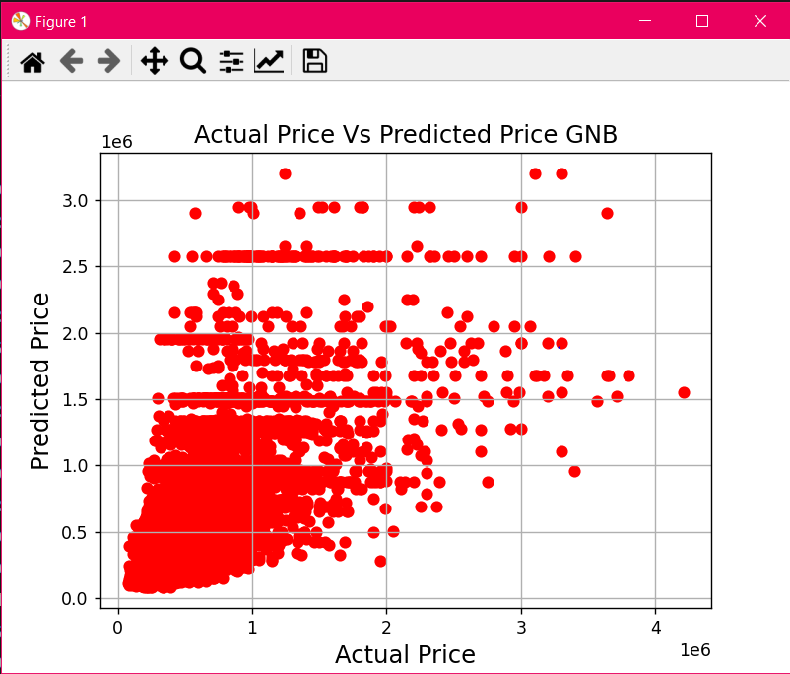
Predicted Price Vs Actual Price Plots
Graphical plots for DTC, BGR, LGR, LR will be shown during execution.

Slide 11
THANK YOU

