Slide 1

Airline Passenger Satisfaction Prediction Using Artificial Neural Network
Presented By -
B.LAHARI

Slide 2
About me
• Name: B. Lahari
• Education Background: Graduated B.Tech [CSE-AIML]
• Why I Want to Become a Data Scientist:
– I want to become a data scientist because I enjoy working with data, finding patterns, and solving real-world problems.
– As a BTech student, I am interested in using my technical skills to turn data into meaningful insights and smart decisions.
• Work Experience:
– I am a fresher, currently focusing on learning and building practical skills

Slide 3
Agenda (This should be the PPT flow)
Introduction
Problem Statement
Dataset Overview
Objectives
Tools & Technologies
Data Preprocessing
Exploratory Data Analysis
ANN Model Architecture
Model Training & Evaluation
Results & Insights
Conclusion

Slide 4
Introduction
Passenger satisfaction is an important factor in the airline industry.
Satisfaction depends on factors such as:
  Flight experience
  Service quality
  Comfort
  Delays
  In-flight services
Machine Learning can help predict passenger satisfaction.

Slide 5
Problem Statement
To develop an Artificial Neural Network (ANN) model that predicts whether an airline passenger is Satisfied or Neutral/Dissatisfied based on passenger and flight-related features.

Slide 6
DataSet Overview & Objectives
DATASET OVERVIEW
Total Records: 103,904
Original Columns: 25
Target Variable: satisfaction
Problem Type: Binary Classification
PROJECT OBJECTIVES
Understand the dataset
Clean and preprocess the data
Perform Exploratory Data Analysis
Build an ANN model
Train and evaluate the model
Predict passenger satisfaction
Analyze model performance
Target Classes
1 → Satisfied
0 → Neutral or Dissatisfied

Slide 7
Tools & Technologies
Programming Language - Python
Data Analysis - Pandas , NumPy
Data Visualization - Matplotlib , Seaborn
Machine Learning - Scikit-learn
Deep Learning - TensorFlow , Keras
Development Environment - Jupyter Notebook

Slide 8
Data Preprocessing
The following preprocessing steps were performed:
Removed unnecessary identifier columns.
Checked for missing values.
Filled missing values in Arrival Delay in Minutes using the median.
Converted categorical variables using One-Hot Encoding.
Encoded the target variable.
Divided data into training and testing datasets.
Applied StandardScaler for feature scaling.
Train-Test Split :
Training Data: 80%
Testing Data: 20%

Slide 9
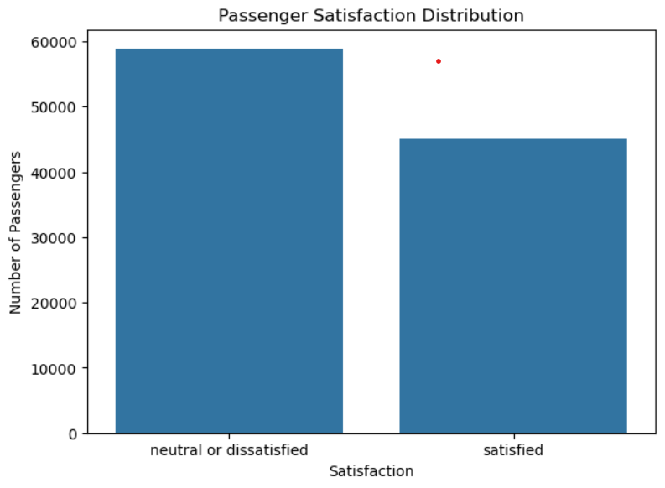
EXPLORATORY DATA ANALYSIS (EDA)
EDA was performed to understand the dataset and identify important patterns
Analysis Performed
Distribution of passenger satisfaction
Numerical feature analysis
Categorical feature analysis
Relationship between features and satisfaction
Identification of patterns and trends
Visualizations
Count plots
Histograms
Box plots
Correlation analysis
Purpose: Understand the data before building the ANN model.

Slide 10
ANN MODEL ARCHITECTURE
Artificial Neural Network (ANN) is a deep learning model inspired by the structure of the human brain.
The model uses:
Input layer to receive passenger features.
Hidden layers with ReLU activation.
Dropout layers to help reduce overfitting.
Output layer with Sigmoid activation for binary classification.
Adam optimizer and Binary Cross entropy loss function.
Prediction: Satisfied or Neutral/Dissatisfied.

Slide 11
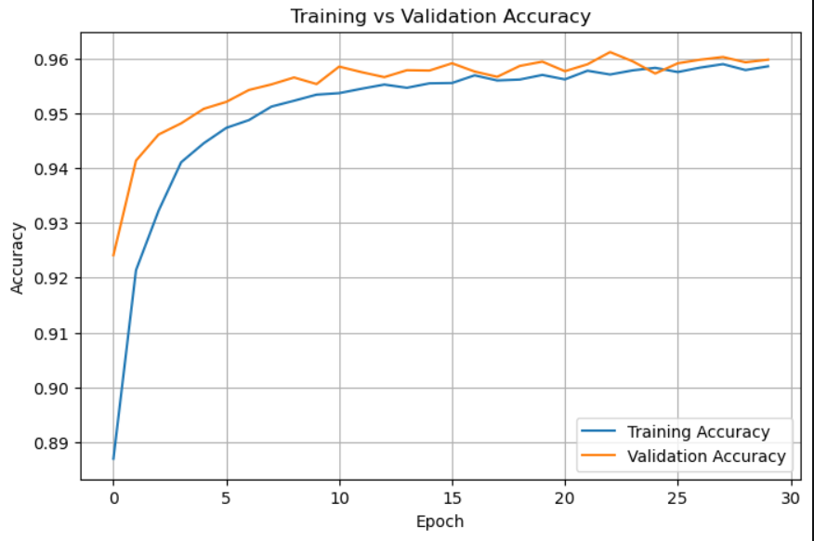
Model Training & Evaluation
MODEL TRAINING
Optimizer: Adam
Loss Function: Binary Cross entropy
Epochs: 30
Batch Size: 32
Validation Split: 20%
MODEL EVALUATION
The model was evaluated using:
Accuracy
Precision
Recall
F1-Score
Confusion Matrix
Training & Validation performance

Slide 12
Results & Insights
MODEL RESULTS RESULTS
Test Loss 0.08491
Test Accuracy 96.14 %
KEY INSIGHTS
The ANN achieved 96.14% accuracy on unseen test data.
The model effectively classified passenger satisfaction.
The low test loss indicates good model performance.
Precision, Recall and F1-Score provide additional classification evaluation.
Overall: The ANN model performed well for airline passenger satisfaction prediction.

Slide 13
Conclusion
An ANN-based classification model was developed to predict airline passenger satisfaction.
The dataset was cleaned and preprocessed before model training.
Categorical features were encoded and numerical features were scaled.
The ANN model was trained using the Adam optimizer and Binary Crossentropy loss.
The model achieved 96.14% test accuracy.
The results demonstrate that ANN can effectively predict passenger satisfaction.

Slide 14

THANK
YOU

