Slide 1

NYKAA PRODUCT ANALYSIS USING WEB SCRAPING, DATA CLEANING & EXPLORATORY DATA ANALYSIS (EDA)
Presented By -
B.LAHARI

Slide 2
About me
• Name: B. Lahari
• Education Background: Graduated B.Tech [CSE-AIML]
• Why I Want to Become a Data Scientist: – I want to become a data scientist because I enjoy working with data, finding patterns, and solving real-world problems.
– As a BTech student, I am interested in using my technical skills to turn data into meaningful insights and smart decisions.
• Work Experience: – I am a fresher, currently focusing on learning and building practical skills

Slide 3
Agenda (This should be the PPT flow)
Introduction
Business Understanding
Problem Statement
Objectives
Tools & Technologies
Methodology
Data Cleaning
Exploratory Data Analysis
Power BI Dashboard
Key Insights
Conclusion
Future Scope

Slide 4
Introduction
Nykaa is one of India's leading beauty and personal care e-commerce platforms that offers thousands of products across multiple brands and categories.
Due to the large volume of product information, manually analyzing prices, discounts, ratings, and reviews becomes difficult.
This project automates data collection using web scraping and performs data analysis to discover useful business insights.

Slide 5
Business Understanding
Businesses need to understand customer preferences, pricing strategies, discounts, and product popularity to improve sales and customer satisfaction.
Problem Statement
Nykaa offers thousands of products across multiple categories. Manual analysis of pricing, discounts, and customer reviews is time-consuming. This project automates data collection and analysis using web scraping and visualization.
An automated system is required to collect, clean, analyze, and visualize Nykaa product data for better business decision-making.

Slide 6
Objectives
Scrape product information from Nykaa
Create a structured dataset
Clean the collected data
Perform Exploratory Data Analysis
Identify pricing and rating trends
Develop an interactive Power BI dashboard
Generate business insights

Slide 7
Tools & Technologies
Tools Used:
Tools | Purpose
Python | Programming Language
Requests | Fetch Website Data
Beautiful Soup | Web Scraping
Pandas | Data Cleaning & Analysis
Num py | Numerical Computation
Matplotlib | Data Visualization
Seaborn | Statistical Visualization
Jupyter Notebook | Data Analysis & EDA
Power Bi CSV | Dashboard Development Data Storage

Slide 8
Methodology
Project Workflow
Nykaa Website
↓
Web Scraping
↓
CSV Dataset
↓
Data Cleaning
↓
Exploratory Data Analysis
↓
Power BI Dashboard
↓
Business Insights

Slide 9
Data Cleaning
Data Cleaning Process
Removed duplicate records
Handled missing values
Corrected data types
Standardized column names
Removed unwanted symbols
Converted price and rating into numeric format

Slide 10
Exploratory Data Analysis
Performed:
Product Distribution
Brand Distribution
Price Analysis
Rating Analysis
Discount Analysis
Customer Review Analysis
Correlation Analysis
Visualizations Used :
Histogram
Bar Chart
Pie Chart
Box Plot
Scatter Plot
Heatmap

Slide 11
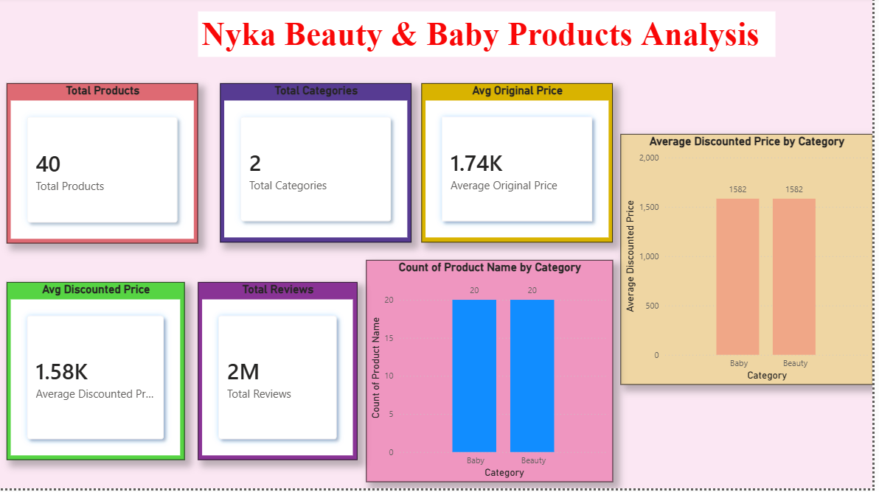
Power BI Dashboard

Slide 12
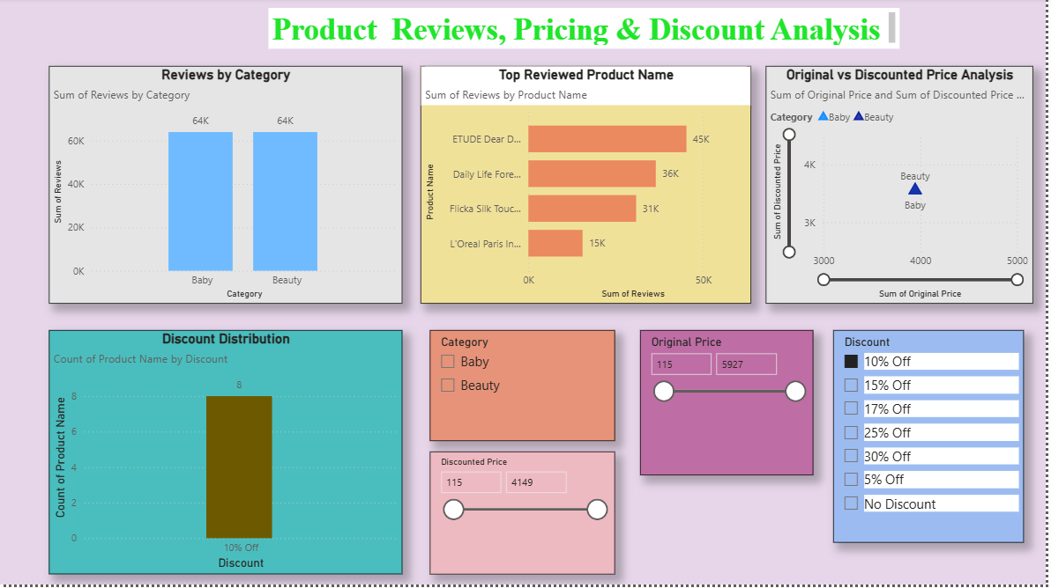

Slide 13
Key Insights
Key Findings :
Beauty products form the largest portion of the dataset.
Some brands offer significantly more products than others.
Premium brands generally have higher prices.
Most products have ratings above 4.
Discount percentages vary across brands.
Higher-rated products often receive more customer reviews.

Slide 14
Conclusion & Future Scope
Conclusion
Successfully collected Nykaa product data using web scraping.
Cleaned and transformed the dataset.
Performed Exploratory Data Analysis.
Developed an interactive Power BI dashboard.
Generated meaningful business insights.
Future Scope
Real-time web scraping
Machine learning for price prediction
Sentiment analysis of customer reviews
Multi-platform product comparison
Live Power BI dashboards

Slide 15

THANK
YOU

