Slide 1
Explainable AI: Transparency, Validation, and Trust in Large Language Models
Laxmi Lahari Naidu Bugata Student ID: 2930252

Slide 2
Understanding how GPT, Claude, Gemini, and LLaMA can become more transparent and reliable
Artificial intelligence is becoming more powerful, but power alone does not create trust. Large language models are now used in education, healthcare, finance, law, and business, which means people need to understand not only what these systems can do, but also how reliable, safe, and accountable they are. Explainable AI, validation, and performance metrics help make these systems more trustworthy by making their behavior easier to evaluate and communicate.

Slide 3
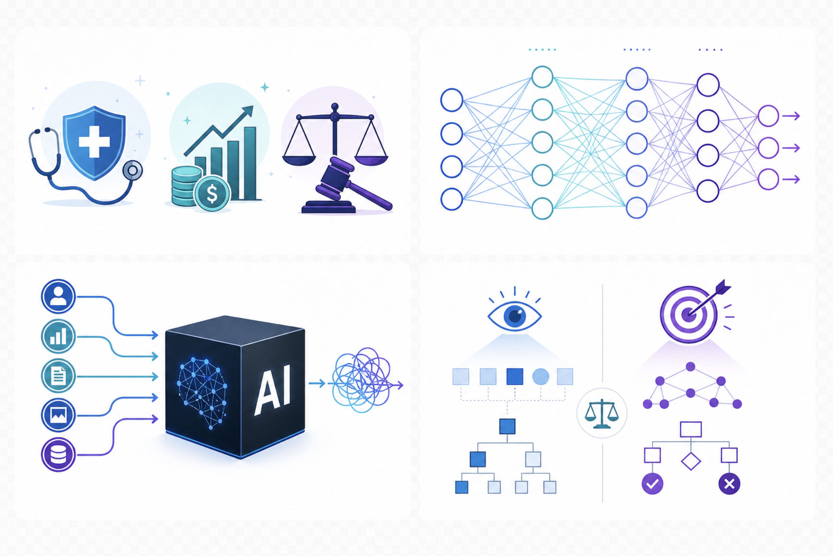

Slide 4
What Is Explainable AI?
Explainable AI, or XAI, is the effort to make AI systems more understandable to human users. In simple terms, it means helping people see why a system produced a result, what factors may have influenced the output, and what limitations should be considered before trusting the answer. In large language models, explainability is essential because responses often appear fluent and confident even when the model may be uncertain, biased, or incorrect

Slide 5
Why Explainability Matters
Explainability matters because AI systems increasingly influence real decisions and real people. In healthcare, a misleading answer could affect clinical judgment. In finance, a flawed recommendation could influence risk assessment or fairness. In law, an unexplainable summary or recommendation could affect interpretation and accountability. When users understand how a system works, what its limits are, and how it has been evaluated, they are in a better position to use it responsibly.

Slide 6
Why LLMs Are Hard to Explain
Large language models are difficult to explain because their outputs are generated through billions of learned parameters interacting in complex, non-linear ways. Unlike a simple rule-based program, an LLM does not follow one visible decision path that a person can easily inspect. Instead, meaning is distributed across the model, which makes it difficult to identify exactly why a specific answer was produced. This is why many LLMs are often described as black-box systems.

Slide 7


Slide 8
Challenge 1: Opacity and Complexity
The first major challenge in explainability is opacity. Even when engineers know the architecture of a model, they may not be able to clearly trace a single output back to a simple explanation. The complexity of the model makes human interpretation difficult, especially when prompts, context, and generated text interact dynamically across many layers. This means a model may be powerful and useful while still remaining difficult to interpret in a precise way.

Slide 9
Challenge 2: Post-Hoc Explanations
Another major challenge is that many AI explanations are post-hoc. This means the model gives an explanation after producing an answer, but that explanation may not perfectly represent the actual internal process that generated the output. A model can produce a fluent and convincing explanation even when the answer itself is weak or when the explanation is only a surface-level reconstruction. As a result, users should not confuse a plausible explanation with a faithful explanation.

Slide 10
Challenge 3: Data Quality and Bias
Large language models learn from massive amounts of data, and that creates another explainability challenge. If the training data contains bias, misinformation, imbalance, or harmful patterns, the model can reproduce those issues in its outputs. This makes explainability harder because the cause of a biased or misleading answer may be spread across patterns learned from many sources rather than from one identifiable error. Better data quality, better documentation, and more careful evaluation are essential for reducing these risks.

Slide 11
Challenge 4: Regulation and Accountability
As AI systems move into sensitive industries, organizations face growing pressure to explain how their systems behave, what risks they carry, and how those risks are managed. This creates a regulatory and accountability challenge because users, institutions, and policymakers want more than marketing claims. They want evidence, documentation, and measurable proof that a model has been tested responsibly. Explainability therefore connects directly to governance, compliance, and public trust.

Slide 12
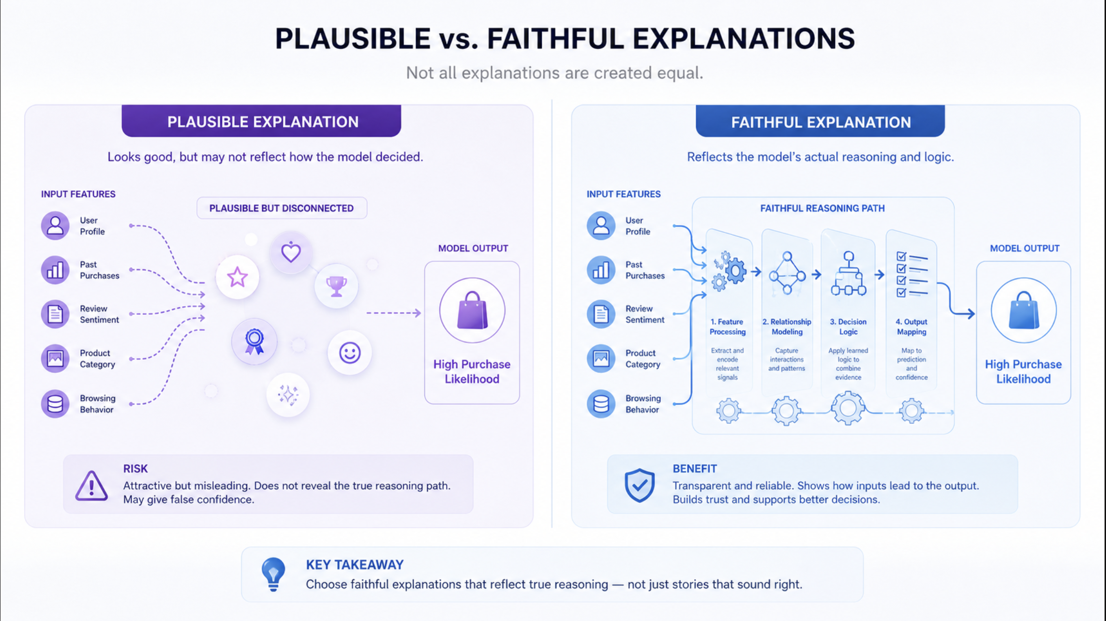

Slide 13
Current Techniques for Explainability
Researchers and organizations use several approaches to improve explainability in generative AI. These include attention visualization, probing internal representations, reasoning-oriented prompting, documentation systems such as model cards and system cards, safety evaluations, and red-teaming. None of these methods fully solves the explainability problem on its own, but together they help users understand model behavior, limitations, and risks more clearly.

Slide 14
Title: OpenAI’s Industry Efforts
OpenAI has taken steps to improve transparency through public documentation and evaluation reporting. Its safety evaluations hub publicly shows how models perform on tests related to hallucinations, jailbreaks, and harmful content, which gives users more visible evidence about model behavior. This matters because transparency becomes more meaningful when it includes measurable results instead of only general claims. OpenAI has also connected model behavior to public-facing guidance through its broader transparency efforts around model behavior and safety.

Slide 15
Anthropic’s Industry Efforts
Anthropic publishes Claude’s constitution as a detailed explanation of the values and priorities it wants Claude to follow. According to Anthropic, the constitution explains how Claude should be broadly safe, broadly ethical, compliant with Anthropic’s guidelines, and genuinely helpful, in that order of priority. This approach helps make model behavior more understandable because it gives users insight into the principles that guide the system’s responses and trade-offs.

Slide 16


Slide 17
Google’s Industry Efforts
Google publishes Gemini model cards to provide essential information about model use, known limitations, mitigation approaches, and safety considerations. These model cards help users understand where the model performs well, what risks remain, and what constraints should be considered in deployment. For explainability, this kind of documentation is valuable because it translates technical model behavior into information that stakeholders can read, compare, and evaluate.

Slide 18
Meta and the Role of System Cards
Meta uses system cards as a transparency tool designed to help people better understand how AI systems work. A system card can describe system purpose, behavior, limitations, and practical implications for users. This matters because explainability is not only about interpreting internal mechanisms; it is also about communicating clearly with stakeholders in ways that improve understanding and support informed use.

Slide 19


Slide 20
Validation and Why It Matters
Validation is the process of checking whether a model performs reliably, safely, and appropriately for its intended use. In trustworthy AI, validation is essential because explainability without evidence is not enough. A model may sound coherent and still fail under pressure, hallucinate facts, or behave unsafely in adversarial situations. Validation provides a structured way to test those risks before and during deployment.

Slide 21
Common Validation Techniques
Organizations use a range of validation techniques to assess AI systems. These include benchmark testing, human review, adversarial testing, red-teaming, ground-truth comparison, and domain-specific review. These methods matter because they measure how the model behaves in realistic and difficult conditions, not just in ideal cases. Strong validation helps organizations identify weaknesses, improve safeguards, and decide whether a model is ready for responsible use.

Slide 22


Slide 23
Performance Metrics for Trustworthy AI
Performance metrics provide evidence about how well a model performs and where it still fails. In large language models, useful metrics include correctness, relevance, hallucination rate, safety behavior, toxicity, bias indicators, and task completion quality. These measures are important because they turn vague ideas like “good” or “safe” into observable results that can be tracked, compared, and improved over time.

Slide 24
Hallucinations, Jailbreaks, and Harmful Content
Some of the most important performance and safety metrics in generative AI focus on failure. Hallucination tests measure whether a model invents unsupported information. Jailbreak tests assess whether the model can be manipulated into ignoring safety boundaries. Harmful content evaluations test whether the system produces unsafe or disallowed outputs. These metrics are especially valuable because they reveal risks that may not be obvious in everyday demonstrations.

Slide 25
How Explainability, Validation, and Metrics Work Together
Explainability, validation, and performance metrics are strongest when they are used together. Explainability helps people understand the system. Validation checks whether the system performs reliably in real conditions. Metrics provide measurable evidence of strengths and weaknesses. When combined, these three elements support trustworthy AI by making systems easier to interpret, evaluate, compare, and improve.

Slide 26


Slide 27
Why This Matters for Society
As generative AI becomes more common, trust in these systems will depend not only on their capabilities but also on their transparency and accountability. Users need to know what a model is designed to do, where it may fail, and how its behavior has been tested. Industry efforts such as model cards, system cards, constitutions, and safety evaluation hubs show that explainability is becoming a central part of responsible AI development, even though major challenges still remain.

Slide 28
Conclusion
Large language models such as GPT, Claude, Gemini, and LLaMA are powerful but difficult to interpret. Their complexity, black-box structure, post-hoc explanations, and data-related risks make explainability a continuing challenge. At the same time, current industry efforts show that transparency is improving through public documentation, constitutions, model cards, system cards, and safety evaluations. Validation techniques and performance metrics are essential because they provide the evidence needed to support trust, reliability, and accountability in real-world AI systems.

Slide 29
THANKYOU

