Slide 1
Theme Based Project Review 1 STS- Safe Than Sorry
By:
Sarika Vishwanatham (102)
Kiranmayi Anupindi (078)
G. Sahithi Reddy (094)
M. Lahari Reddy (020)

Slide 2
Contents
1. Contents 1
2. Document Owners 1
3. Overview. 2
4. Data store. 2
4.1. Overview.. 2
4.2. Schema. 2
5. Data Layer 2
5.1. Overview.. 2
5.2. Retrieve Routes. 3
5.3. Retrieve Establishments. 3

Slide 3
Contents
6. Application Layer 3
6.1. Overview.. 3
6.2. Storing Data. 3
6.3. Calculating Route. 3
6.4 Calculating Route to Police Stations.. 4
6.5 Calculating Route to Hospitals.. 5
7. Presentation Layer 5
7.1. Overview.. 5
7.2. Home Page..6
7.3. Find Hospitals (Button).. 6
7.4. Find Police Stations (Button).. 6

Slide 4
Problem Statement
Women surveyed said that they feel uncomfortable or unsafe when taking trips alone, and two in five women reported experiencing harassment while doing so.
Statistics show that :
Nearly two-thirds of female travellers (65%) research the relative safety of their destination before they go.
To gather the information they need, they are most likely to reach out to people who have travelled to the destination(31%).
Others report they have read reviews about the topic(28%), consulted guide book or blogs (18%), looked at the crime statistics(16%) or visited message boards or travel communities (16%).

Slide 5
Description
STS - Safe Than Sorry is an app to prevent users from travelling through isolated or unfrequented routes.
The user will get an alert when he is deflecting from the most frequently used route.
As long as the app is running in the background, it checks if he has entered an isolated location.
He will receive an alert and can choose to dismiss the alert or redirect onto a route with more commercial establishments.

Slide 6
Why STS?
Always know the narrow and dingy paths you might be led into.
Know how to get back onto a relatively crowded area, in case one might need help.
Get to the nearest help i.e. Police Station, Hospital or close by establishments like malls, hotels, pharmacies etc.

Slide 7
Working
STS calculates the safety of a route based on the commercial establishments present along the route, taking into account:
Their timings
The user’s estimated time of arrival to the destination
Safety quotient (probability of finding help) of the type of establishment.

Slide 8
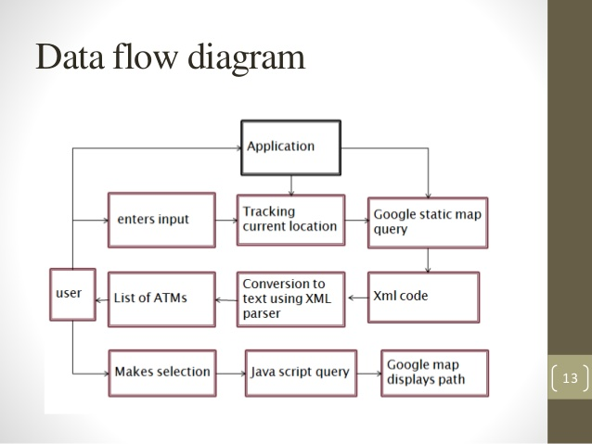
DATA FLOW DIAGRAM

Slide 9
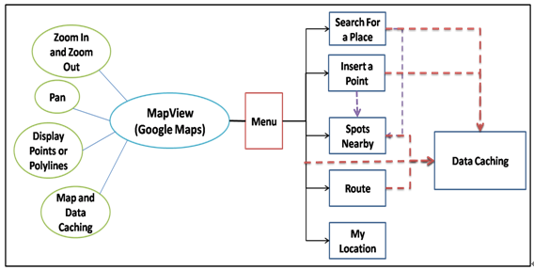
USE CASE DIAGRAM

Slide 10
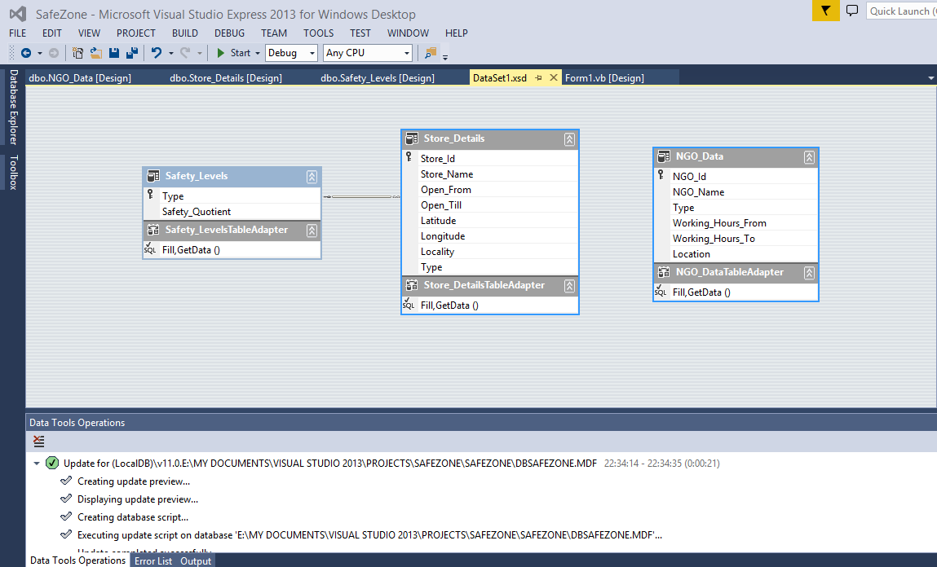
DATABASE SPECIFICTION

Slide 11
ARCHITECTURE SPCIFICATION
Data Layer | Retrieve Routes | Retrieve Establishments
Application Layer | Store Data | Calculate Routes | Calculate Route to Police Station | Calculate Route to Hospital
Presentation Layer | Home Page | Find Hospitals | Find Police Stations

Slide 12
THANK YOU

