Slide 1

MACHINE LEARNING PROJECT · B.TECH
GUIDE
Player Performance Prediction Using Ridge and Lasso Regression
Dr. Y. Lakshmi Prasanna, Assistant Professor, CSIT
DEPARTMENT
Computer Science and Information Technology
UNIVERSITY
KL University (Koneru Lakshmaiah Education Foundation)
A. Jhansi Priya · 2520090205
K. Laxmi Lahari · 2520090206
BATCH:5
ACADEMIC YEAR
2026-27

Slide 2
Introduction
02 · INTRODUCTION
Background
Domain
Why it is needed
ML is widely used in sports analytics
Predicts performance, aids team selection
Historical stats feed the models
Cricket: batting and bowling statistics
Supervised learning (regression)
Target: Performance Score, 0 to 100
Expert opinion can be subjective
Data gives an objective second view
Regularization keeps models stable

Slide 3
Problem Statement
03 · PROBLEM STATEMENT
Existing problem
Challenges
Who is affected
Players judged by opinion and raw averages
No single objective score
Stats overlap (runs, 50s, 100s)
Overfitting on small samples
Unclear which stats matter
Coaches and selectors
Sports analysts
Players and teams
How can we reliably predict a player's performance score from historical statistics?

Slide 4
Motivation
04 · MOTIVATION
01
Combines sports interest with core ML ideas: regularization and the bias-variance trade-off.
Why this project
02
Teams need quick, objective ways to compare players and support selection.
Real-world need
03
Sports analytics is growing; regularized regression is a standard, explainable baseline.
Industry and research

Slide 5
Objectives
05 · OBJECTIVES
Main objective: predict a player's Performance Score with Ridge and Lasso Regression and compare them.
1
2
3
4
Preprocess and scale the player data
Train Ridge (L2) and Lasso (L1) models
Evaluate with MAE, MSE, RMSE and R²
Build a Flask web app for live predictions

Slide 6
Existing System
06 · EXISTING SYSTEM
Current approach
Technologies
Limitations
Scouting and expert judgement
Simple career averages
Manual spreadsheet comparison
Excel and basic statistics
Plain linear regression
Tree and neural models
Subjective, inconsistent
Plain regression is unstable with correlated stats
Complex models are hard to explain

Slide 7
Proposed System
07 · PROPOSED SYSTEM
Subjective opinion
Data-driven Performance Score prediction
Correlated features
Ridge (L2) shrinks coefficients for stability
Overfitting, weak features
Lasso (L1) can shrink weak features to zero
Hard for users to try
Flask web form with instant predictions from both models

Slide 8
System Architecture
08 · SYSTEM ARCHITECTURE
OFFLINE TRAINING (train_model.py)
CSV dataset
Preprocess
Ridge and Lasso
Saved models
200 players, 7 features
80/20 split, StandardScaler
sklearn pipelines
.pkl files + metrics.json
ONLINE PREDICTION (app.py)
User form
Flask route
Predict
Output
HTML/CSS input page
validates the 7 inputs
loads both models
two predicted scores

Slide 9
Methodology / Workflow
09 · METHODOLOGY
1
2
3
4
Load data
Clean and check
Split
Scale
200 players, 8 columns
No missing or duplicate rows
80% train, 20% test
StandardScaler on 7 features
Output: Performance Score
5
6
7
Train
Evaluate
Deploy
Ridge α=1, Lasso α=0.1
MAE, MSE, RMSE, R²
Flask serves predictions

Slide 10
Technology Stack
10 · TECHNOLOGY STACK
Language and tools
Framework
ML libraries
Python
Jupyter / Colab, VS Code
Flask
Jinja2 HTML templates
scikit-learn
pandas, NumPy
Model storage
Frontend
Data and hardware
joblib (.pkl files)
metrics.json
HTML5, CSS3
DM Sans, Space Grotesk fonts
CSV file, no database
Standard laptop, no GPU

Slide 11
System Modules / Components
11 · SYSTEM MODULES
Data collection
Preprocessing
ML module
player_performance CSV
StandardScaler in pipeline
Ridge and Lasso, train_model.py
Model store
Prediction module
UI and reporting
ridge, lasso .pkl + metrics.json
app.py route, input validation
index.html, style.css, metric cards

Slide 12
Implementation
12 · IMPLEMENTATION
Train: fit scaler + model pipelines
pipe = Pipeline([
("scaler", StandardScaler()),
("regressor", Ridge(alpha=1.0)),
])
pipe.fit(X_train, y_train)
joblib.dump(pipe, "models/ridge_model.pkl")
# app.py
p = ridge_model.predict(player_df)[0]
Save: joblib .pkl and metrics.json
Serve: Flask loads models at startup
Predict: POST form, validate, show both scores

Slide 13
Dataset / Input Data
13 · DATASET
Feature | Min | Max | Mean
Matches | 20 | 100 | 60.78
Runs | 366 | 4964 | 2587.1
Batting_Average | 15.22 | 54.96 | 35.37
Strike_Rate | 85.41 | 174.89 | 131.75
Fifties | 2 | 40 | 19.68
Hundreds | 0 | 15 | 7.54
Wickets | 0 | 80 | 37.79
Performance_Score | 0 | 100 | 48.7
200
7 + 1
player records
features + target
0
160 / 40
missing / duplicates
train / test
Synthetic dataset. Player_ID dropped as an identifier; all features are numeric, so no encoding was needed.

Slide 14
Algorithm / Model
14 · ALGORITHM / MODEL
Ridge Regression (L2)
Lasso Regression (L1)
Penalty: α · Σ w²
Shrinks all coefficients, keeps every feature
Good with correlated features
α = 1.0
Penalty: α · Σ |w|
Can shrink weak coefficients to zero
Built-in feature selection
α = 0.1, max_iter = 10,000
7 input features
StandardScaler
Ridge / Lasso
Performance Score

Slide 15
Results
15 · RESULTS
0.943
3.27
best R² (Lasso)
lowest MAE (Lasso)
Metric | Linear | Ridge | Lasso
MAE | 3.292 | 3.290 | 3.269
MSE | 17.684 | 17.663 | 17.473
RMSE | 4.205 | 4.203 | 4.180
R² | 0.942 | 0.942 | 0.943
Test set, 40 players. Linear regression is the unregularized baseline. Precision/recall/F1 are classification metrics, so they do not apply here.

Slide 16
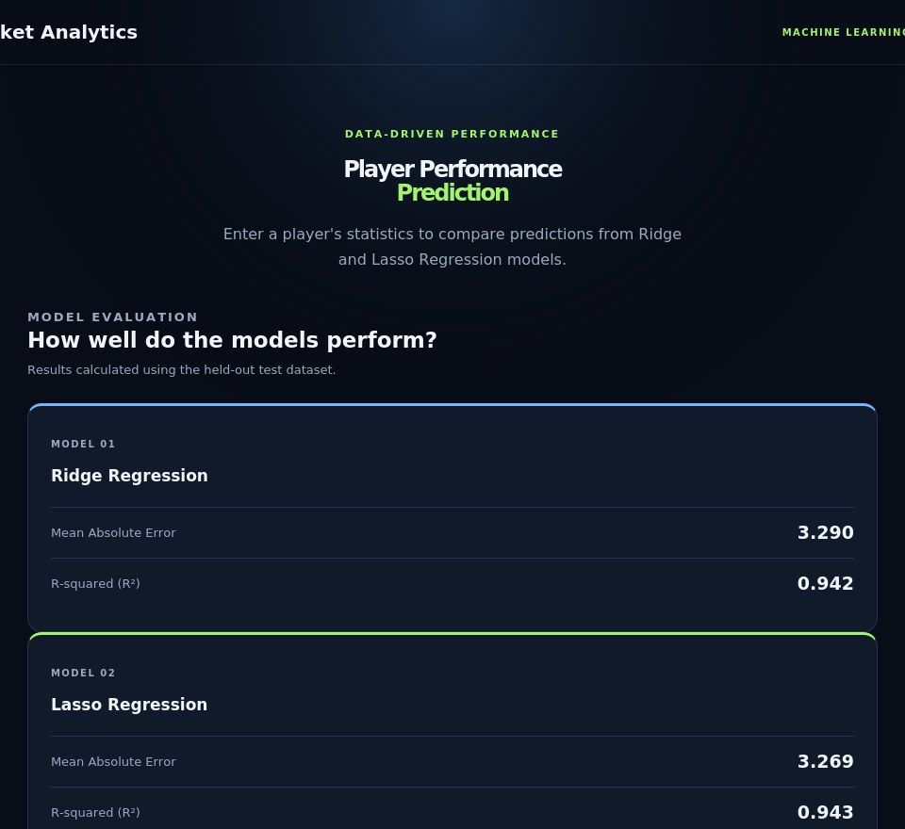
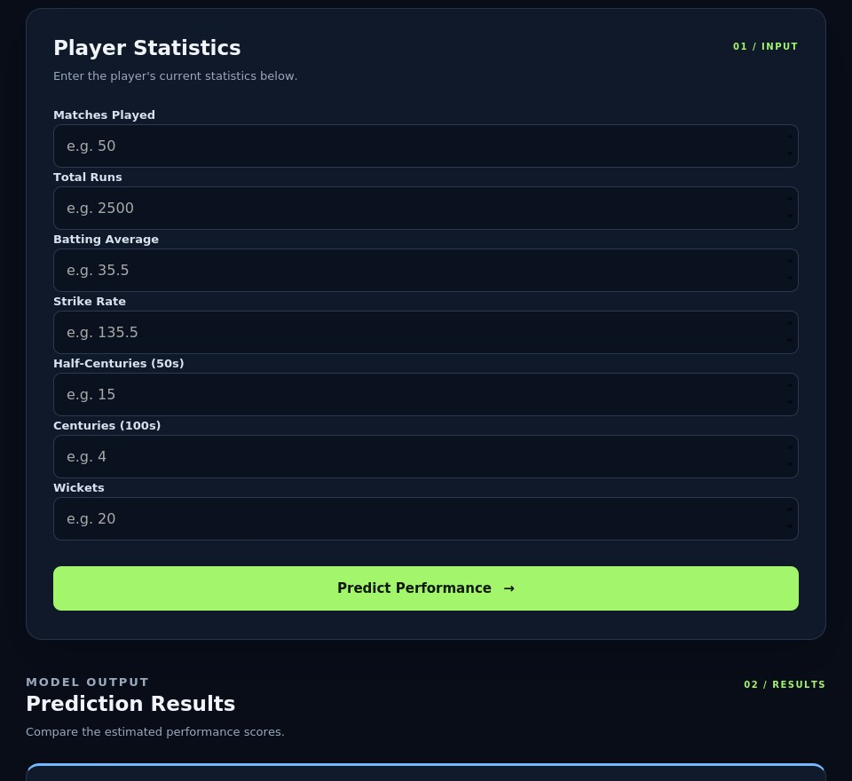
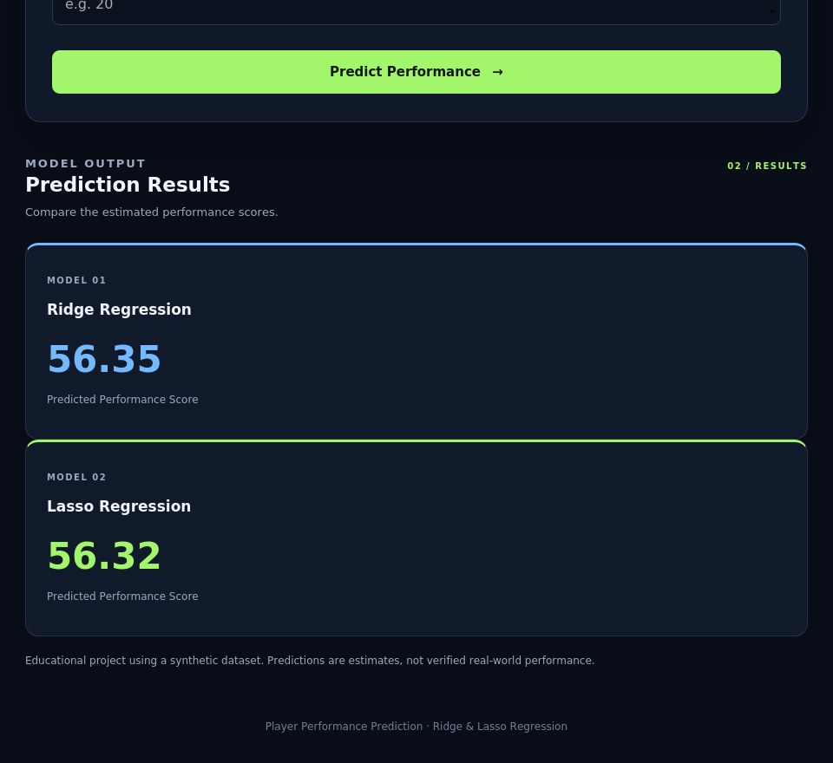
Screenshots / Demo
16 · SCREENSHOTS / DEMO
Home: model metrics
Input: player statistics
Output: predicted scores
Processing: the form POSTs to the Flask route, which validates the inputs and runs both models. Sample input: 60 matches, 3000 runs, average 40, strike rate 140, 20 fifties, 8 hundreds, 30 wickets gives Ridge 56.35 and Lasso 56.32.

Slide 17
Advantages
17 · ADVANTAGES
Accurate
Explainable
R² ≈ 0.94 on unseen test data
Coefficients show which stats matter
Stable
Easy to use
Regularization limits overfitting with correlated stats
Web form gives instant predictions from both models

Slide 18
Applications
18 · APPLICATIONS
Real-world uses
Target users
Other areas
Team selection and squad planning
Player scouting and comparison
Training focus for players
Coaches and selectors
Sports analysts
Academies and clubs
Football and basketball analytics
Teaching regression in ML courses

Slide 19
Limitations
19 · LIMITATIONS
Dataset
Technical
Synthetic data, only 200 players
Batting stats and wickets only: no economy rate or catches
Score definition is fixed
Fixed α, no cross-validation
Single 80/20 split
Lasso kept all 7 features at α = 0.1
No login, database or hosting

Slide 20
Future Scope
20 · FUTURE SCOPE
Improvements
New features
Deployment
Use real match data
Tune α with RidgeCV / LassoCV
Compare Elastic Net and tree models
Bowling economy, catches, form
Feature charts in the UI
Downloadable reports
Host on the cloud
Add database and login
Extend to other sports

Slide 21
Conclusion
21 · CONCLUSION
0.943
≈ 3.3
7 of 7
R² (Lasso, test set)
average error on a 0 to 100 scale
features kept by both models
Built an end-to-end pipeline: data, Ridge and Lasso models, and a Flask web app
Both models perform almost identically; Lasso is marginally ahead
Batting average was the strongest driver of the score
Contribution: an explainable, easy-to-use player performance predictor

