Slide 1

PREDICTING BANK TERM DEPOSIT SUBSCRIPTION
THE UNIVERSITY OF TEXAS AT DALLAS
BUAN 6356.006 – Business Analytics with R – Fall’23
Group 15

Slide 2
Abstract
In today's competitive banking landscape, financial institutions are constantly seeking strategies to enhance customer engagement and boost profitability. One such strategy involves predicting customer behavior, particularly in terms of their propensity to subscribe to term deposits.
Term deposits, also known as time deposits, offer customers a higher interest rate in exchange for committing their funds for a predetermined period. Accurately predicting term deposit subscription rates enables banks to effectively target potential customers and optimize their marketing campaigns, leading to increased revenue and overall business growth.

Slide 3
Abstract
There has been a revenue decline in the Portuguese Bank and their customers are not investing enough in long-term deposits. So, the bank would like to identify existing customers that have a higher chance to subscribe for a long-term deposit and focus marketing efforts on such customers.
Thus, the project’s motive and objective is to predict the term insurance subscription with the bank dataset using machine learning models. The existing data shows there is 12.6% term subscription rate. Since 12.6% is a small percentage, we must accurately predict this rate, as the bank is more interested in finding this group and targeting them for getting furthermore subscriptions.

Slide 4
Data Set
We have taken the Portuguese bank dataset from Kaggle. The data speaks about predicting the bank term deposit subscriptions. The multivariate dataset has 32950 instances and 15 attributes (5 numerical and 10 categorical). The target variable is a binary feature (Yes/No).
DATASET
Total records | 32950
Attributes | 15
All missing columns | 0
Duplicate records | 8
Records with single/multiple unknowns | 8643
Missing observations | 0
Total observations used | 24299

Slide 5
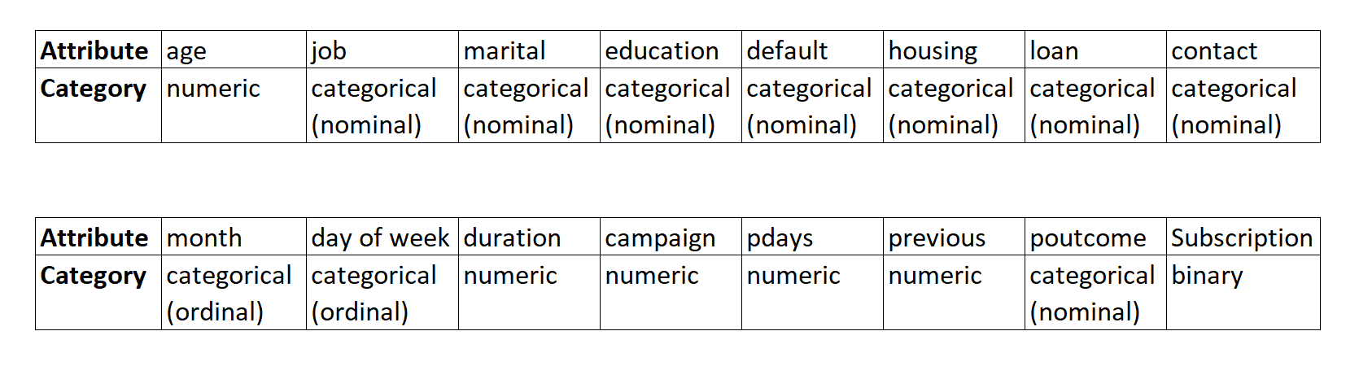
Data Cleaning
The dataset has 32950 records and there are no null values. There are 8 duplicates in the dataset and have been removed. The data has been further checked for unknown values and there are 8643 records which consist of single or multiple unknowns, they have been removed as they will not be useful for building the model and prediction. After removing the unknowns there are a total of 24299 records.

Slide 6
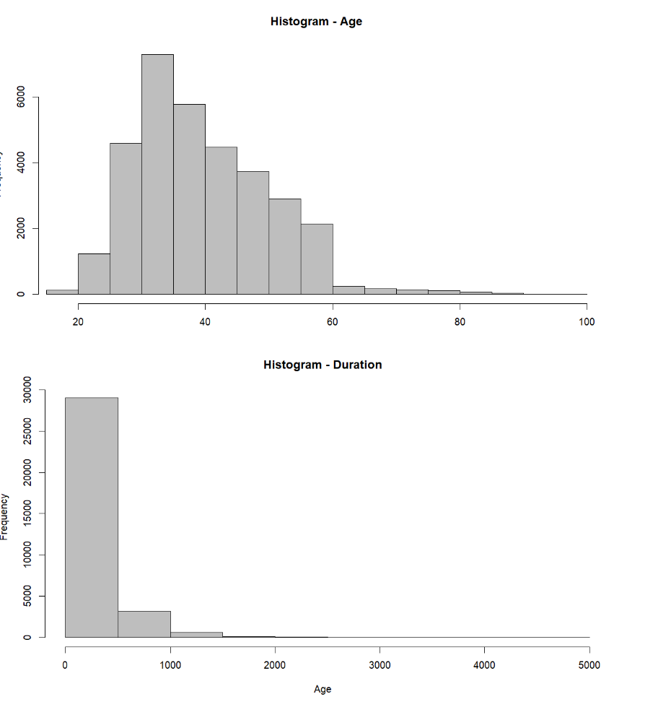
Histograms
Here we can see the distributions of different variables like age and duration are right skewed.

Slide 7
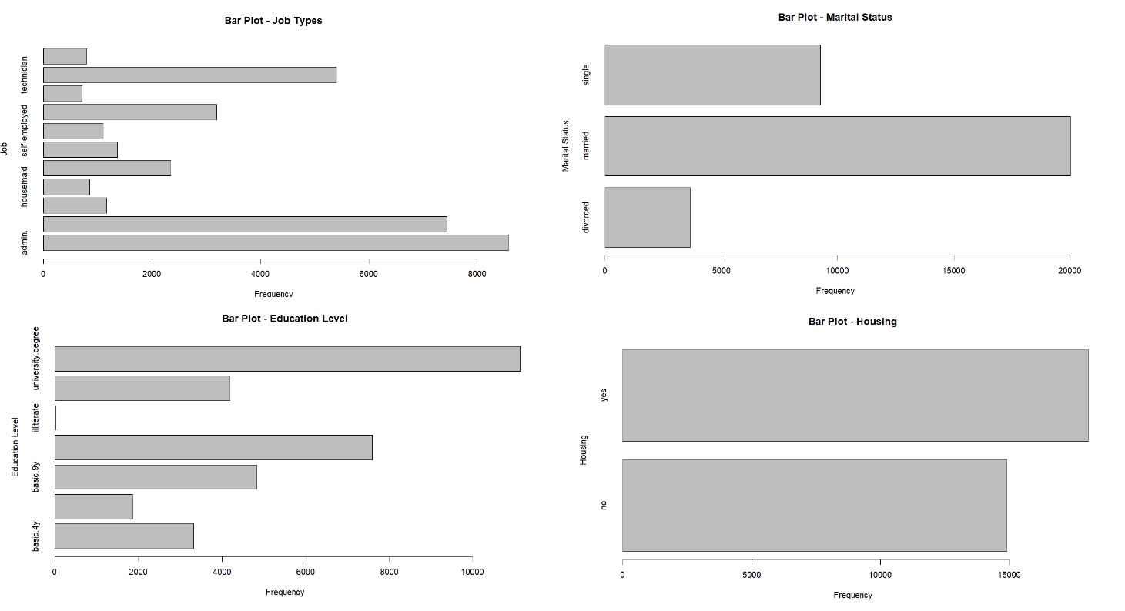
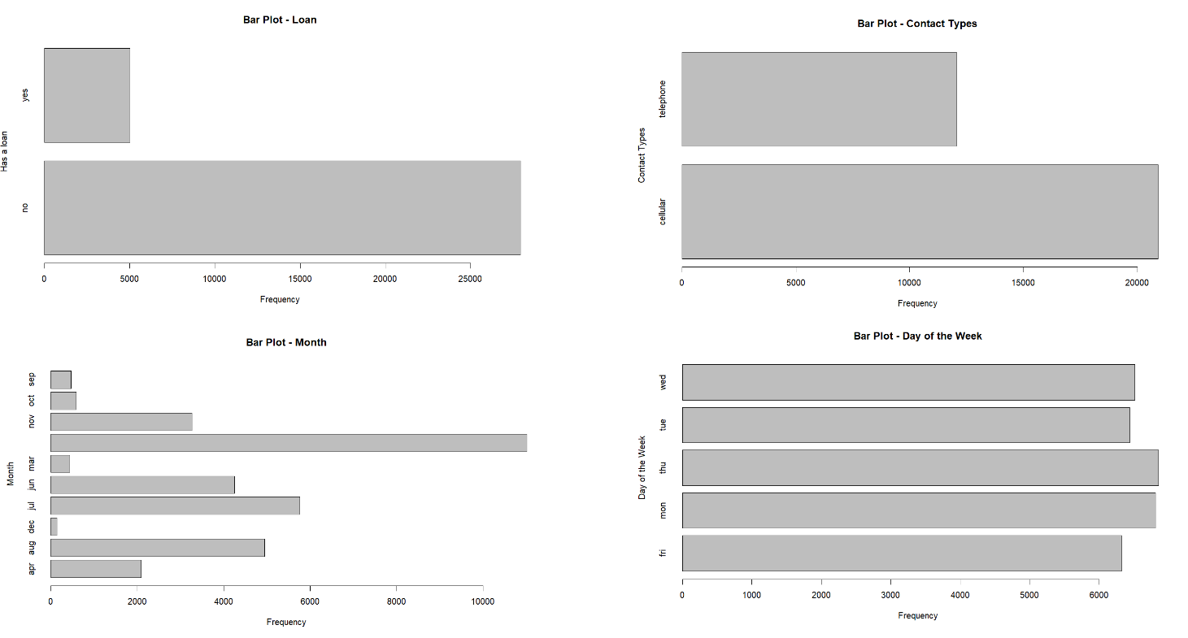
Bar Plot
Here we can see distributions of different categorical variables.

Slide 8
Modelling Technique
Model
Logistic Regression
Decision Tree
Random Forest
KNN
SVM
Approximately 12.6% of the bank's customers have subscribed for Term Insurance. Therefore, the basic model may project a 12~13% subscription rate. We will be using Client subscription (Y/N) as a dependent variable and run the 5 techniques to classify. We will be taking the best model which has the highest accuracy.

Slide 9
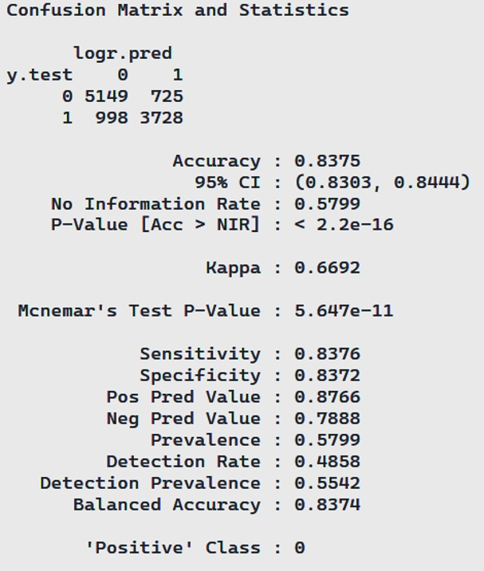
Model I: Logistic Model

Slide 10
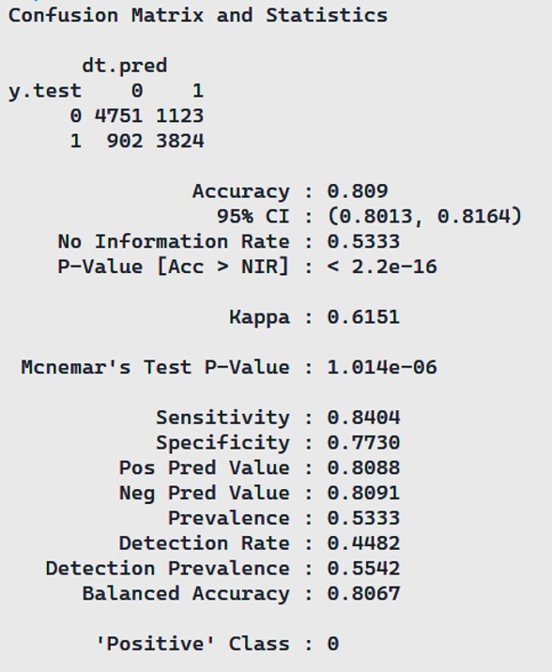
Model II: Decision Tree

Slide 11
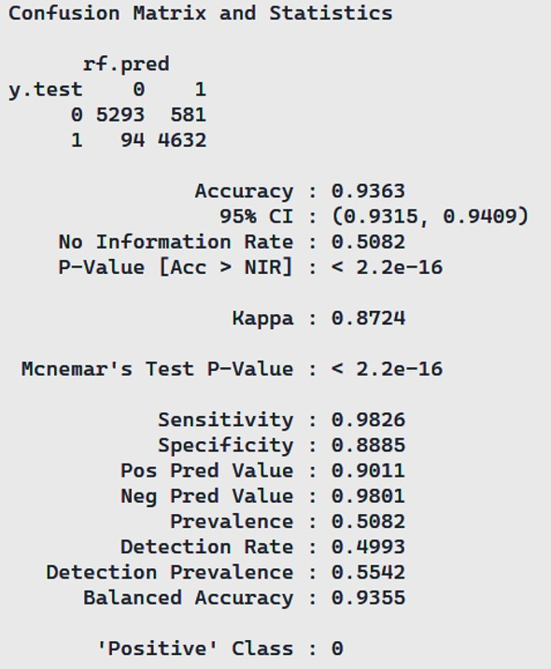
Model III: Random Forest

Slide 12
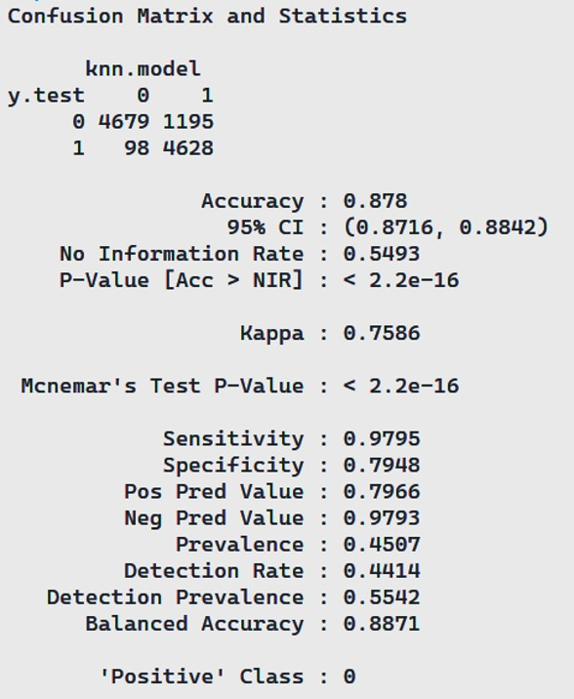
Model IV: KNN

Slide 13
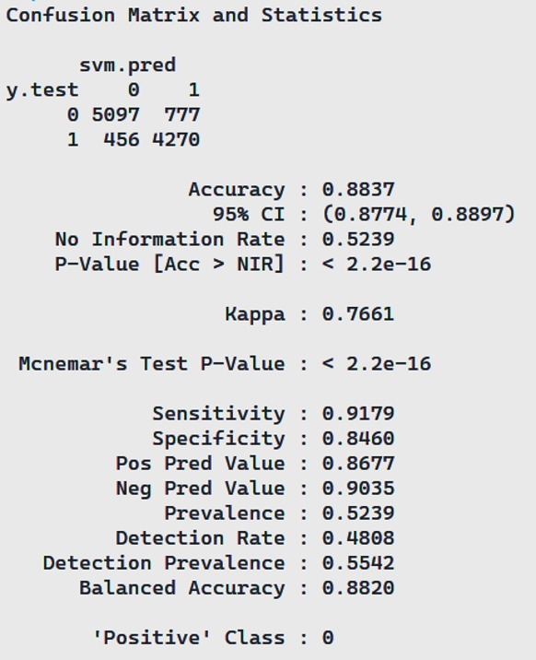
Model V: SVM

Slide 14
Best model
Model | Logistic Regression | Decision Tree | Random Forest | KNN | SVM
Accuracy | 0.8375 | 0.809 | 0.9363 | 0.878 | 0.8837
Sensitivity | 0.8376 | 0.8404 | 0.9826 | 0.9795 | 0.9179
Specificity | 0.8372 | 0.773 | 0.8885 | 0.7948 | 0.846
95% CI | (0.8303, 0.8444) | (0.8013, 0.8164) | (0.9315, 0.9409) | (0.8716, 0.8842) | (0.8774, 0.8897)
The Performance Metrics like accuracy, sensitivity & specificity for 5 models have been evaluated for selecting the best model.
The Random Forest model has performed most accurately compared to other models.
Thus Random Forest model can be used for further predictions on the population.

Slide 15
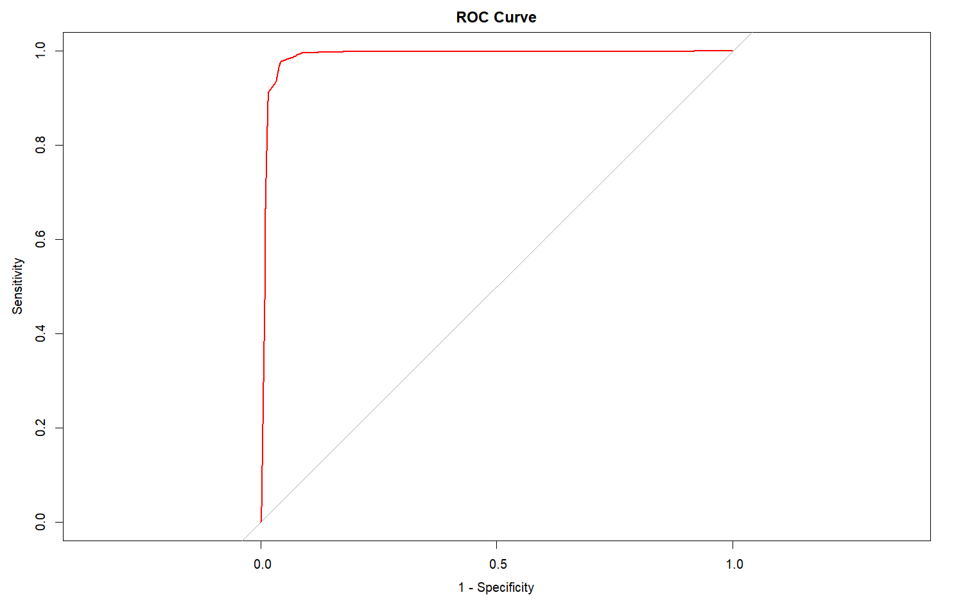
Best model
The Random Forest model has performed most accurately compared to other models with an accuracy of 93.63%.
The ROC Curve for the Random Forest model depicts the model performance.
Thus Random Forest model can be used for further predictions.

Slide 16
Conclusion
By leveraging such predictive insights, the bank can efficiently channel its marketing efforts towards the identified customer segment, fostering increased long-term deposit subscriptions and revitalizing its financial landscape
It suggests that the model can effectively identify customers who are likely to subscribe to a term deposit, which can be valuable for Portuguese bank in several ways as given below:
Targeted marketing
Customer segmentation
Resource Allocation
Reduced Churn

