Slide 1

A Novel Deep Learning Model On Early Detection and
Progression Prediction of Diabetic Retinopathy
UNDER THE GUIDANCE OF
Mrs. Madhumita Chanda
Assistant professor (C)
Department of IT
BATCH NO : 14
P. Archana (21VV1A1248)
M.L.Lahari (21VVIA1240)
Ch. Uday Kiran (21VVIA1215)

Slide 2
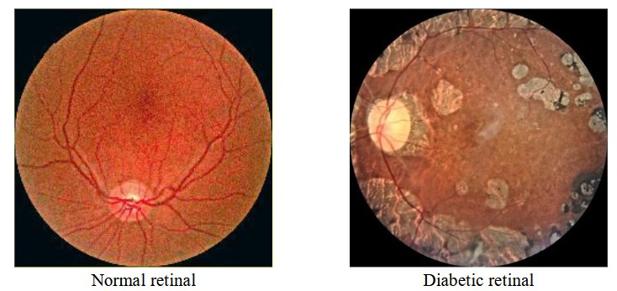
Diabetic Retinopathy
Diabetic Retinopathy (DR) is one of the most severe complications of diabetes and a leading cause of vision impairment and blindness worldwide. It occurs due to prolonged high blood sugar levels, which damage the small blood vessels in the retina, causing leakage, swelling, or abnormal vessel growth. Early detection and accurate prediction of DR progression are crucial to prevent irreversible damage.

Slide 3
Objective
Diabetic Retinopathy (DR) is a major complication of diabetes.
Early detection is critical to prevent blindness.
Proposed: Vision Transformer, Swin Transformer, and Quantum-enhanced ViT.
Evaluated on APTOS dataset with a custom front-end UI.
Real-world testing was attempted on 100 unlabelled patient images.
Classify severity into 5 stages.
Integrate prediction into a working web interface.

Slide 4
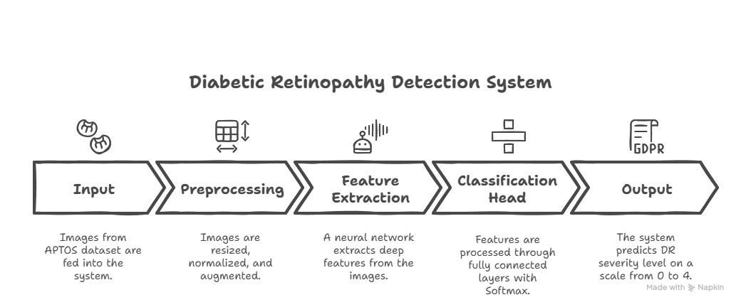
APTOS Dataset
The Asia Pacific Tele-Ophthalmology Society (APTOS) 2019 Blindness Detection dataset comprises a total of 3,662 retinal fundus images. These images are divided into 3,662 training images and 1,928 test images.
Labels:
0 – No DR
1 – Mild DR
2 – Moderate DR
3 – Severe DR
4 – Proliferative DR
https://www.kaggle.com/competitions/aptos2019-blindness-detection/data

Slide 5



Project Objectives
Early Detection and Classification
Performance Enhancement
Comparative Analysis
Develop an AI-based model to detect diabetic retinopathy at an early stage.
Accurately classify severity levels to aid in timely medical intervention.
Utilize different models for robust feature extraction.
Improve model performance by integrating Swin Transformers and GNN.
Perform extensive evaluation using accuracy, precision, recall, and F1-score.
Compare the proposed model with CNN-based architectures

Slide 6
Technologies
Machine Learning: The Core of DR Detection Model
Deep Learning : The Key to DR Prediction model
Convolutional Neural Network: Employed for extracting spatial features critical to DR diagnosis.
From CNNs to Transformers: To enhance DR detection performance by integrating the strengths of CNNs with advanced Transformer-based architectures.
Transformers: To explore the potential in capturing global context for more precise DR prediction.
Programming
Python, PyTorch
Kaggle GPU (100 hours)
Html/Css/JavaScript for frontend interface.

Slide 7

Proposed Models
Why This Comparison?
Swin Transformer
Extracts both local and global retinal features using a shifted window attention mechanism, improving lesion detection.
CNN Models
They enable accurate classification and grading of DR severity by learning patterns such as microaneurysms, hemorrhages, and exudates.
QuantumViT
It is a Hybrid deep learning model that integrates classical deep learning (DL) techniques with quantum transfer learning.

Slide 8
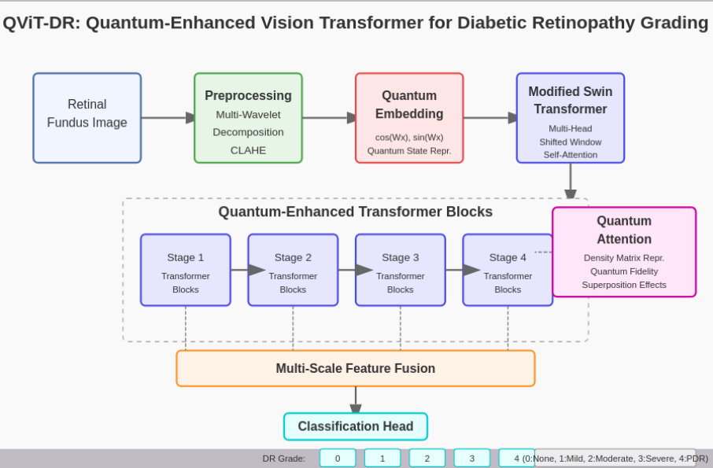
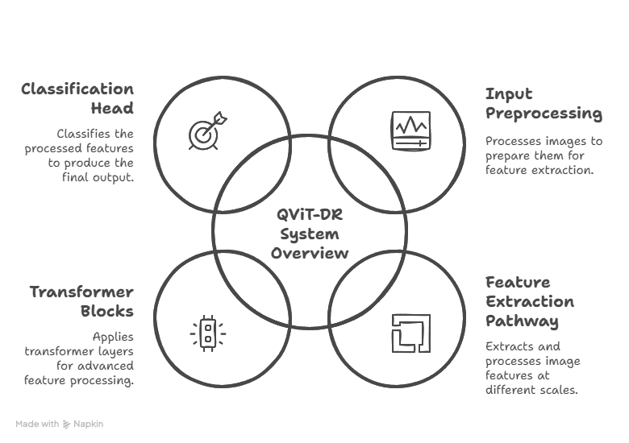
Architecture of Proposed Model

Slide 9
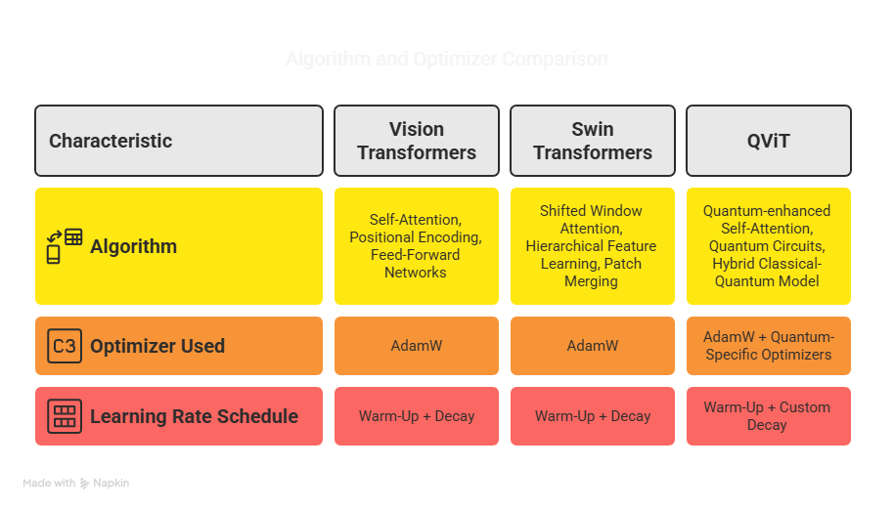
Algorithm and Optimizer

Slide 10
Vision Transformers
Current scenario:
Through extensive research, we found that Vision Transformer (ViT) models have shown promising results in medical image analysis, particularly in Diabetic Retinopathy detection.
Effective in handling complex retinal structures.
Outperforms CNNs when trained on large datasets.
Can be adapted for multi-class classification of DR stages.

Slide 11
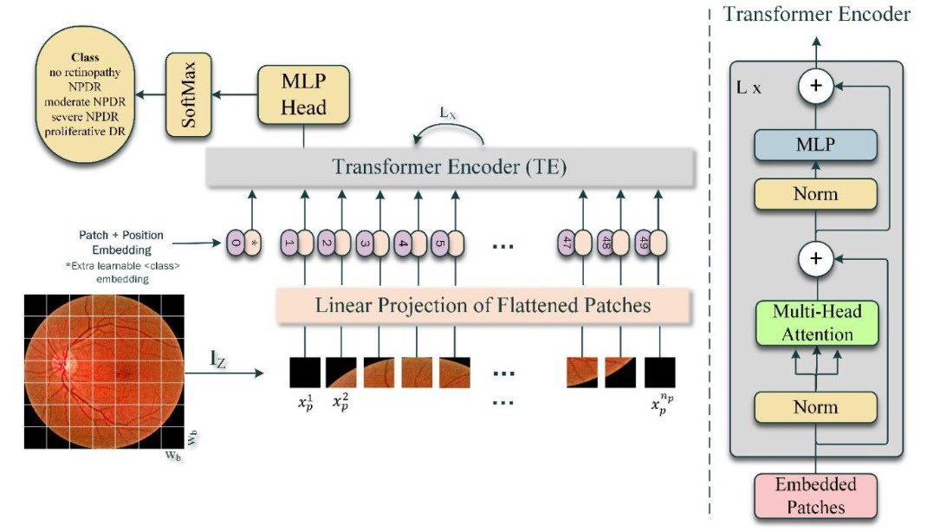
Vision Trasnformers Workflow
Image → Patches → Embeddings → Transformer Encoder → MLP Head → Diagnosis

Slide 12
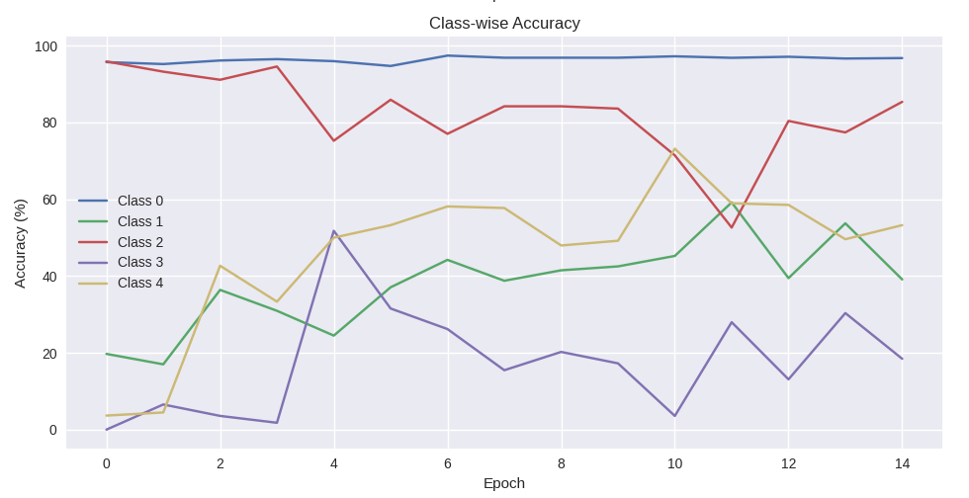
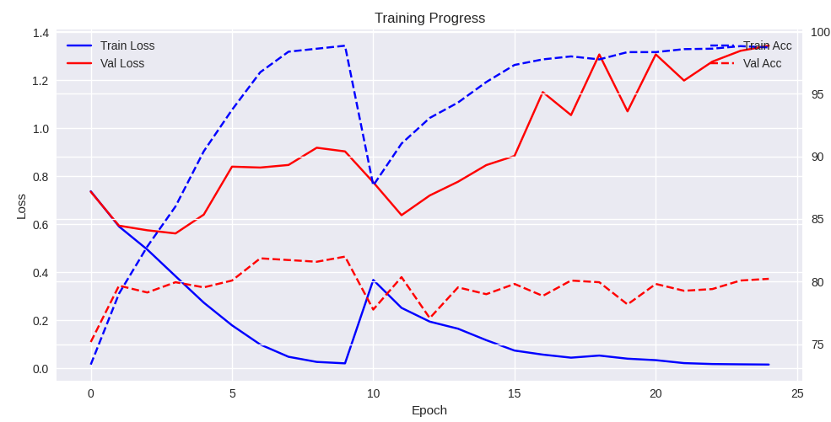
Vision Transformers analysis
The ViT Transformer model was implemented on the APTOS dataset, yielding critical insights and performance metrics that define the project's analytical outcomes.
Class 0 – No DR Class 3 – Severe NPDR,
Class 1 – Mild NPDR Class 4 – Proliferative DR
Class 2 – Moderate NPDR NPDR - Non-Proliferative Diabetic Retinopathy.

Slide 13
Constraints of Vision Transformer
Vision Transformers (ViT) have shown promising results in many computer vision tasks, including medical imaging like diabetic retinopathy (DR) detection. But there are some limitations in this model.
ViT need large labeled datasets to generalize well due to their lack of inductive biases.
APTOS dataset (~3,662 images) is relatively small for ViT, leading to overfitting.
ViT struggles to capture fine-grained local features like microaneurysms and hemorrhages which are crucial in DR detection.
Vision Transformers may miss finer details, reducing performance.
High memory usage due to global self-attention.

Slide 14
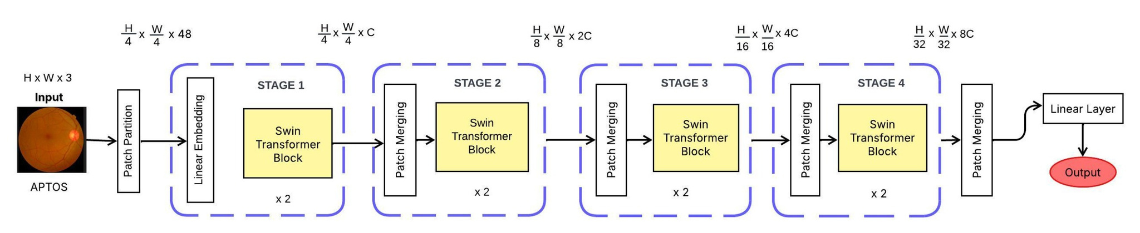
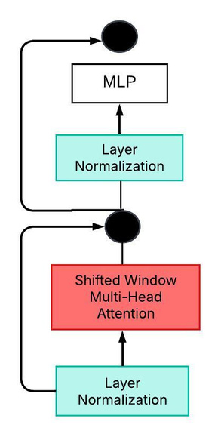
Swin Architecture
Swin Transformer is used in computer vision, based on transformer models by combining hierarchical structure and self attention mechanisms. Swin Transformers can serve as backbones for various computer vision architectures, excelling in tasks like image classification, object detection, and instance segmentation.
Swin Transformer
Block

Slide 15
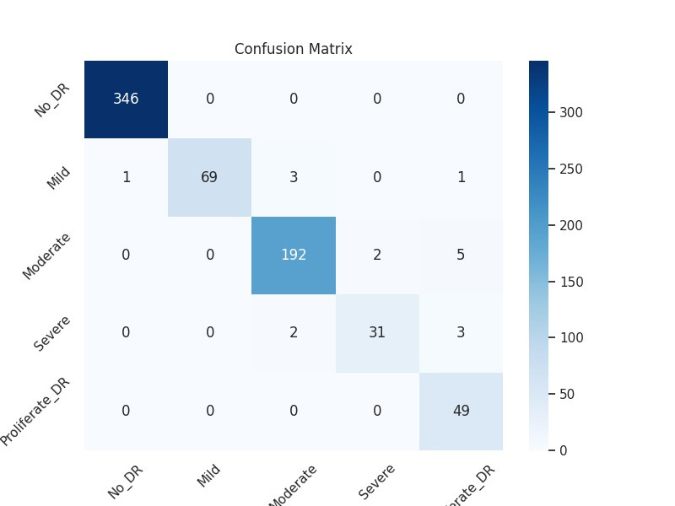
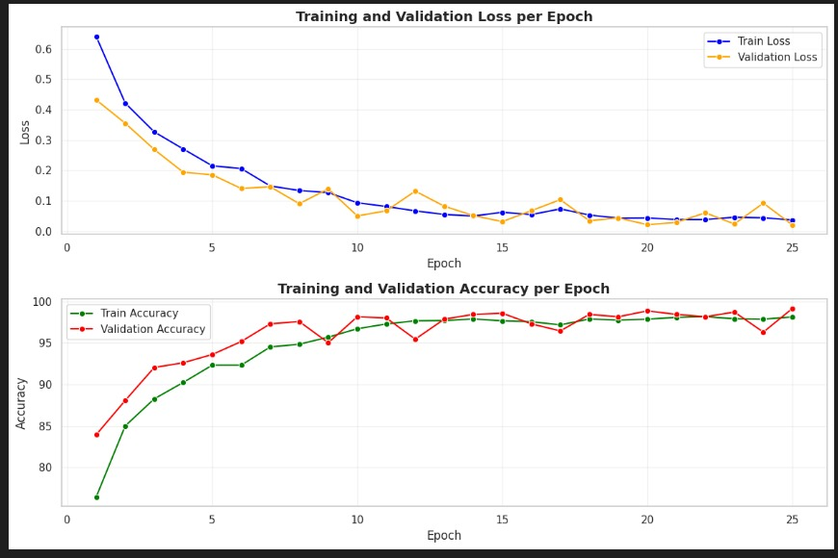
Swin Transformer analysis

Slide 16
QViT: Quantum-Enhanced Vision Transformer
QViT: Quantum-Enhanced Vision Transformer is an emerging model in the field of quantum machine learning, which aims to combine the power of Vision Transformers (ViTs) with quantum computing principles to improve performance on computer vision tasks like image classification, segmentation, and medical image analysis.It consists if
Patch Embedding
Quantum-enhanced Encoding
Quantum Attention Mechanism
Hybrid Output Layer

Slide 17
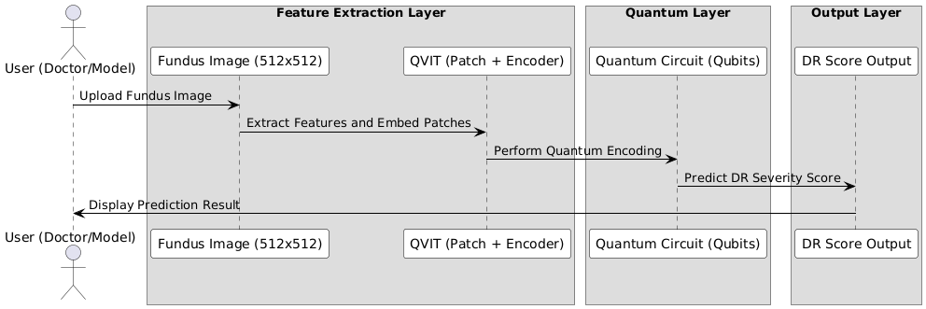
Workflow of QViTDR

Slide 18
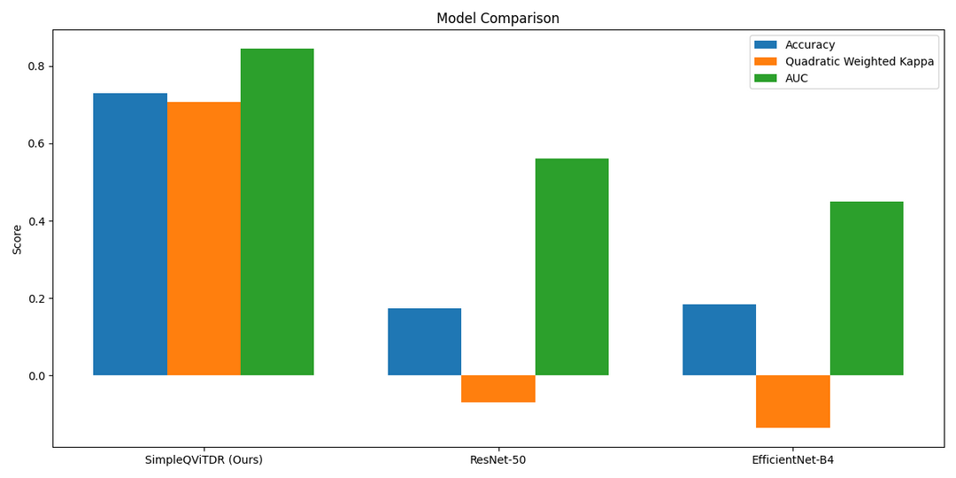
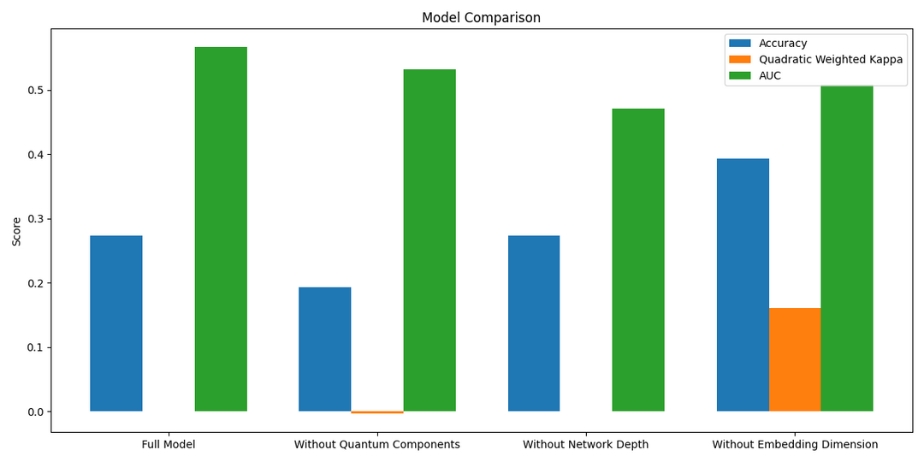
Here the proposed SimpleQViTDR model achieves the highest scores in Accuracy, Quadratic Weighted Kappa, and AUC, proving that it performs better than both ResNet-50 and EfficientNet-B4.
It shows the ablation study, which helps understand the importance of each part of the model. When components like quantum features, network depth, or embedding dimensions are removed, the model's performance drops.
Metrics :
🟦 Accuracy
🟧 Quadratic Weighted Kappa
🟩 AUC
Models (X-axis):
SimpleQViTDR (Ours)
ResNet-50
EfficientNet-B4
Model Variants (X-axis):
Full Model
Without Quantum Components
Without Network Depth
Without Embedding Dimension

Slide 19
Architecture Comparison
Convolutional Neural Network (ResNet, EfficientNet)
These are the bricklayers of vision AI. They scan images with a local eye—great for textures and edges.
Residual Network breaks the depth barrier with skip connections.
Efficient Network squeezes every drop of performance by balancing width, depth, and resolution.
Solid. Reliable. Good performance.
2. Vision Transformers:
Better than CNNs, especially with large data.
3. Swin Transformer :
It is best for high-resolution images, segmentation, detection.
4. Quantum ViT :
Still emerging—promising but experimental.
Model | Feature Type | Complexity | Performance
CNN (ResNet,EfficientNet) | Local features | Medium | Good
Vision Transformers | Global dependencies | High | Better
Swin Transformer | Local + Global | High | Best
Quantum ViT | Non-linear quantum | Very High | Emerging

Slide 20
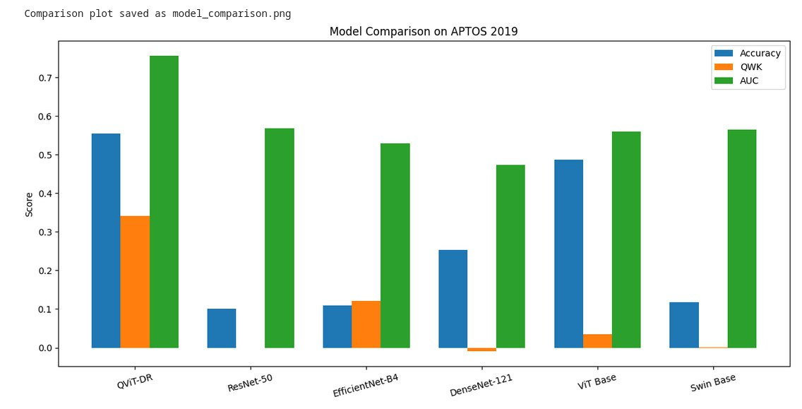
Comparing Model Performances
Model | Accuracy | Precision | Recall | F1-Score
ViT | 0.804 | 0.804 | 0.804 | 0.804
Swin Transformer | 0.96 | 0.94 | 0.94 | 0.94
Quantum ViT | 0.71 | 0.38 | 0.38 | 0.34
ResNet | 0.89 | 0.80 | 0.86 | 0.88
EfficientNet | 0.91 | 0.87 | 0.83 | 0.90
Metrics :
🟦 Accuracy
🟧 Quadratic Weighted Kappa
🟩 AUC

Slide 21
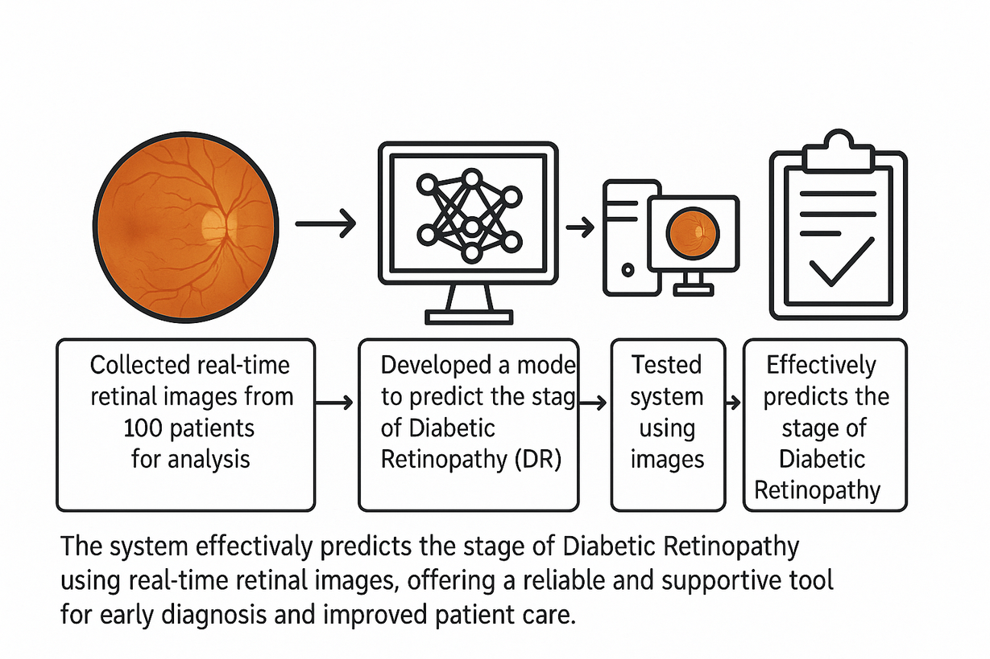
Testing on Real-time Retinal Images

Slide 22
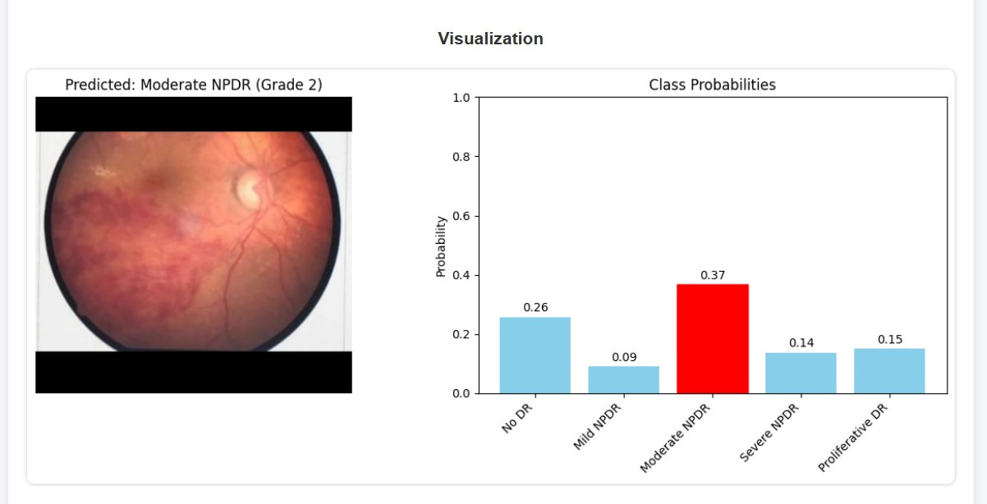
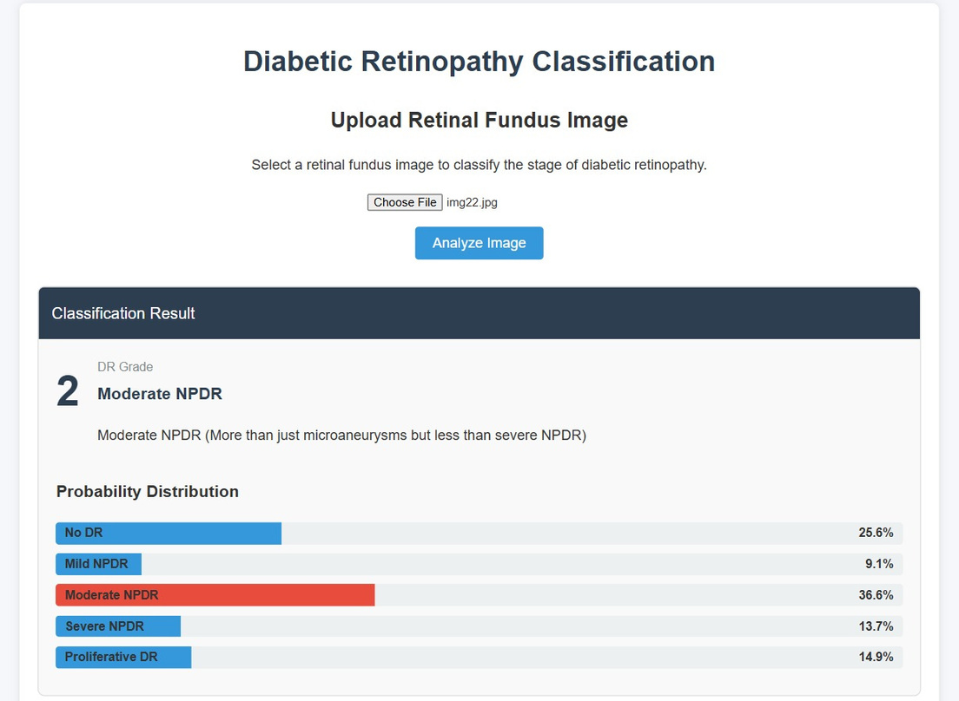
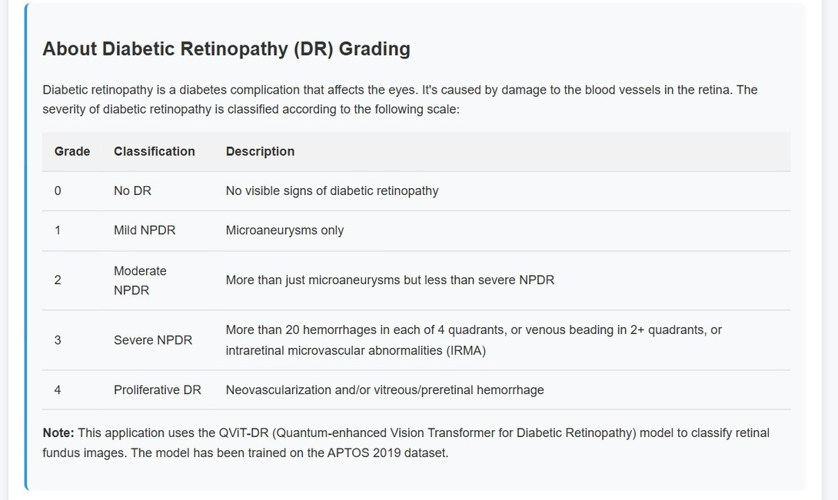
Classification Result

Slide 23
Conclusion
Our project demonstrated the use of transformer-based deep learning models -Vision Transformer (ViT), Swin Transformer, and Quantum Vision Transformer (QViT) for early detection and classification of Diabetic Retinopathy (DR).
Among the tested models, Swin Transformer achieved the best performance on the APTOS dataset due to its superior local and global feature extraction.

Slide 24
Future Scope
Collect more real-world images with labels for better evaluation.
Optimize models for faster and real-time predictions.
Add explainable AI tools (e.g., attention maps) to visualize model decisions.
Explore mobile deployment for use in rural and clinical settings.
Progression prediction of Diabetic Retinopathy integrated with a light weight IOT device.

Slide 25
References
The project builds on the methodologies proposed in the base research paper :
Waleed Nazih, Ahmad O. Aseeri, Osama Youssef Atallah, Shaker El-Sappagh "Vision Transformer Model for Predicting the Severity of Diabetic Retinopathy in Fundus Photography Based Retina Images." (2023).
Yuanyuan Liu, Dazhi Yao, Yongwen Ma, Hua Wang, Jinming Wang, Xuefeng Bai, Guang Zeng, Yuejuan Liu
STMF-DRNet : A multi-branch fine-grained classification model for diabetic retinopathy using Swin-TransformerV2 .
QuantumNet: An enhanced diabetic retinopathy detection model using classical deep learning-quantum transfer learning

Slide 26
Thank you

