Slide 1
Submitted By:- Name: Darshan Gajanan Lahase USN: CS25D003 Subject: Python
Project Topic: Digital Notice Board System

Slide 2
Project Statement
Create a Python-based digital notice board where administrators can post, update, and delete notices.
Users can view notices sorted by date or category.

Slide 3
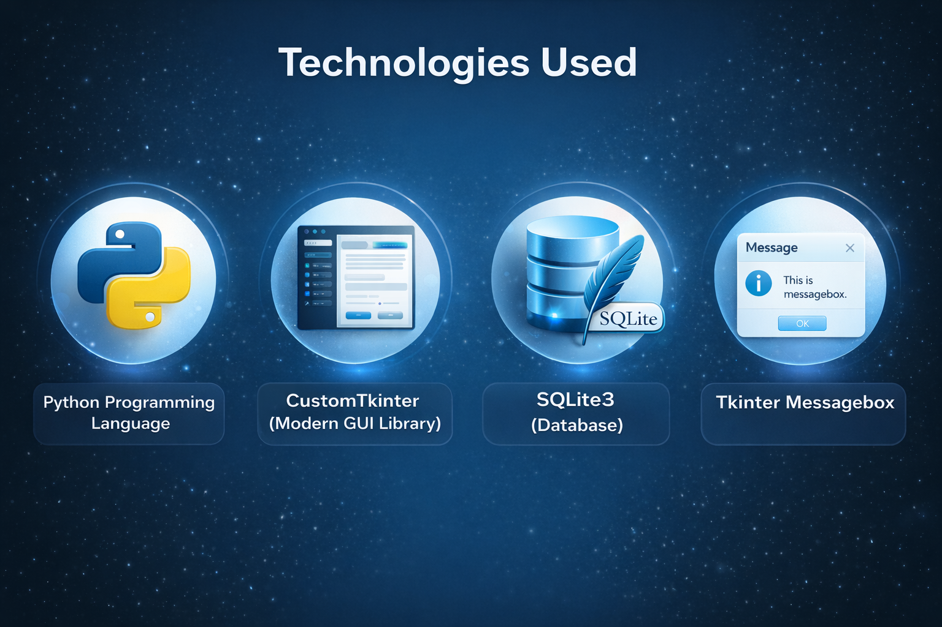

Slide 4
System Features (Admin + User)
Admin Features:
Add Notice
Update Notice using ID
Delete Notice using ID
View All Notices
User Features:
View Notices
Sort by Date or Category
Filter by Category

Slide 5
Important Functions
Add
add_notice() – Inserts new notice into database.
Update
update_notice() – Updates notice using Notice ID.
Delete
delete_notice() – Deletes notice using Notice ID.
View
view_notices() – Displays notices with sorting & filtering.
Load
load_admin_notices() – Loads all notices for admin view.
Clear
clear() – Clears current window widgets.

Slide 6
Advantages
• Organized Notice Management
• Easy CRUD Operations
• Category Based Filtering
• Persistent Data Storage
• User Friendly GUI

Slide 7
Future Enhancements
Admin Login Authentication
Cloud Database Integration
Email/SMS Notifications
Web-Based Version

Slide 8
Conclusion
Digital Notice Board simplifies notice handling.
Provides efficient admin control.
Improves accessibility for users.
Built with Python & Modern GUI.

