Slide 1
PHASE 1
Technical Foundation
Sets up the whole skeleton: stack, database, auth, design system and 3 languages.
● Next.js 16 + Laravel 13 + PostgreSQL + Redis + Docker
● Login / logout with authentication & authorization
● Dashboard shell: sidebar + top bar
● Reusable design system (buttons, cards, forms)
● i18n — French, English, Arabic

Slide 2
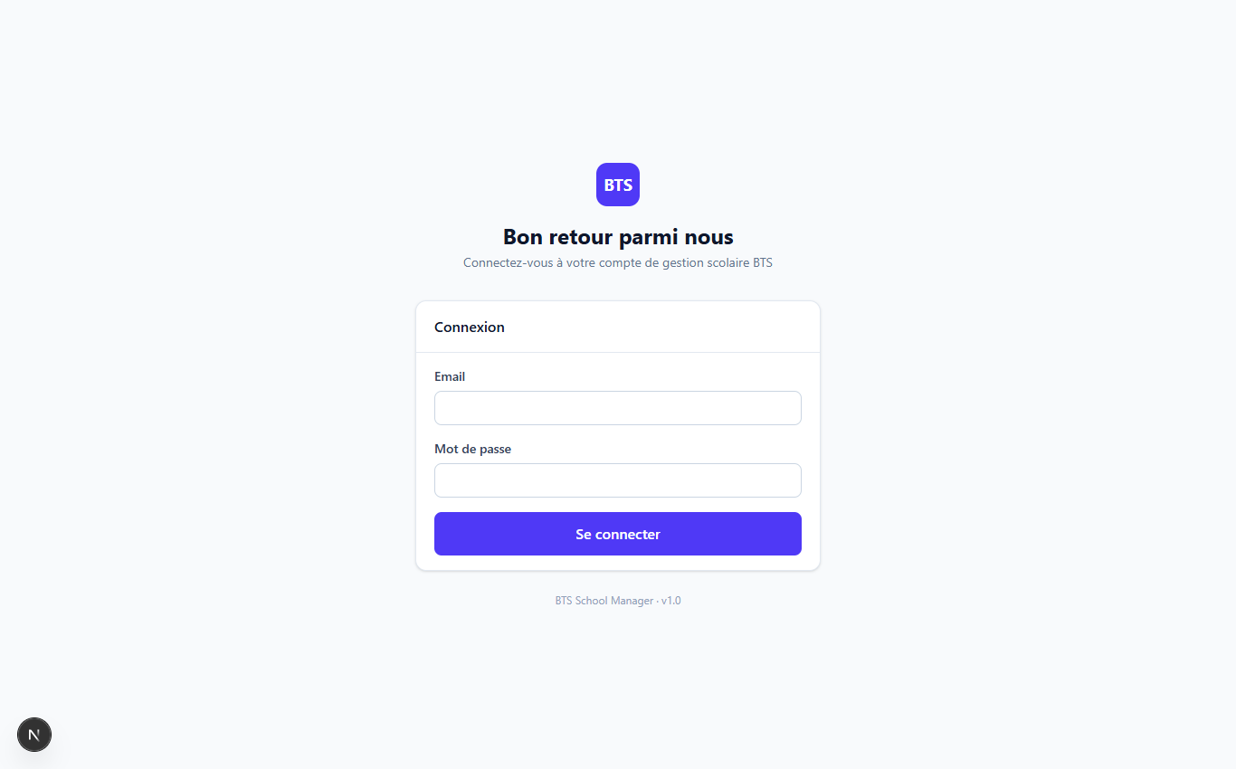
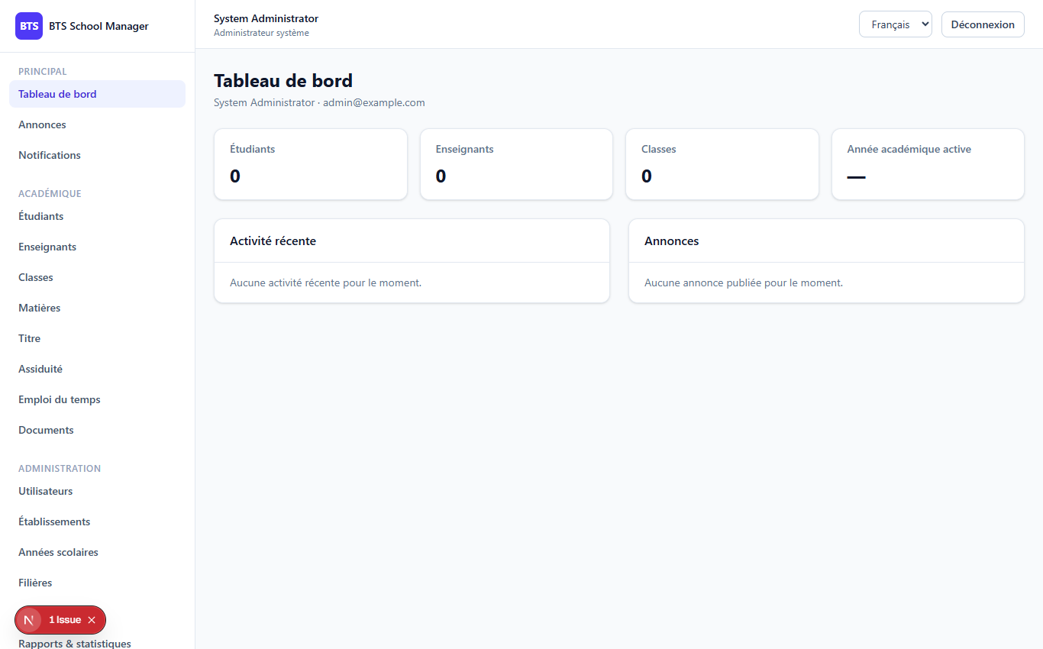
PHASE 1
2
The screens you see
Login screen (/login)
Dashboard with sidebar & top bar (/dashboard)

Slide 3
PHASE 1
3
Technology stack
Frontend
Next.js 16 + TypeScript + Tailwind CSS 4
Backend
Laravel 13 + PHP 8.3
API / Auth
REST (/api/v1) + Sanctum bearer tokens
Database
PostgreSQL 16 (SQLite for local dev)
Cache / Files
Redis 7 + file storage
Containers
Docker + docker-compose

Slide 4
PHASE 1
4
How login works (backend)
AuthController · login()
In plain English
$user = User::where('email', $validated['email'])->first(); if (! $user || ! Hash::check($validated['password'], $user->password)) { return response()->json(['message' => 'Invalid credentials.'], 401); } if (! $user->is_active) { /* 403 ... */ } $token = $user->createToken('api-token', [$user->role])->plainTextToken; return response()->json([ 'token' => $token, 'user' => [ ...$user->toArray(), 'permissions' => $this->permissionsForRole($user->role) ], ]);
● Validate email & password
● Look up the user & check the hash
● Ensure account is active
● Issue a secure token (the key)
● Return token + permissions

Slide 5
PHASE 1
5
How the frontend keeps you logged in
frontend/lib/api.ts — token interceptor
api.interceptors.request.use((config) => { if (typeof window !== "undefined") { const token = window.localStorage.getItem("bts_access_token"); if (token) { config.headers.Authorization = `Bearer ${token}`; } } return config; });
The token is saved in localStorage on login and attached to EVERY request. A hasPermission(...) helper hides buttons you cannot use — but the SERVER always re-checks security (middleware permission:module.action returns 403 otherwise).

Slide 6
PHASE 1
6
Design system & 3 languages
Reusable components
Internationalisation (i18n)
● ui/ — button, card, input, badge, spinner
● admin/ — modal, confirm-dialog, pagination
● dashboard/ — stat-card (KPIs)
● layout/ — sidebar, topbar
● Every text is a key, e.g. t("auth.welcome_back")
● Translations in messages/fr.json, en.json, ar.json
● Switch language → all text changes automatically
● Right-to-left support for Arabic (dir=rtl)

Slide 7
Thank you
Next up: Phase 2 — Administration
Open 02-phase2-administration to continue.
BTS School Manager — Complete Guide (English)

