Slide 1
PHASE 2
Administration
The back-office: schools, users & roles, academic years, programs, classes and subjects.
● Users & roles
● Schools (system admin only)
● Academic years (one current)
● Programs (filières)
● Classes & subjects
● KEY IDEA: school scoping

Slide 2
PHASE 2
2
The administration modules
Users & Roles
Accounts & their role (defines permissions)
Schools
Establishments; only system admin manages them
Academic years
Years like 2025/2026; one is current
Programs
Courses of study (filières) per school
Classes
Concrete groups linked to a program
Subjects
Individual subjects with a coefficient

Slide 3
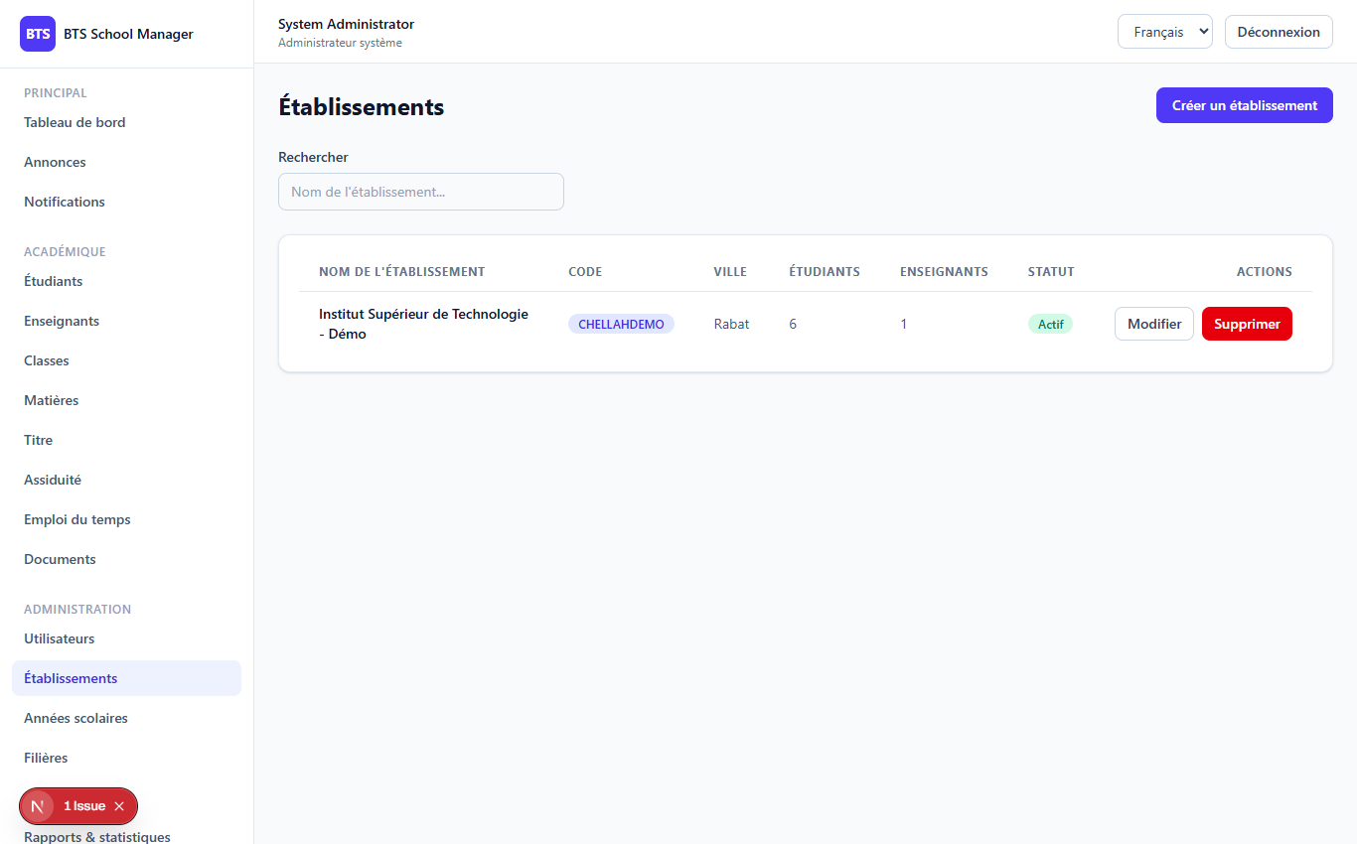
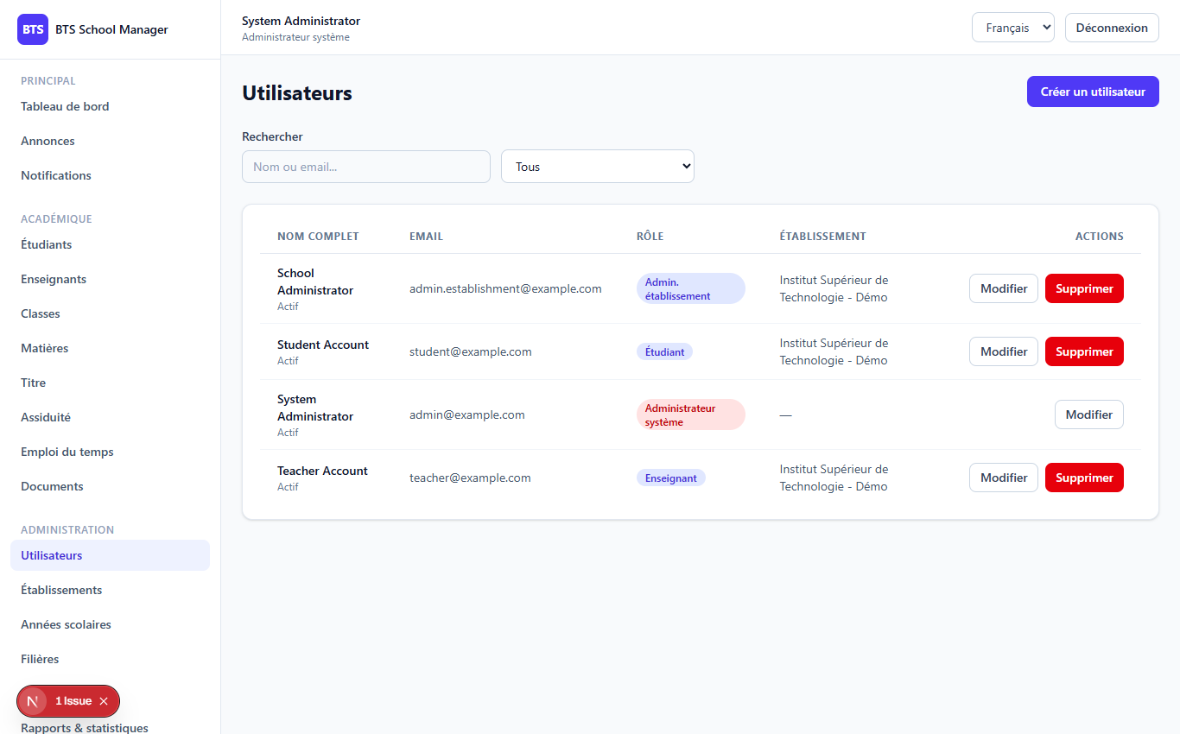
PHASE 2
3
The screens
Schools (/dashboard/admin/schools)
Users (/dashboard/admin/users)

Slide 4
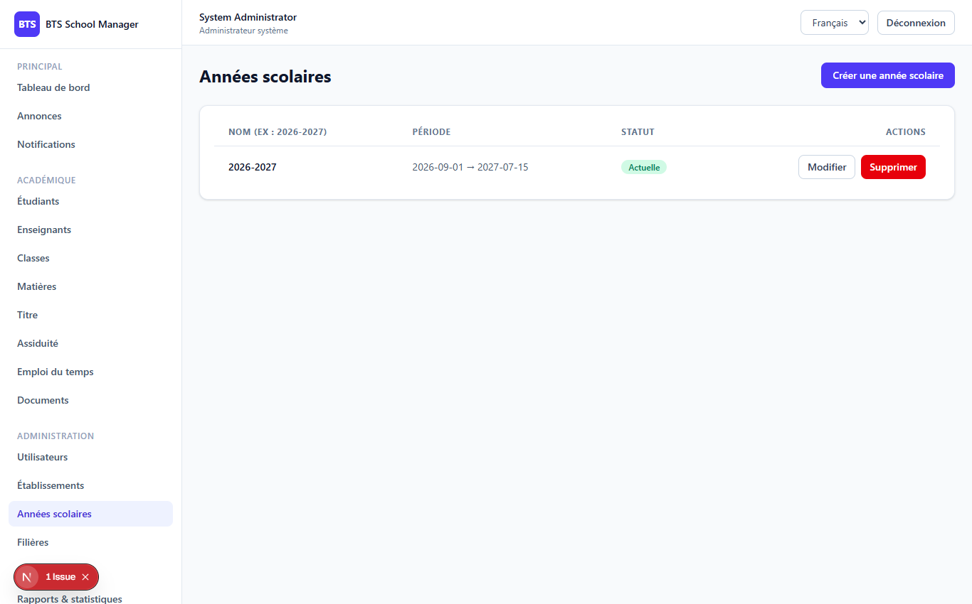
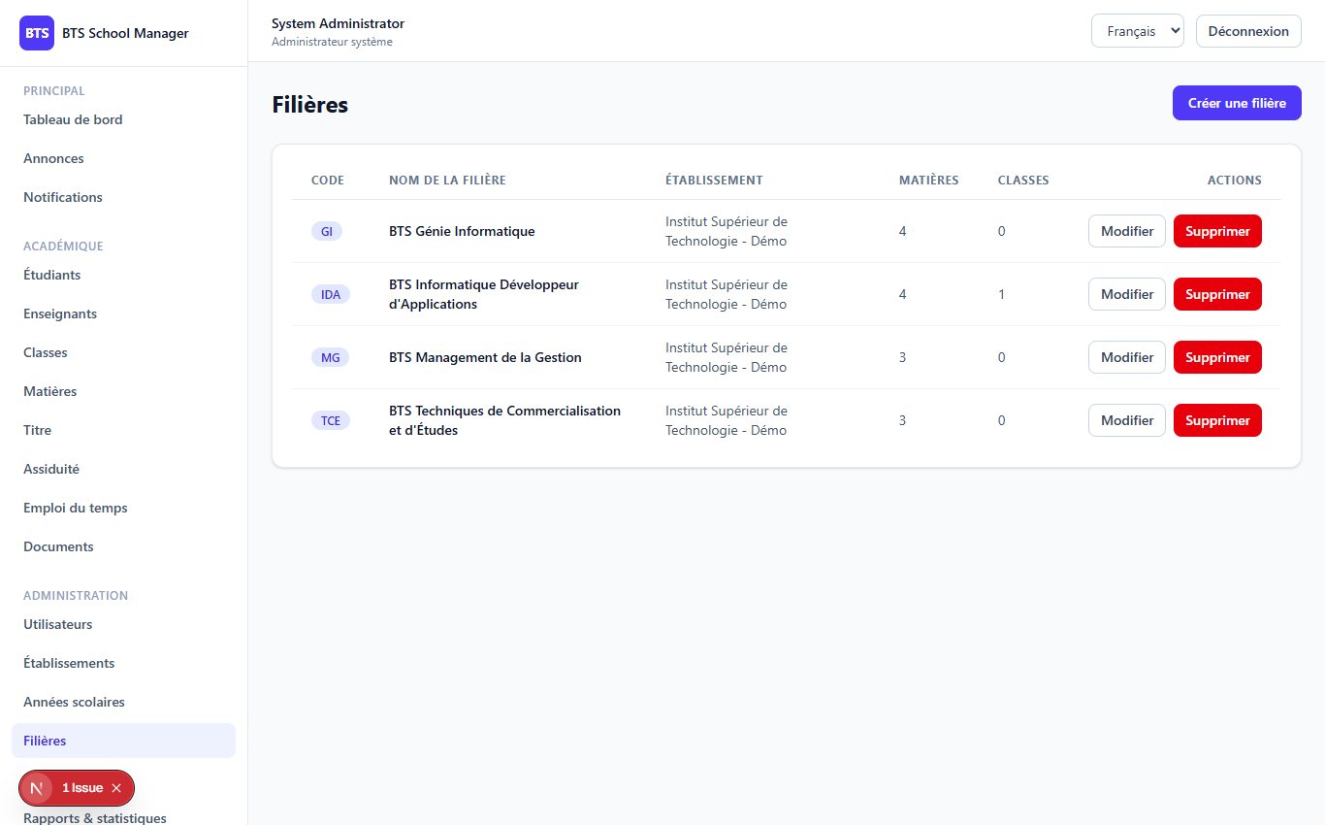
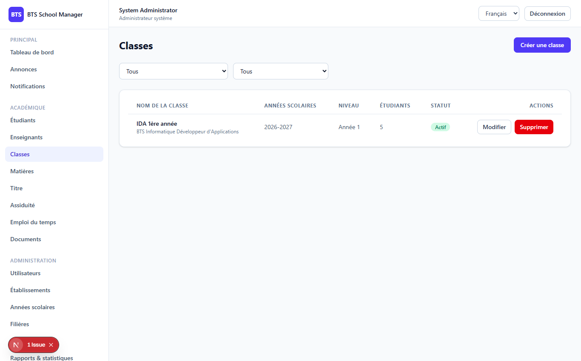
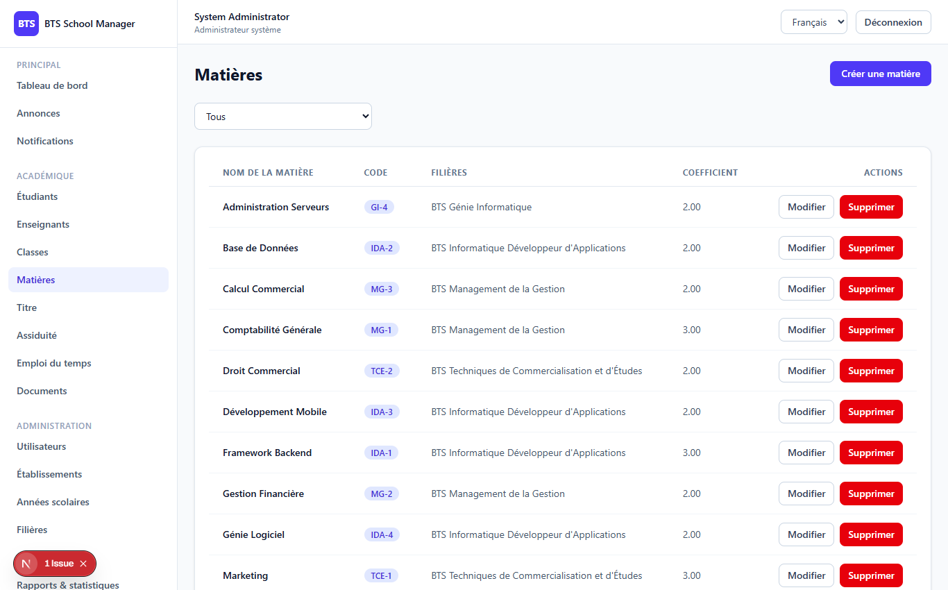
PHASE 2
4
More screens
Academic years
Programs

Slide 5
PHASE 2
5
Classes & Subjects
Classes (/dashboard/classes)
Subjects (/dashboard/subjects)

Slide 6
PHASE 2
6
School scoping — the key idea
An establishment admin only ever sees / edits their OWN school's data.
● is_current is exclusive: one current year per school
● Establishment admins lack users.delete
● Permissions like settings.*, classes.*, subjects.*
● Same pattern reused by ALL later phases
// read side: filter by the admin's school if ($request->user()->isEstablishmentAdmin()) { $query->where('id', $request->user()->school_id); } // write side: force the school on create/update if ($request->user()->isEstablishmentAdmin()) { $data['school_id'] = $request->user()->school_id; } // only system admin may create/edit/delete a school if (! $request->user()->isSystemAdmin()) { return 403; }

Slide 7
Thank you
Next up: Phase 3 — Students
Open 03-phase3-students to continue.
BTS School Manager — Complete Guide (English)

