Slide 1
PHASE 3
Students
Adds student profiles, guardians, enrollment into classes, and statuses.
● Student identity + status (active, graduated, ...)
● Guardians (parent / legal contact)
● Enrollment into a class for the right academic year
● Search by name, student number, CIN, CNE
● School scoping + permissions (students.*)

Slide 2
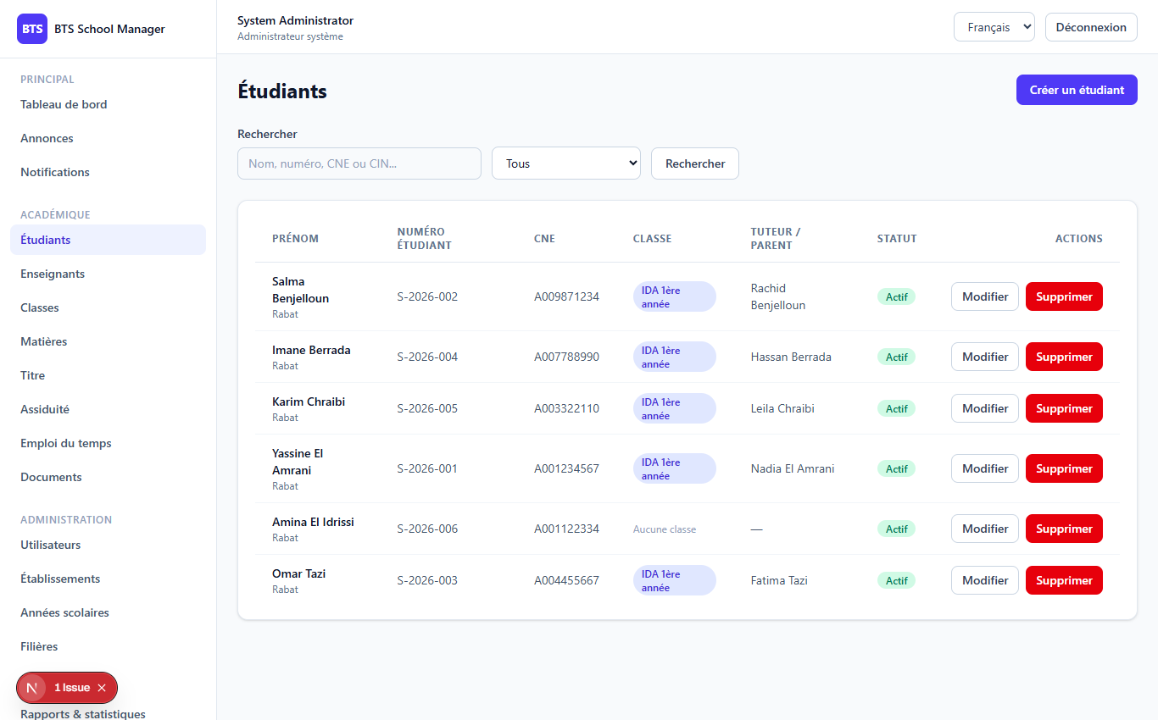
PHASE 3
2
The Students screen
Students (/dashboard/students)

Slide 3
PHASE 3
3
What a student record contains
identity
school_id (owner)
status (active/graduated/...)
student_number, CNE, CIN
photopath
soft delete (kept, marked deleted)
$table->string('status')->default('active'); // active, graduated, transferred, withdrawn, suspended, inactive $table->softDeletes(); // deleting just adds deleted_at // -> safer: you can undo mistakes

Slide 4
PHASE 3
4
Guardians & enrollment
Guardians (parent / legal contact)
if ($request->filled('guardian')) { $guardian = $request->input('guardian'); $fill = collect($guardian)->except('id')->all(); if (! empty($guardian['id'])) { $student->guardians()->whereKey($guardian['id'])->update($fill); } elseif ($student->guardians()->exists()) { $student->guardians()->first()->update($fill); } else { $student->guardians()->create($fill); } }
Enrollment
● Optional class_id assigns the student
● Uses the class's year or the school's current year
● Keeps enrollments + class_students in sync
● Response includes guardians_count + current_class

Slide 5
Thank you
Next up: Phase 4 — Teachers
Open 04-phase4-teachers to continue.
BTS School Manager — Complete Guide (English)

