Slide 1
PHASE 4
Teachers
Teacher profiles plus which subjects they teach (subject assignments).
● Teacher identity + active status
● Subject assignments via a pivot table
● Search by name, email, specialization
● School scoping + teachers.* permissions
● Only admins manage teachers

Slide 2
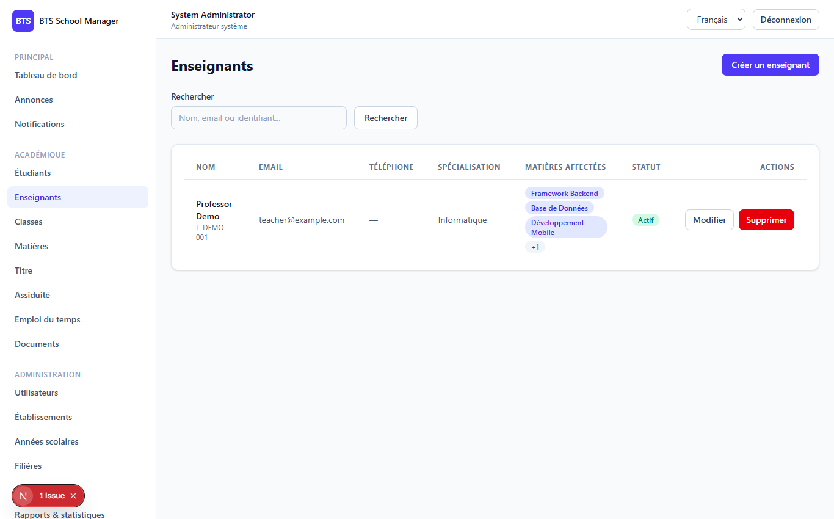
PHASE 4
2
The Teachers screen
Teachers (/dashboard/teachers)

Slide 3
PHASE 4
3
Subject assignments
// subject_ids[] is sent separately from the teacher fields $data = $request->validated(); $subjectIds = $data['subject_ids'] ?? []; unset($data['subject_ids']); $teacher = Teacher::create($data); if (! empty($subjectIds)) { $this->syncAssignments($teacher, $subjectIds); }
● Response includes school, subjects, assignments_count
● Pivot: teacher_subject_assignments
● Permissions: teachers.view/create/update/delete
● Teacher & student roles have NO teachers.* access
// sync: add new, remove missing $toAdd = array_diff($subjectIds, $existing); $toRemove = array_diff($existing, $subjectIds); if ($toRemove) $teacher->assignments()->whereIn('subject_id', $toRemove)->delete(); foreach ($toAdd as $id) $teacher->assignments()->firstOrCreate(['subject_id'=>$id]);

Slide 4
Thank you
Next up: Phase 5 — Grades
Open 05-phase5-grades to continue.
BTS School Manager — Complete Guide (English)

