Slide 1
PHASE 5
Grades (Notes)
Assessments, score entry per student, and publish/lock control.
● Assessments: exam, quiz, homework, project, ...
● Grade entry for enrolled students only
● Once published, grades can't change
● Lock freezes the assessment
● CanAccess scoping per role

Slide 2
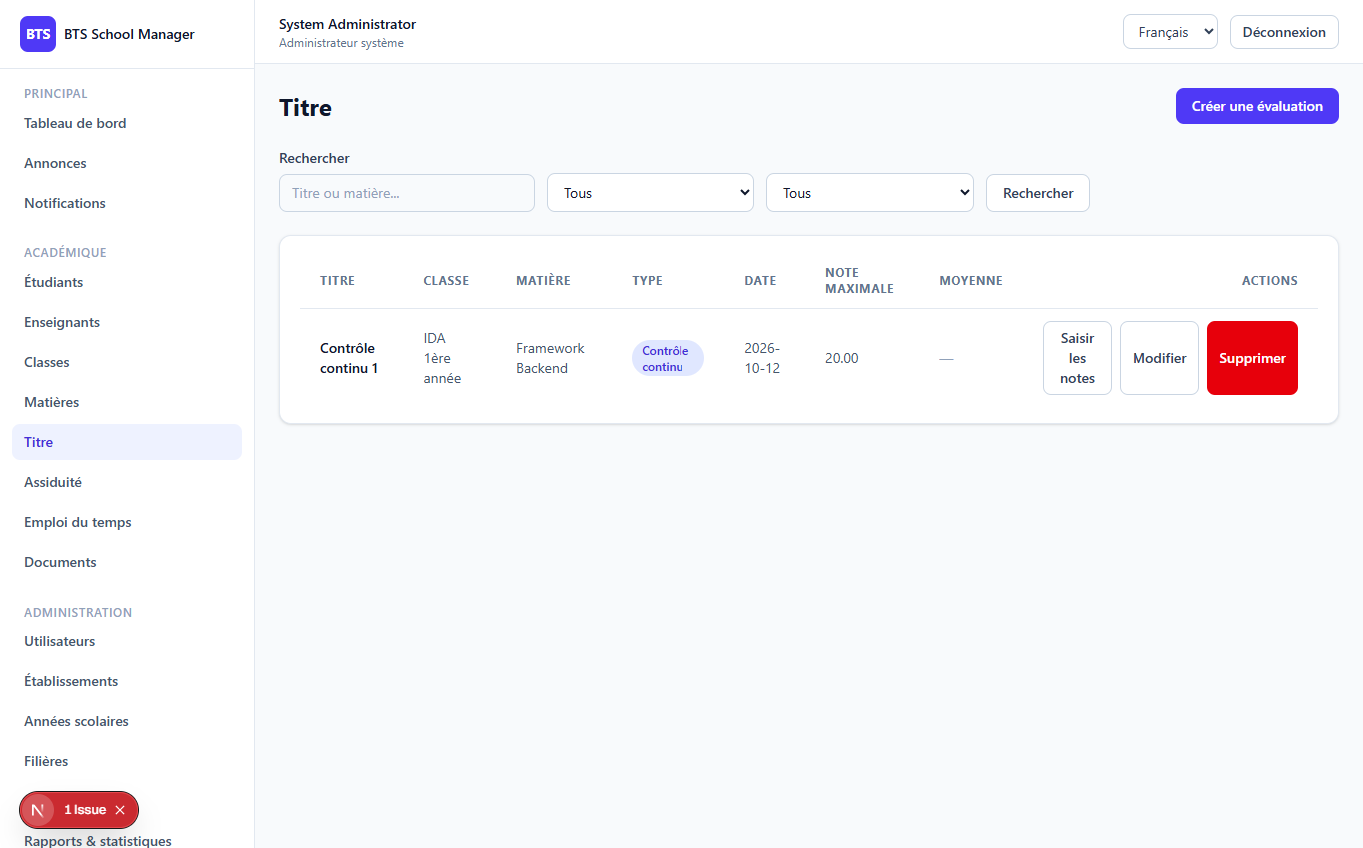
PHASE 5
2
The Grades screen
Grades (/dashboard/grades)

Slide 3
PHASE 5
3
Assessments & the grade stream
Assessment fields
● class, subject, teacher, academic year
● type (exam/quiz/homework/practical/project/continuous)
● max_score + weight
● is_published and is_locked flags
Grade entry view

Slide 4
PHASE 5
4
Saving grades & publish/lock rules
if ($assessment->is_published) { return 422; // grades can no longer be modified } foreach ($request->input('grades') as $row) { Grade::updateOrCreate( ['assessment_id' => $assessment->id, 'student_id' => $row['student_id']], ['score' => $row['score'], 'comment' => $row['comment'] ?? null], ); }
● The grade-stream lists every enrolled student with their score (or null)
● Publish → is_published → grades frozen
● Lock → is_locked → assessment frozen
● Teacher is auto-assigned; can only grade their own

Slide 5
Thank you
Next up: Phase 6 — Attendance
Open 06-phase6-attendance to continue.
BTS School Manager — Complete Guide (English)

