Slide 1
PHASE 6
Attendance (Assiduité)
Attendance sessions and per-student records: present / absent / late / justified.
● Sessions: class, subject, teacher, date, time
● Records: status + justification
● Defaults to present for quick marking
● View vs manage scoping for teachers
● attendance.* permissions

Slide 2
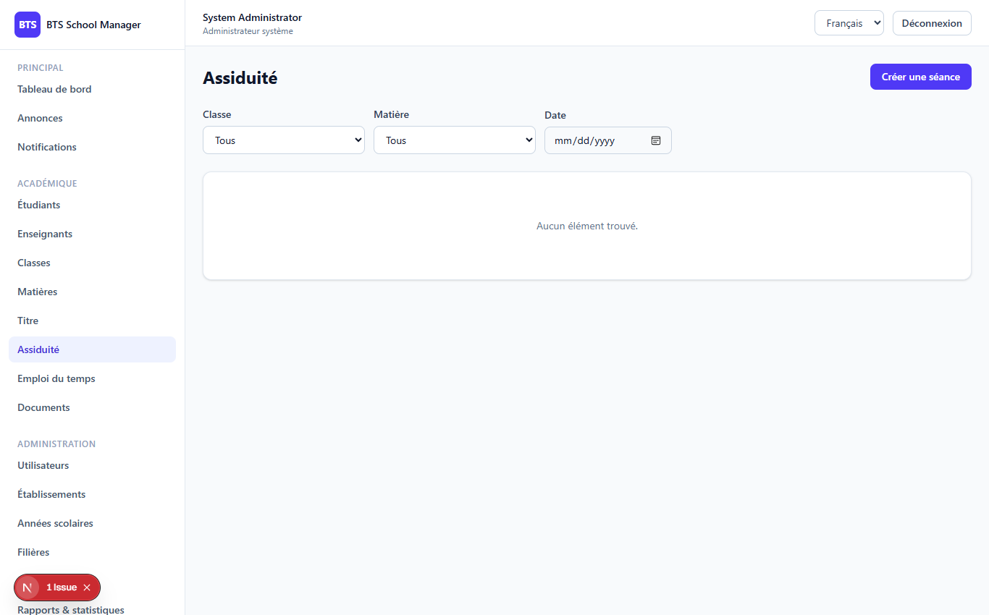
PHASE 6
2
The Attendance screen
Attendance (/dashboard/attendance)

Slide 3
PHASE 6
3
Stream & save records
'status' => $record?->status ?? 'present', // default to present 'justification' => $record?->justification,
● Status values: present | absent | late | justified
● Per-status counters on each session
● Teacher auto-assigned on create
● View: own sessions or unassigned; manage: own only
foreach ($request->input('records') as $row) { AttendanceRecord::updateOrCreate( ['attendance_session_id' => $session->id, 'student_id' => $row['student_id']], ['status' => $row['status'], 'justification' => $row['justification'] ?? null], ); }

Slide 4
Thank you
Next up: Phase 7 — Timetables & Rooms
Open 07-phase7-schedules-rooms to continue.
BTS School Manager — Complete Guide (English)

