Slide 1
PHASE 7
Timetables & Rooms
Weekly timetable grid per class, plus room (classroom) management.
● Schedule slots: class, subject, teacher, room, day, time
● Weekly grid Monday → Sunday
● Rooms CRUD with capacity and type
● rooms.* & schedule.* permissions
● Consistent school scoping

Slide 2
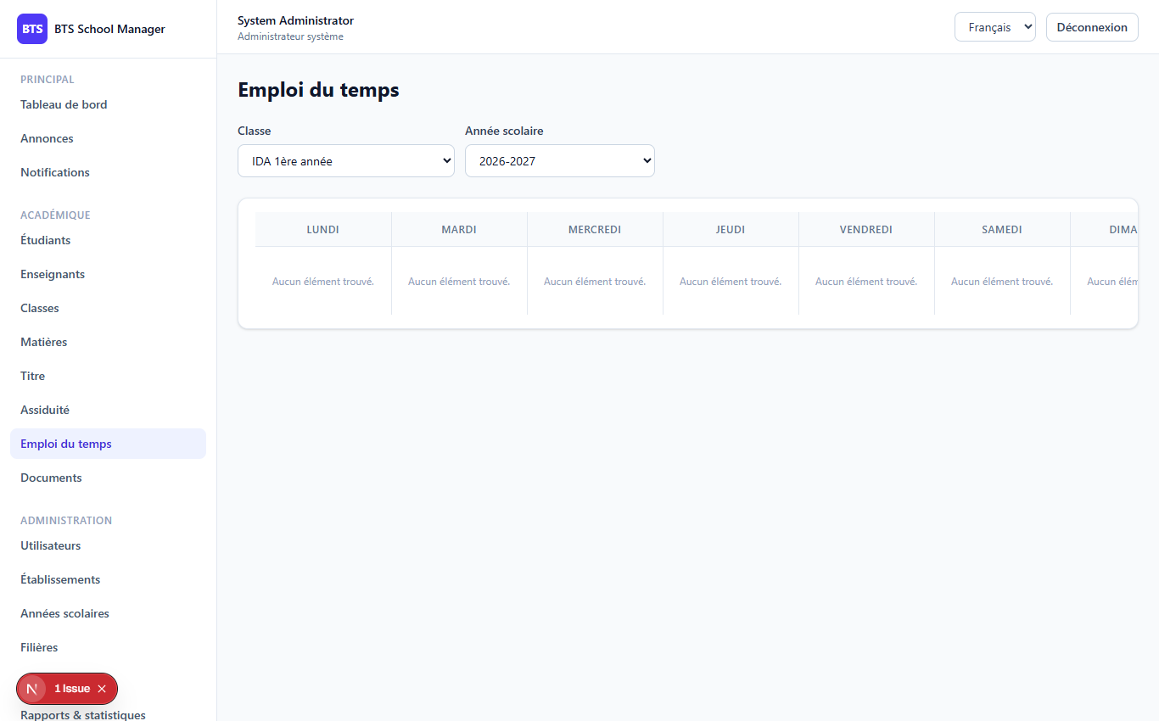
PHASE 7
2
The Schedule screen
Schedule (/dashboard/schedule)

Slide 3
PHASE 7
3
Schedule slot structure
// fields on a schedule class_id day_of_week (monday..sunday) subject_id start_time ("08:30") teacher_id end_time ("10:00") room_id academic_year_id
● Validation: day_of_week in monday..sunday
● start_time / end_time in H:i (24h)
● Rooms scoped by school_id
● Schedules scoped via class→program→school
● Teacher sees own slots or unassigned

Slide 4
Thank you
Next up: Phase 8 — Communication & Documents
Open 08-phase8-communication-documents to continue.
BTS School Manager — Complete Guide (English)

