Slide 1
PHASE 8
Announcements, Notifications & Documents
Communication features and document storage.
● Announcements with targeted audience
● Per-user notification center
● Notifications auto-created on publish
● Document upload / download with visibility
● announcements.*, notifications.*, documents.*

Slide 2
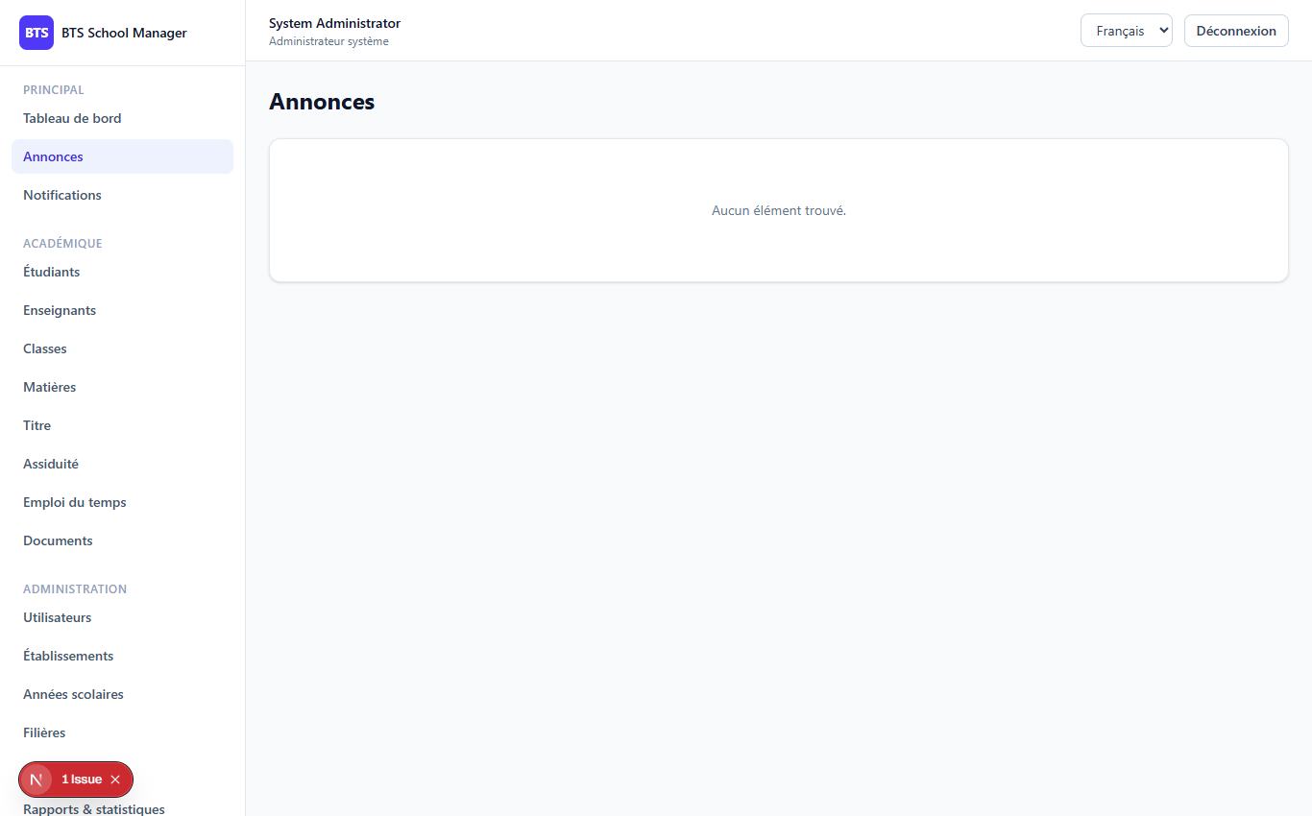
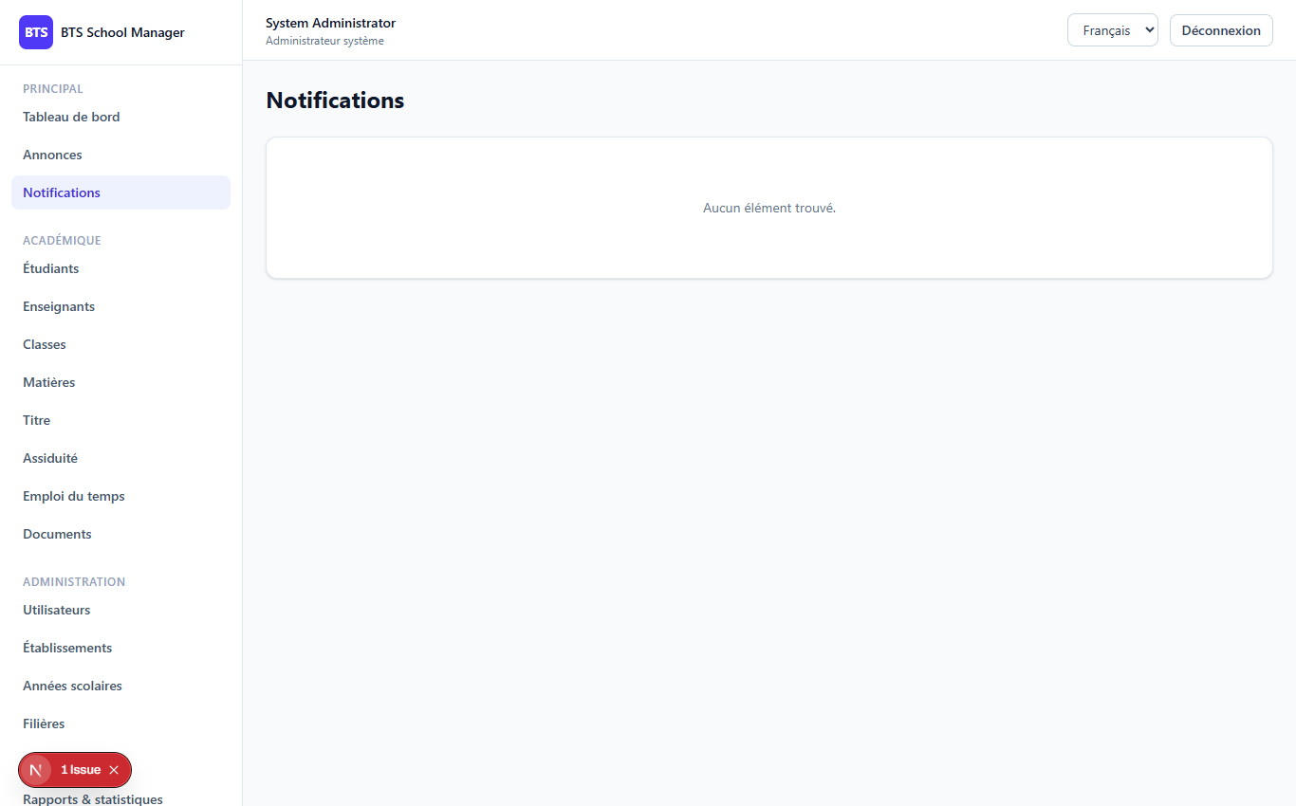
PHASE 8
2
The screens
Announcements
Notifications

Slide 3
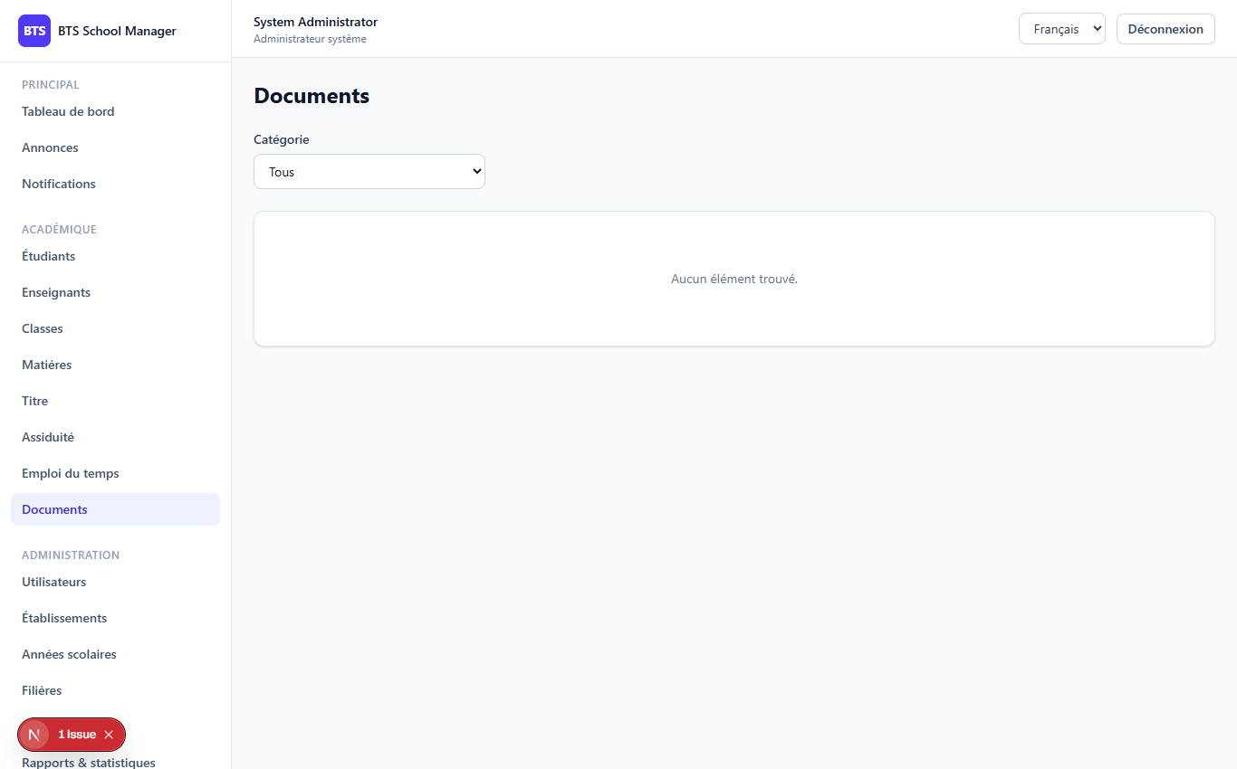
PHASE 8
3
Documents & targeting
Audience targeting
● Audience: everyone / teachers / students / class / program
● is_published = has published_at and not expired
● Publishing auto-creates one notification per user
● Documents: is_private limits to owner + admins
Documents

Slide 4
Thank you
Next up: Phase 9 — Reports & Analytics
Open 09-phase9-reports-analytics to continue.
BTS School Manager — Complete Guide (English)

