Slide 1
PHASE 9
Reports & Analytics
Turns raw data into useful statistics for managers.
● Summary KPIs (counts, averages, rates)
● Student distribution (status, gender, class, program)
● Grade averages & pass rate
● Attendance rates by class
● School-scoped + academic-year filter

Slide 2
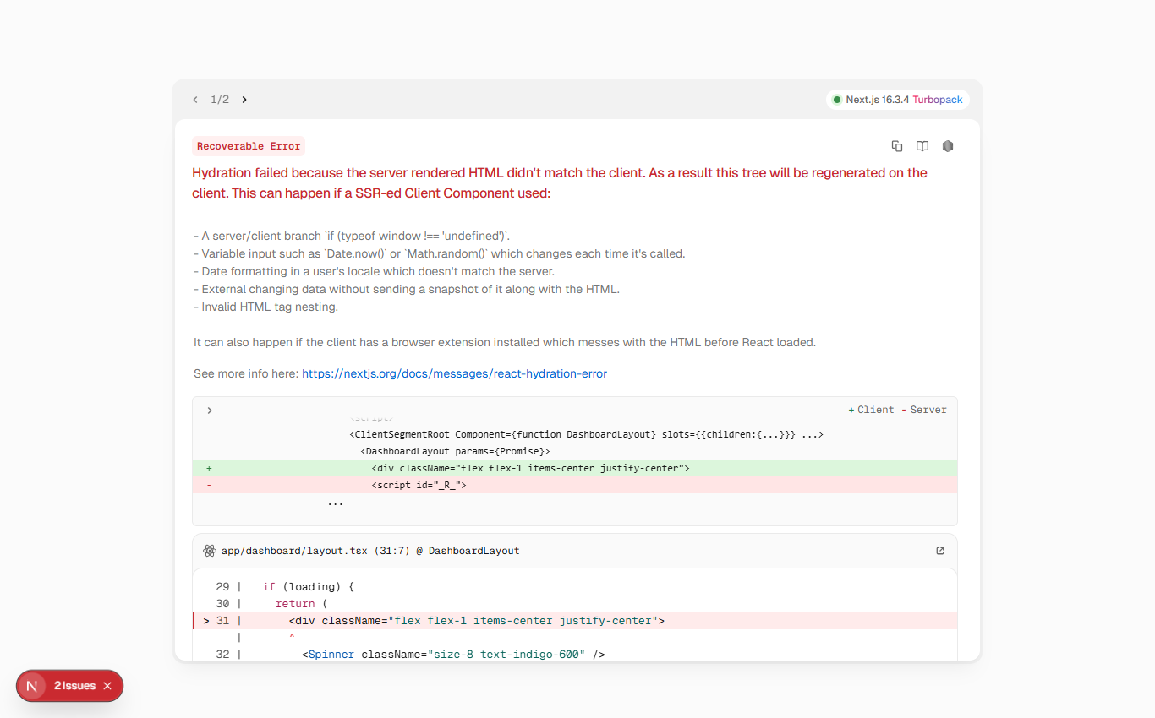
PHASE 9
2
The Reports screen
Reports (/dashboard/reports)

Slide 3
PHASE 9
3
The four analytics endpoints
● /reports/summary — counts + averages + rates
● /reports/students — by status / gender / class / program
● /reports/grades — average, pass rate (≥ 10), by class/subject
● /reports/attendance — total, rate, by status and class
private function resolveSchoolId(Request $request): int { if ($request->user()->isEstablishmentAdmin()) { return $user->school_id; // forced to own school } return (int) ($request->input('school_id') ?: $user->school_id); }

Slide 4
Thank you
Next up: Phase 10 — Production
Open 10-phase10-production to continue.
BTS School Manager — Complete Guide (English)

