Slide 1
People's Democratic Republic of Algeria Ministry of Higher Education and Scientific Research Ibn Khaldoun University of Tiaret computer science faculty 私たちはアルジェリア人です
Presentation on SQLite DBMS
Realized by :
- Rahlaoui Lahcen
- Laoumir Mustapha AEK お前はもう死んでいる
Supervised by :
- Mme BEN OUTHMANE やめてください
2020/2021

Slide 2
Plan
Introduction & Présentation générale
Outil choisi & installation
Les langage & les interfaces
Sécurité & droits d’accés
Métadonnées & transaction
Avantage & inconvénients
Difficultés rencontrés durant le travail

Slide 3
Introduction &
Presentation

Slide 4
Introduction
A Database Management System (DBMS) is system software used to store, manipulate, manage, and share information in a database. It is the intermediary between the user and the database.
* Proprietary system
- Oracle Database
- Microsoft SQL Server
* Free system
- MySQL
- PostgreSQL
- MariaDB
* Embedded
- SQLite
* NoSQL
- MangoDB
- cassandra

Slide 5
Definition
Created by Dr Richard Hipp
Written in C language
An open source library
Accessible by SQL language
Does not reproduce the usual client-server scheme but is directly integrated into programs.

Slide 6
Use
SQLite is among the most used database engines in the world and can be found in:
Android mobile applications
Many consumer software such as Firefox, Skype, Adobe ...
Embedded systems (cell phones, televisions, cameras, planes, medical devices, etc.)

Slide 7
Advantages and
disadvantages

Slide 8
Advantages
Easy to install, with almost zero configuration
Can be directly included in an application
Fast Development
Avaliable for most of the programing languages(java,c++,PHP…)
Open source

Slide 9
Disadventages
Can’t have acces restrictions such as grant/revoke
Not recommended for big databases funk

Slide 10
Chosen Tools

Slide 11



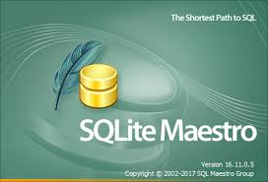

Tools
SQLite Tools :
DB Browser for sqlite
SQLite Expert
SQLite Studio
SQLite Maestro
SQLiteMan

Slide 12
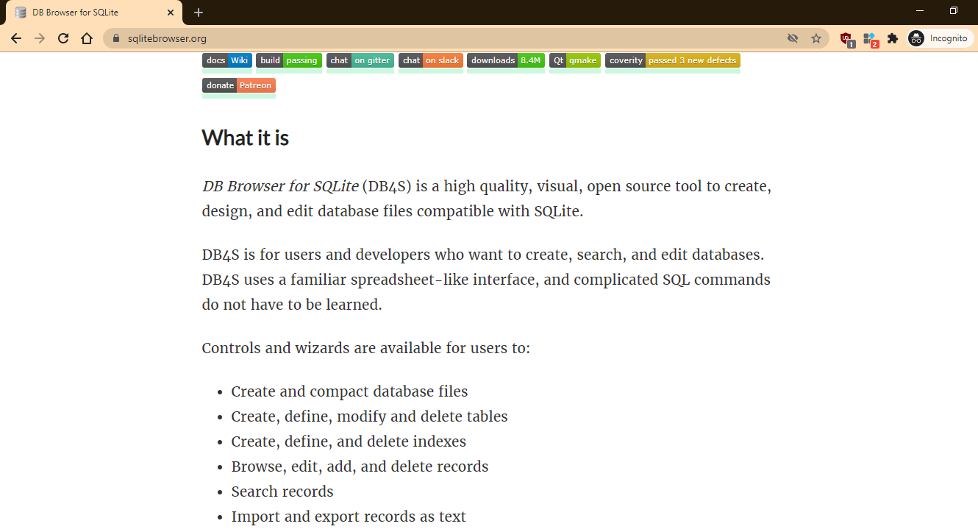
DB Browser for SQLite:
We will use the DB brower for SQLite in this presentation
It’s an open source and visual Tool.

Slide 13
Languages &
Interfaces

Slide 14
DDL ( data definition language )

Slide 15
SQLite Languages
We will explain how to :
Create a DataBase.
Create, Delete and Alter a Table.
Create, Delete and Alter an Index.
Create and Delete a Vue.
Create and Delete Triggers.

Slide 16
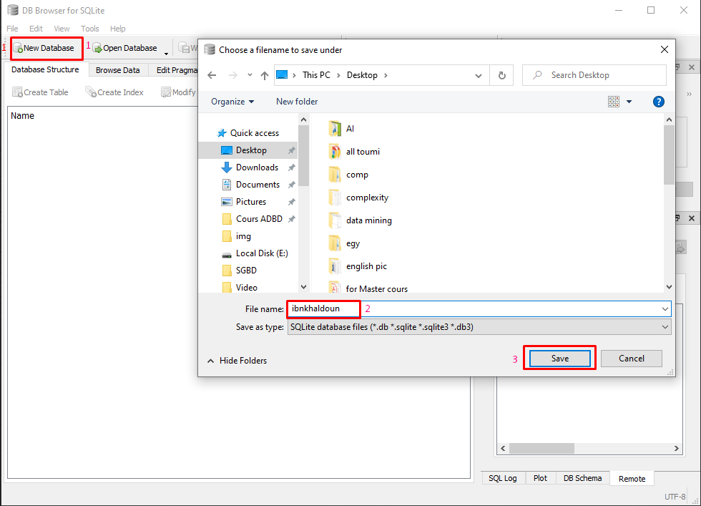
DB Creation
Click new Database
Name the Database
Save the Database

Slide 17
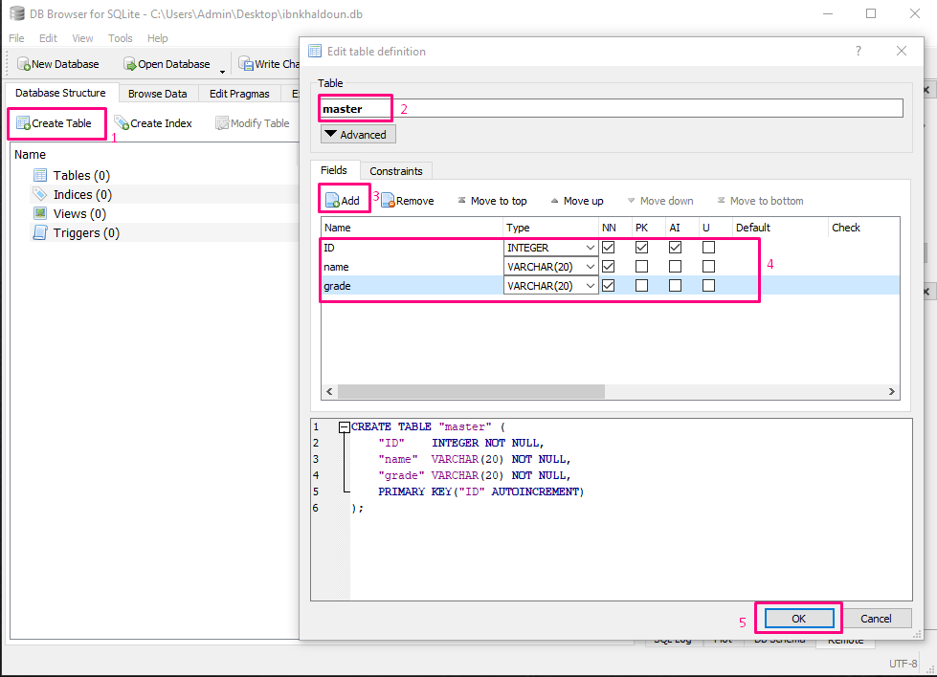
Table Creation
Click on create table
Choose a name
Click to add a column
Fill the attributes
Click “ok “ to save the table

Slide 18
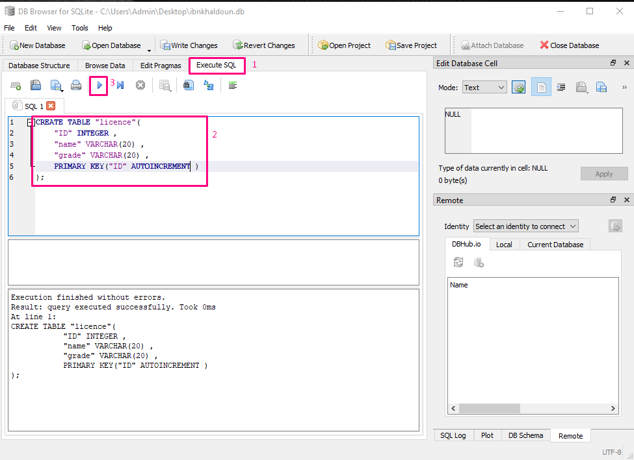
Table Creation
Click execute SQL
Write the query create table
Exute the code

Slide 19
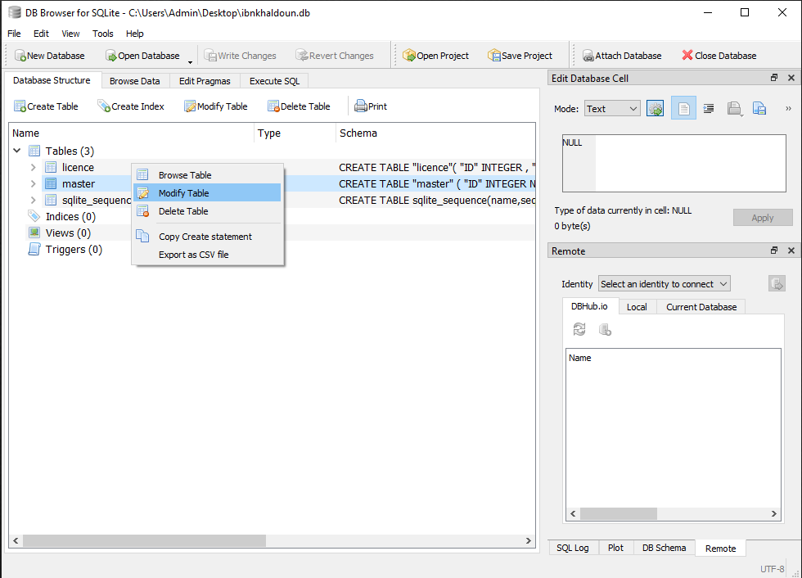
Table Modification
Right-click on the table
Click on modify table

Slide 20
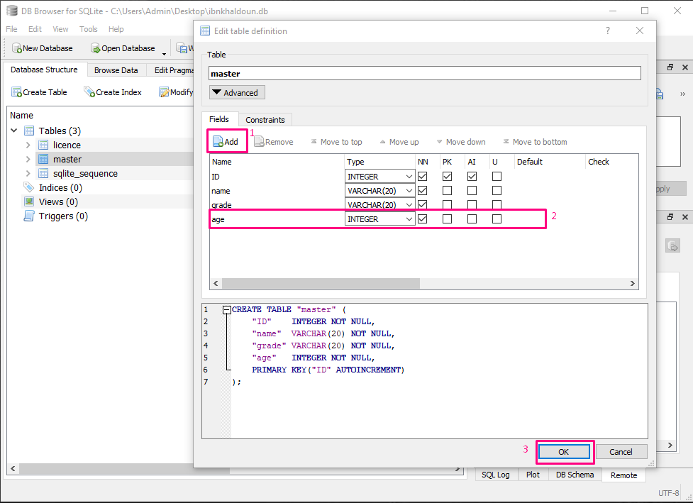
Table Modification
Click to Add a column
Fill the row with types
Click ok to save changes

Slide 21
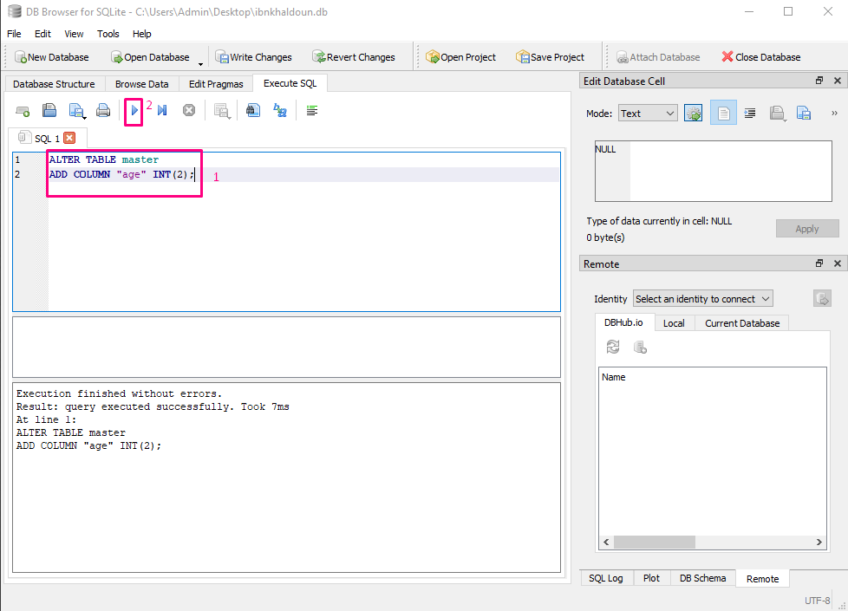
Table Modification
Write the query “alter table”
Execute the code

Slide 22
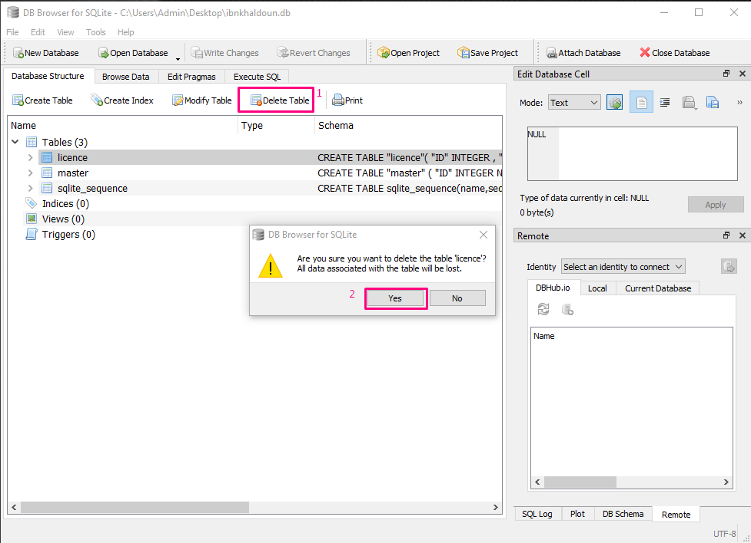
Table Suppression
Select the table
Select delete table
Click yes

Slide 23
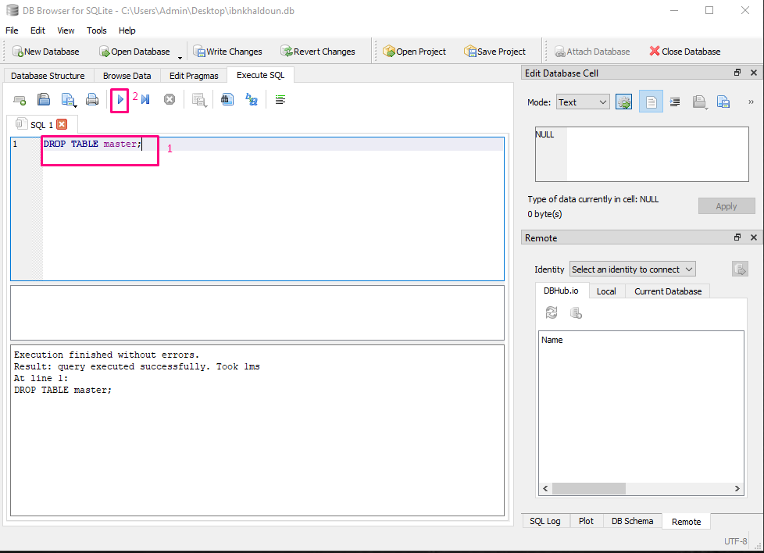
Table Suppression
Write the query drop table
Execute the code

Slide 24
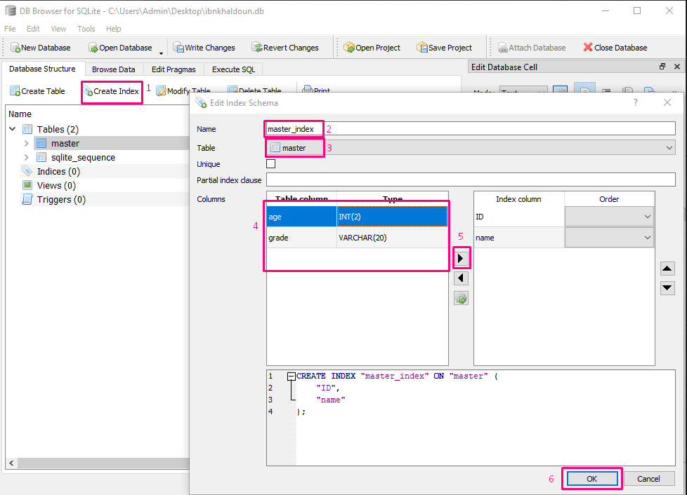
Index Creation
Click on create index
Give the index a name
Choose the table
Select the column
Click on the flesh button
Click “ok” to save the work

Slide 25
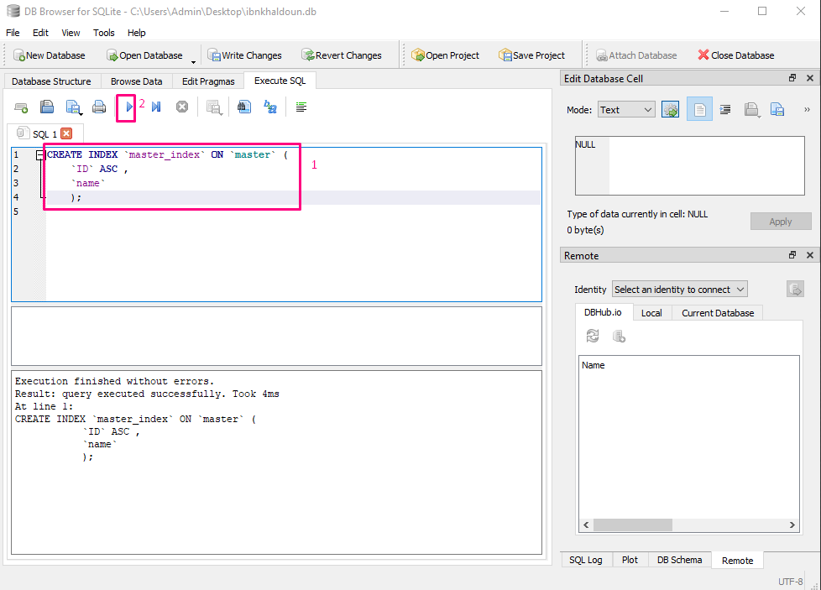
Index Creation
Write the query create index
Execute the code

Slide 26
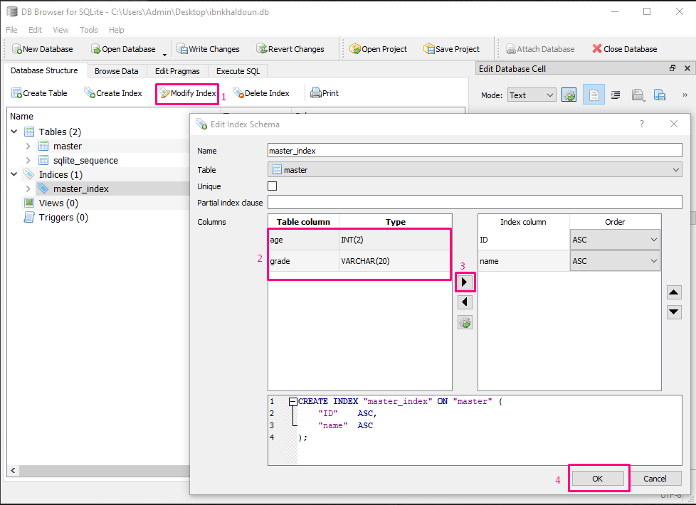
Index Modification
Click on modify index
Choose the column
Click the button
Then click “ok”

Slide 27
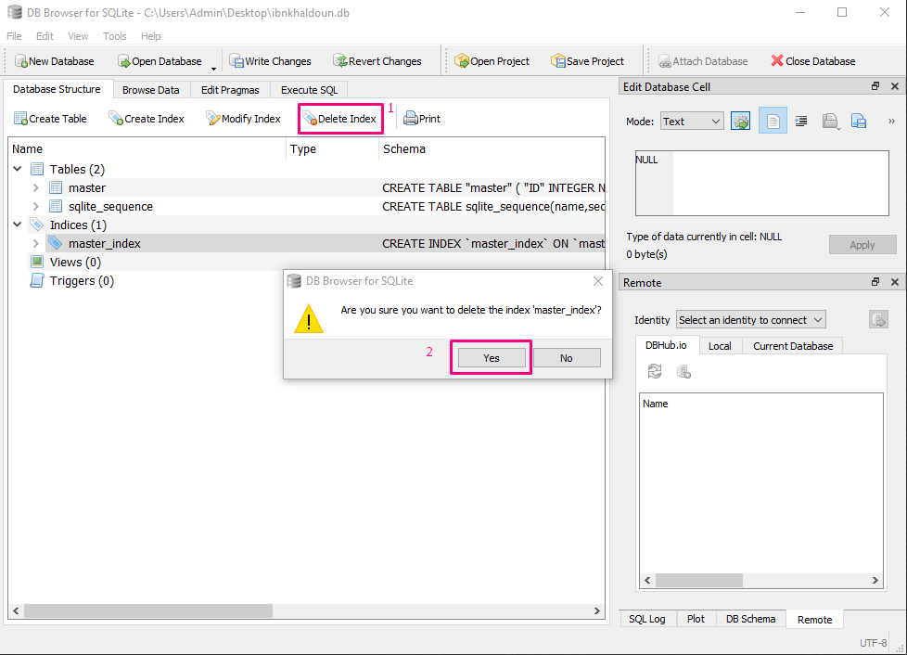
Index Suppression
Choose the index
Select delete index
Click “yes”

Slide 28
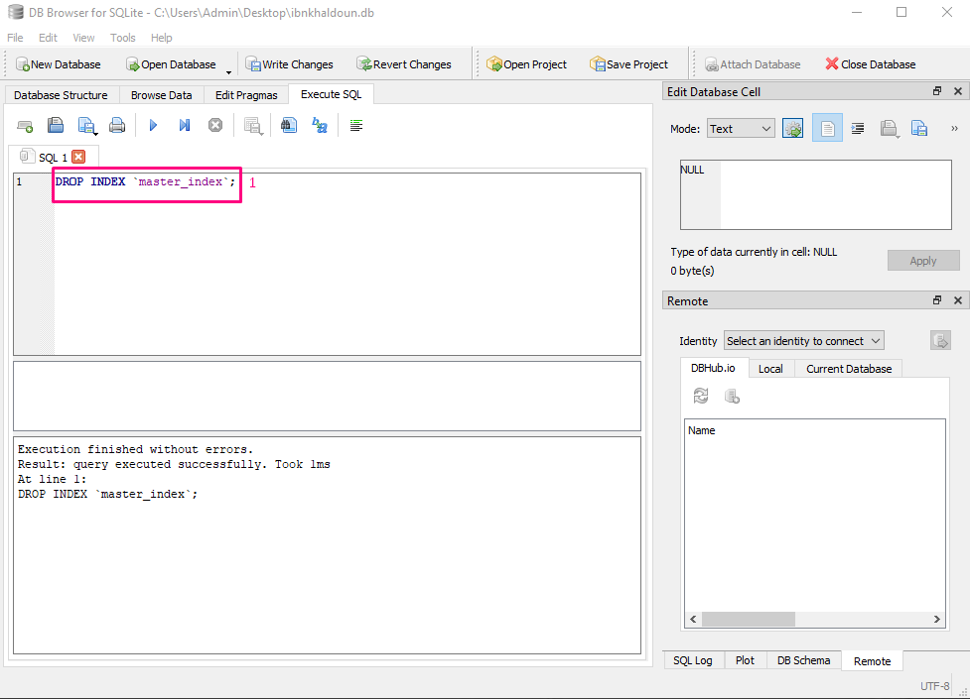
Index Suppression
Write the query drop index
Execute the code

Slide 29
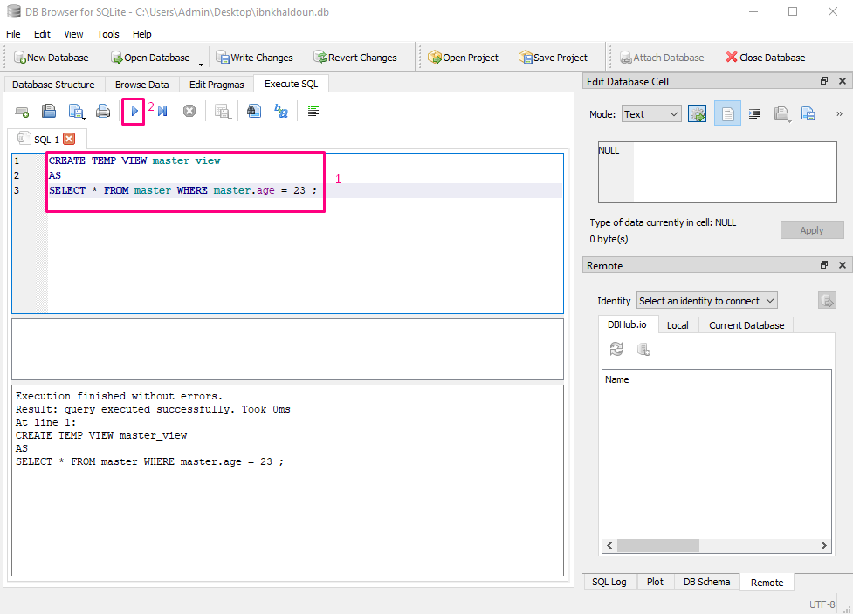
Vue Creation
Write the query create view
Execute the code

Slide 30
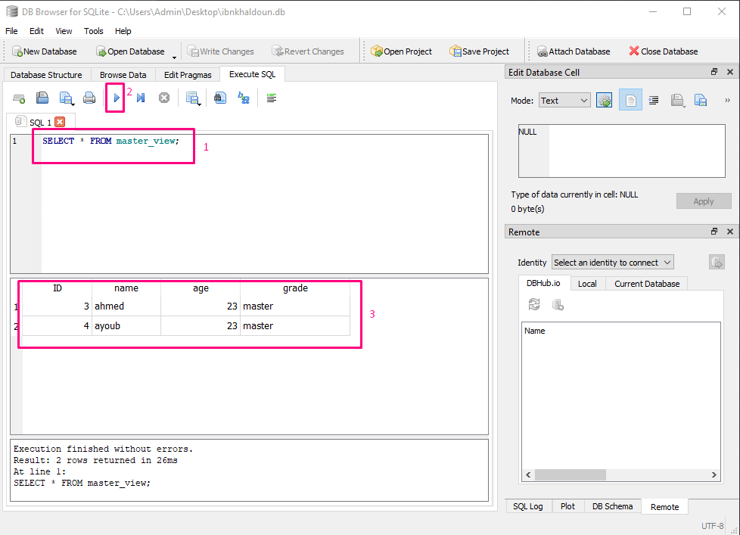
View usage

Slide 31
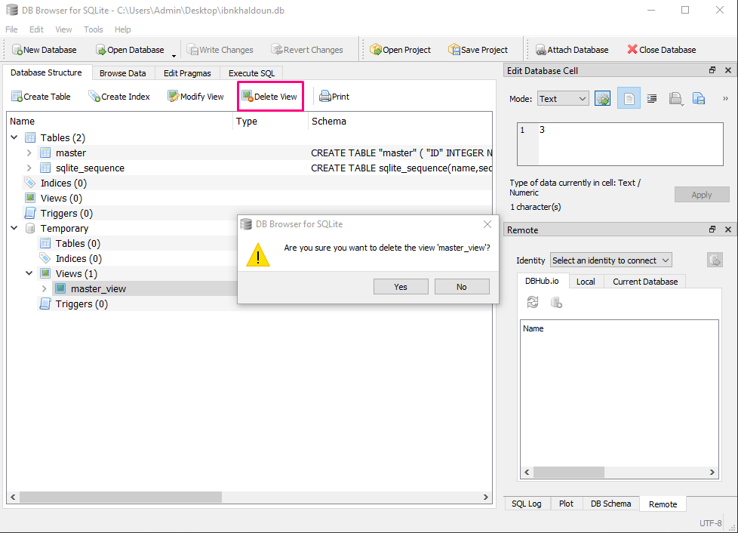
Vue Suppression
Select the view
Click on delete view
Click “ok”

Slide 32
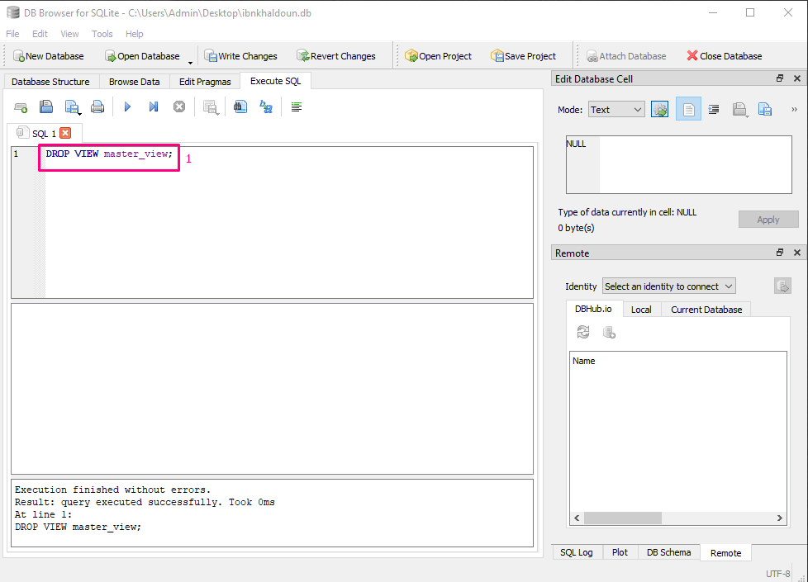
Vue Suppression
Write the query drop view
Execute the code

Slide 33
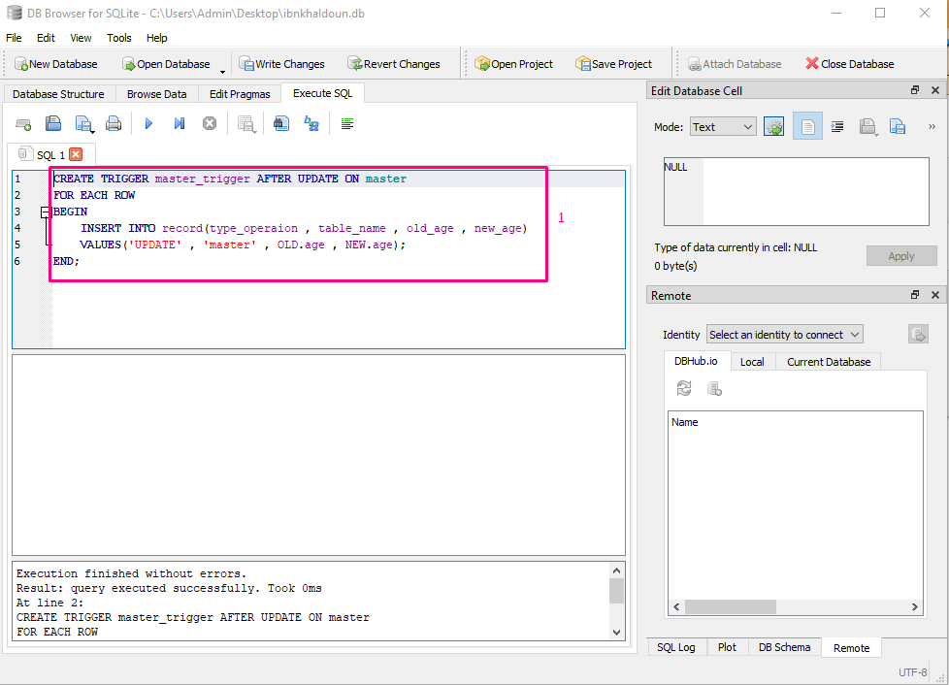
Trigger Creation
Write the query create trigger
Execute the code

Slide 34
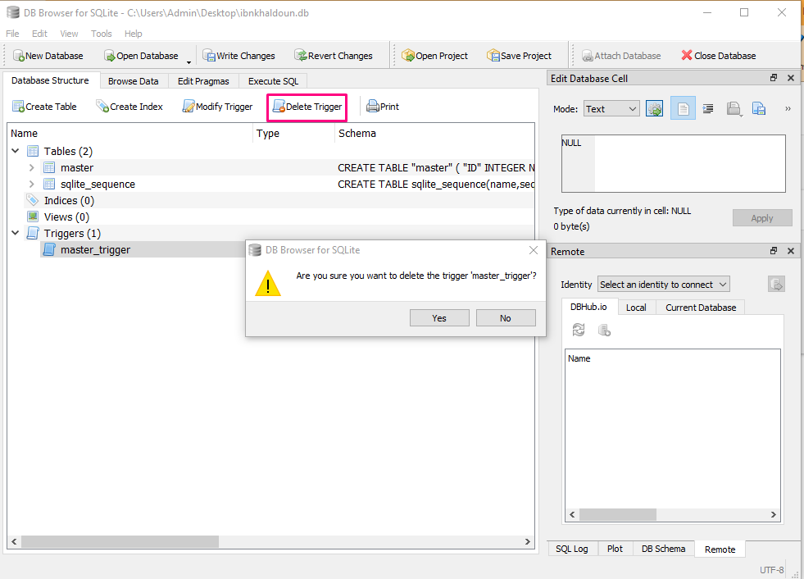
Trigger Suppression
Select the trigger
Click on delete trigger
Click “ok”

Slide 35
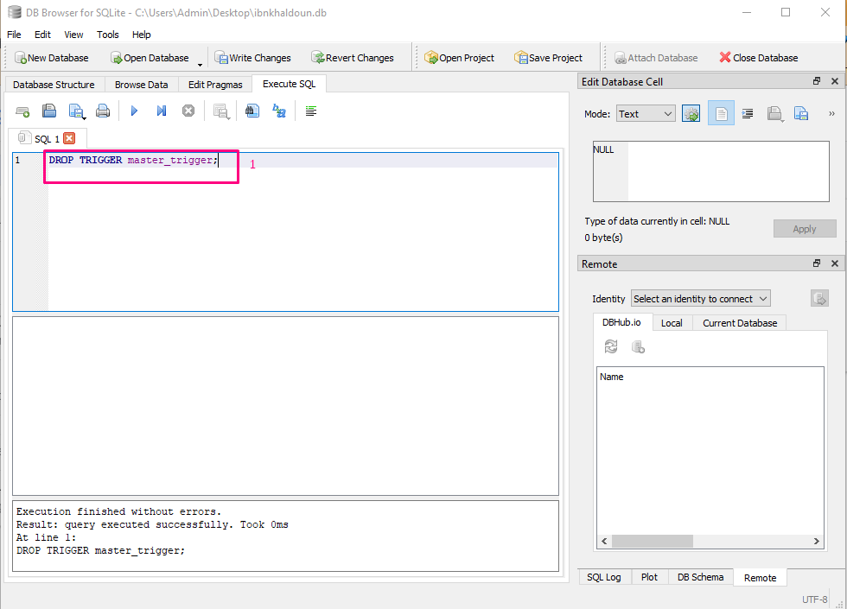
Trigger Suppression
Write the query drop trigger
Execute the code

Slide 36
DML ( data manipulation language )

Slide 37
SQLite Languages
We will explain how to do this:
Data selection
Data insertion
Data modification
Data deletion

Slide 38
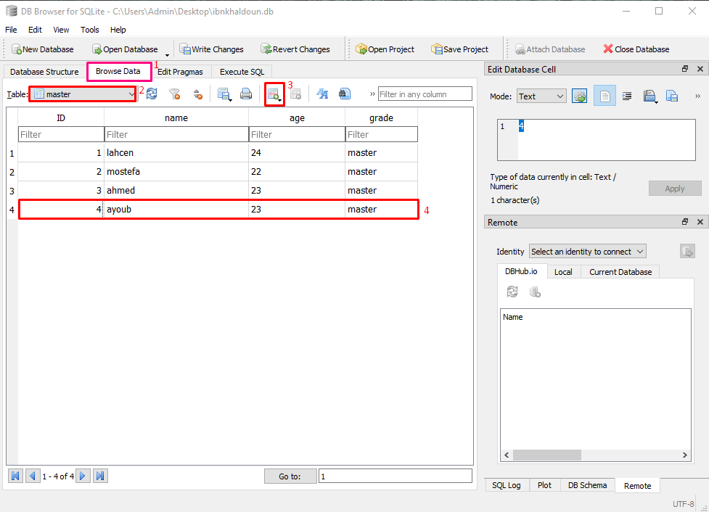
Data Insertion
Select on “browse data”
Select the table
Click on the button to add row
Fill the row with your data

Slide 39
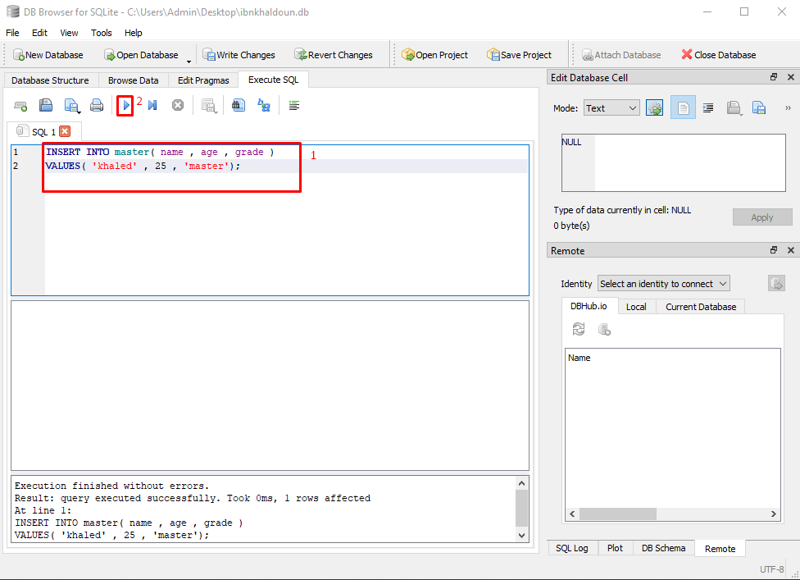
Data Insertion
Write the query “insert into”
Execute the code

Slide 40
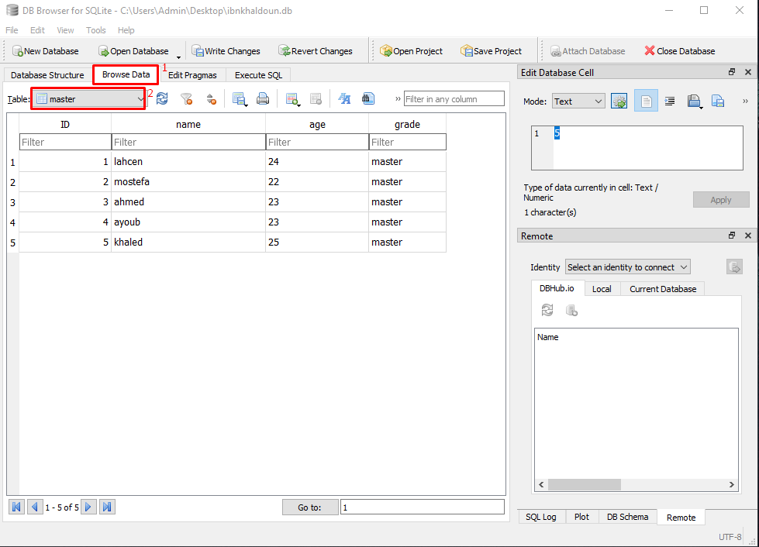
Data Selection
Select on “browse data”
Select the table
- And you will see the data in this table

Slide 41
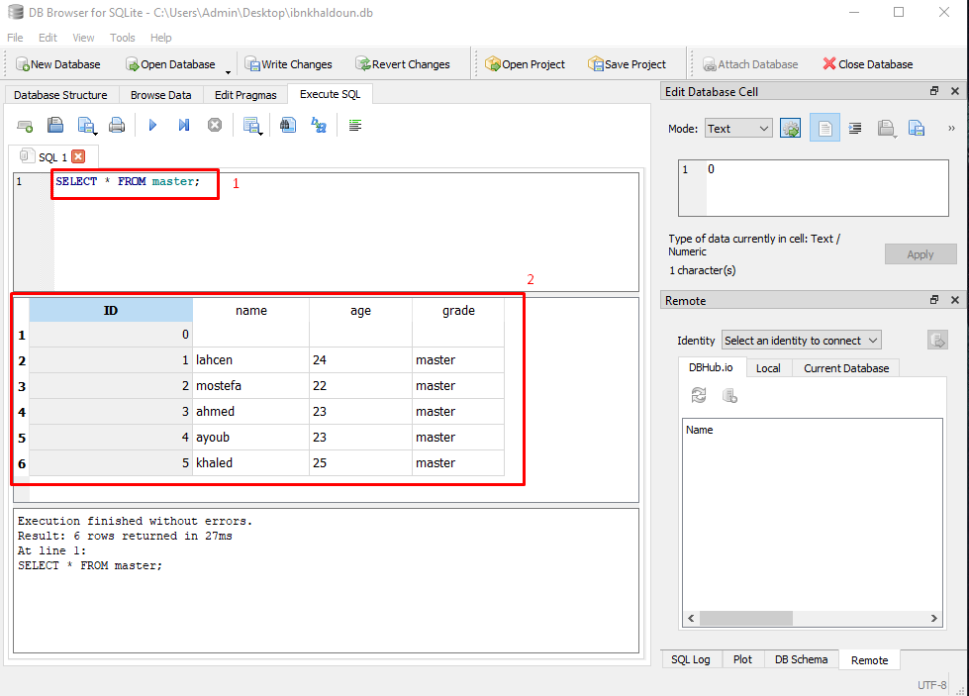
Data Selection
Write the query “select * ”
Execute the code

Slide 42
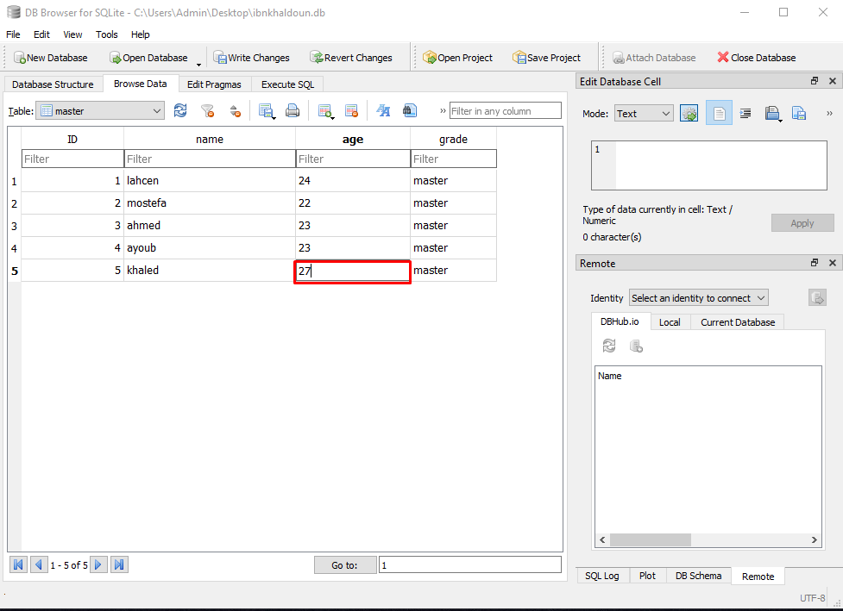
Data Update
- On browse data select the field you want to update and change the value and hit enter to save your changes

Slide 43
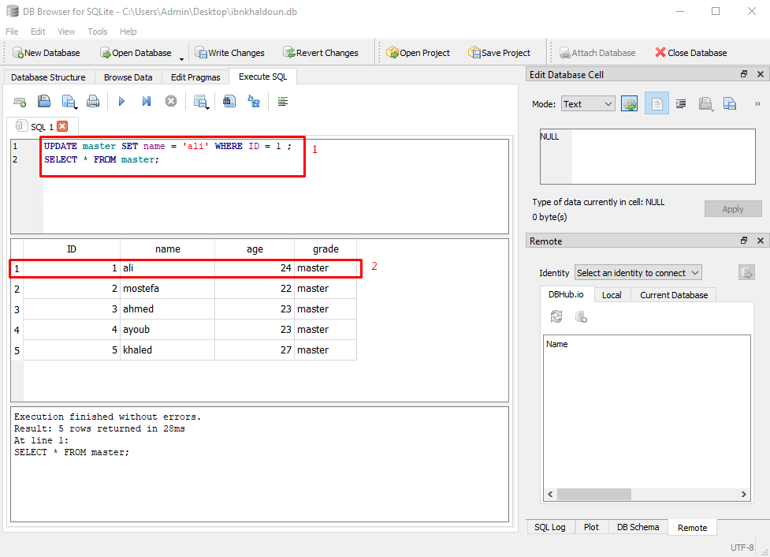
Data Update
Write the query “Update”
The data is updated successfully

Slide 44
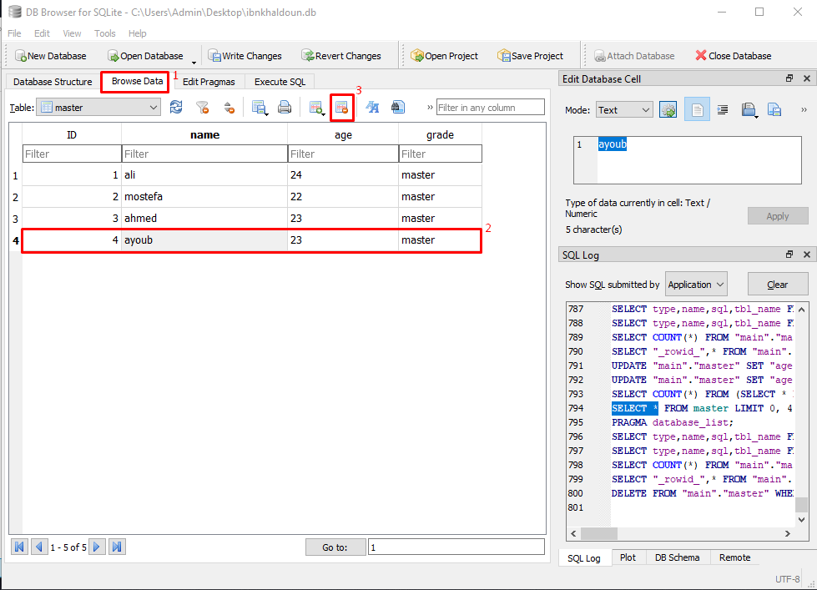
Data Suppression
Select on browse data
Select a row
Click on the button to delete the row

Slide 45
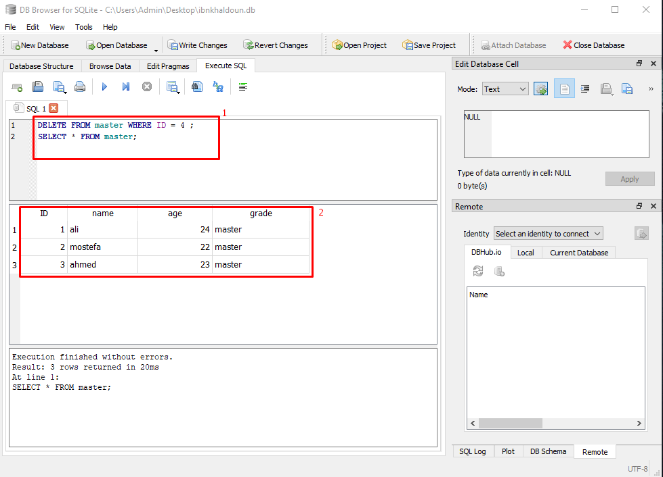
Data Suppression
Write the query “delete ”
The row is deleted

Slide 46
DCL (Data Control Language)

Slide 47
Access privileges Management doesn’t
exist in SQLite we will explore this point
further below.

Slide 48
TCL (Transaction Control Language)

Slide 49
SQLite Languages
We find in this language:
LOCKS
COMMIT
ROLLBACK
SAVEPOINT

Slide 50
Locks
There are 5 types of locks in SQLite, for each one of them there’s a lock unless the « unlocked » type which has no locks :
UNLOCKED : No session can do anything on data
SHARED : In this state, many sessions can read data simultaneously but, none can write.
RESERVED : One session at a time can write on the DB, this state can coexist with the state SHARED, changes will be stored in cache and won’t be modified on the disk.
EXCLUSIVE : Only when a session tries to validate changes or transactions
PENDING : Is when the process that hold the lock would like to write in the DB when possible and waits for all the shared locks are deleted so it can get the EXCLUSIVE lock.

Slide 51
Transactions Types
DEFERRED : By default a transaction is DEFERRED (doesn’t obtain any lock until necessairy).
IMMEDIATE : An IMMEDIATE transaction gets a RESERVED lock once the command BEGIN is executed.
EXCLUSIVE : An EXCLUSIVE transaction gets an EXCLUSIVE lock on the DB it guarantees that no other session is active in the DB and you can write or read from it with no conflicts.

Slide 52
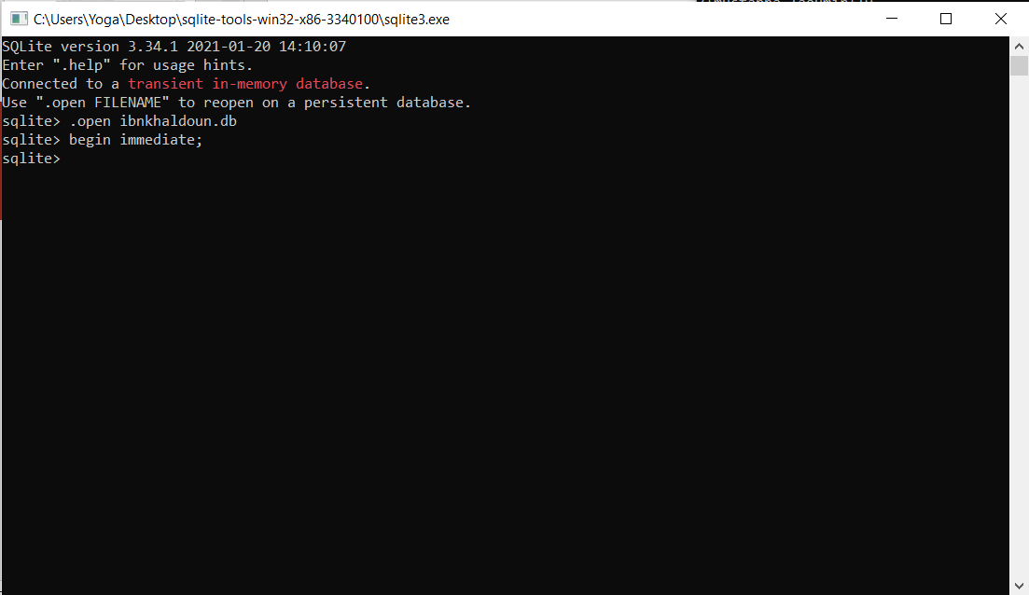
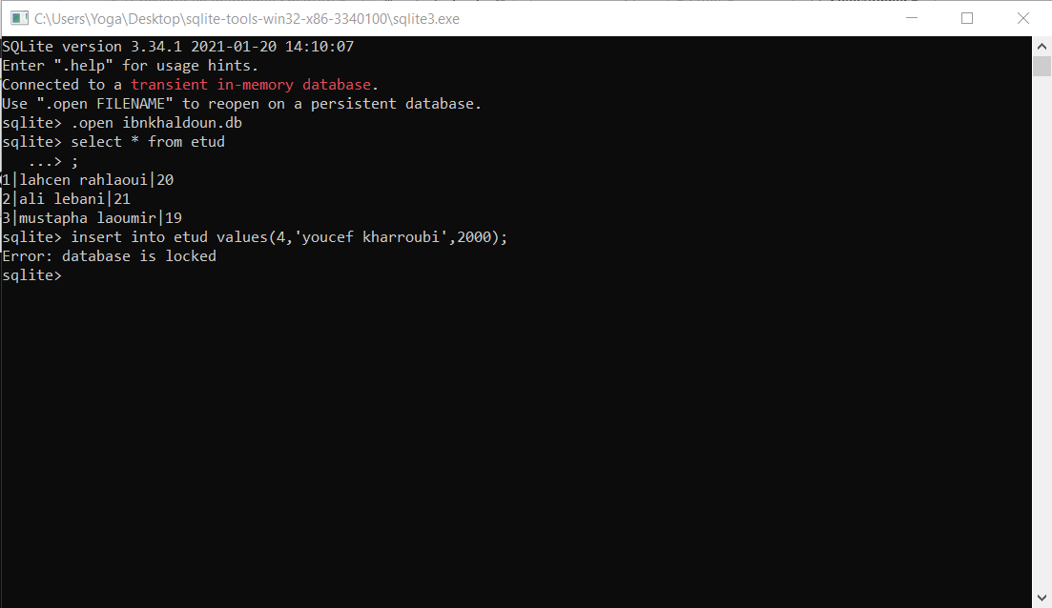
BEGIN IMMEDIATE
Example : Two sessions simultaneously , writing is locked.

Slide 53
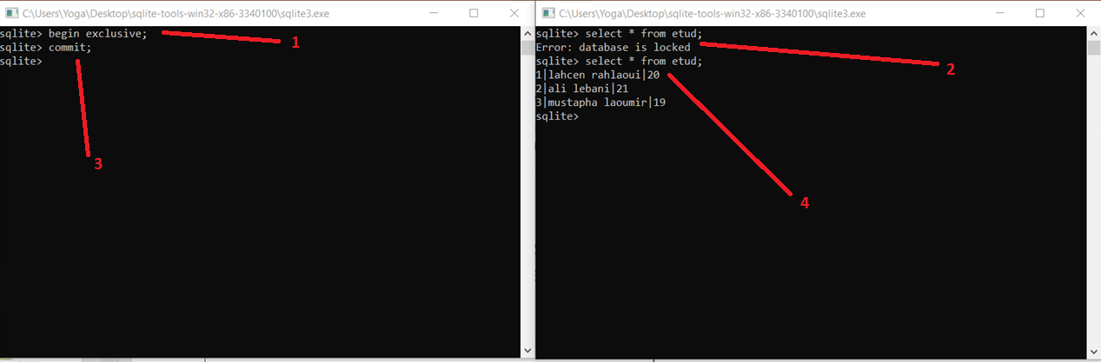
BEGIN EXCLUSIVE et COMMIT
Example : Two sessions simultaneously, Read and Write are locked.

Slide 54
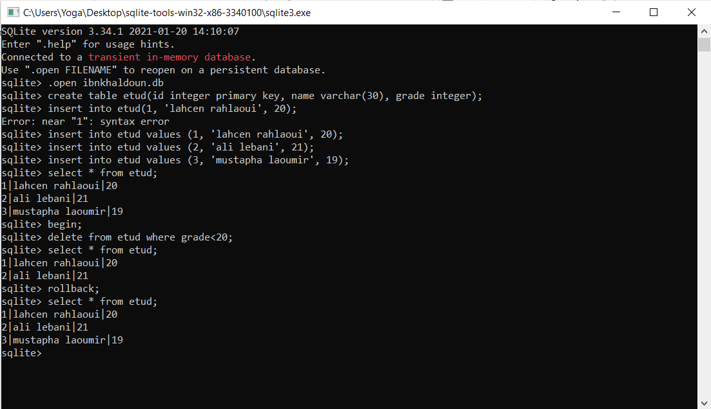
BEGIN and ROLLBACK
Example :
Deleted user that has
Grade<20
Then rollback to
Have the data
again.

Slide 55
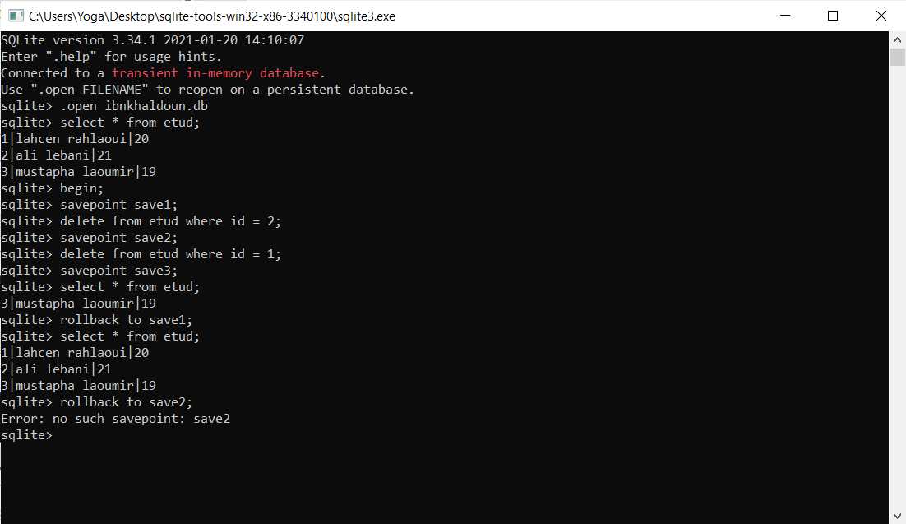
SAVEPOINT et ROLLBACK TO
Example :
Creating savepoints and rolling back to them.

Slide 56
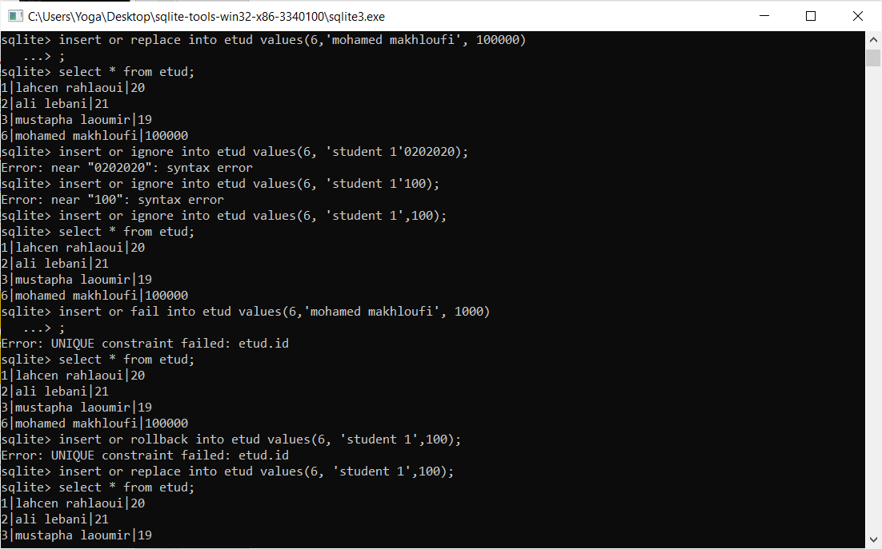
REPLACE, IGNORE, FAIL, ABORT
Example :
Data insertion that violates integrity consraints

Slide 57
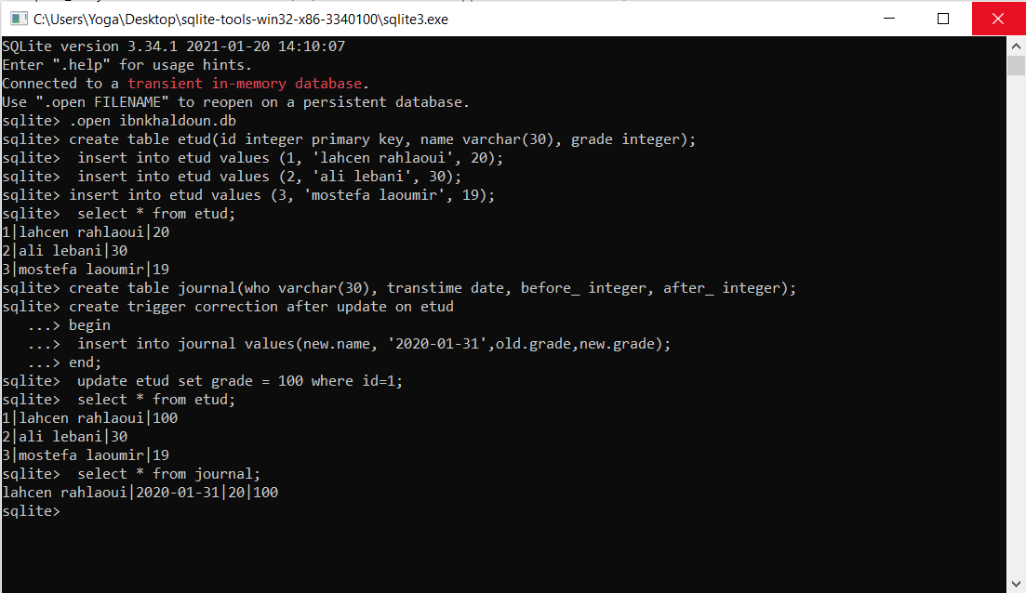
Journalisation with TRIGGERS
Example :
journal saving of a transaction using a trigger.

Slide 58
Importance of DBMS Interfaces
DBMS are just like any software, needs an interface to :
Access and use the various services and features
Check the correct functioning of the system
System maintenance

Slide 59
Utilization of interactive interfaces
Utilization of SQL through command line
Utilization of SQLite tools like « DB Browser for SQLite »

Slide 60
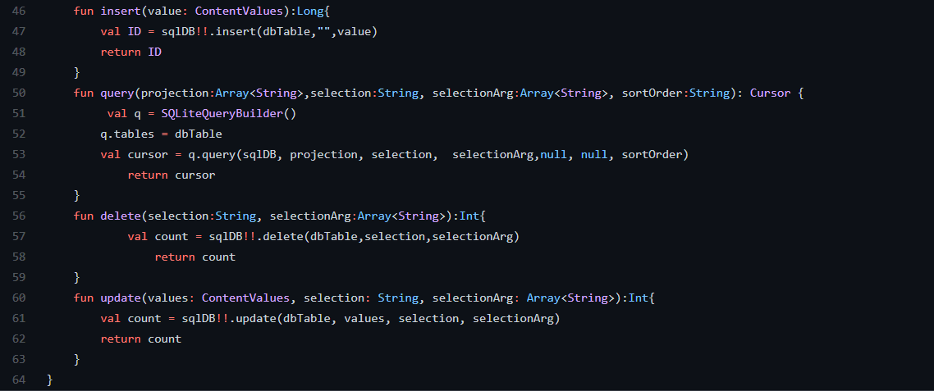
L’utilisation d’interface programmée
C’est l’interrogation du SGBD SQLite Via Un langage de programmation en utilisant SQL
Exemple : Insertion, Delete and Update in table through Kotlin language in Android

Slide 61
Metadata

Slide 62
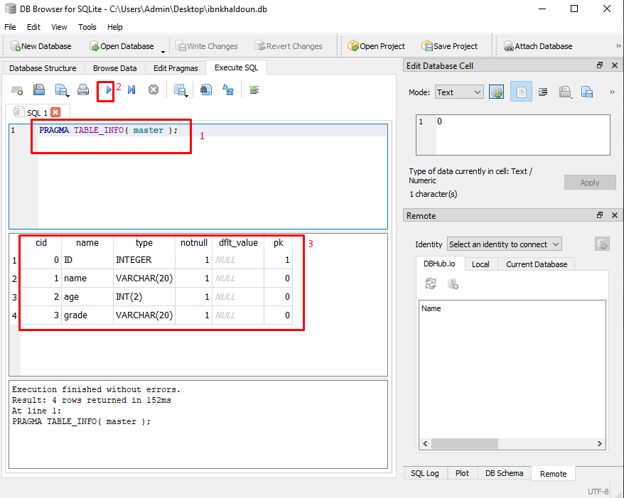
MetaData
Write the query “pragma table_info() ”
Execute the code
The result about the table “master”

Slide 63
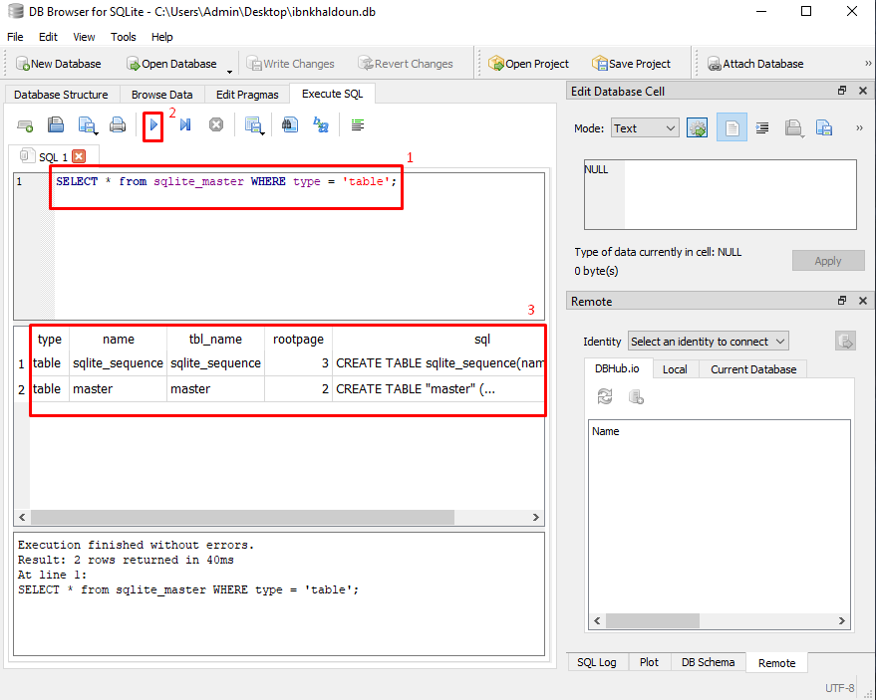
MetaData
Write the query “select * ” types that like table
Execute the code
The result is all the table in the database

Slide 64
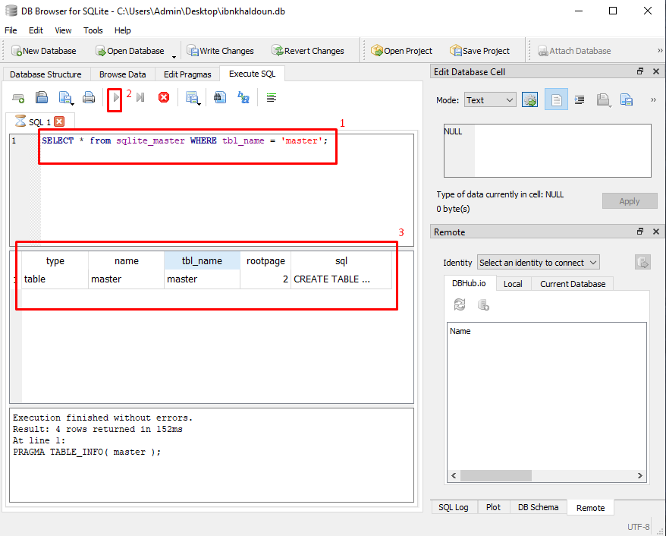
MetaData
Write the query “select *” and specify the table
Execute the code
The result is all tables “master” in the database

Slide 65
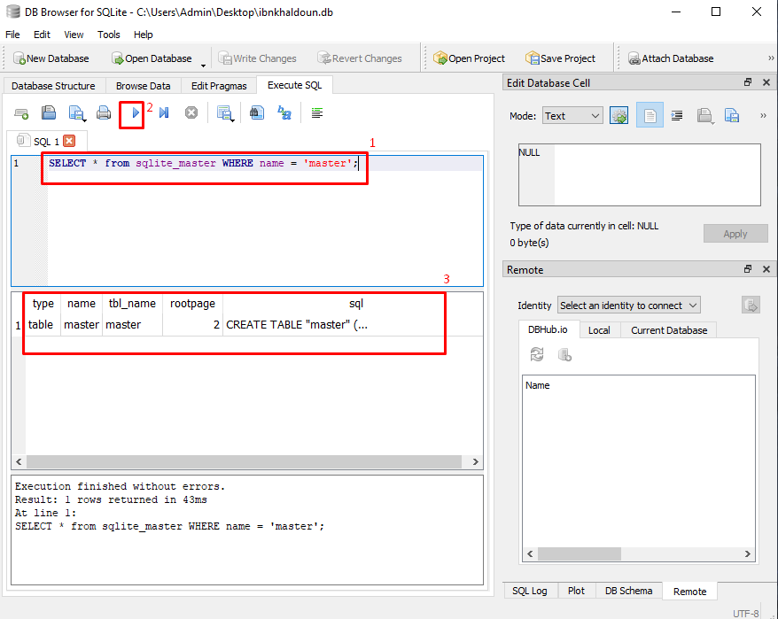
MetaData
The same as the last slide
Write the query “select *” and specify the table
Execute the code
The result is all tables “master” in the database

Slide 66
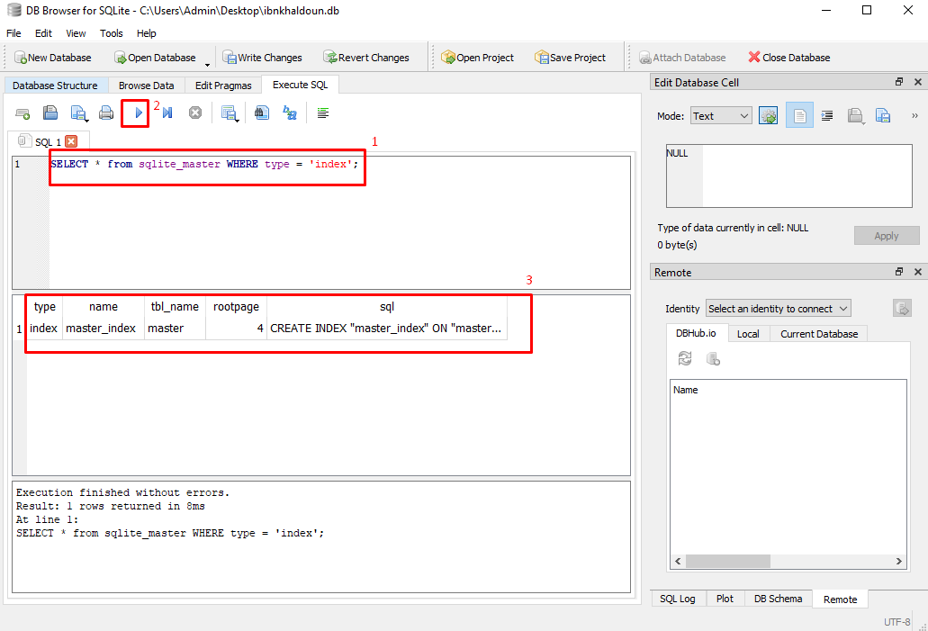
MetaData
Write the query “select *” types index
Execute the code
The result is all the indexes in the database

Slide 67
Security and
Access Permisions

Slide 68
The importance of Security in DBMS
Asserting Confidentiality : protection against data theft and infiltrations
Asserting Data Integrality
Block unauthorized Access

Slide 69
Access Permissions in SQLite
SQLite does not provide a control mechanism to access permissions
The only Access Permission is the one provided by the Operating System

Slide 70
Why the lack of SQLite Access Rights?
Number of users is Limited
Considered to be structured system files
Very low probability of attack or intrusion

