Slide 1

GROUP 6
SOFTWARE TESTING
GROUP ASSIGNMENT

Slide 2


Tip: Use links to go to a different page inside your presentation. Links work best for pages like this one!
How: Highlight text, click on the link symbol on the toolbar, and select the page in your presentation that you want to connect.
1
Introduction
Kindly delete this note after editing this page. Thank you!
Pyweb
2
Test case design and coverage
Website application
3
Bug Report
4
Performance Testing

Slide 3

1. Introduction
Brief introduction of our project
Flask + MySQL

Slide 4
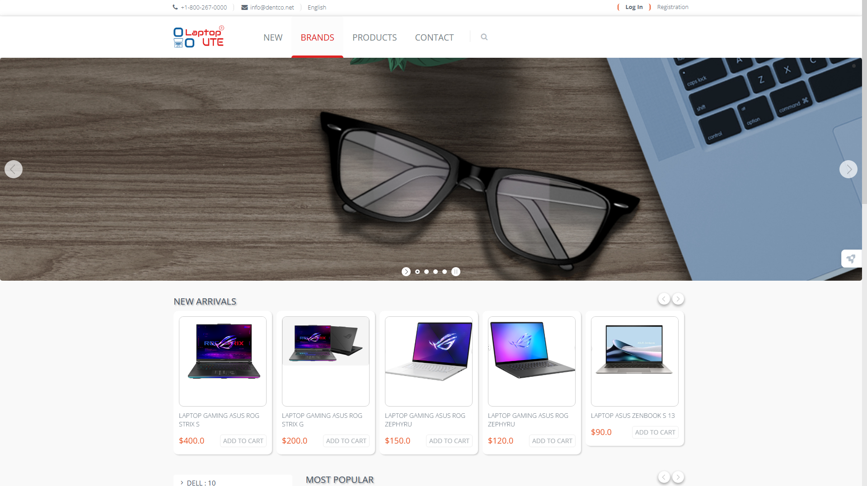
Website Application

Slide 5

We will focus on:
+ Front-end Testing
+ Back-end Testing
+ Security Testing
+ Performance Testing

Slide 6


TEST ON DIFFERENT BROWSER
Google Chrome
Microsoft Edge

Slide 7

2. Test case design and coverage
— A little about test case design and coverage

Slide 8
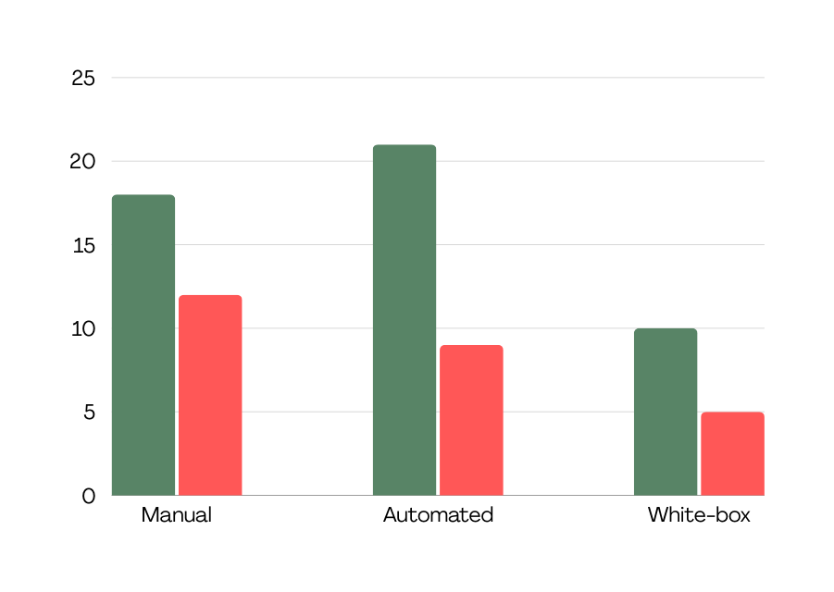
Bar chart of testing types
31
2. Test cases
18
12
Briefly elaborate on test cases.
12
9
5
: pass
: fail

Slide 9
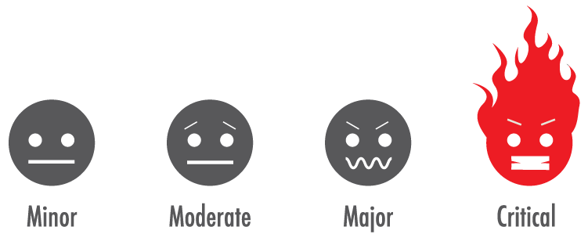
3. Bug Report
Summary
Minor
Major
Critical
There are 3 minor severities.
There are 10 major severities.
There are 2 critical severities.

Slide 10

Take a break
Does anyone have a question about the parts I’ve just mentioned ?

Slide 11

4. Performance Testing
Apache Jmeter:
Tool for performance testing

Slide 12
Case 1: Standard Response Testing
3 cases:
Case 2: Test with Parameters
Case 3: Stress Test

Slide 13
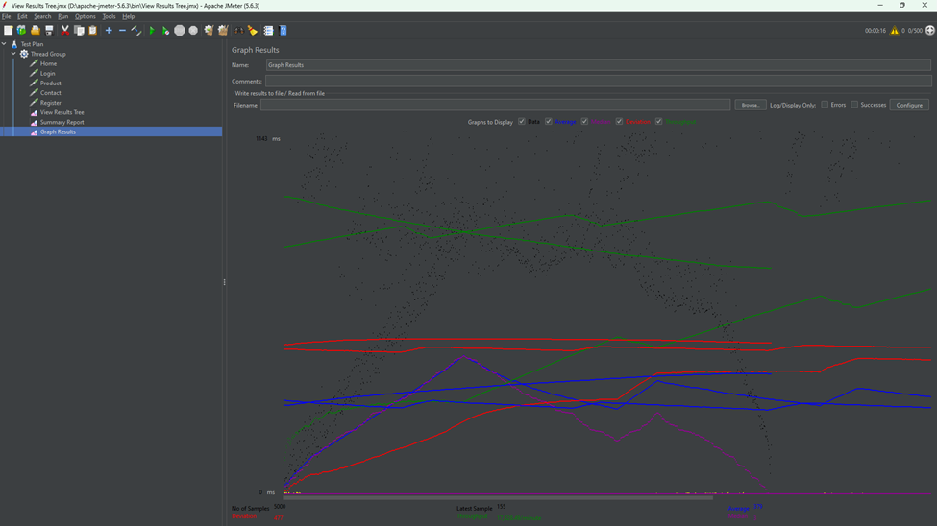
Standard Response Testing
01
5 main paths of website:
+ Homepage
+ Login Page
+ Product Page
+ Contact Page
+ Register Page
Graph Results

Slide 14
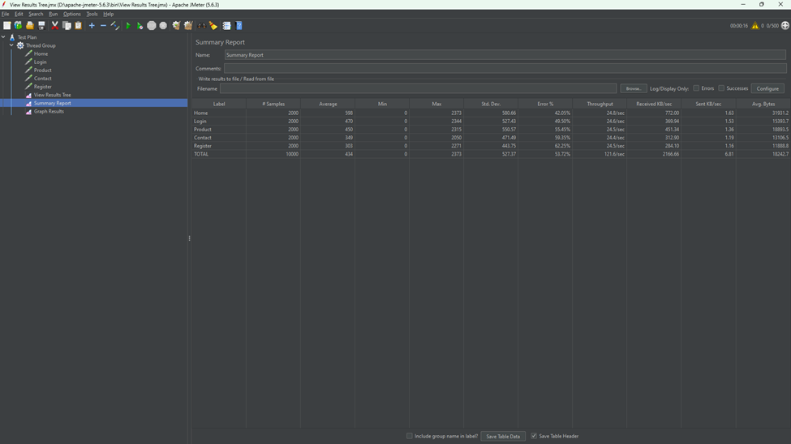
Standard Response Testing
01
5 main paths of website:
+ Homepage
+ Login Page
+ Product Page
+ Contact Page
+ Register Page
Summary Report

Slide 15
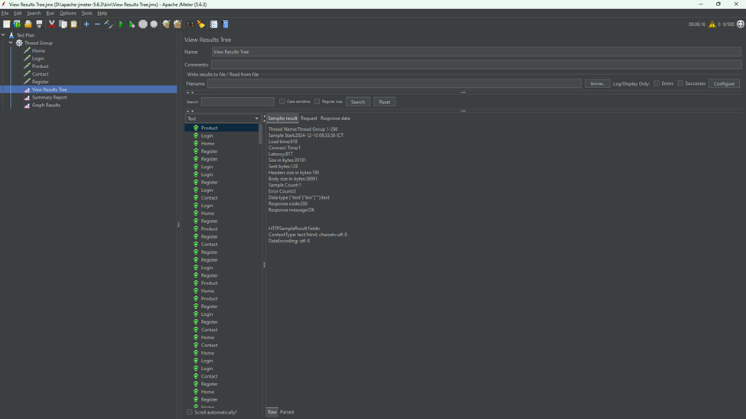
Standard Response Testing
01
5 main paths of website:
+ Homepage
+ Login Page
+ Product Page
+ Contact Page
+ Register Page
View Results Tree

Slide 16
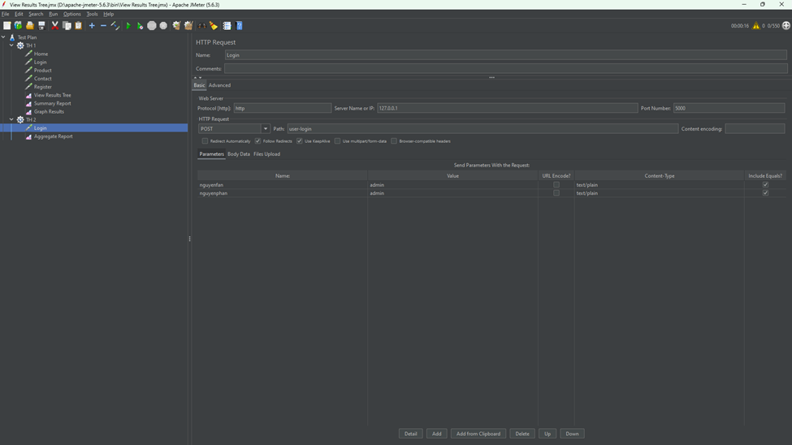
Test with Parameters
02
Parameters with login
Config thread group of case 2

Slide 17
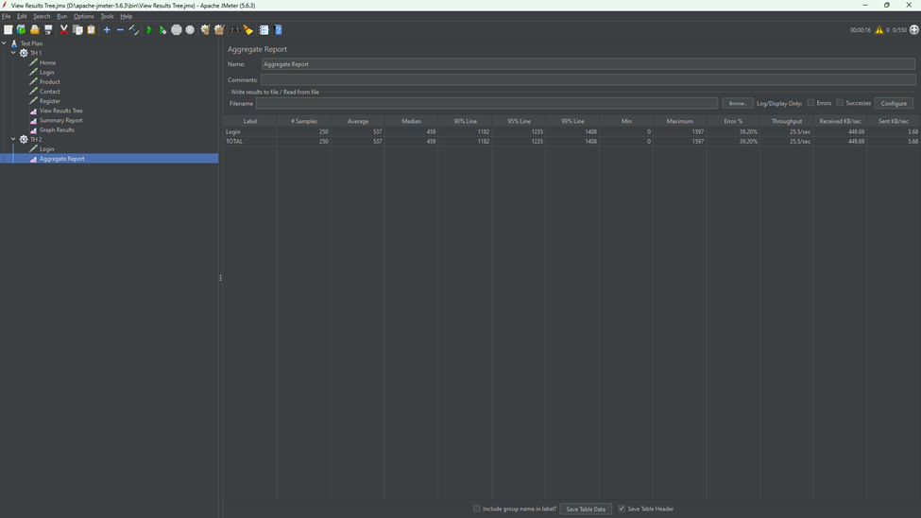
Test with Parameters
02
Parameters with login
Aggregate Report

Slide 18
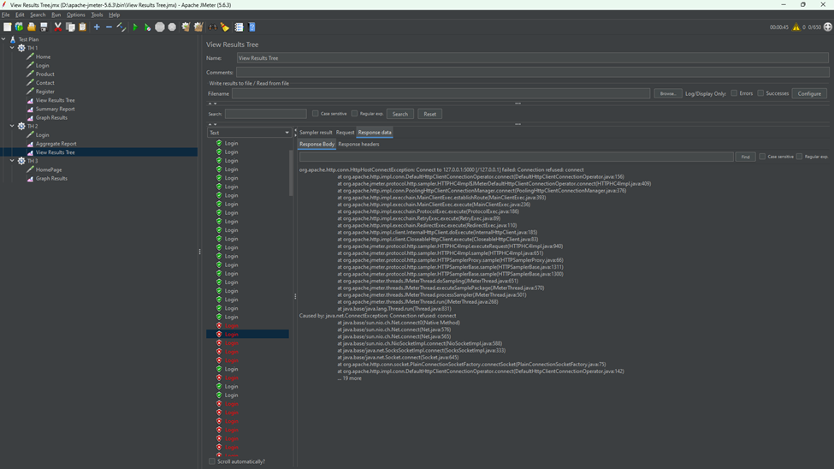
Test with Parameters
02
Parameters with login
View Results Tree

Slide 19
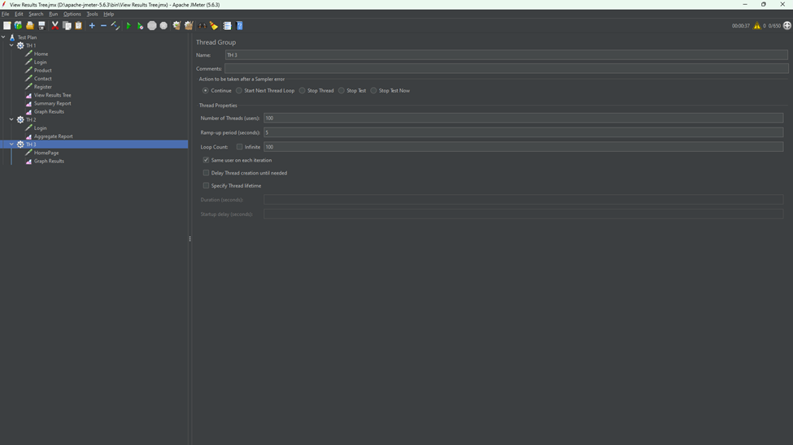
Stress Test
03
Website load testing
Config thread group of case 3

Slide 20
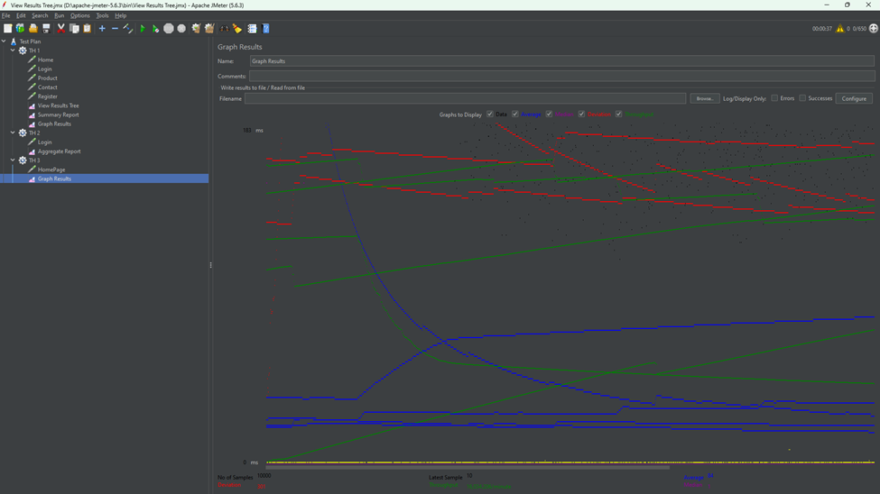
Stress Test
03
Website load testing
Config thread group of case 3

Slide 21
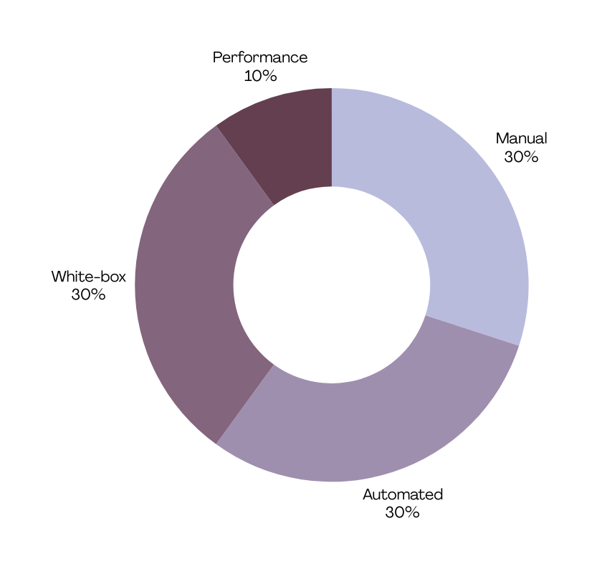
Summary:
Total test cases:
+ Pass: 61
+ Fail: 26
Overall Assessment: PyWeb has good performance, high load capacity and fast response time. However, check for unusual requests to improve stability.

Slide 22
Test Cases For API Testing
Test Cases For Login Page
Test Cases For Registration Page
Test Cases For Banking Application
Test Cases For E-commerce website
Test Cases For Search Functionality
Preferences:

Slide 23

Thank you for listening!
Thank gpt and claude for supporting us! ^^
Does anyone have a question for us?

