Slide 1
Learning Management System – NSBM

Slide 2
Project name: Learning Management System – NSBM
Purpose: Learning Management System is a web application for NSBM, that manages, retrieves and stores the student’s details, course details and module details also. Due to this web application we can identify the new suggestions, drawbacks and the views of the students about their modules. Students are allowed to find useful information for Student Societies, Clubs and Student Activities. And also, I think that this is a good opportunity to establish the unity of the NSBM .Using this web application make a good bond between the NSBM.
Team Name:
Team Members: Dharmarathna R H K P W W L Pradeep BSC-PLY-COM-15.2-019 G Chamathka D Y BSC-PLY-COM-15.2-035 Himalka J K Ashan BSC-PLY-COM-15.2-037

Slide 3
Contribution of the team members
Dharmarathna R H K P W W L Pradeep: Created Login Page and the Responsive Part(Instead of using Bootstrap and used HTML 5, CSS3, Media Quarries).
Created the Comment Box by using PHP.
G Chamathka D Y: Created the structures of webpages by using HTML.
Created the Documentation, and all the designing parts.
Himalka J K Ashan: Created all the Internal pages of the website by using HTML and CSS.
Created the Calendar by using JS Libraries.
Created the Image Slider using JS Libraries

Slide 4
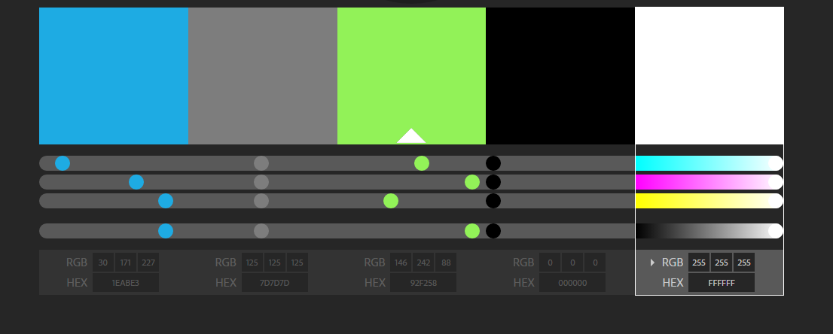
The colors what we used

Slide 5
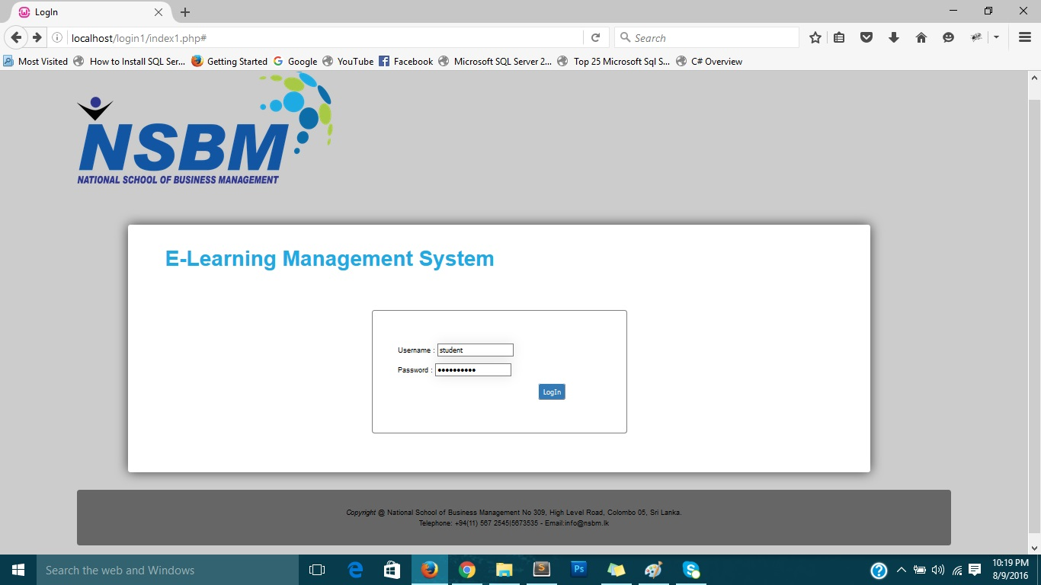
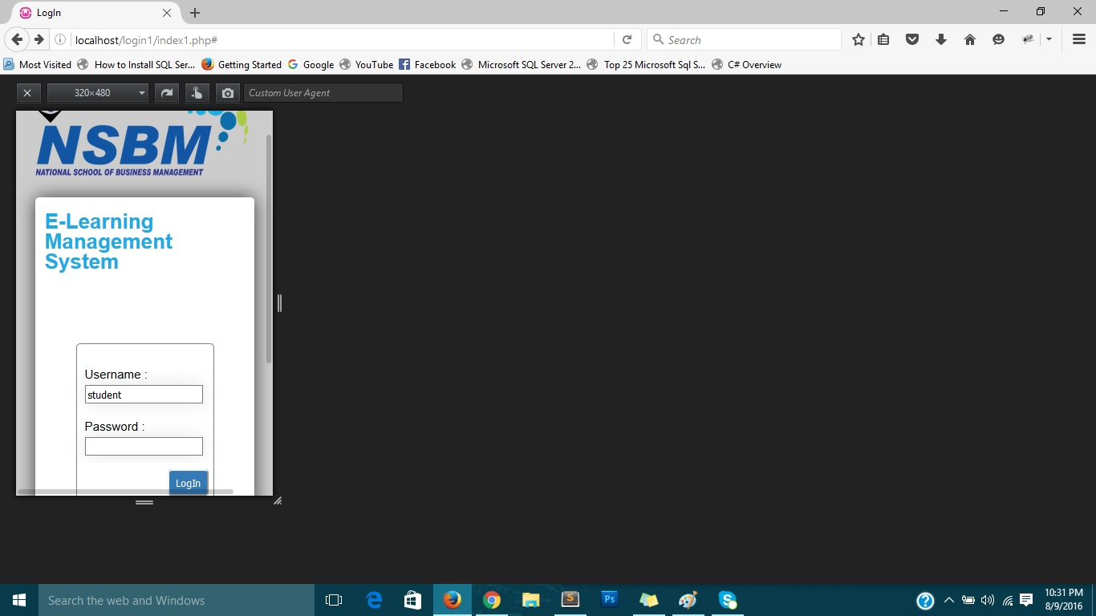
Responsive Part When we create the responsive of the webpage we never used Bootstrap, instead of bootstrap we used HTML5 and CSS (media queries) to create our webpages. Using media queries also we can create responsive webpage. We have tried to do this part in a different way. That is why we have created like this. Below images will prove that.
Login Page – Standard View
Login Page – Mobile View

Slide 6
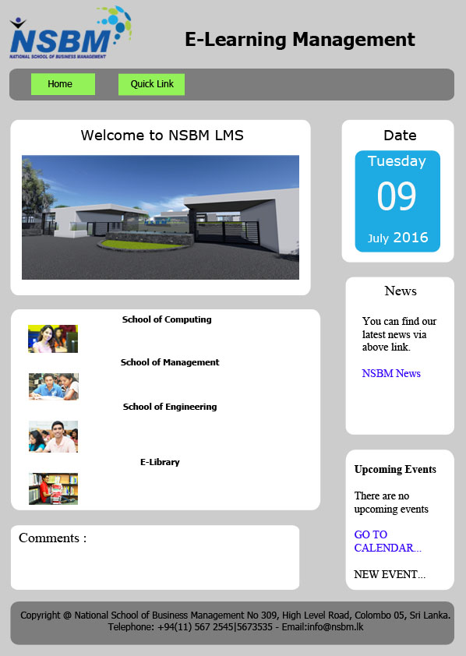
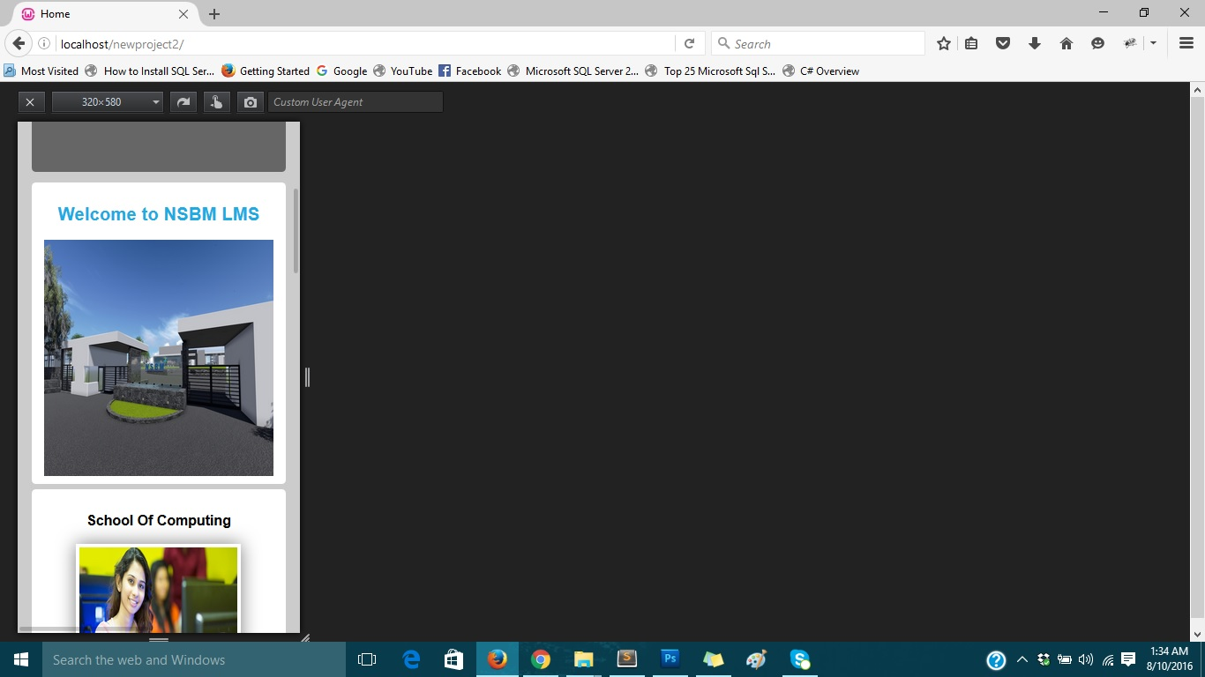
Home Page – Standard View
Home Page – Mobile View

Slide 7
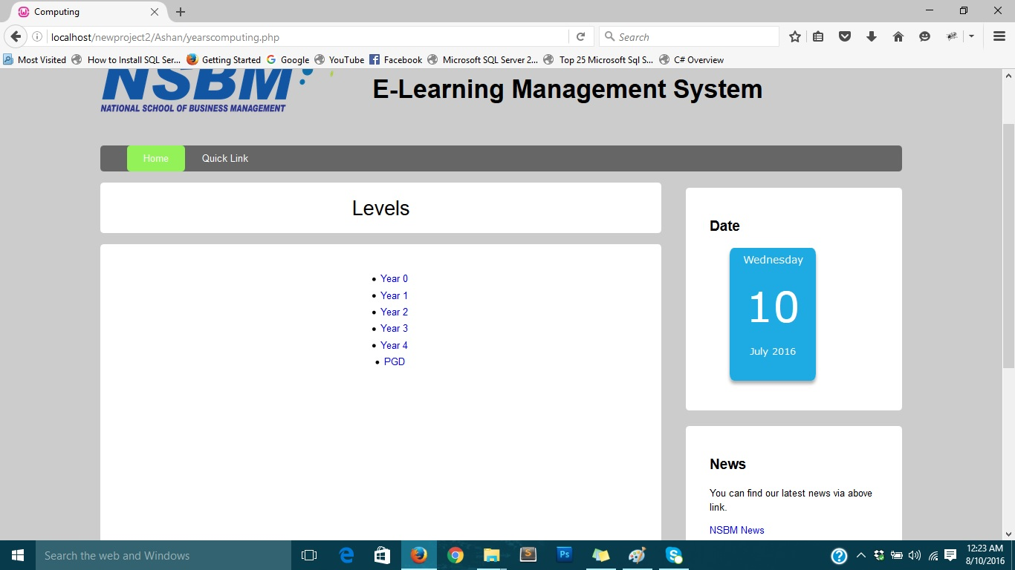
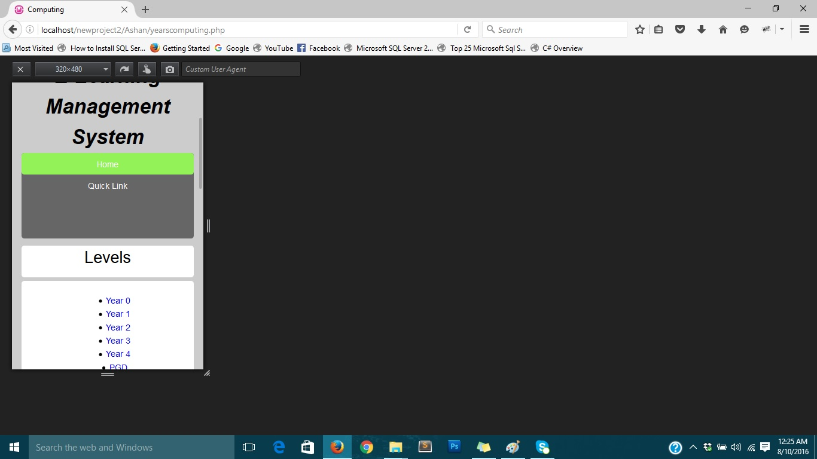
Computing Page – Standard View
Computing Page – Mobile View

Slide 8
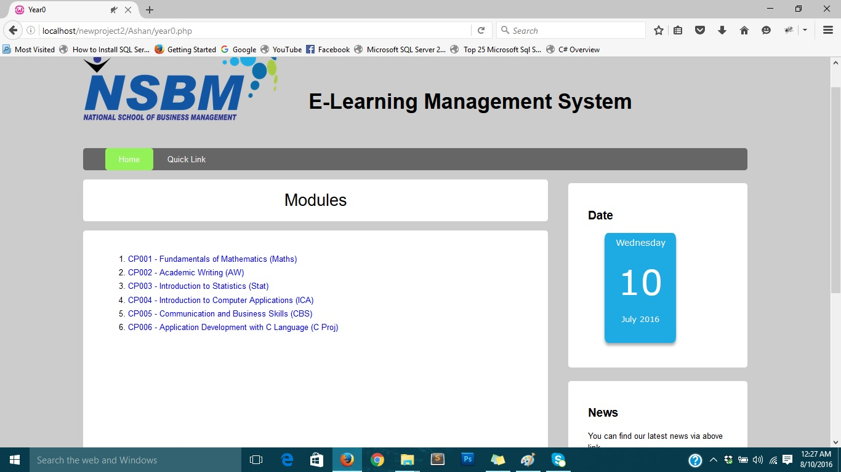

Modules Page – Standard View
Modules Page – Mobile View

Slide 9
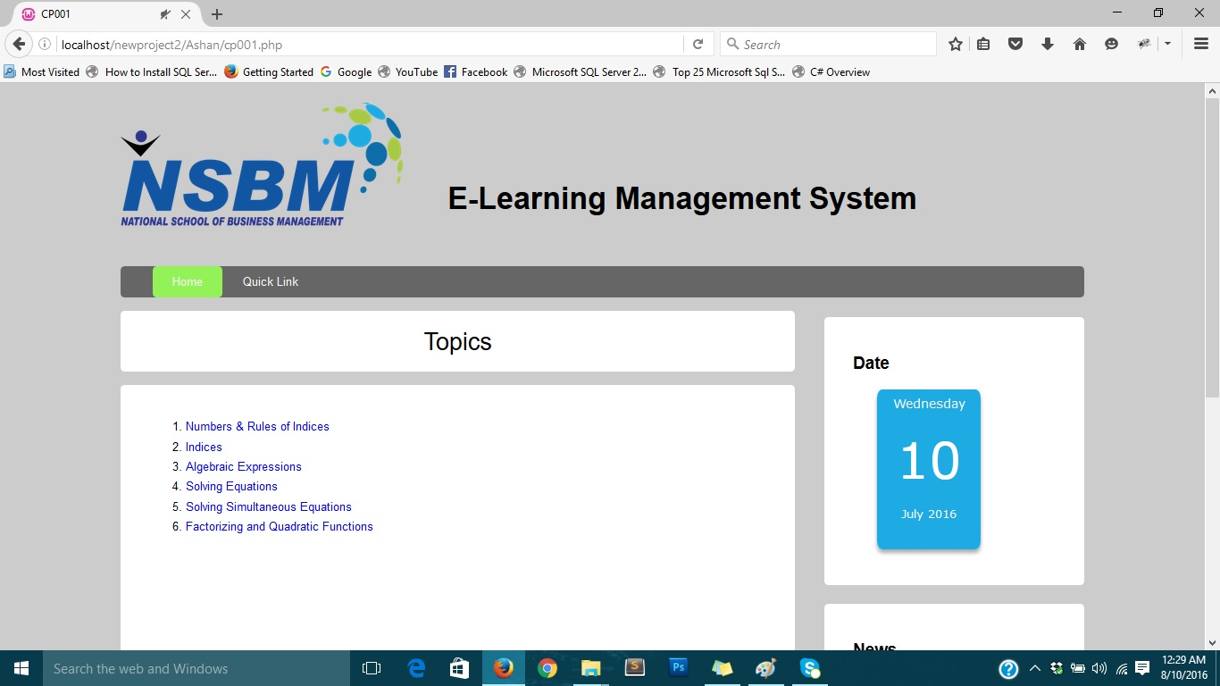
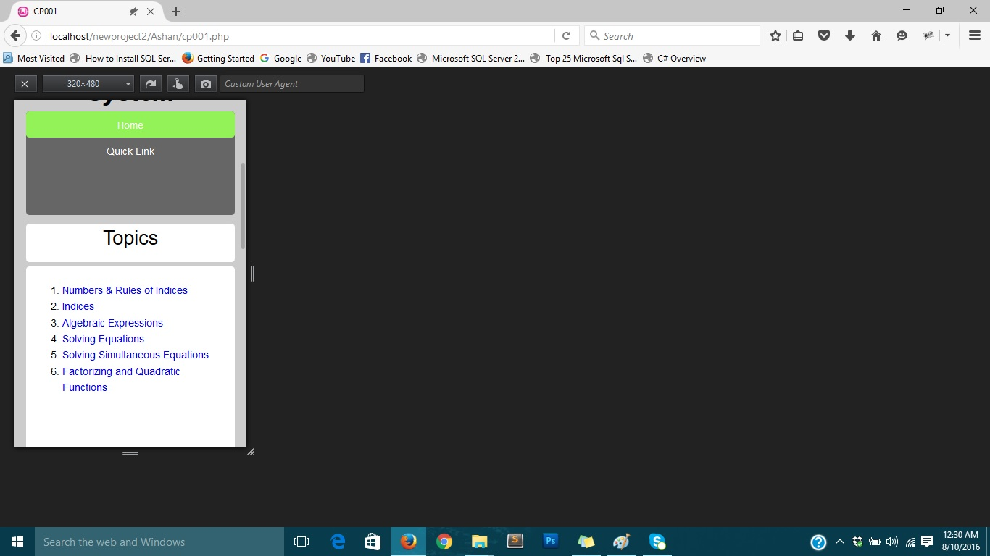
Topics Page – Standard View
Topics Page – Mobile View

Slide 10
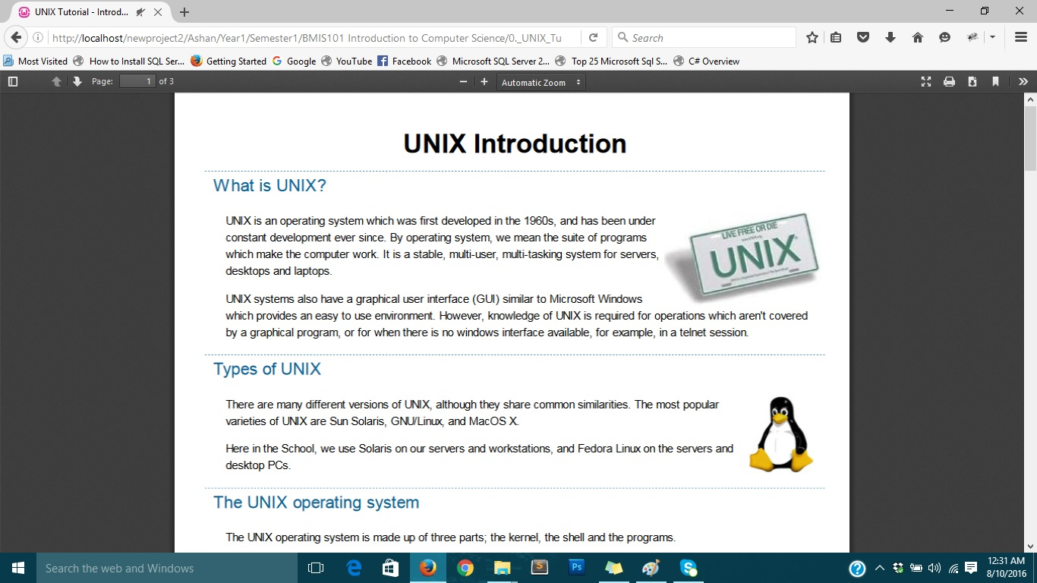
Sample File

Slide 11
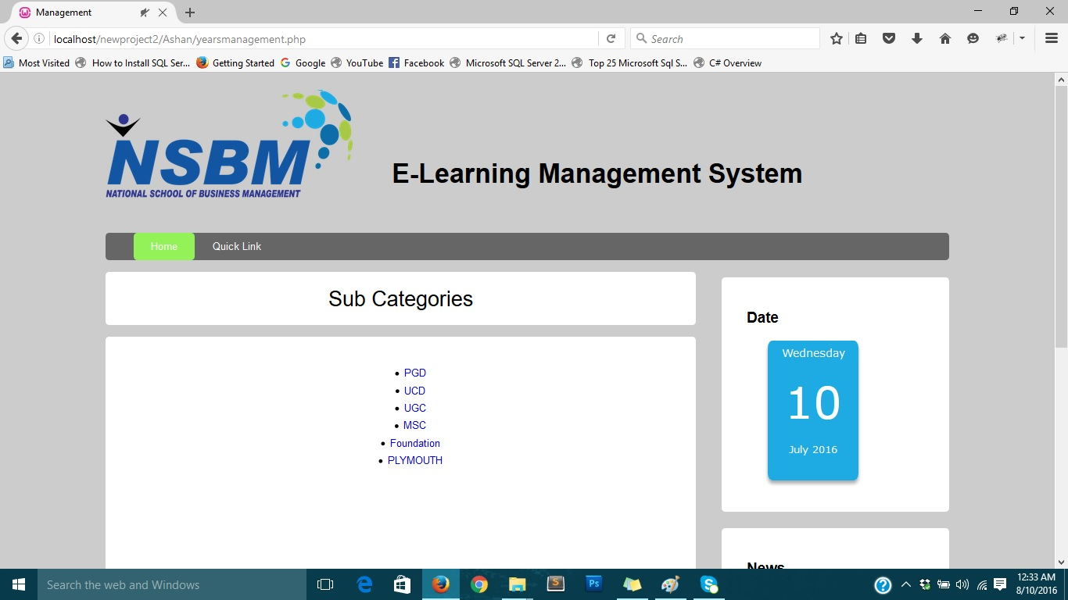

Management Page – Standard View
Management Page – Mobile View

Slide 12
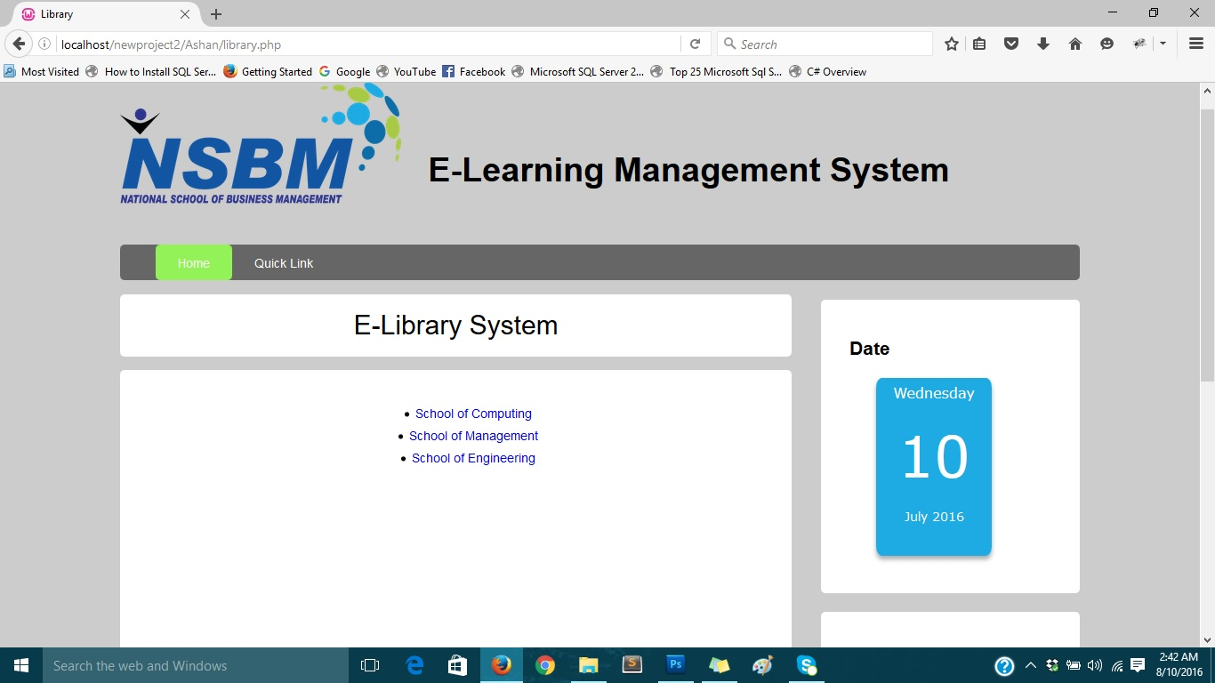
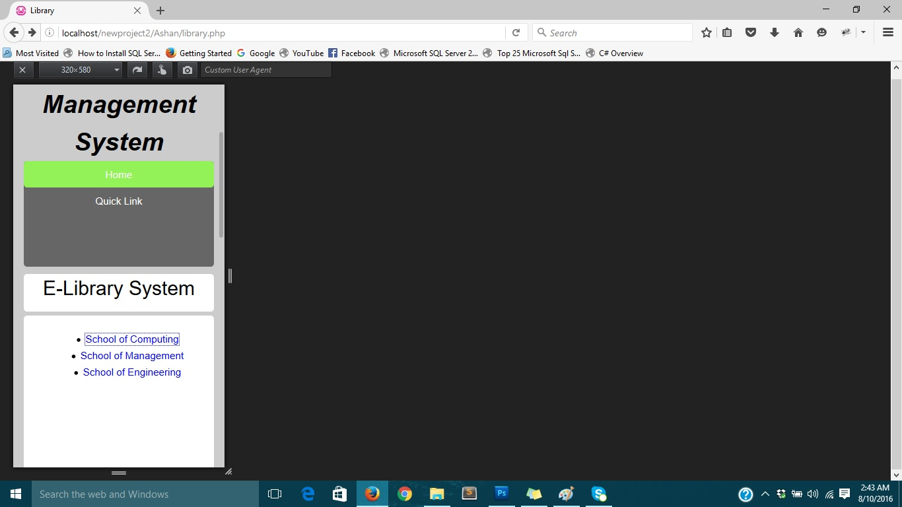
E-Library Page – Standard View
E-Library Page Page – Mobile View

Slide 13
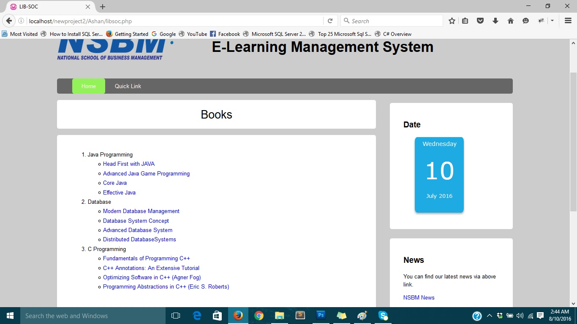
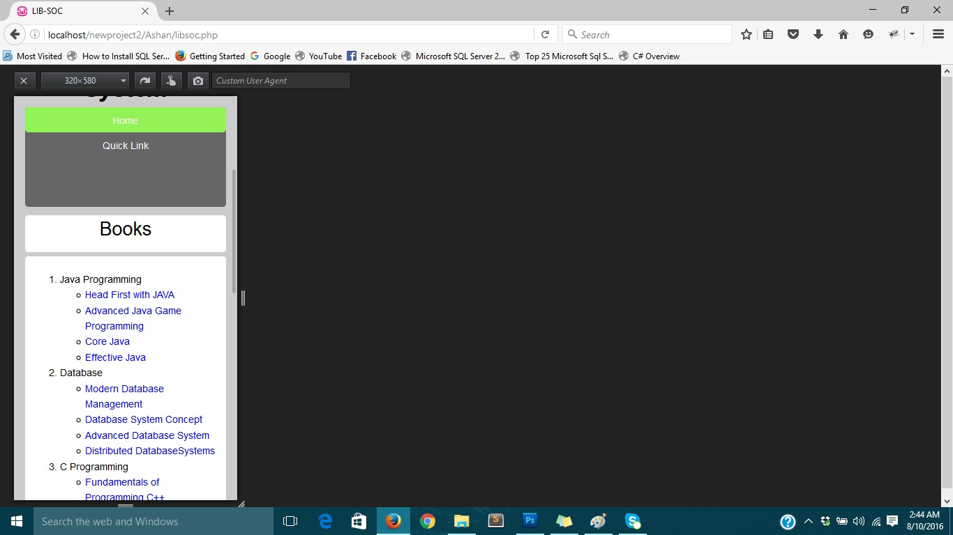
Library Computing Page – Mobile View
Library Computing Page – Mobile View

