Slide 1



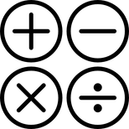

GROSS MOTOR SKILLS
SPEAKING SKILLS
BASIC MATHEMATICS
WRITING SKILLS
MULTISENSORY LEARNING TOOL FOR
CHIDLREN WTIH DOWN SYNDROME

Slide 2

INTRODUCTION
PURPOSE:
IMPROVE EDUCATIONAL, SOCIAL, AND HUMAN SKILLS FOR CHILDREN WITH DOWN SYNDROME (AGES 5-10) IN SRI LANKA.
PROBLEM:
LIMITED ACCESS TO AFFORDABLE, EFFECTIVE EDUCATION TOOLS; CHALLENGES IN WRITING, SPEECH, MATH, AND MOTOR SKILLS.
SOLUTION:
AFFORDABLE, E-LEARNING PLATFORM FOR HOME USE.
KEY FEATURES:
FOCUSES ON 4 AREAS: WRITING, SPEECH, MATH, GROSS MOTOR SKILLS
USER-FRIENDLY, LOW-COST, AND MODERN.

Slide 3
BACKGROUND & RESEARCH PROBLEM
Background:
In Sri Lanka, children with Down syndrome lack proper education.
Many face delays in reading, writing, math, and movement skills.
Research Problem:
Schools lack special classes, trained teachers, and enough resources.
Parents struggle to teach their children at home without proper guidance.
Most learning tools are expensive or complex.
Current teaching methods are not effective enough.
Expensive medical support.
Gap:
No widely available, parent interactive, low-cost solutions.

Slide 4
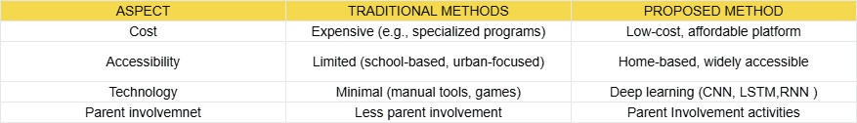
RESEARCH GAP
Challenges Identified:
Writing: Limited tools for hand writing skills.
Speech: Pronunciation delays affect communication.
Math: Difficulty with basic concepts; Finger Math helps.
Gross Motor: limits physical activity apps.

Slide 5
RESEARCH GOALS
Objective: Improve quality of life for Down syndrome children in Sri Lanka.
Target Audience: Low-income families with limited resources.
Approach:Multisensory learning (visual, auditory, kinesthetic).
Parental involvement for supervision (30 mins/day).
Make it easy for parents and teachers to use.

Slide 6
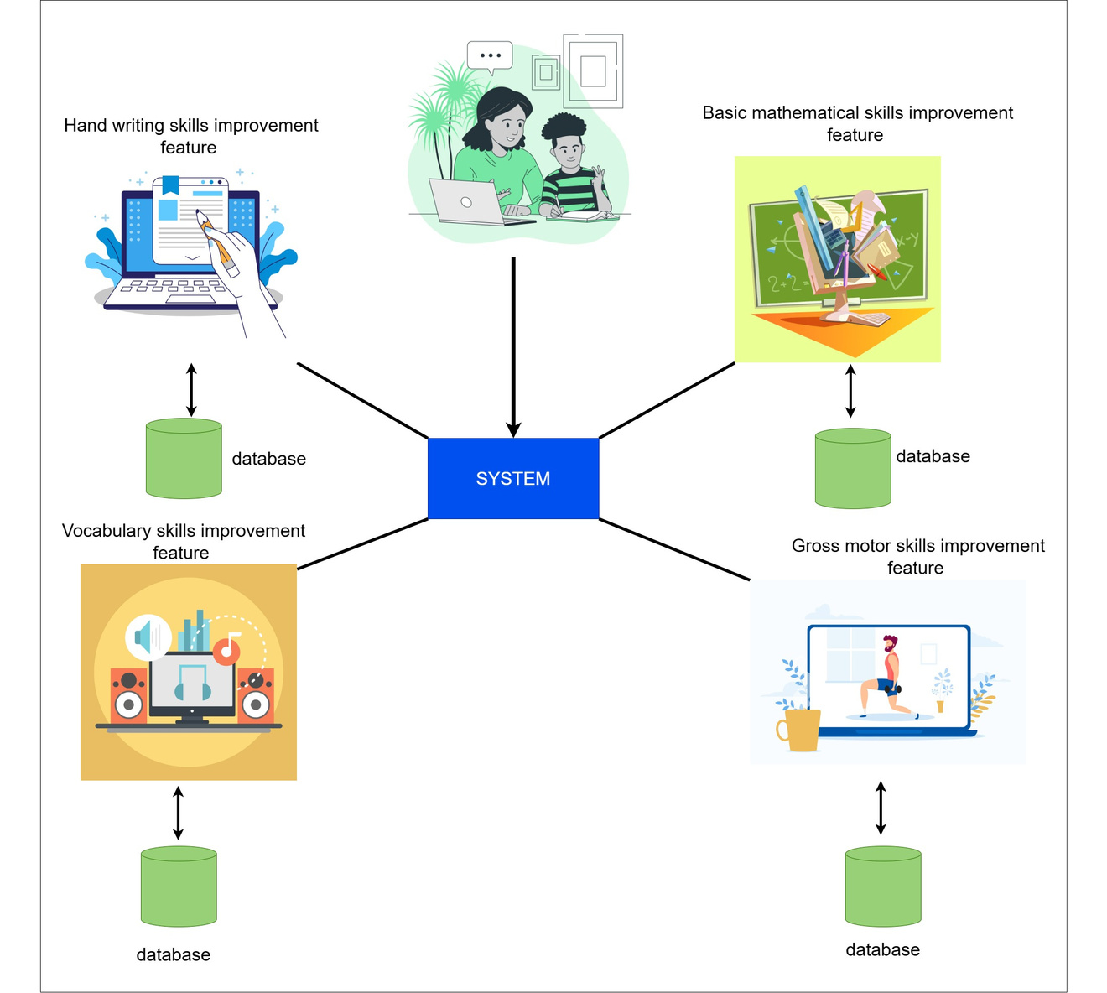
SYSTEM OVERVIEW

Slide 7

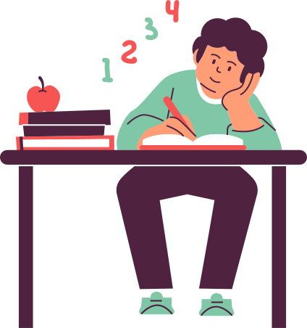
TEACHING BASIC MATHEMATICS USING FINGER MATHS
Goal:
Teach children with Down syndrome numbers and basic arithmetic using finger maths.
Why It Matters:
Maths is hard for kids to grasp.
Finger Math uses touch and visuals to make learning concrete.
Fact:
All humans learn numbers and math using fingers as kids because moving fingers helps the brain remember numbers with muscle memory.
Target Skills:
Number recognition, sequences, addition, subtraction

Slide 8
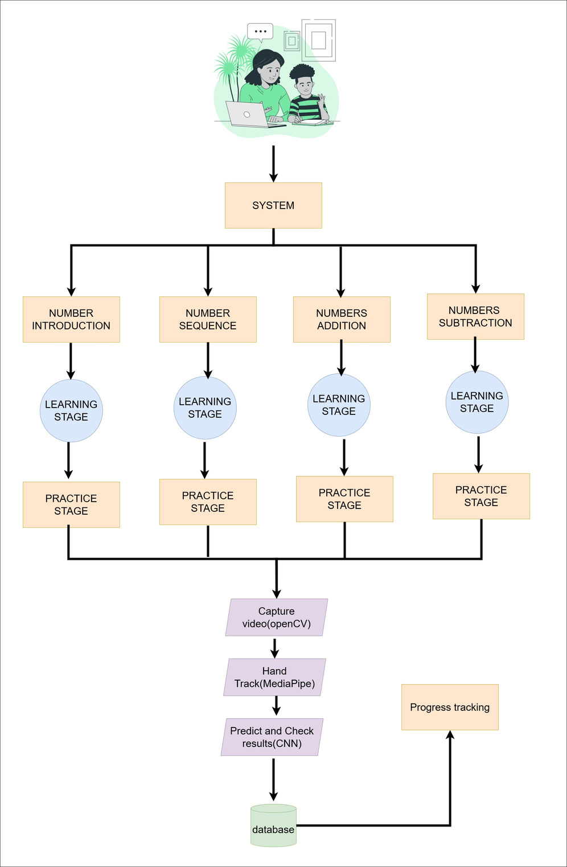
METHODOLOGY
Approach:
Stage 1: Learn single digits (0-10) with images and Sinhala audio and practice.
Stage 2: Learn number sequences (e.g., 1, 2, 3…) and practice.
stage 3:Learn Addition of two numbers and practice
stage 4:Learn Subtraction of two numbers and practice
Technology:
Zustand: State management
CNN: Recognizes hand gestures from video input.
MediaPipe & OpenCV: Real-time finger tracking (by key points).
Exercises:
Number identification, sequence, addition, subtraction.

Slide 9
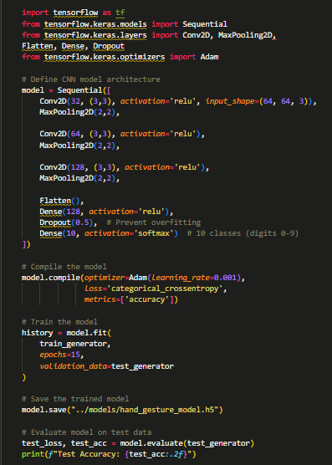
METHODOLOGY
Dataset:
Kaggle "Sign Language Hand Gestures" (0-9 + Unknown).
CNN Model:
Input: 64x64 RGB images, normalized [0,1].
Layers: Convolutional (feature extraction), MaxPooling, Dense, Softmax.
Training:
80% train, 20% test; 15-20 epochs, batch size 32.
Enhancements:
Batch normalization for stability.
Dropout to prevent overfitting.
Real-Time: MediaPipe extracts 21 finger points; OpenCV captures video.

Slide 10
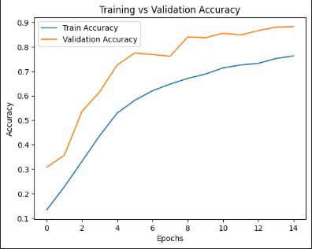
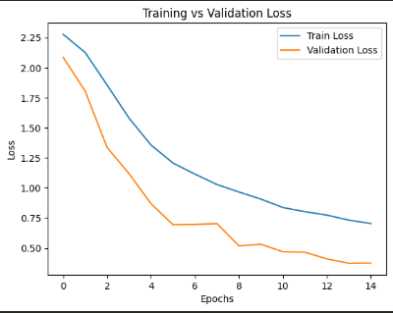
RESULTS
Performance:
Accuracy: 88%.
Loss: 0.35%.
Outcomes:
Correct gestures recognition(>0.6) predict the number.
Low-confidence gestures (<0.6) prompt "Unclear Gesture! Try Again."
Progress Tracking:
History logged for parents to identify weak areas.

Slide 11
BENEFITS & IMPACT
Benefits:
Engaging: Audio, visuals, and rewards boost memory.
Effective: Finger Math simplifies number comprehension.
Accessible: Real-time feedback at home.
Impact:
Improves math skills for daily life.
Empowers children and parents with an interactive tool.

Slide 12
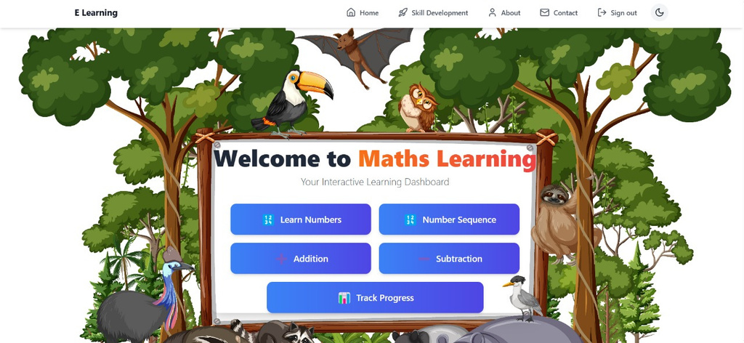
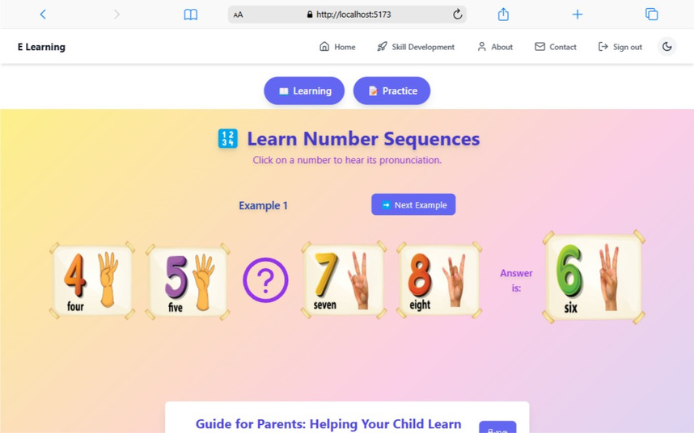
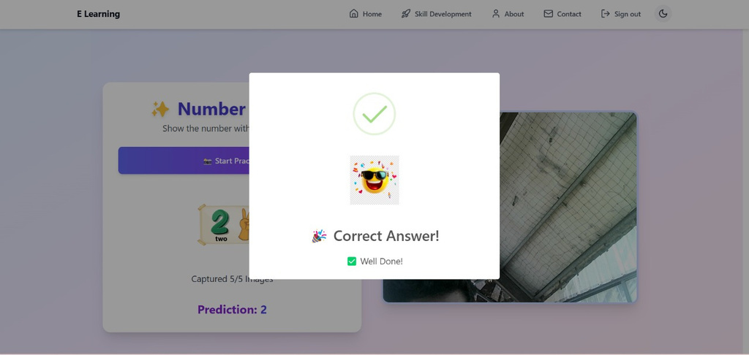
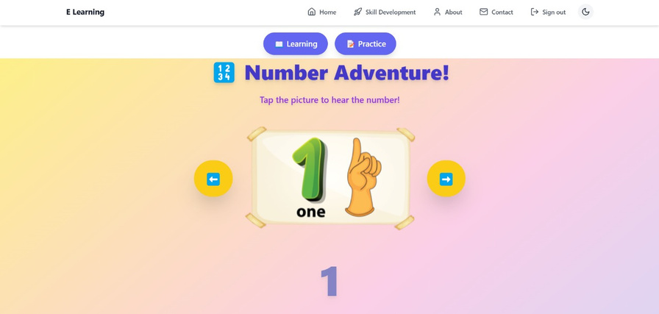
UI

Slide 13

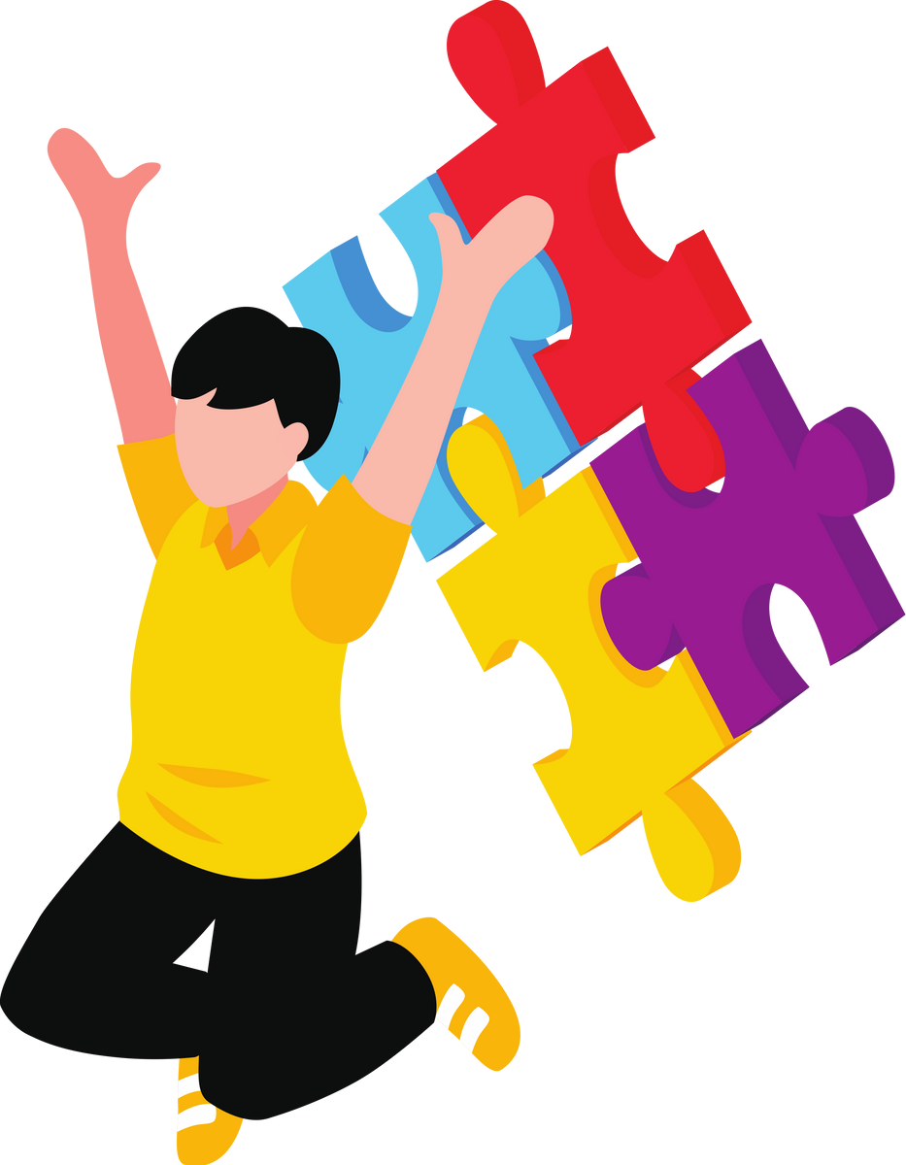
ENHANCING GROSS MOTOR SKILLS
Improve gross motor skills in children with Down Syndrome using an interactive system
Goal:
To help children with Down syndrome improve their gross motor skills through interactive, child-friendly activities
Target Skills:
Balance
Strength
Mobility
Coordination

Slide 14
METHODOLOGY
How IT Works
Identifies the child’s skill level
Provides a random gross motor skill activity.
Captures or uploads a video for analysis.
Predicts the action and classifies skill level (easy, medium, hard).
Provides feedback and personalized activity recommendations.

Slide 15
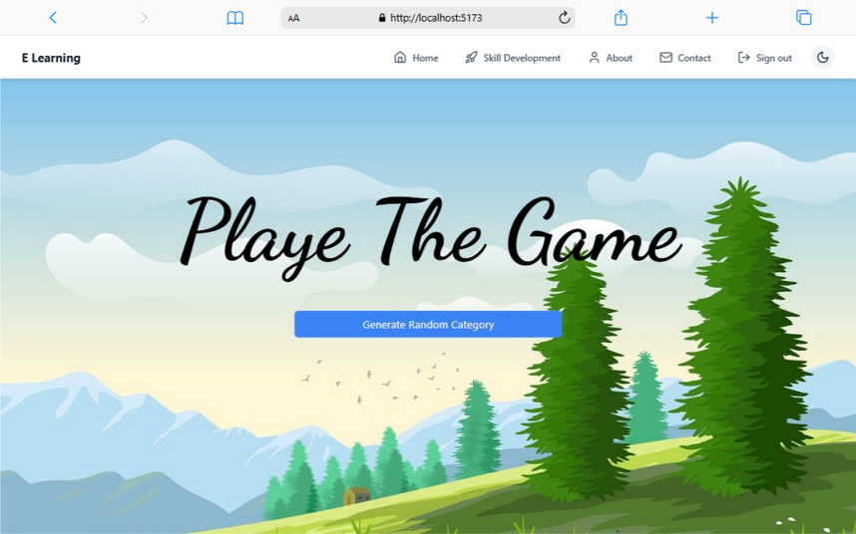
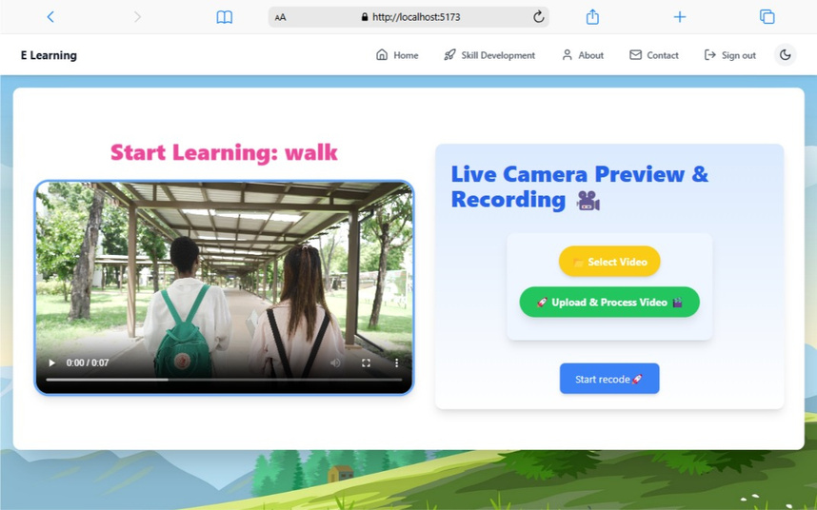
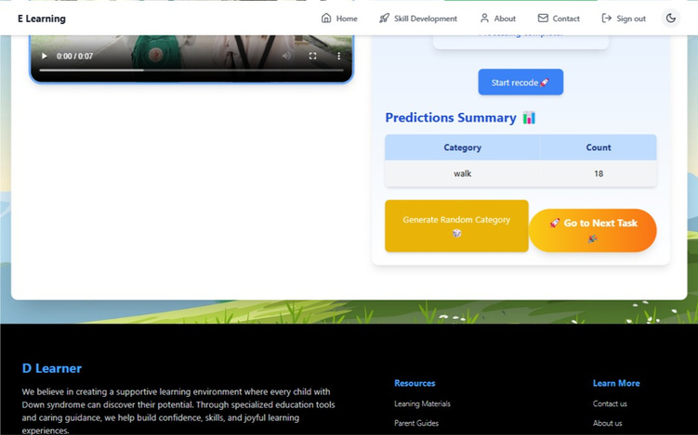
UI

Slide 16

DEVELOPING WORD PRONUNCIATION
Goal:
To enhance the pronunciation and vocabulary skills of children with Down syndrome, enabling them to communicate more clearly and confidently.
Target Skills:
Pronunciation Accuracy
Mouth Coordination
Breathing Control
Vacabulary Expansion

Slide 17
METHODOLOGY
How IT Works
Learn mouth movements and breathing for clear speech.
Pronounce words accurately with guided practice.
Expand vocabulary by linking words to real-life objects.
Improve through feedback and progress tracking.
How IT Works

Slide 18
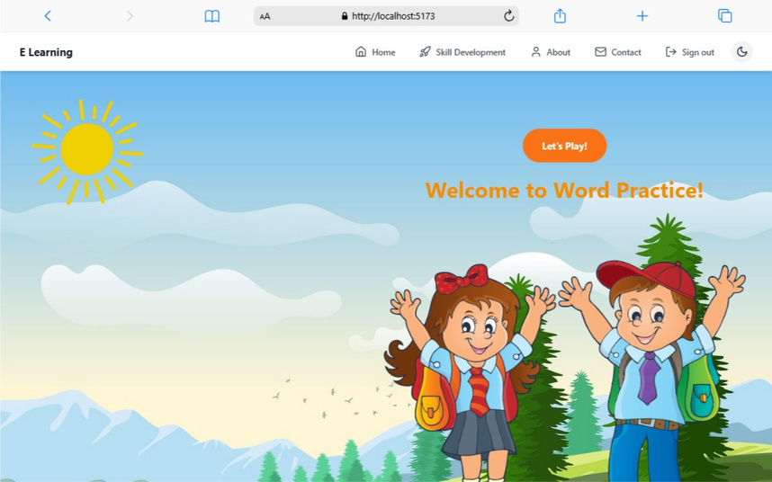
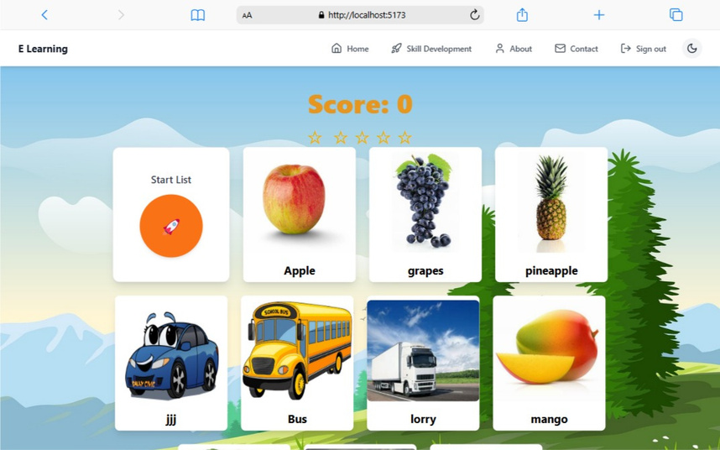
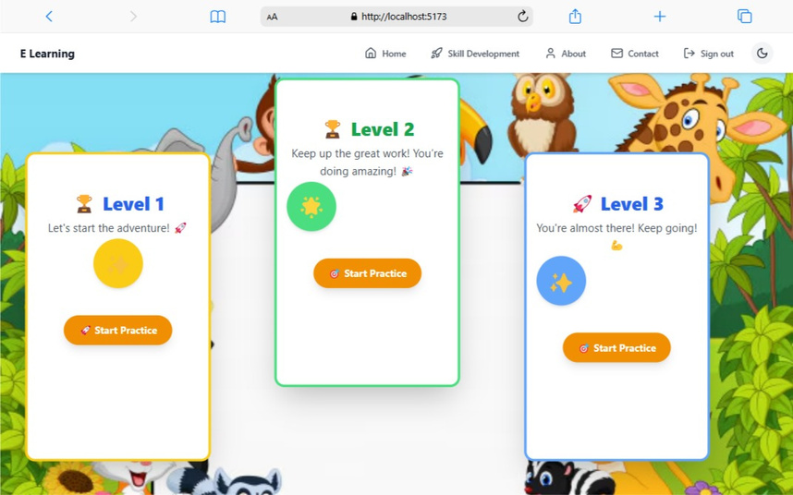
UI

Slide 19

IMPROVING WRITING SKILLS
How IT Works
Goal:
To create an AI-driven educational tool that enhances Sinhala letter recognition and writing for children with Down syndrome through real-time feedback and adaptive learning
Target Skills:
Letter Recognition
Handwriting Accuracy
Fine Motor Skills
Cognitive Processing
Confidence in Writing

Slide 20
METHODOLOGY
How IT Works
Use a diverse dataset with rotations, distortions, and viewpoint changes to improve generalization
Display a Sinhala character and let the child draw on a touchscreen interface.
Capture, normalize, and evaluate the drawing using CNN confidence scoring.
Adjust learning dynamically, reinforcing weak areas and guiding mastery

Slide 21
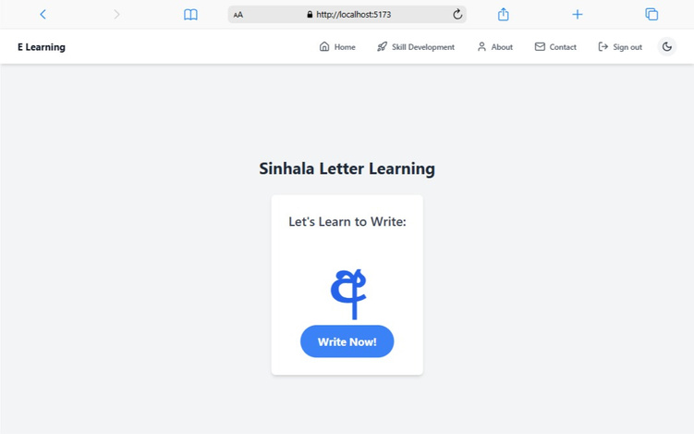
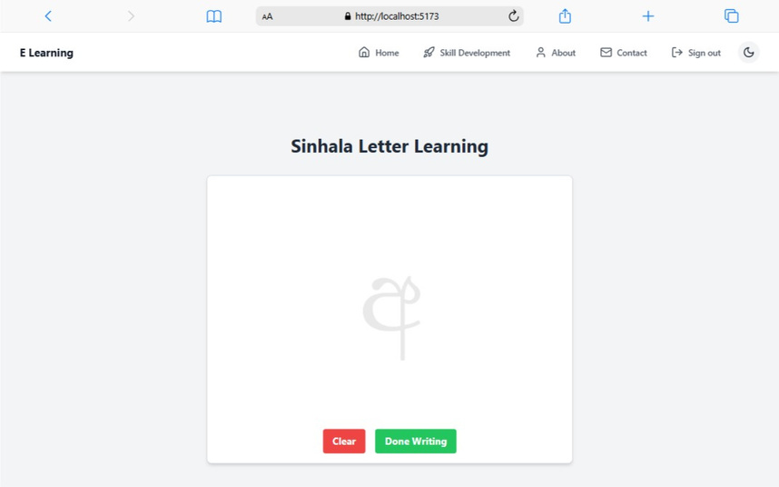
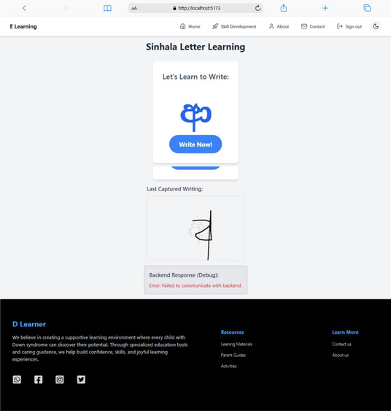
UI

Slide 22
THANK
YOU

