Slide 1


Multisensory Learning Tools for Improving Skills in Children with Down Syndrome
24-25J-096

Slide 2
RESEARCH PROBLEM
How To provide web application-based solutions to
Improve the writing skills in children with down syndrome
Improve the fundamental mathematical skills in children with down syndrome
Improve the Vocabulary
Improve the gross motor skills in children with down syndrome

Slide 3

Come Up Solutions

Slide 4

SOLUTION
The goal of the solution, "Multisensory Learning Tools for Improving Skills in Children with Down Syndrome," is to enhance support and inclusion for children with Down syndrome .
The software focuses on four main areas:
-Vocabulary expansion
-Teaching gross motor skills
-Teaching foundational mathematics
-Improving writing and drawing skills
The app provides engaging and personalized learning experiences tailored to meet the specific needs of children with Down syndrome.
The primary focus is on the Sinhala language to increase accessibility and impact.

Slide 5






TECHNOLOGY USE

Slide 6
Link
E-Down syndrome

Slide 7
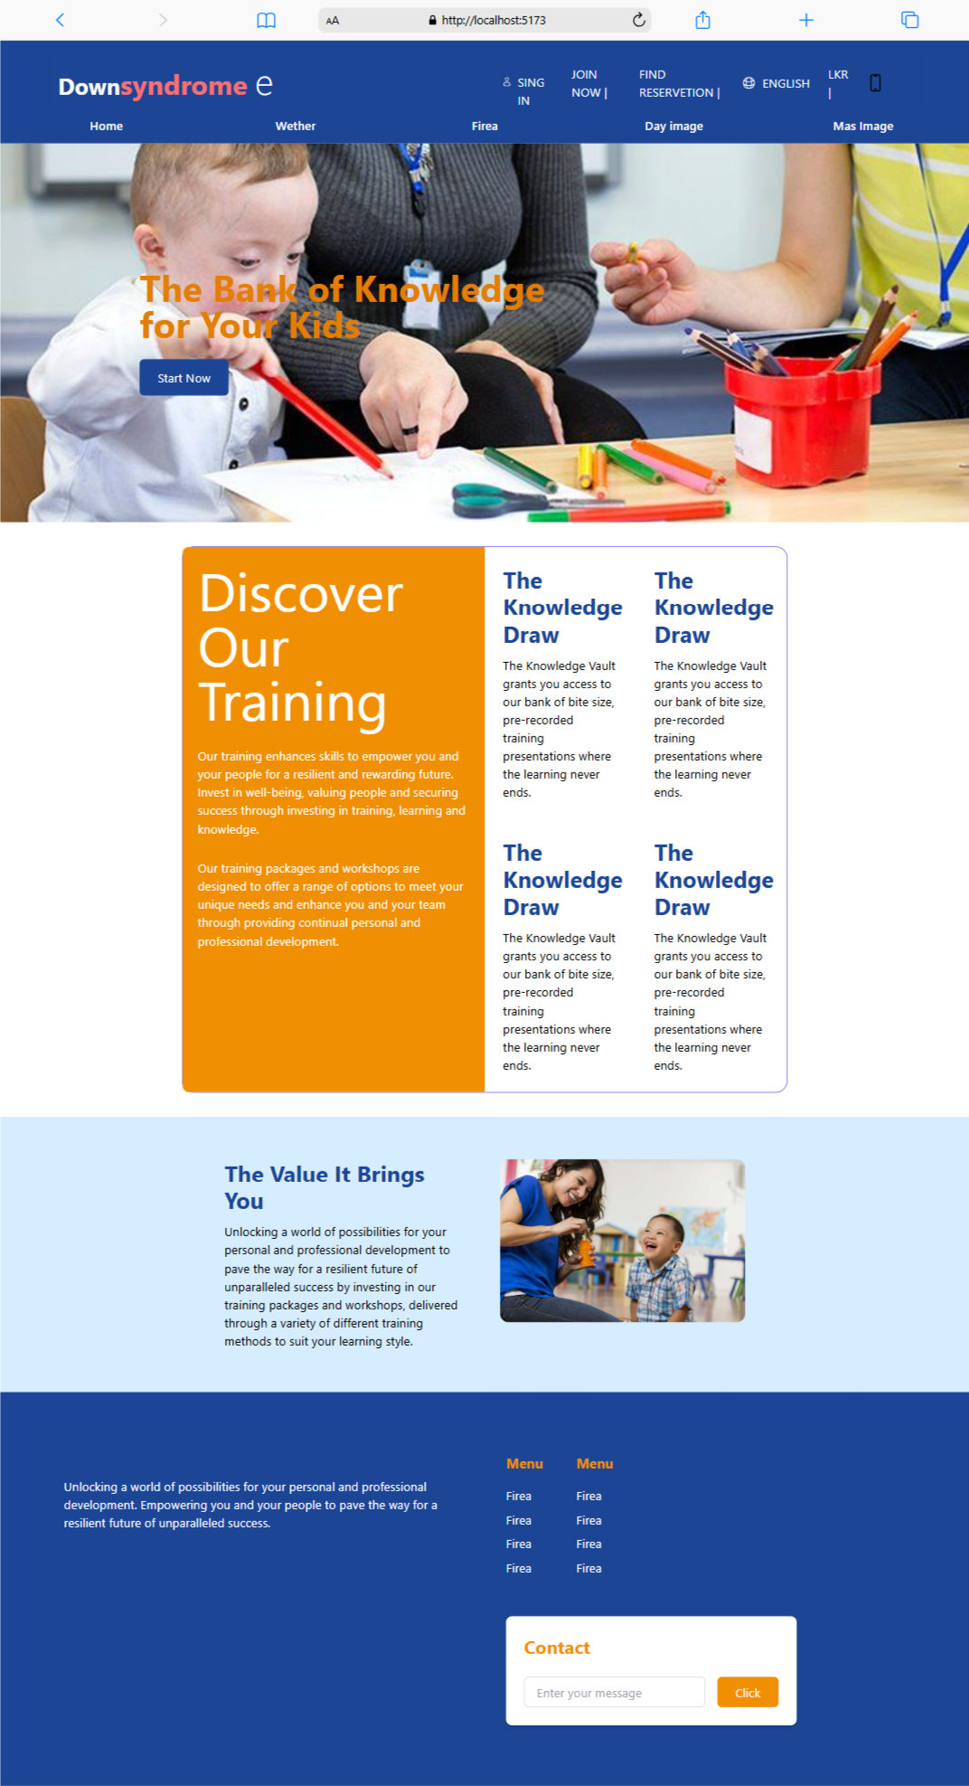
Home page

Slide 8
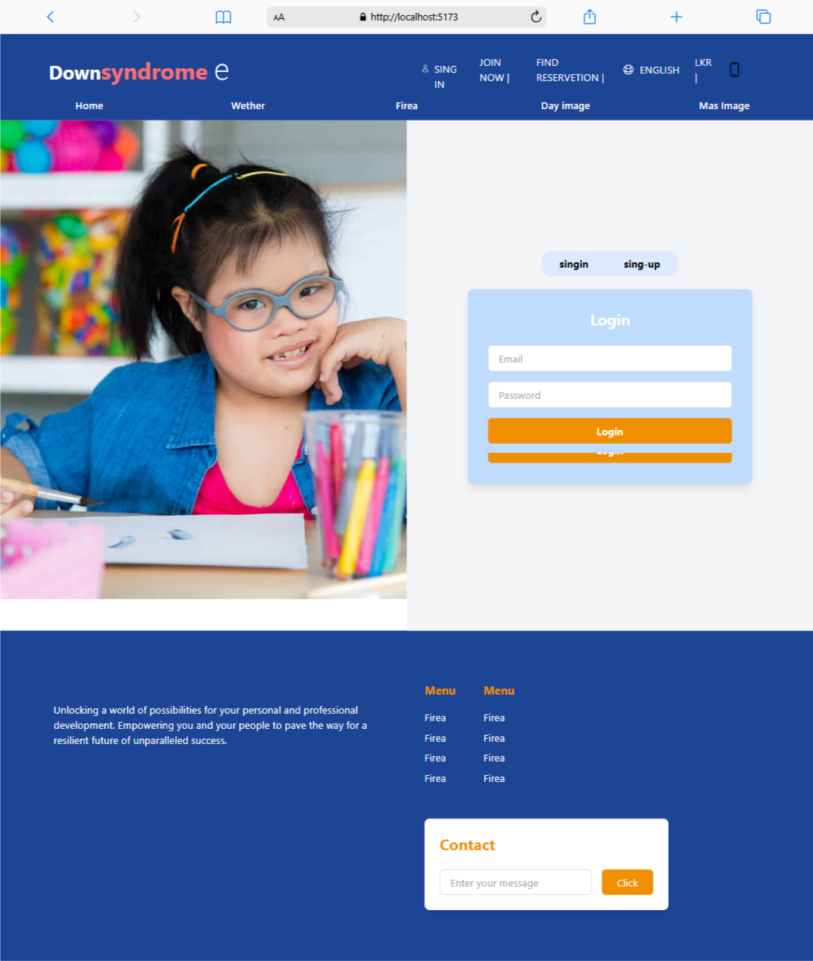
Login

Slide 9
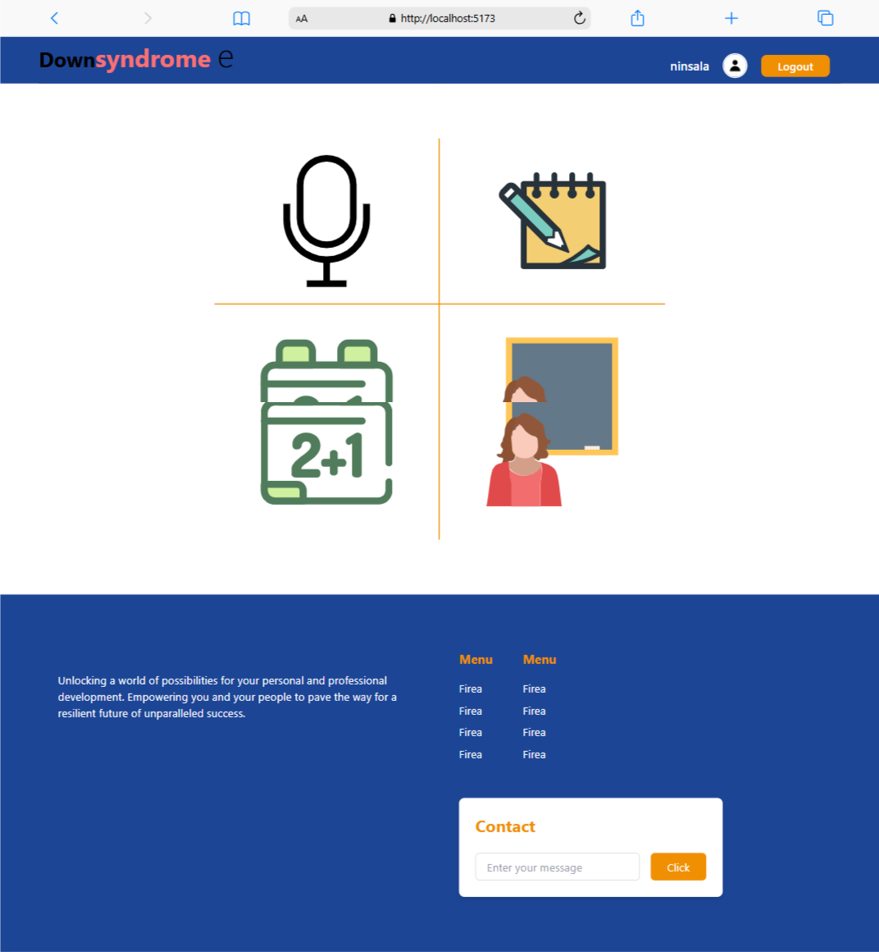
Dashboard

Slide 10
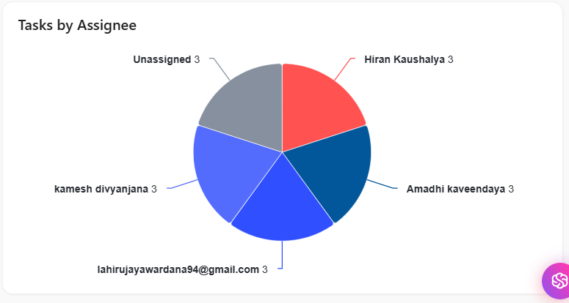
Project Management Tool

Slide 11
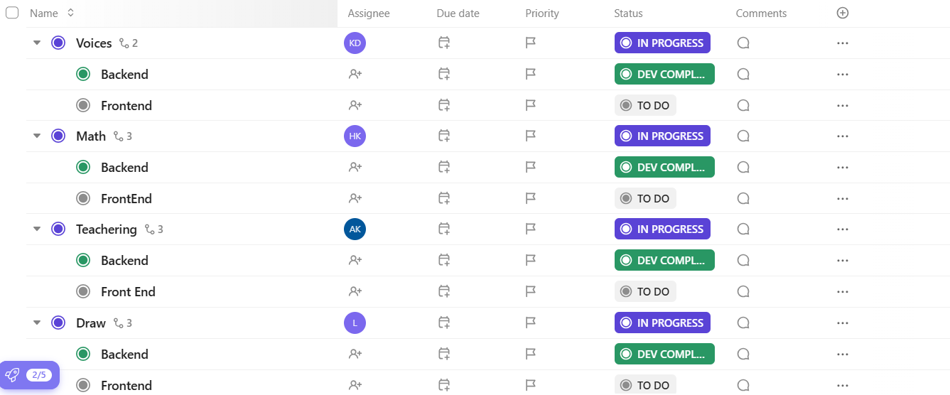
Project Management Tool

Slide 12
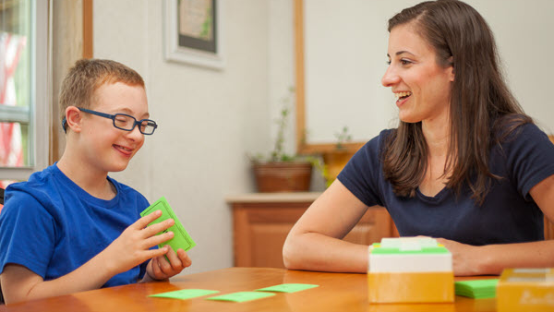
Teaching Vocabulary Words

Slide 13
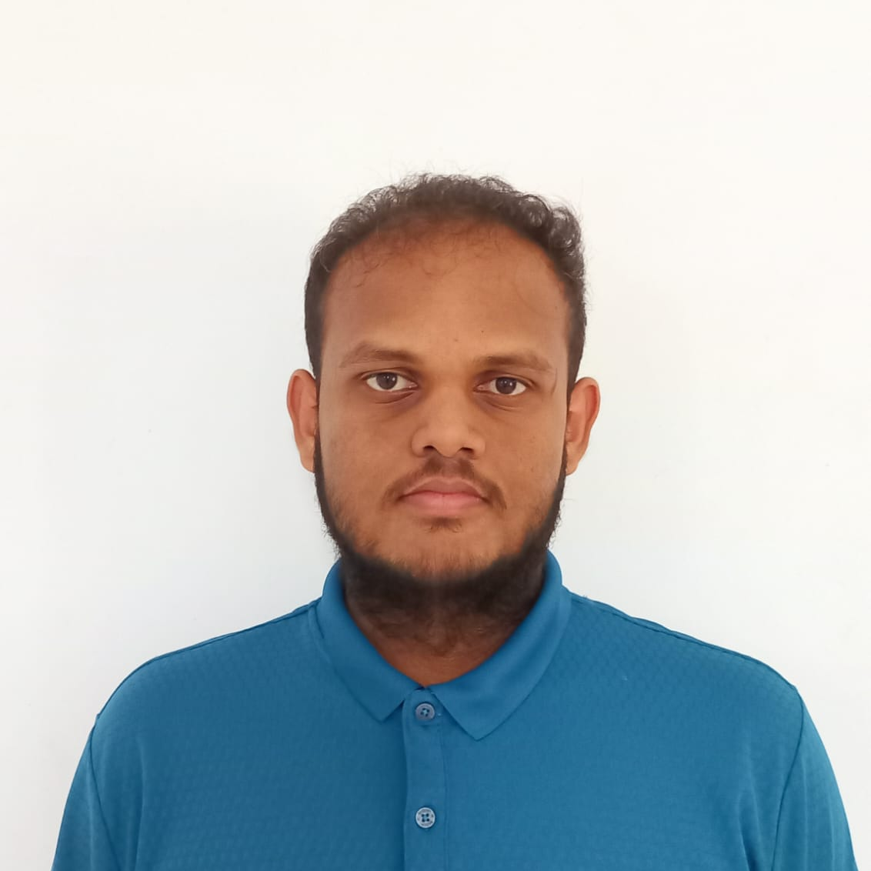
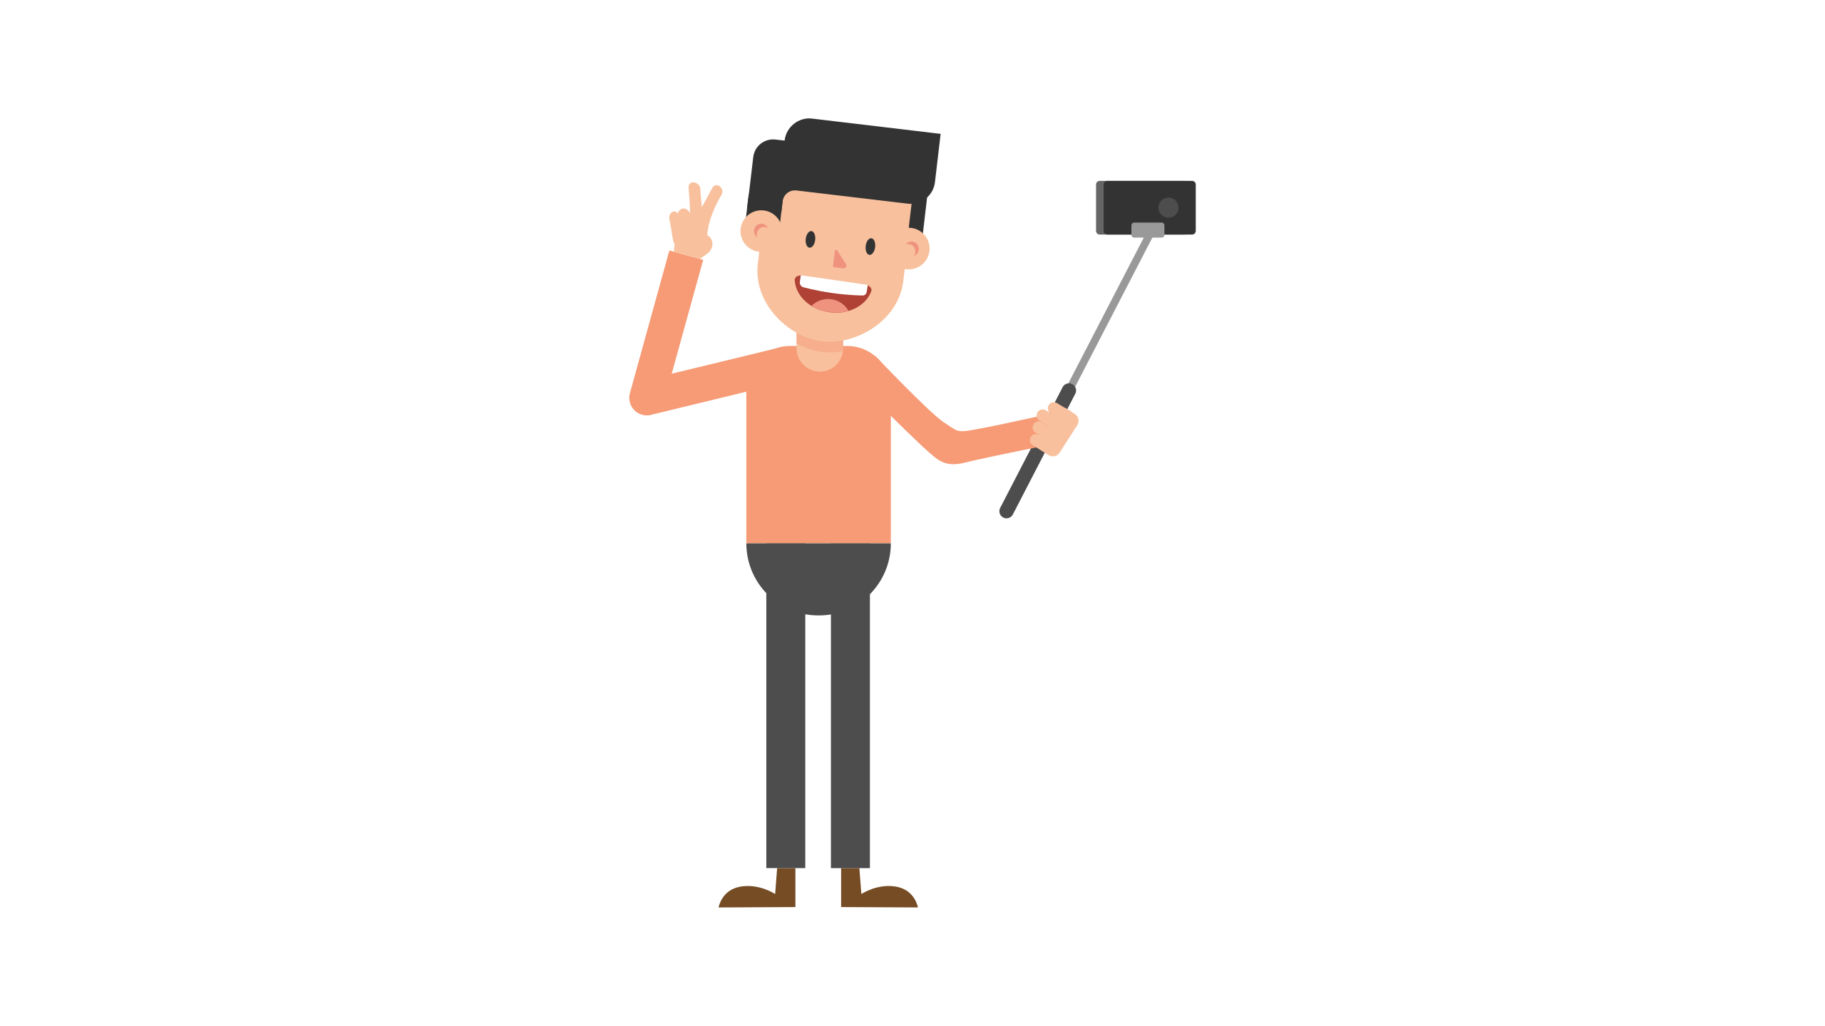
IT21155352 H K Diviyanjana
Specialization in Software Engineering

Slide 14

PROBLEMS
Children with Down Syndrome develop language skills more slowly than other children, thus delaying language acquisition and vocalization
Children with Down Syndrome low Vocabulary use experiences consider with other people
IT21155352|
H.K.Diviyanjana |
24-25J-096

Slide 15
SUB OBJECTIVE
Word pronation: this task provides Down syndrome children to listing re pronation
Audio speed recognition: this task according to children’s speck frequency predict decide listing sound speed normal slow or medium
Customer word adding: The user can add different words in the system and generate sound
E-Down syndrome
IT21155352|
H.K.Diviyanjana |
24-25J-096

Slide 16
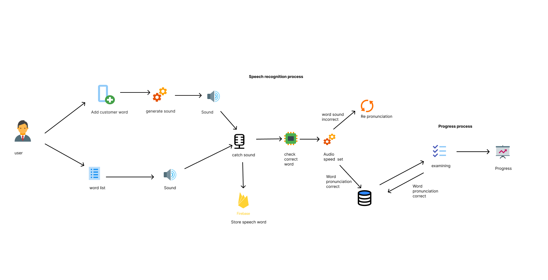
System Overview
IT21155352|
H.K.Diviyanjana |
24-25J-096

Slide 17
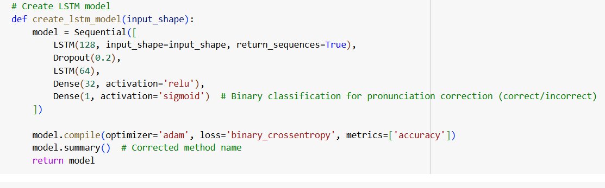
Model
IT21155352|
H.K.Diviyanjana |
24-25J-096

Slide 18
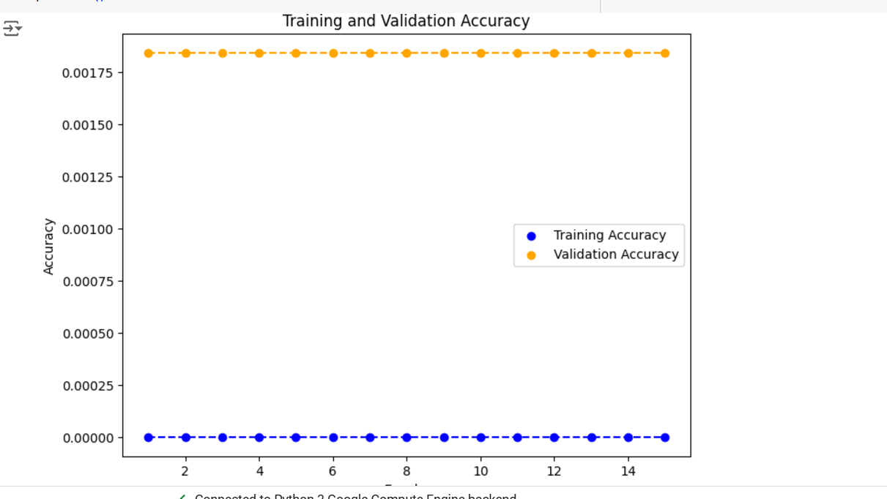
Model Accuracy
IT21155352|
H.K.Diviyanjana |
24-25J-096

Slide 19
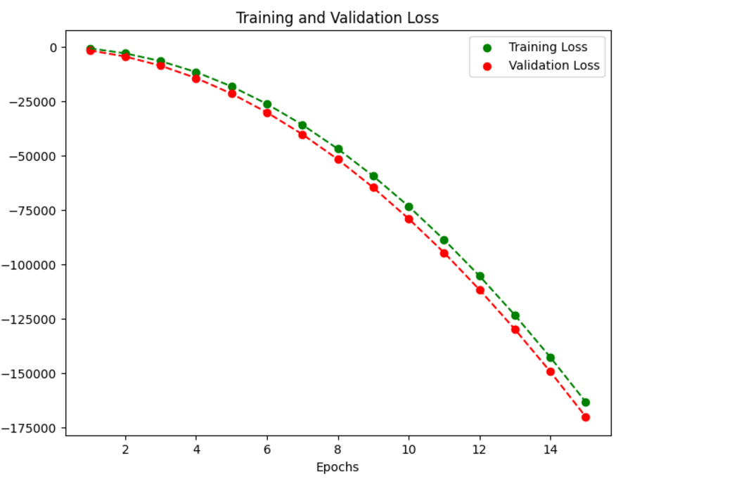
System Overview
IT21155352|
H.K.Diviyanjana |
24-25J-096

Slide 20
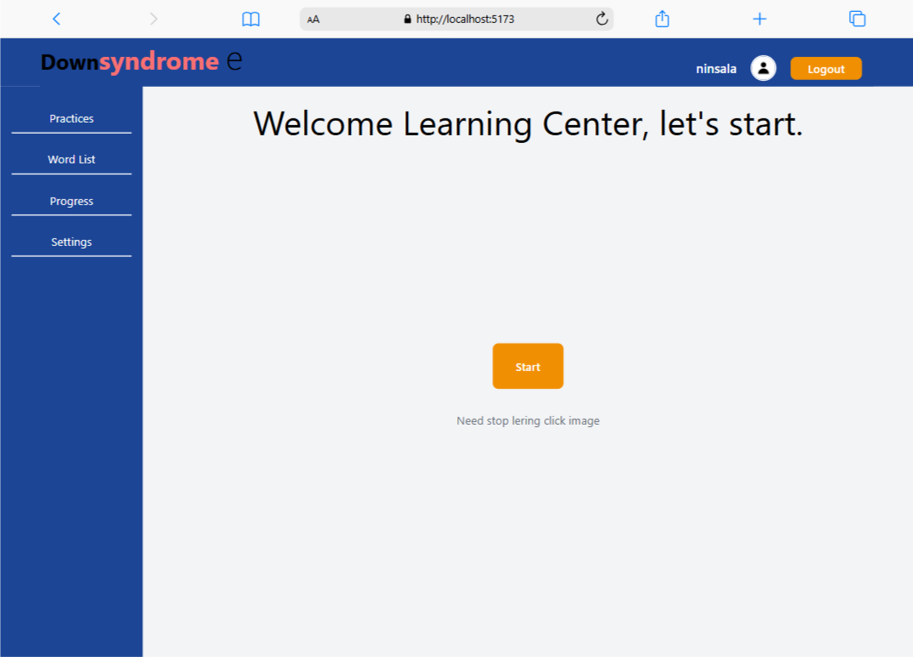
UI/UX
UI/UX
IT21155352|
H.K.Diviyanjana |
24-25J-096

Slide 21
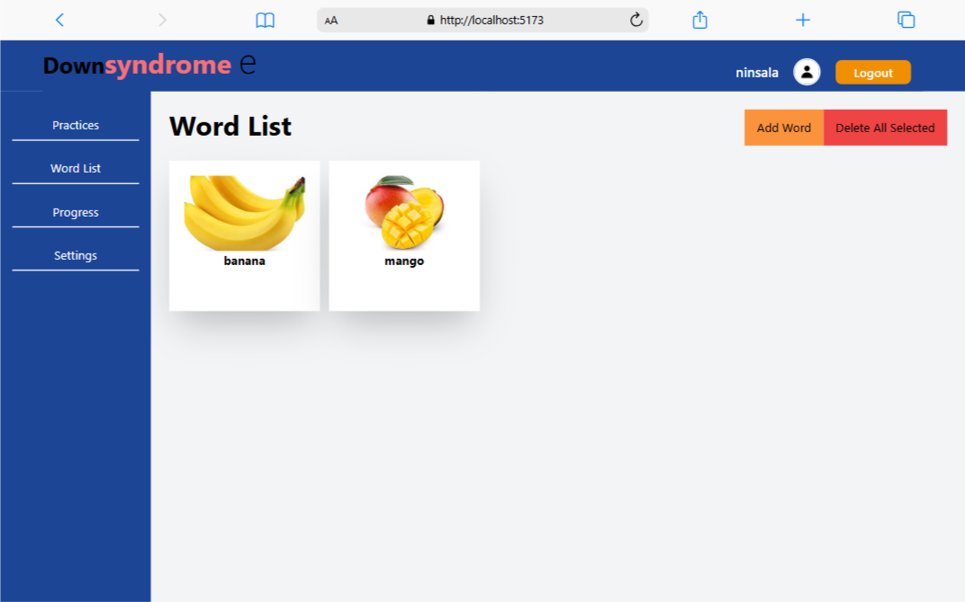
UI/UX
UI/UX
IT21155352|
H.K.Diviyanjana |
24-25J-096

Slide 22
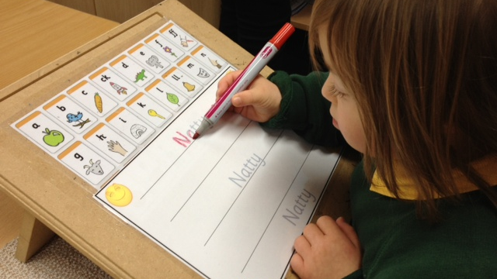
Improve handwriting and drawing skills

Slide 23
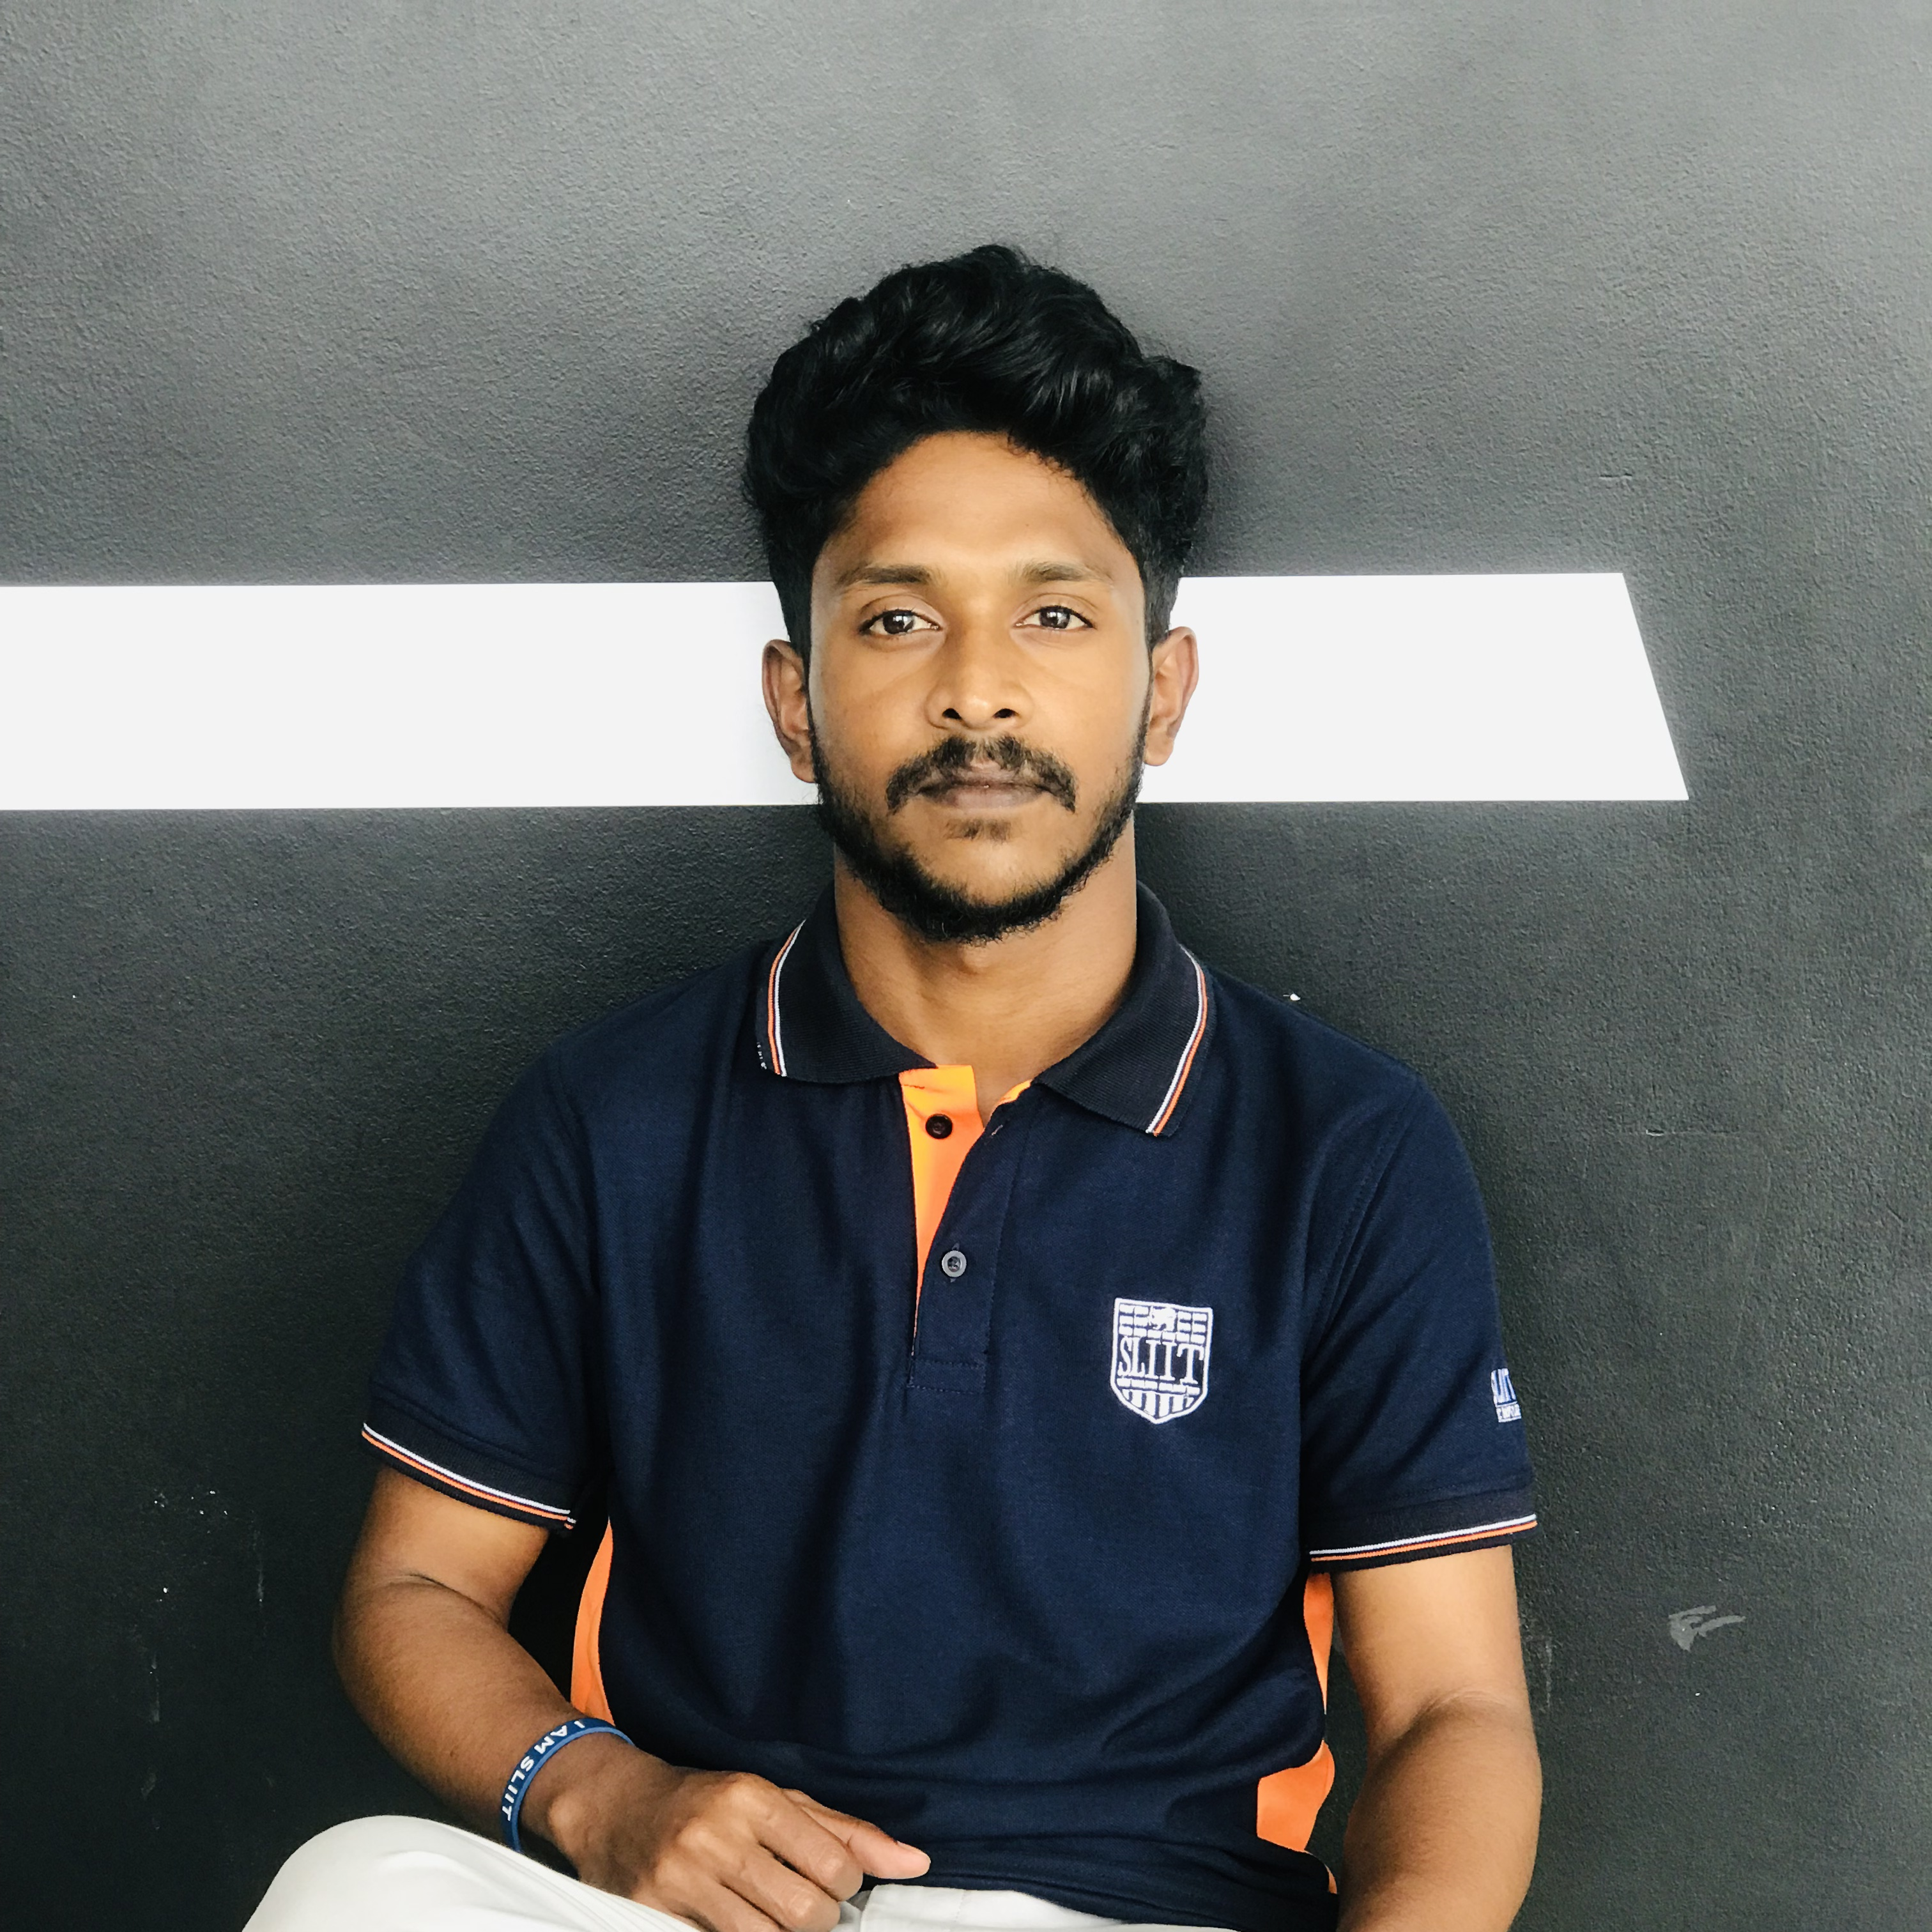
IT21187100 Jayawardhana W.G.L.P
Specialization in Software Engineering

Slide 24

BACKGROUND
why it is important to improve handwriting?
children with Down syndrome struggle with their handwriting abilities
Handwriting is a critical skill for academic success and social integration
Down syndrome often face challenges in acquiring this skill
IT21187100 |
Jayawardhana W.G.L.P |
24-25J-096

Slide 25

RESEARCH PROBLEM
Improve handwriting and drawing skills
Sinhala native letters
personalized activities
How to provide effective, adaptive digital solution to
IT21187100 |
Jayawardhana W.G.L.P |
24-25J-096

Slide 26
Objectives
Main Objective
To develop a digital system that enhances handwriting and drawing skills in children with Down syndrome through personalized multisensory learning experiences
create a mechanism for capturing and evaluating handwriting
Create an adaptive learning algorithm to personalize the difficulty level for each child.
Design an engaging, user-friendly interface suitable for children with Down syndrome.
Implement a progress tracking system to monitor and visualize improvement over time
Sub Objectives
IT21187100 |
Jayawardhana W.G.L.P |
24-25J-096

Slide 27
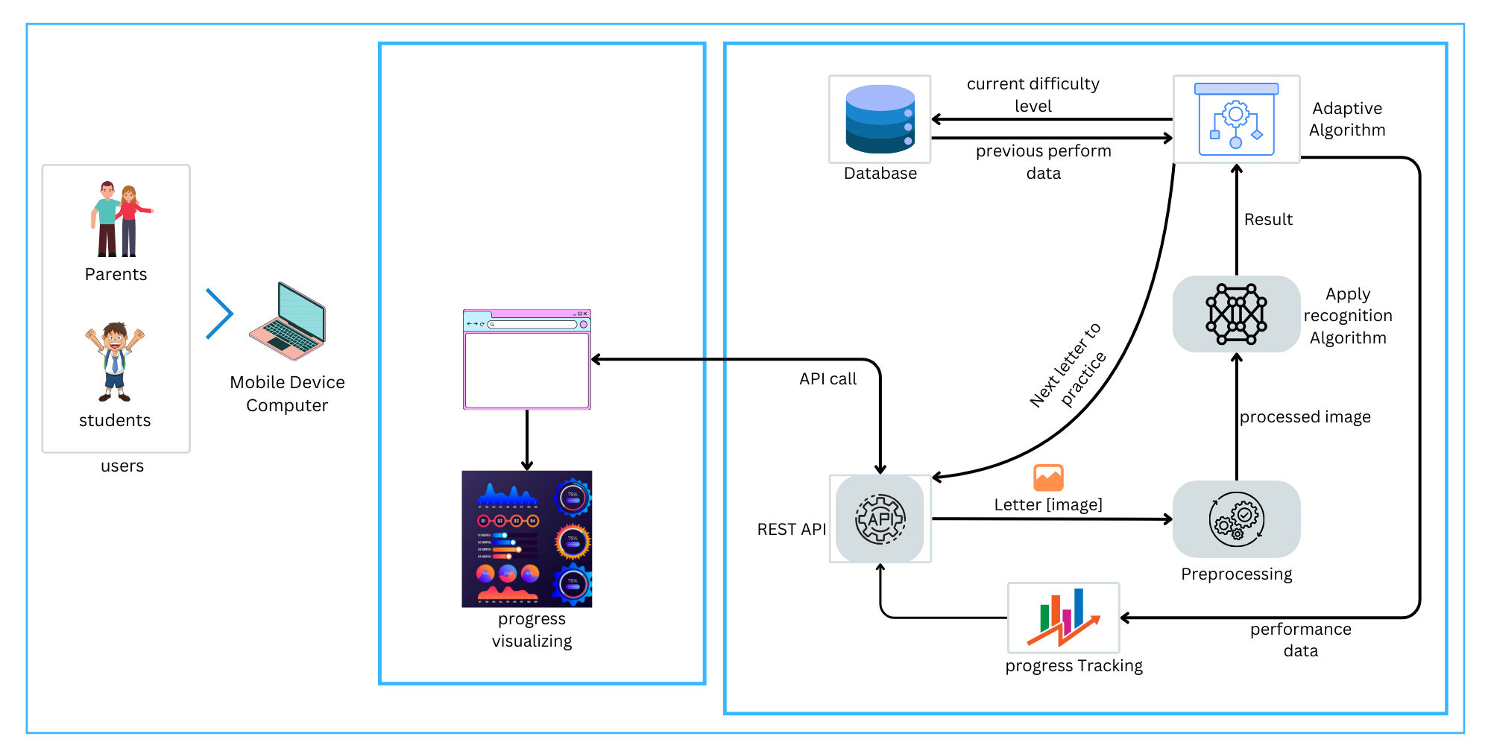
System Overview

Slide 28
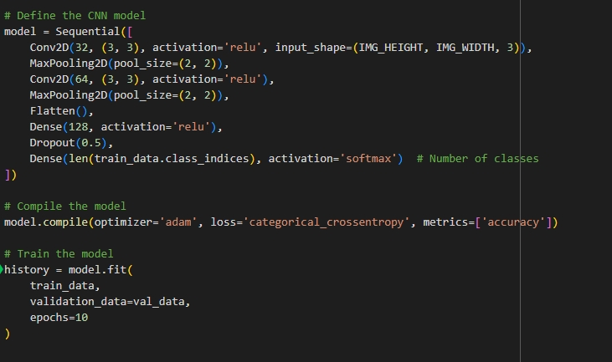
Modal Implementation

Slide 29
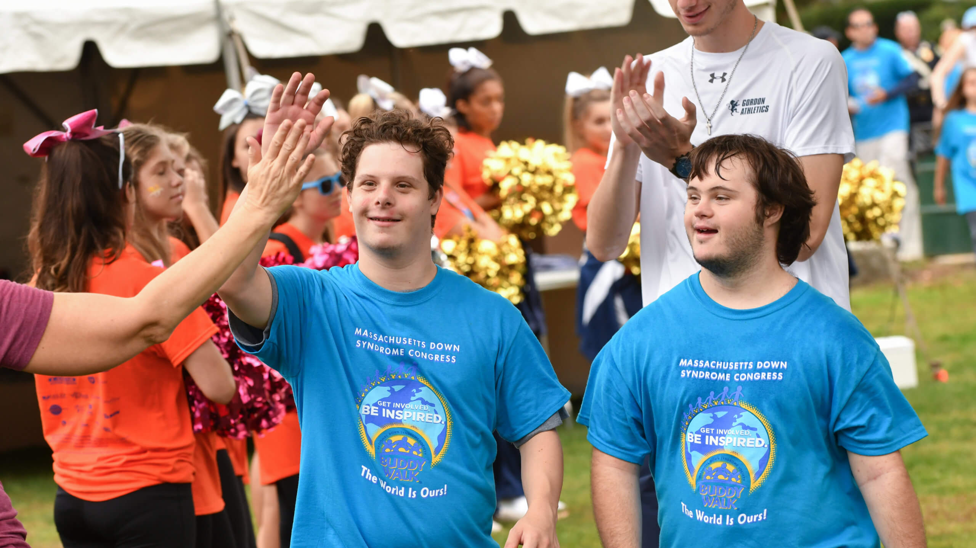
Teaching Basic Mathematics

Slide 30
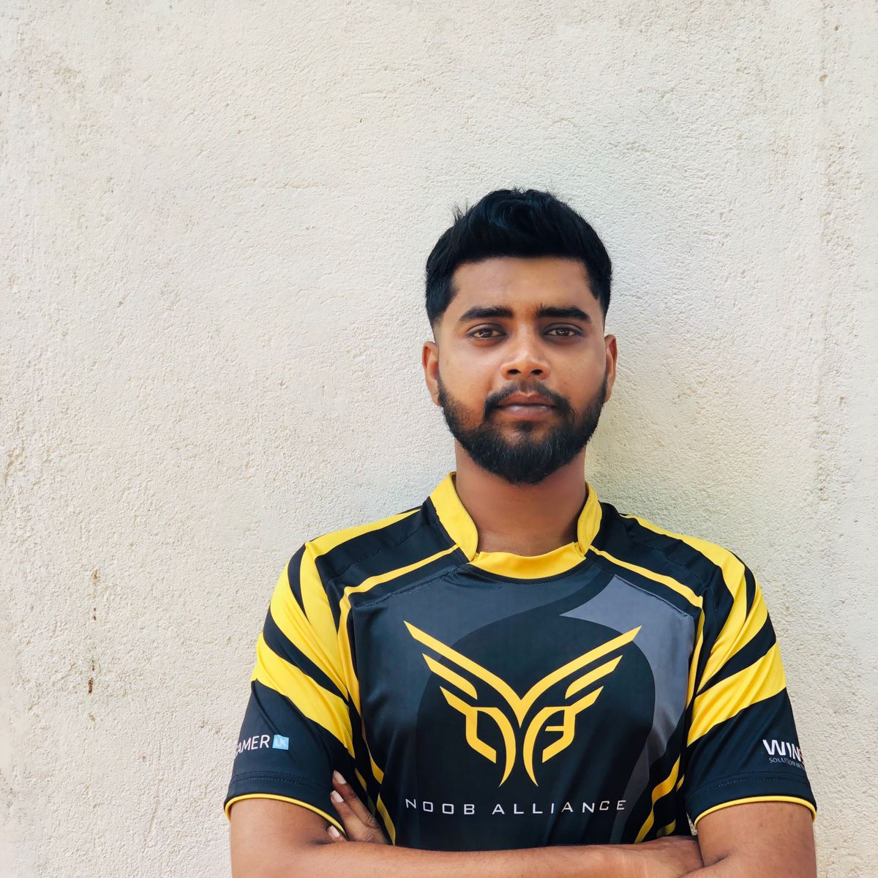
IT21287022 Kumara W.R.A.H.K
Specialization in Software Engineering

Slide 31
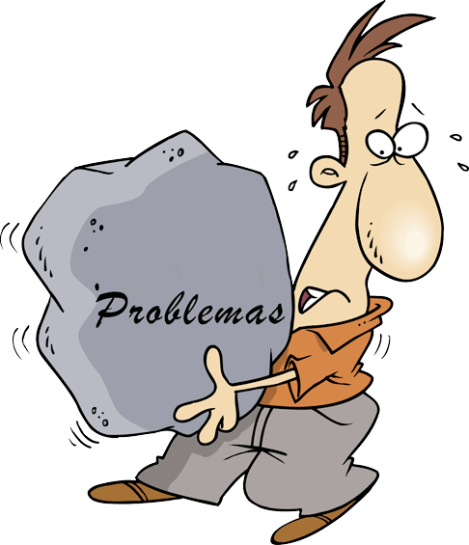
RESEARCH PROBLEM
Children with Down Syndrome often lack interest in subjects like mathematics. Traditional teaching methods may not engage them effectively due to their unique learning needs and preferences. This lack of engagement can make it difficult for them to learn basic mathematical concepts.
Children with Down Syndrome often struggle with understanding and memorizing numbers. They have difficulties in retaining and recalling mathematical concepts and operations. This challenge makes it hard for them to progress in mathematics using traditional teaching methods.
IT21287022 |
Kumara W.R.A.H.K |
24-25J-096

Slide 32
SUB OBJECTIVES
Teaching Stage : Create an engaging curriculum that teaches children with Down Syndrome basic numbers, counting, addition, and subtraction using finger images, and sounds.
Practice and Evaluate : Use sign language and hand gestures to make the learning process interactive and supportive to the children with Down Syndrome.
Feedback: Implement a system that compares children's gestures with correct ones, offering positive feedback through happy faces and badges to motivate and engage them in the learning process.
IT21287022 |
Kumara W.R.A.H.K |
24-25J-096

Slide 33
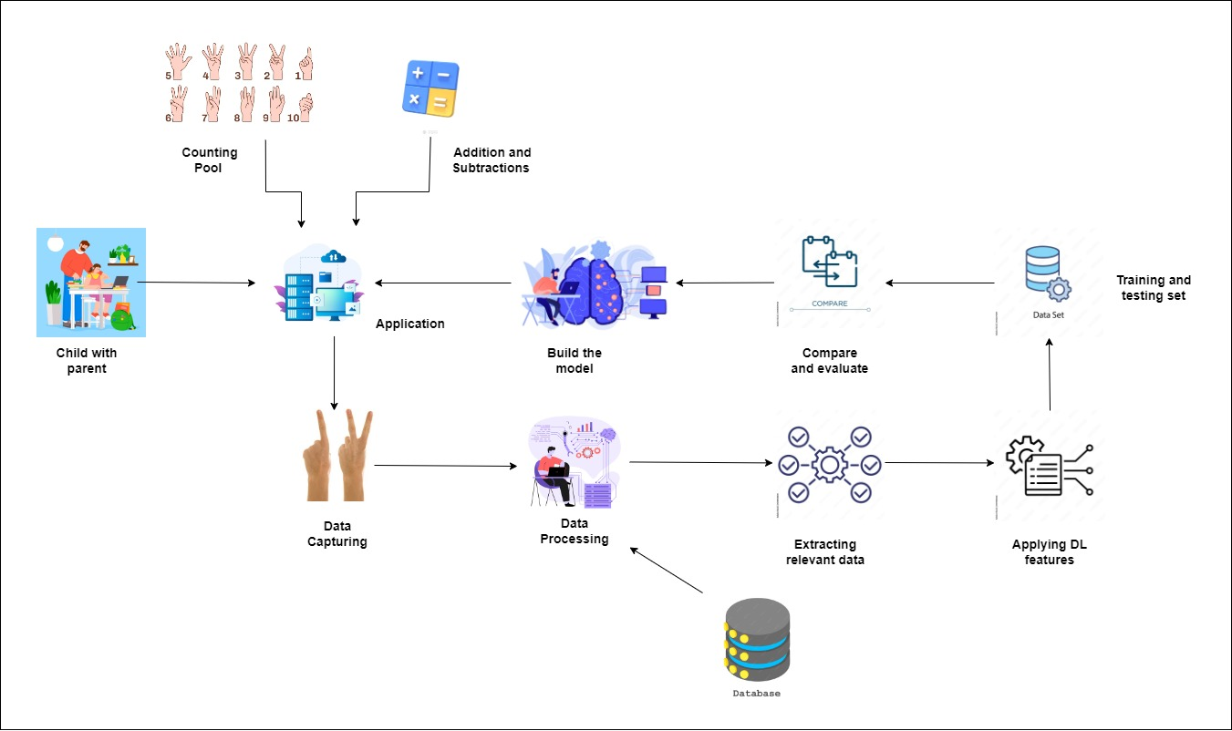
System Overview
IT21287022 |
Kumara W.R.A.H.K |
24-25J-096

Slide 34
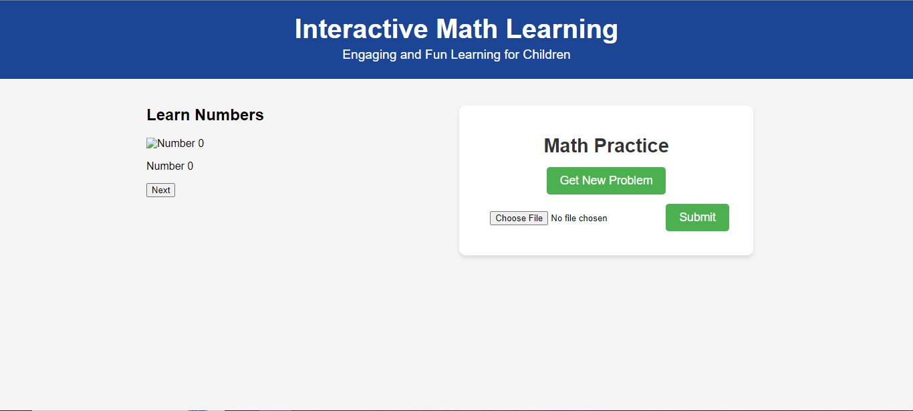
What I did so far
IT21287022 |
Kumara W.R.A.H.K |
24-25J-096

Slide 35
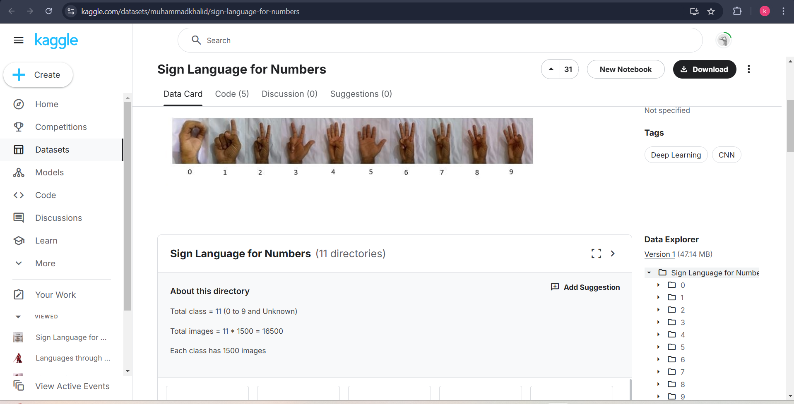
Data set : From Kaggle

Slide 36
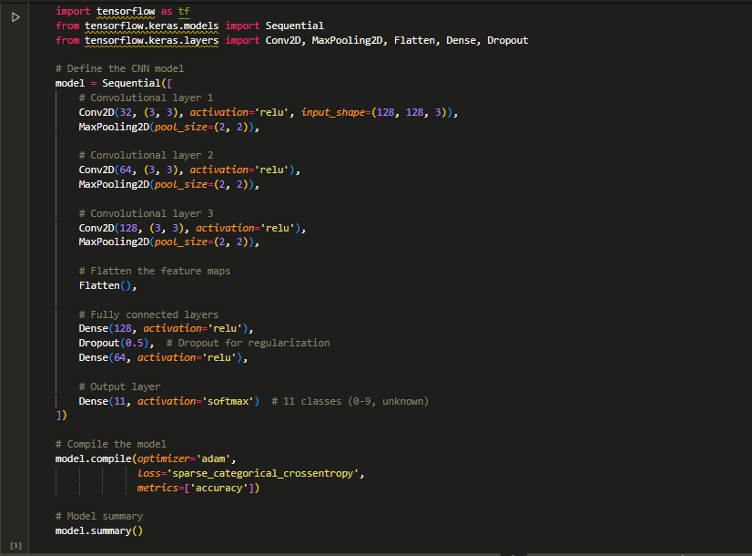
Model
IT21287022 |
Kumara W.R.A.H.K |
24-25J-096

Slide 37
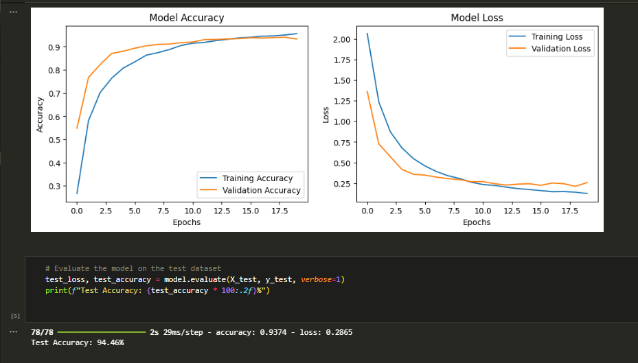
Model
IT21287022 |
Kumara W.R.A.H.K |
24-25J-096

Slide 38
Next steps
Webcam integration for real-time hand recognitions.
Learning Stage implementation.

Slide 39
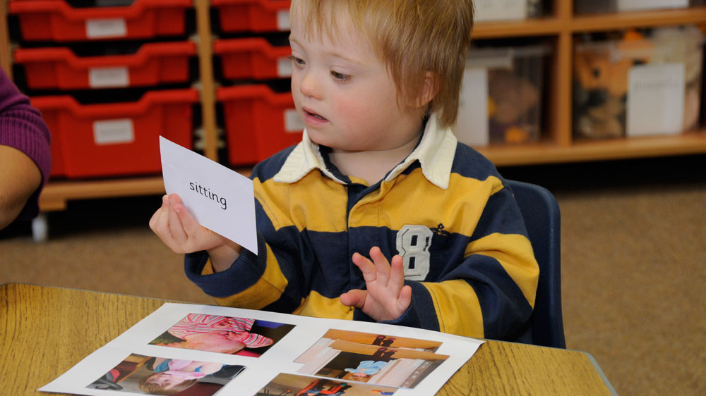
Teaching Gross Motor Skills

Slide 40
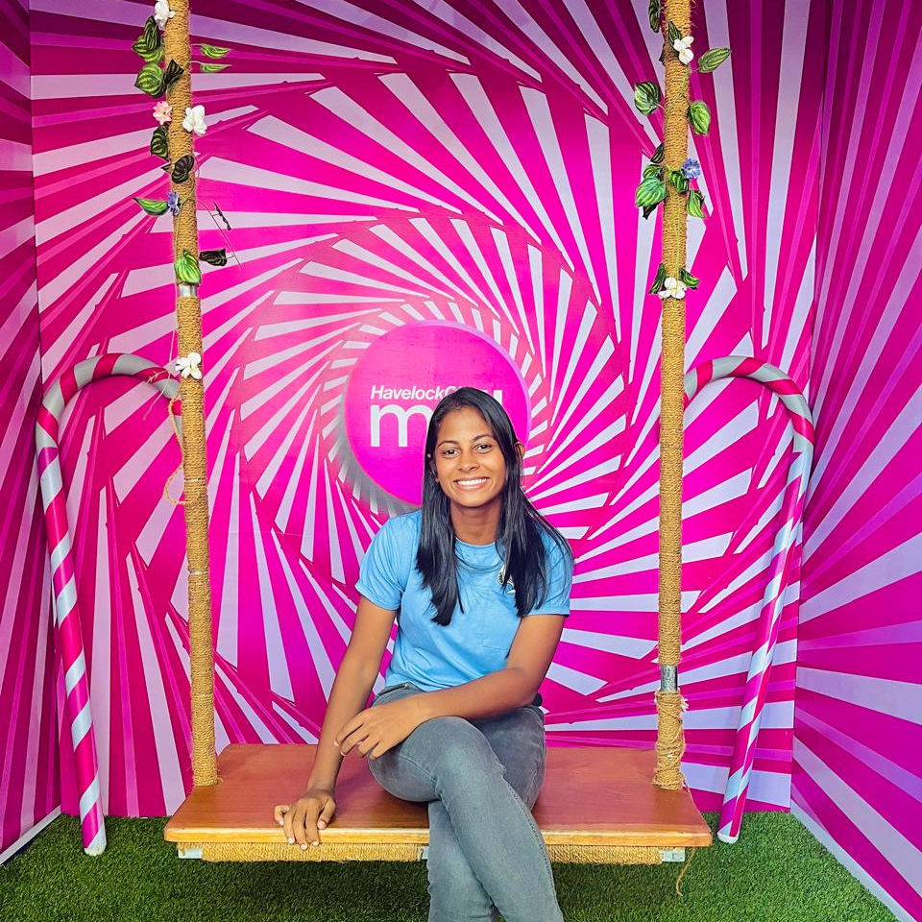

IT21338120 Wijesinghe S.A.A.K
Specialization in Information Technology

Slide 41
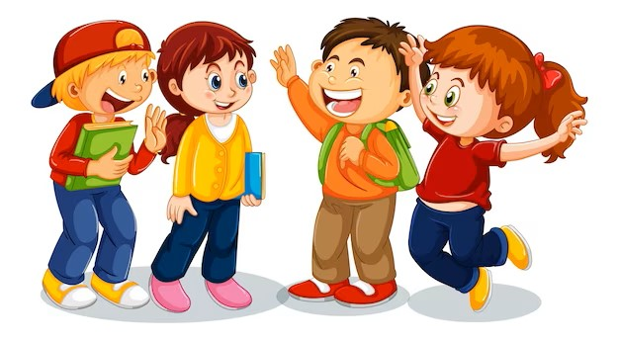
BACKGROUND
Children with Down Syndrome often experience delays and difficulties in developing gross motor skills, which are essential for physical activities such as walking, running, jumping and balance. These skills are fundamental for their overall physical development, independence, and participation in daily activities.
Such a system would offer continuous and adaptive learning opportunities, allowing children to progress at their own pace and receive immediate feedback. By incorporating technology, such as animated video clips and task recognition models, the system can engage children in a fun and interactive way, making the learning progress more effective and enjoyable.
This approach aims to enhance the gross motor skills of children with Down Syndrome, promoting their physical development and improving their quality of life.
IT21338120 |
Wijesinghe S.A.A.K |
24-25J-096

Slide 42
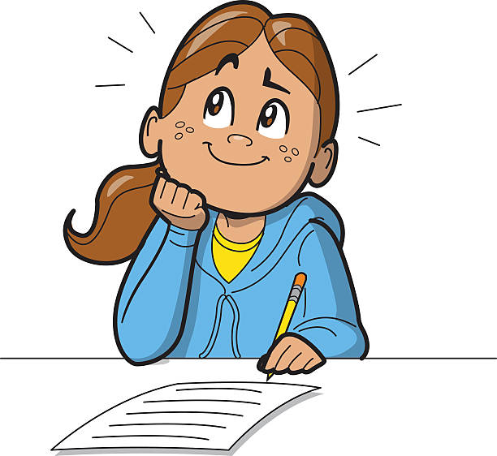
RESEARCH PROBLEM
•Children with Down Syndrome often face challenges in developing gross motor skills, which are crucial for their overall physical development and daily functioning.
•There is a need for a system to assess children with Down Syndrome's gross motor skill level through simple tasks then provide personalized tasks that match their identified skill level ( easy, medium ).
•The system should offer continuous and adaptive learning opportunities to enhance these skills effectively.
IT21338120 |
Wijesinghe S.A.A.K |
24-25J-096

Slide 43
SUB OBJECTIVE
Initial Skill Assessment: The initial task is clear and easy for children with Down Syndrome to understand and perform
Task Recognition Model: Implementing model that can analyze and compare the child’s performance with predefined skill levels
Personalized Task Recognition: Give tasks based on the child’s assessed skill level ( easy, medium )
Feedback Mechanism: Ensure the system delivers immediate and constructive feedback on the child’s performance
IT21338120 |
Wijesinghe S.A.A.K |
24-25J-096

Slide 44
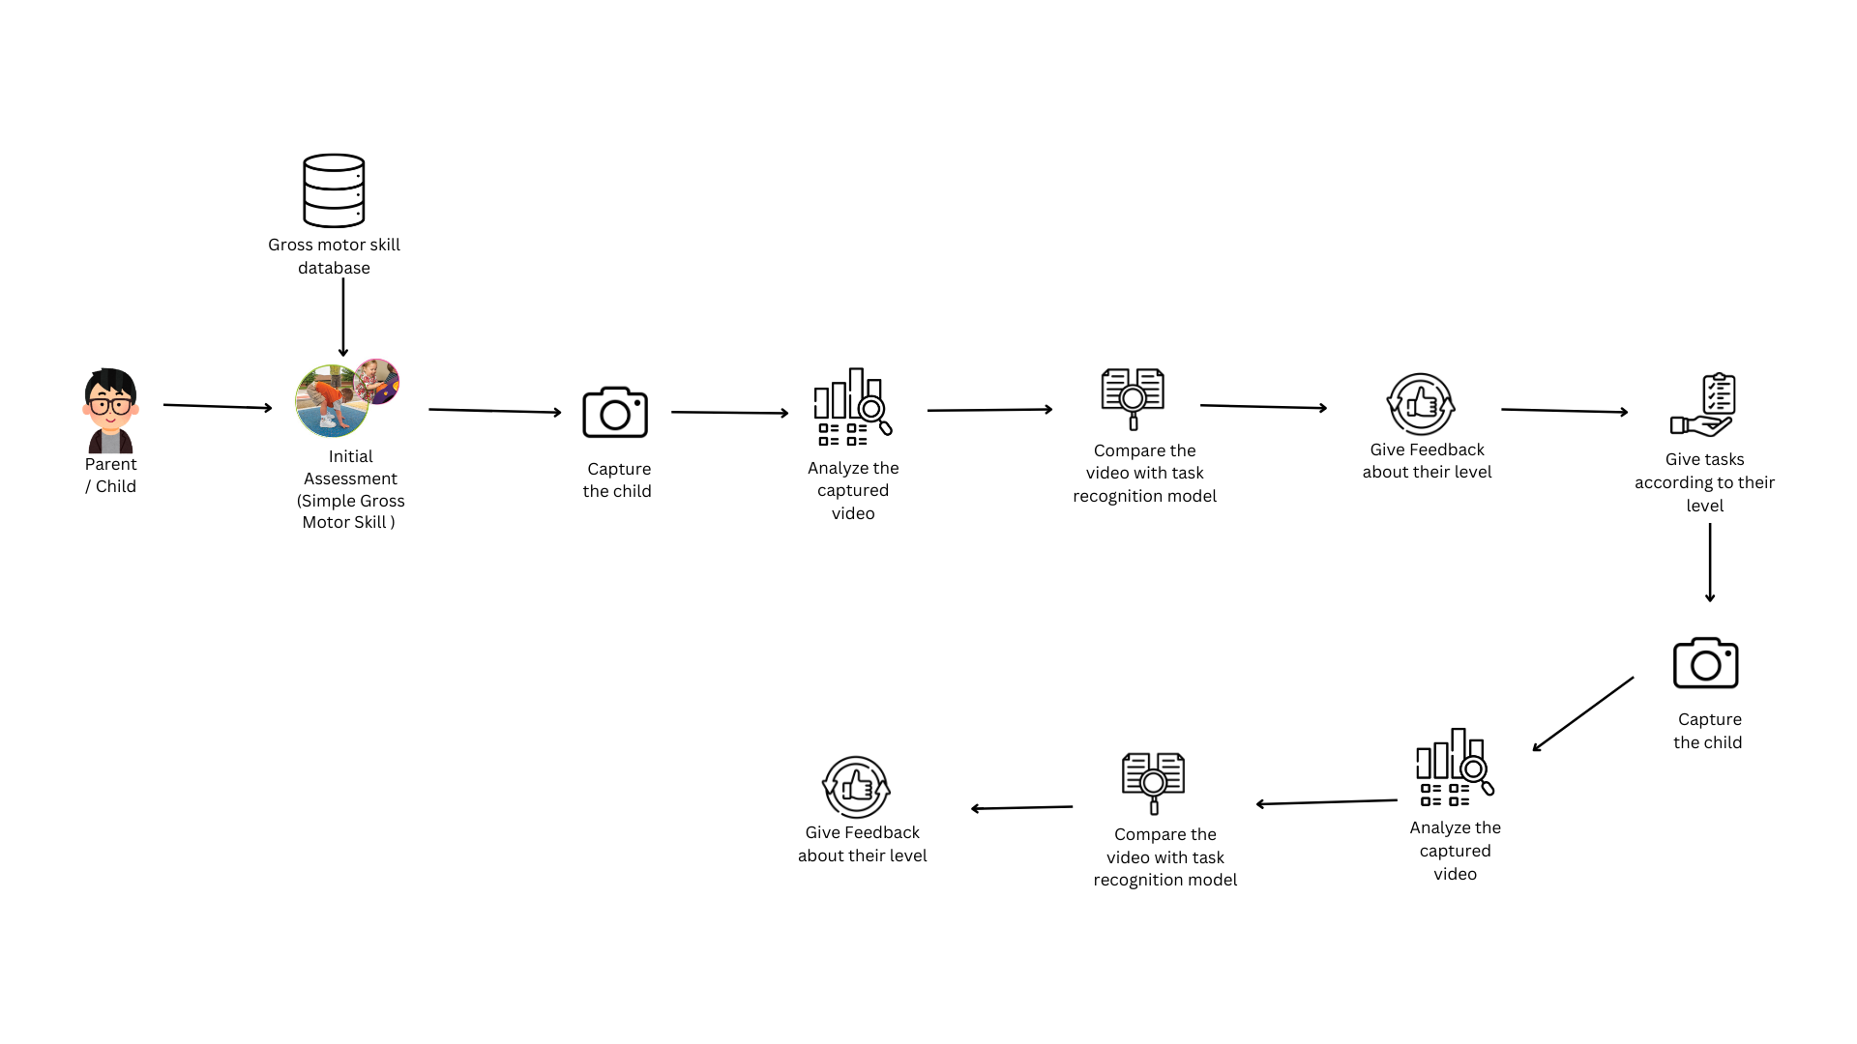
System Overview
IT21338120 |
Wijesinghe S.A.A.K |
24-25J-096

Slide 45
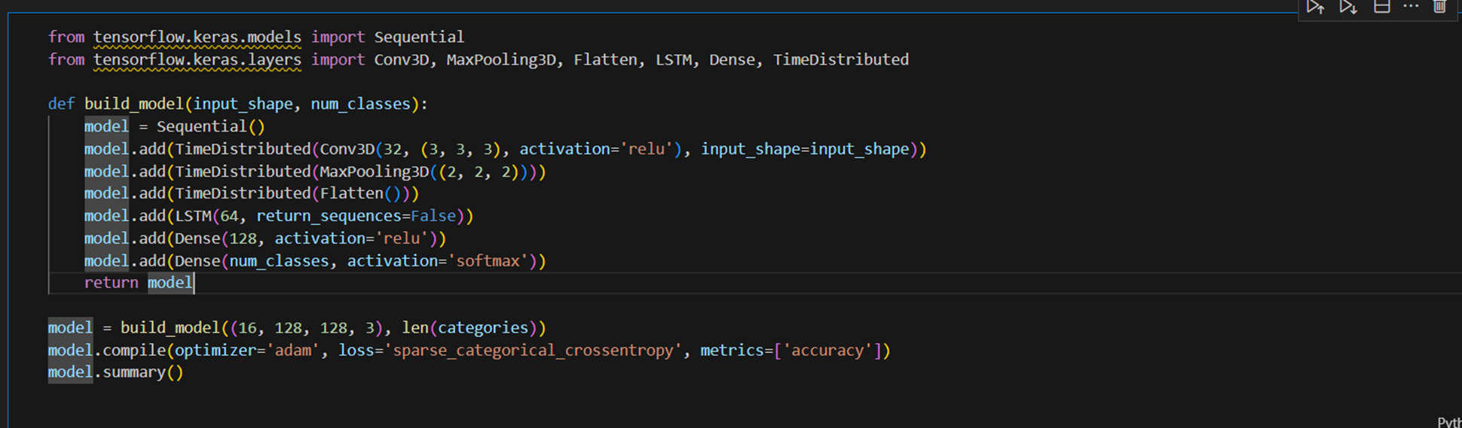
Model
IT21338120 |
Wijesinghe S.A.A.K |
24-25J-096

Slide 46
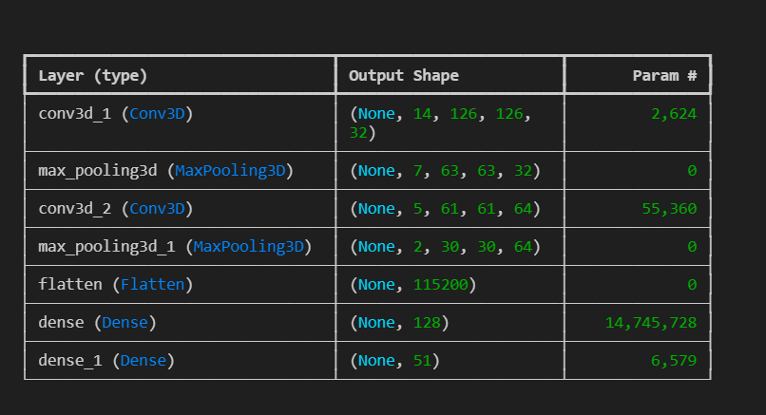
Summary of the Model
IT21338120 |
Wijesinghe S.A.A.K |
24-25J-096

Slide 47
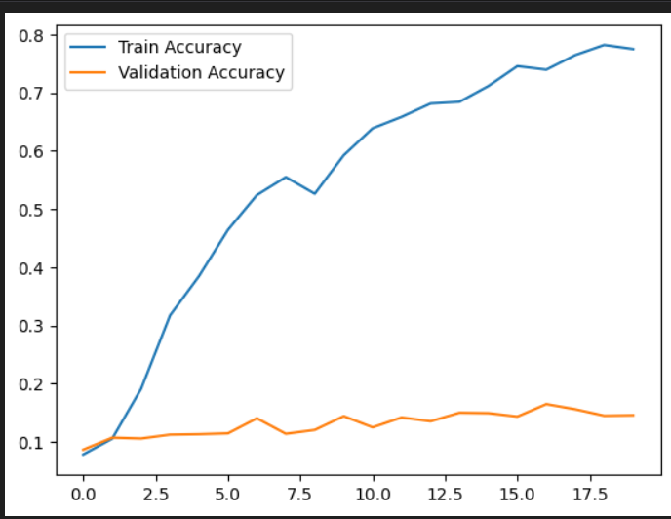
Model Accuracy
IT21338120 |
Wijesinghe S.A.A.K |
24-25J-096

Slide 48
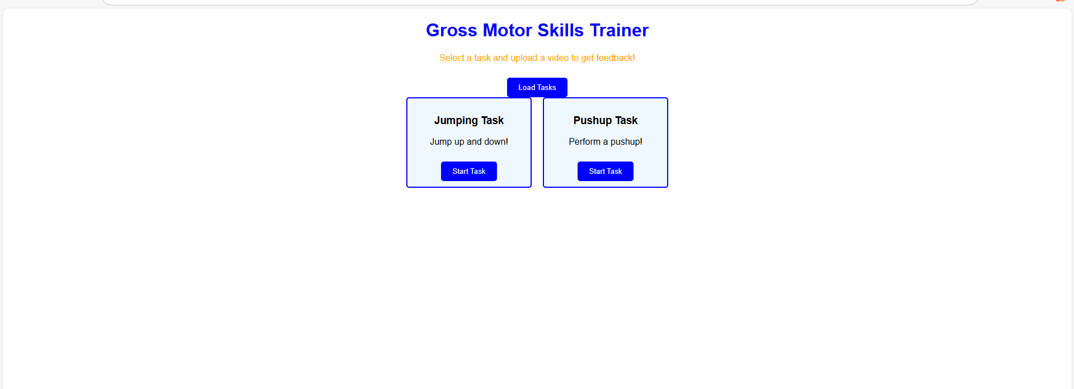
UI/UX
IT21338120 |
Wijesinghe S.A.A.K |
24-25J-096

Slide 49

UI/UX
IT21338120 |
Wijesinghe S.A.A.K |
24-25J-096

Slide 50
Thank you

Slide 51


