Slide 1
Cloud-based Lecture Capturing System
Supervisor: Dr. Malitha Wijesundara
Student ID | Student Name
IT15010322 | L. C. Tennakoon
IT15021076 | H.M.S.V. Mudalige
IT15087898 | A.P. Jayasinghe
IT15081094 | V.R. Wijayagunawardene

Slide 2

Introduction
A smart, cloud based lecture capture system.
Uses a real-time video recording mechanism.
Support for multiple video and audio sources.
Biometric Authentication of remote participants.
Supports interaction with the lecturer for all audiences.
IT15081094-V.R Wijayagunawardene

Slide 3
Research Gap
Biometric authentication of remote participants using facial recognition.
Intelligent management of data usage.
Focus on a speaker based on a specific gesture.
Keeping track of lecture slides along with voice recordings.
IT15081094-V.R Wijayagunawardene

Slide 4
Main Objective
“To facilitate lecture delivery and participation in lectures through real-time video streaming, while ensuring the maximum possible level of interaction between all parties involved.”
IT15081094-V.R Wijayagunawardene

Slide 5
Specific Objectives
To provide an interactive interface for the delivery and participation of lectures.
To ensure authentication through biometric details.
To optimize bandwidth and quota management.
To maintain chronological records of lecture slides along with respective voice recordings.
To track movements and the lecturer and audience using PTZ cameras.
IT15081094-V.R Wijayagunawardene

Slide 6

Literature Survey
• Online body tracking by a PTZ camera in IP surveillance system , P.D.Z. Varcheie (2009)
• Remote control of the PTZ camera system for lecture rooms , M. M. H. R. Jacko (2015)
• Autonomous lecture recording with a PTZ camera , T.G.Dries Hulens (2014)
• OpenTrack - Automated Camera Control for Lecture Recordings , B.Wulff (2011)
• A Tabletop Lecture Recording System , Yong-Quan CHEN (2015)
• Virtual Cameraman , Chiung-Yao Fang (2015)
IT15021076- H.M.S.V. Mudalige

Slide 7

Key Features
Real time best viewing experience for the audience.
Easy screen sharing.
Interacting with the question of a single student with all participants.
Real-time focus on a guest speaker from audience.
Biometric authentication to authenticate remote users and mark attendance.
After the session, a readable text of the lecture.
Offline video with thumbnails of the chapter.
Intelligent bandwidth management.
IT15021076- H.M.S.V. Mudalige
Notes:
• Remote control of the PTZ camera system for lecture rooms , M. M. H. R. Jacko (2015)
to remote control PTZ camera system from one place with simultaneous image capturing ability. Users of this application are able to choose number of presets and this functionality is provided programmatically by sending queries to CCTV system
• Autonomous lecture recording with a PTZ camera , T.G.Dries Hulens (2014)
Detect and track a single person/lecturer, Take cinematographic rules into account, Work in Real-Time
• OpenTrack - Automated Camera Control for Lecture Recordings , B.Wulff (2011)
OpenTrack is not to completely replace human camera operators, but to allow universities to produce lecture recordings, with a video that contains all important information in enough detail (image processing)
• A Tabletop Lecture Recording System , Yong-Quan CHEN (2015)
lecturer can control the PTZ camera to record the teaching process by the gestures
• Virtual Cameraman , Chiung-Yao Fang (2015)
two PTZ cameras have different utilities. One is named full-shot PTZ camera and the other is movement PTZ camera. To get camera movement information, the system first obtains continuous images from full-shot PTZ camera and then extracts four fuzzified movement features

Slide 8



Existing Systems
Panopto
Support capturing video feeds from any camera and any screen.
Video content management with strong search capability.
Video analytics - number of views and duration of views.
BigBlueButton
Breakout Rooms.
Viewing captions in Playback.
Faster Screen Sharing.
IT15021076- H.M.S.V. Mudalige
Notes:
Breakout Rooms
Any moderator (usually the instructor) can now place students into breakout rooms, monitor their interaction, and end the breakout rooms at any time.

Slide 9


Existing Systems
Kaltura
Interactive Online Video Quizzing & Solutions.
Video Editing Tools.
Web Conferencing.
Echo360
Optimized Encoding.
Student Response.
Confusion Alerts.
IT15021076- H.M.S.V. Mudalige
Notes:
Student Response
With Echo360, student response activities can be embedded into classroom presentations and videos to assess student learning and provoke thoughtful discussions. Choose from multiple question types, including graphic response, and students can answer using their preferred device.
Confusion Alerts
Students often don’t speak up when they are feeling lost, but Echo360 makes it easy to give simple feedback to the instructor. Whether in class or when reviewing the recording, students can indicate that they are struggling so instructors know which topics to reinforce.

Slide 10
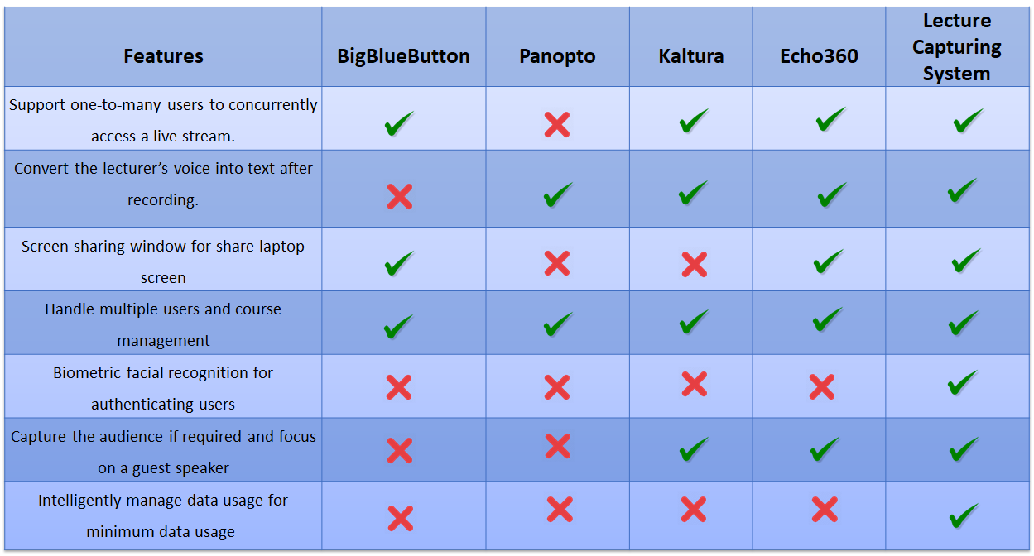
Existing Systems Comparison
IT15021076- H.M.S.V. Mudalige

Slide 11

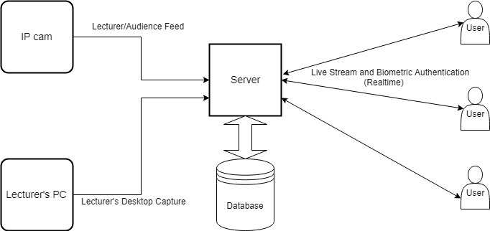
System Architecture
IT15010322 - L. C. Tennakoon

Slide 12
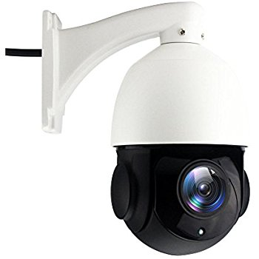
Research Methodology
Audio and Video Conferencing
IP PTZ camera to track lecturer and audience
Live streaming of the lecture
Share lecturer’s computer screen
IT15010322 - L. C. Tennakoon

Slide 13
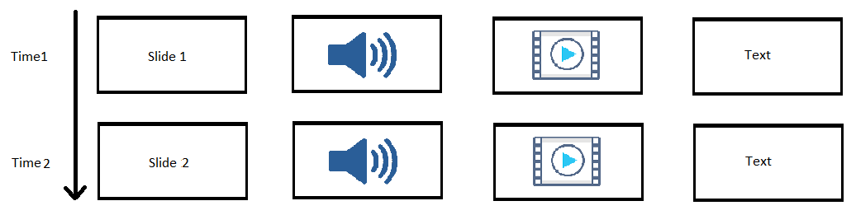
Research Methodology
Screen Capturing
Record desktop screen and lecturer’s voice
Split video to represent each presentation slide
Convert audio to text
IT15010322 - L. C. Tennakoon

Slide 14
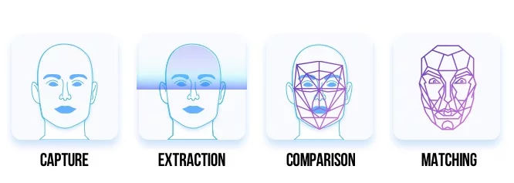
Research Methodology
Attendance Management
Detection of remote students’ faces
Comparison with existing images
Biometric authentication of remote students
IT15010322 - L. C. Tennakoon

Slide 15
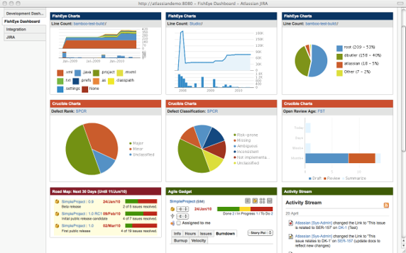
Research Methodology
Enterprise Dashboard
User management
Course management
Bandwidth management
Quota management
IT15010322 - L. C. Tennakoon

Slide 16






Main Technologies
opencv4nodejs
IT15087898 A.P. Jayasinghe

Slide 17





Testing and Deployment
IT15087898 A.P. Jayasinghe

Slide 18







Tools
IT15087898 A.P. Jayasinghe

Slide 19
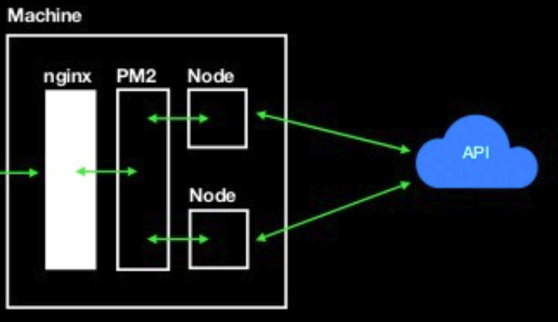
Scalability Technologies
node cluster module
NGINX
node pm2 module
User
Source : https://www.slideshare.net/secret/gUdGDEiOIFdGhE
IT15087898 A.P. Jayasinghe

Slide 20
Business Plan
Target Market
Education institutions such as Universities
Business Conferences
Marketing Strategy
Conducting awareness , training programs.
Using social media , creating video tutorials.
Sending sample, free or trial versions.
IT15087898 A.P. Jayasinghe

Slide 21
Individual Components
L.C.Tennakoon | V. Mudalige | A.P. Jayasinghe | V.R. Wijayagunawardana
Screen Capture | Lecture Movement Capturing | Authenticate users | Audio & Video Conferencing
Audio-to-text | Screen Sharing | Mark Attendance | User Management
Quota Management | Course Management | Bandwidth Management | Administrator Dashboard (Enterprise)
 |  |  | Audience Capturing (Gesture)

Slide 22
Thank You!
Any questions?

