Slide 1
Lecture Capturing System
SRI LANKA INSTITUTE OF INFORMATION TECHNOLOGY

Slide 2

Research Problem

Slide 3
Research Problem
Always need to be present physically to the lecture.
Lecturer clears his whiteboard sketches rapidly.
No way to revive the last lecture before coming to current lecture.
No recordings of the lecture or the practicals.

Slide 4
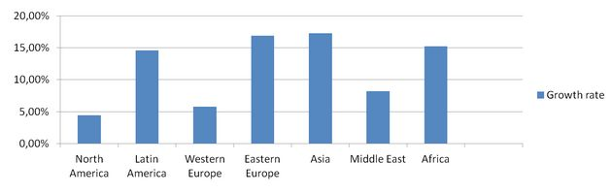
Usage of e-learning

Slide 5
Our Solution

Slide 6
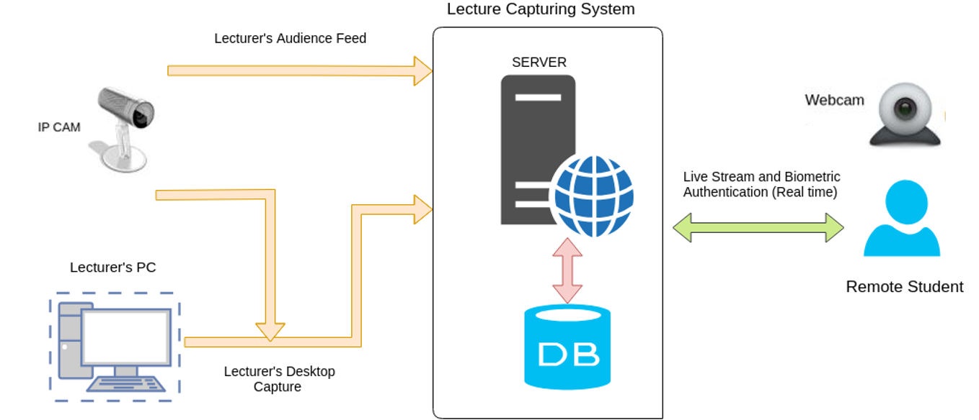
System Architecture

Slide 7
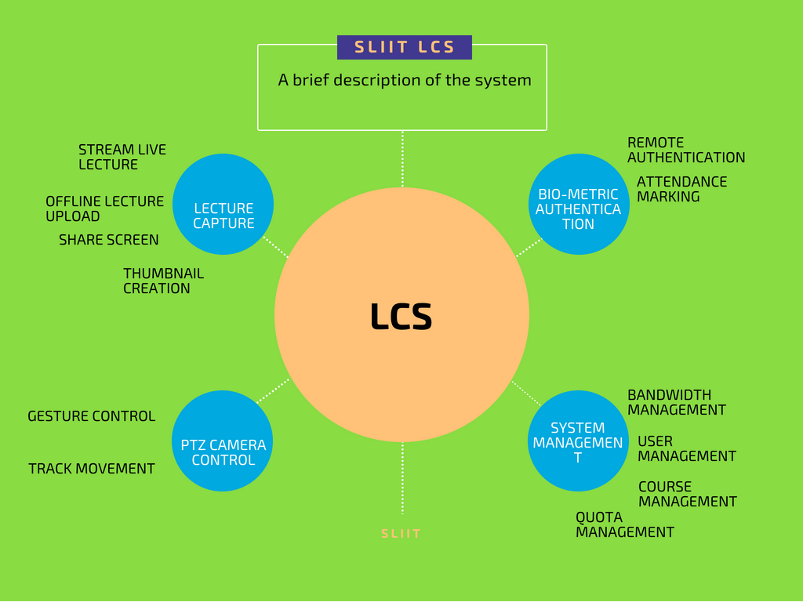

Slide 8


Demo

Slide 9
Competitor Analysis

Slide 10

Features
Lecture Capturing System
BigBlueButton
Panopto
Kaltura
Echo360
Speech Recognition
Live Laptop Screen Sharing
Multiple Course and User Management
Biometric facial recognition for authenticate Users
Capture the audience and focus on a Student
Intelligent Bandwidth and Quota Management
Facial recognition based Attendance Marking
Recognizing Gestures and follow Lecturer

Slide 11

Our Marketing Plan

Slide 12
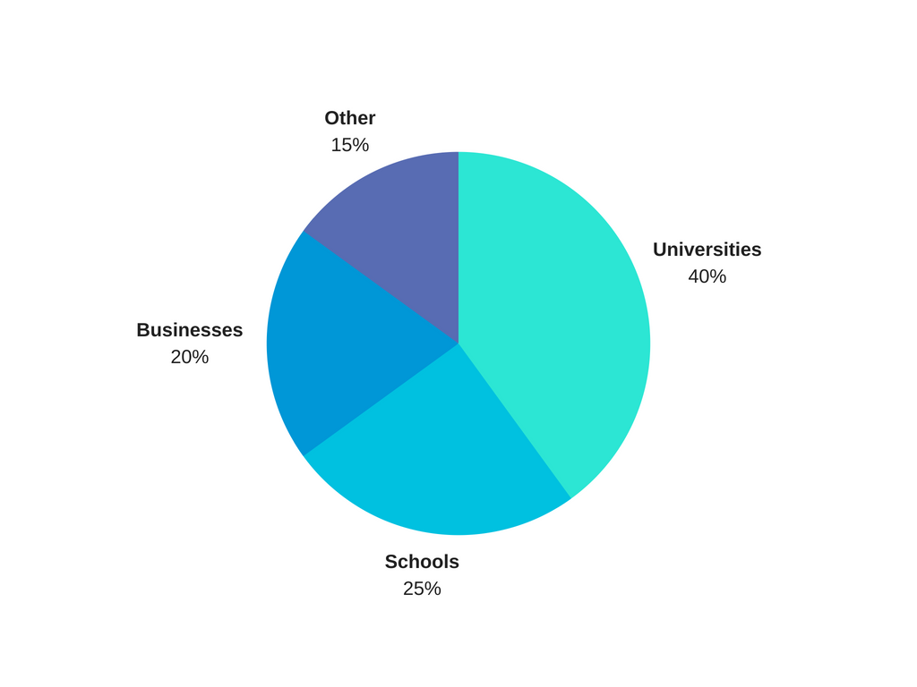
Target Market

Slide 13
Market Value
Target Market
Education institutions such as Universities and Schools.
Business Conferences.
Marketing Strategy
Conducting awareness , training programs.
Using social media , creating video tutorials.
Sending sample, free or trial versions.

Slide 14
THANK YOU!

