Slide 1
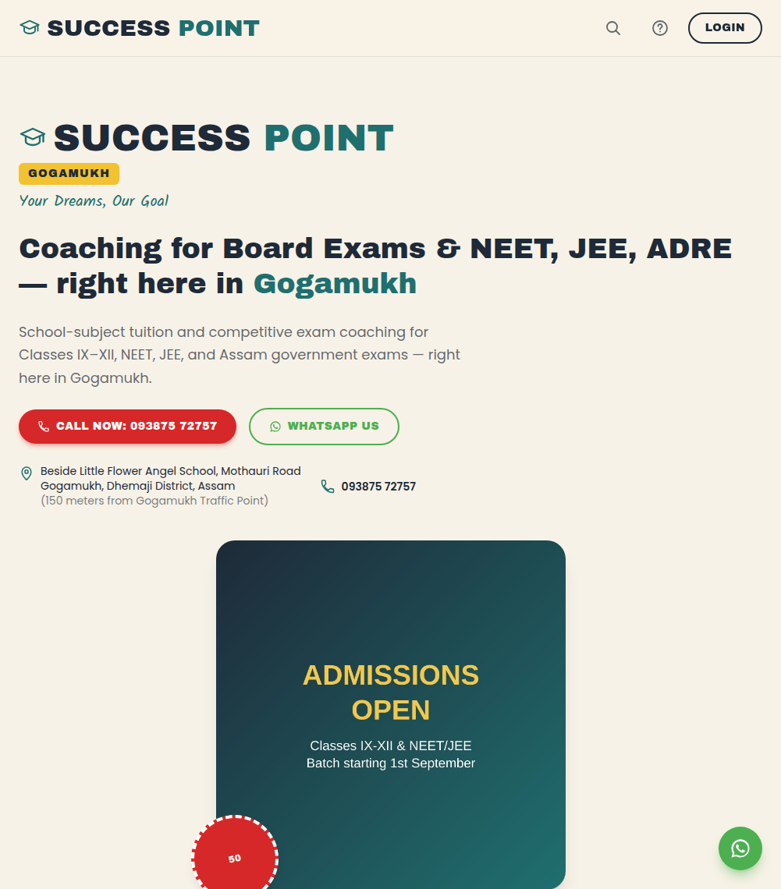
LAHON.IN TECH
Run your coaching center
like a business, not a
WhatsApp group.
A complete website, live-class, and management platform for coaching centers and colleges — built, launched, and supported end to end.
successpointgogamukh.com — live today
Custom software, built and run personally by Sourav Lahon · lahon.in

Slide 2




Every coaching center hits the same wall
Great teaching, invisible operations — growth stalls not because the coaching is bad, but because everything behind it is improvised.
Invisible online
Classes scattered everywhere
Parents comparing institutes on their phone at 10pm never find you, and never call.
A Zoom link here, a WhatsApp group there, recordings uploaded somewhere else.
Admin eats the whole day
No real record of anything
Enrollments, fee follow-ups, faculty coordination — all tracked by hand, in someone's head.
No way to see who's actually enrolled, who answered a student's doubt, or who changed a price.
02

Slide 3





One platform. Everything runs through it.
A public website that wins admissions, live classes without third-party apps, a dashboard for every role, and a record of everything — one system, not five subscriptions.
Website
Live Classes
Dashboards
Communication
Every screen that follows is the live platform, in production today.
03

Slide 4
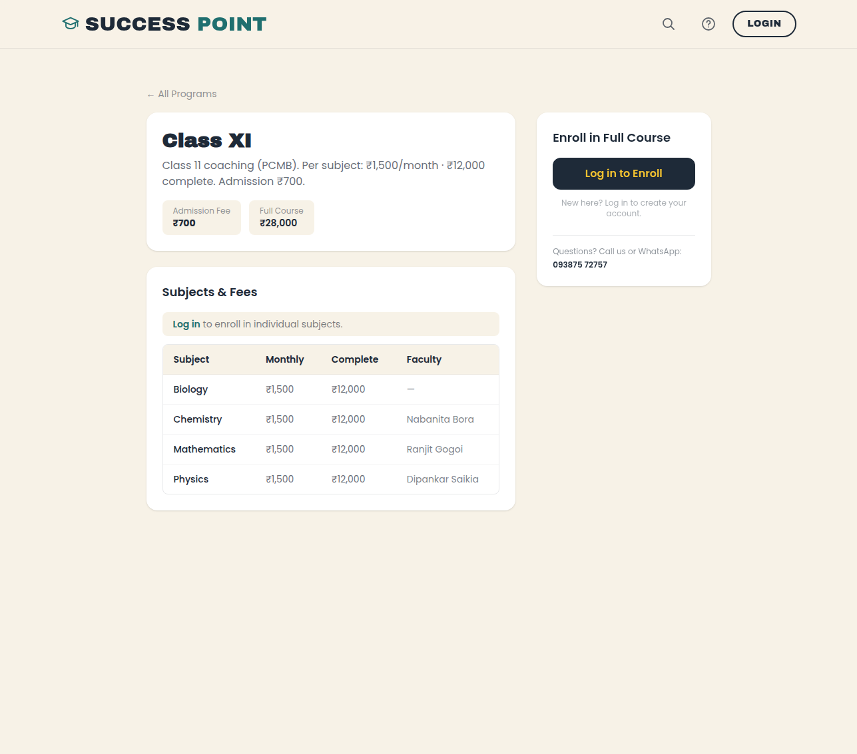

Not a concept. A real platform, live today.
Success Point Gogamukh
Gogamukh, Dhemaji District, Assam
NEET, JEE, board-exam tuition (Classes IX–XII), and Assam government exam coaching (ADRE, SSC GD, Assam Police). Zero online presence before this platform.
4
role-based dashboards
16
active courses live
100%
of enrollments tracked, none on paper
04

Slide 5

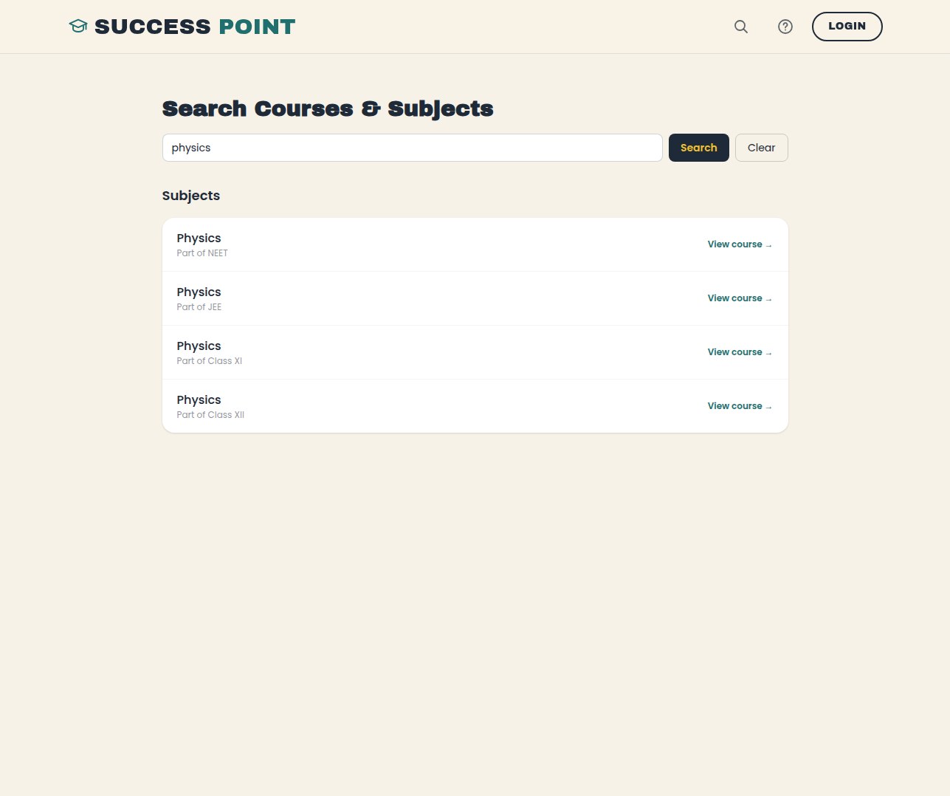
A website that actually wins admissions
Exam badges, program cards, and transparent fees — no “call for pricing”
Floating WhatsApp button, click-to-call, embedded map
Search: find any course or subject by name from the header
Full SEO — metadata, JSON-LD, sitemap — so Google can actually find you
Installable as an app on Android and iOS, works offline
05

Slide 6
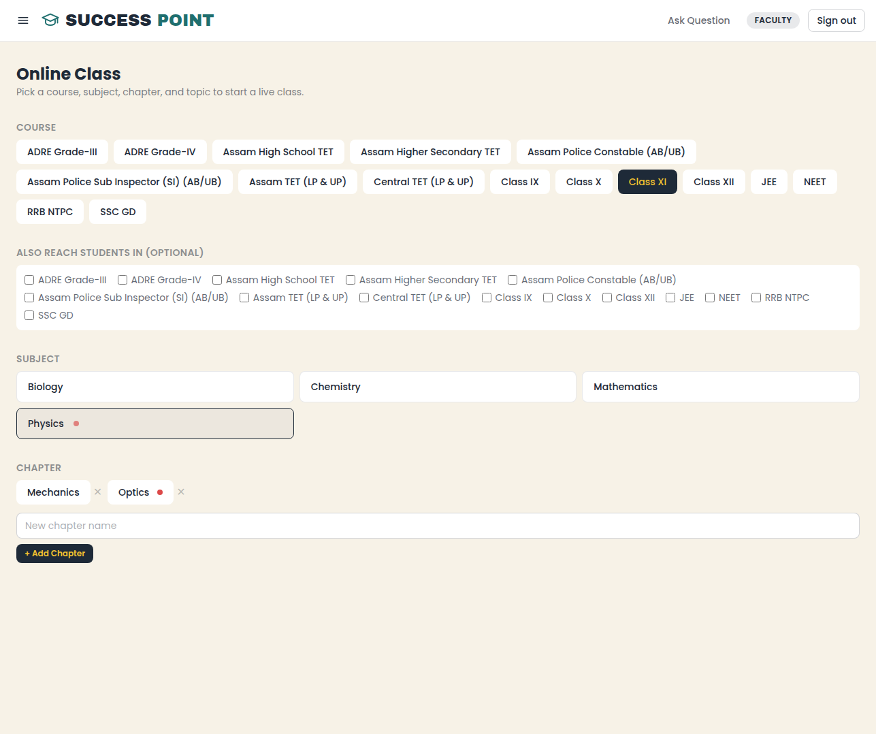
Live classes without Zoom or YouTube subscriptions
Go live in one click: pick course → subject → chapter → topic
Cross-link one class to reach students in other batches too
Ending the class cuts off every watching student automatically
Every join is logged for attendance — a real record, not a guess
Playback watermarked with the viewer's identity
06

Slide 7
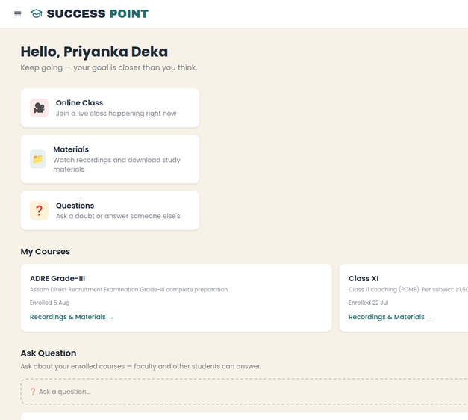
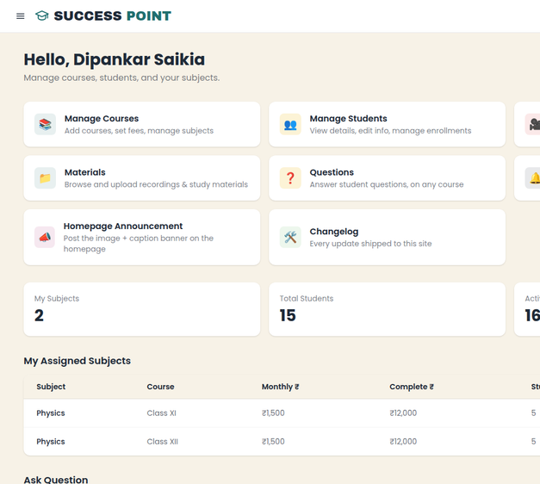
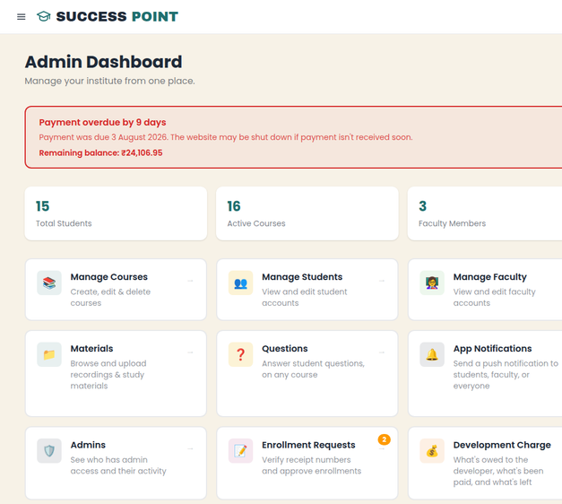
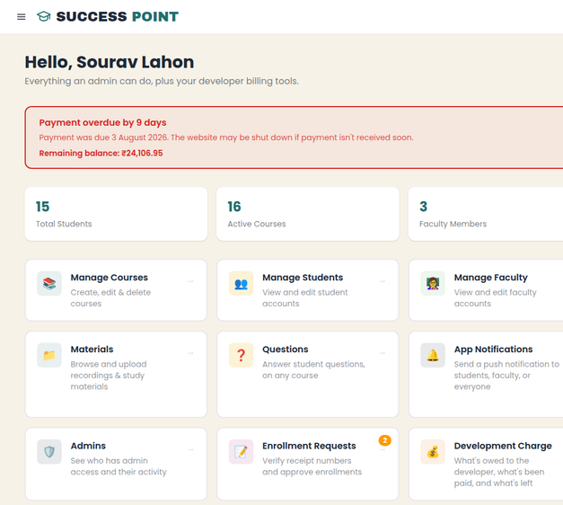
Everyone gets exactly what they need
Four roles, four dashboards — nobody sees more than they need to.
Student
Faculty
Admin
Owner
Enrolled courses, live classes, questions
Assigned subjects, students, materials
Courses, pricing, enrollments, staff
Everything admin can do, plus billing
07

Slide 8
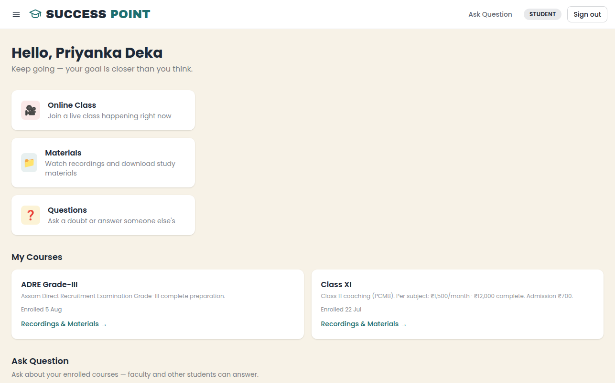
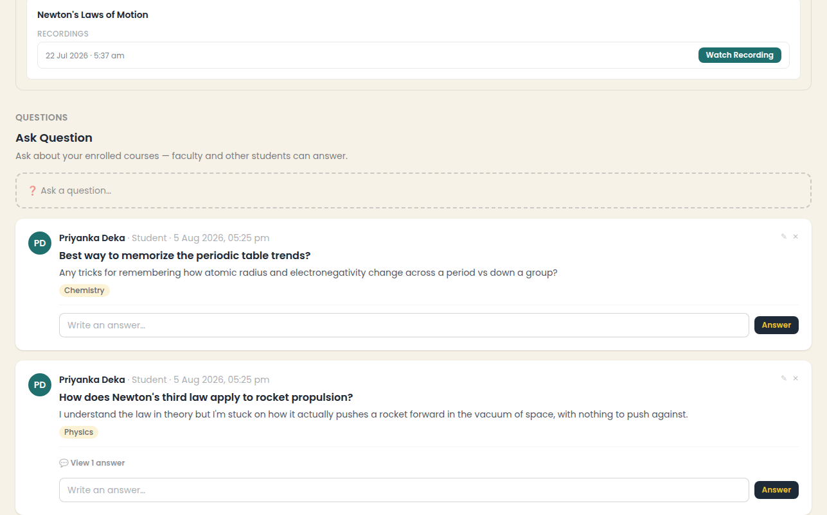
Every course, its own space
Students don't hunt through chats for this — each enrolled course carries its own dashboard, recordings, materials, and doubts.
Student Dashboard: enrolled courses, live classes, and quick links to everything else
Materials: recordings and files, with Ask Question embedded right below — scoped to that course
08

Slide 9
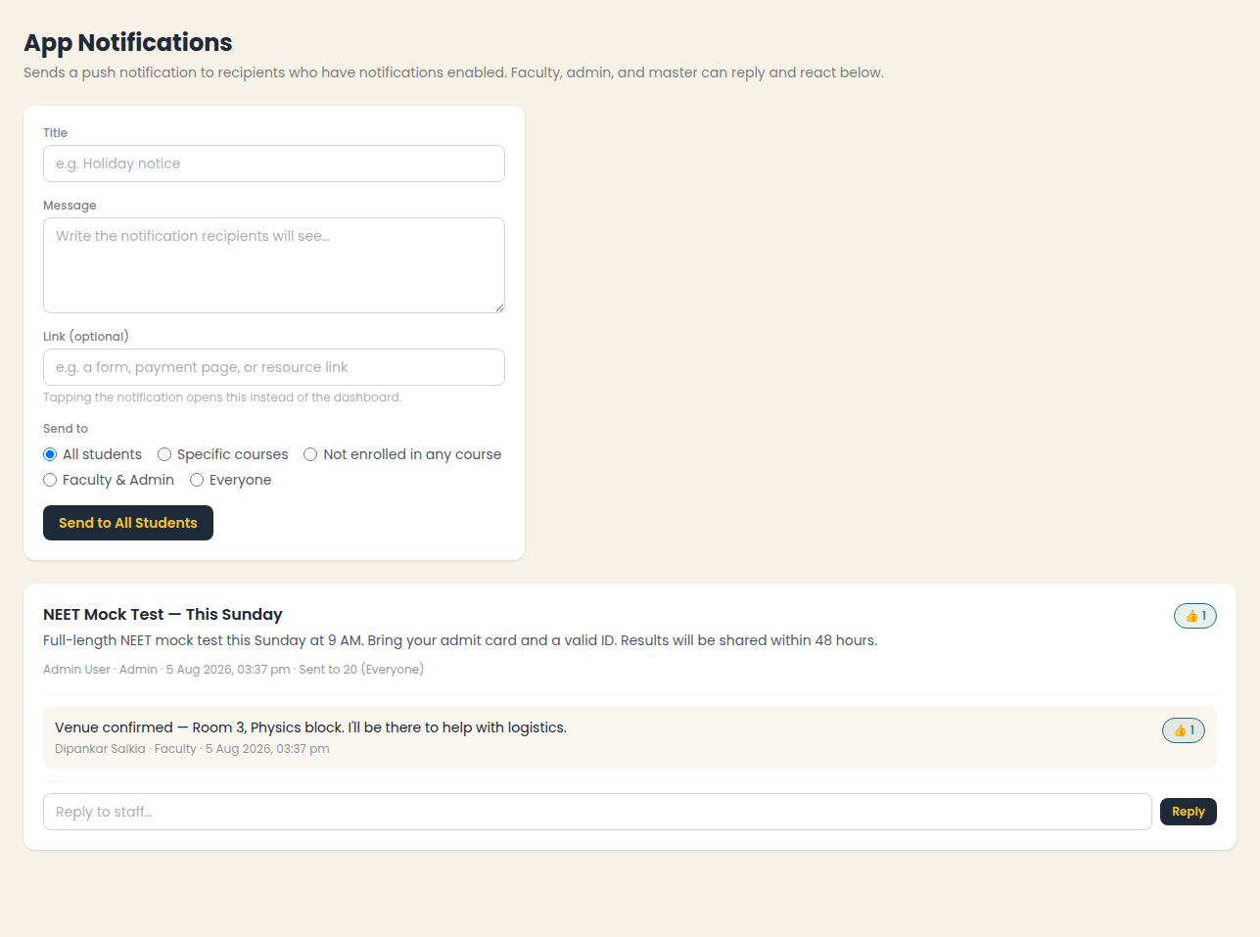
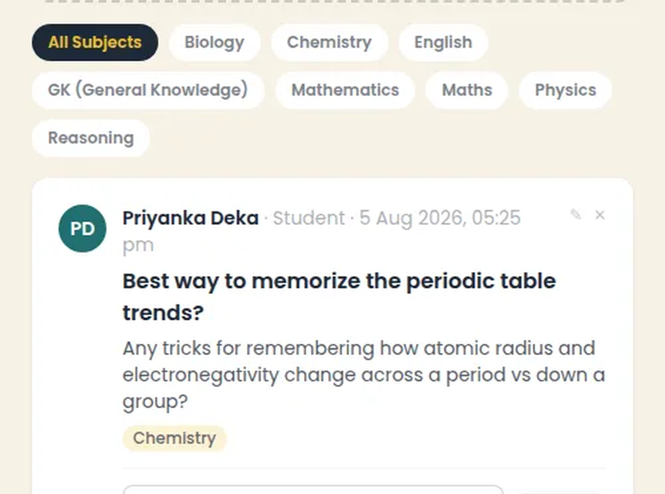
App Notifications and doubts, built in
No more “did everyone see this” over WhatsApp, and no more doubts that vanish into a group chat.
App Notifications: five audience options, replies, and 👍 reactions
Ask Question: a social-style Q&A feed with ✅/❌ answer reactions
09

Slide 10

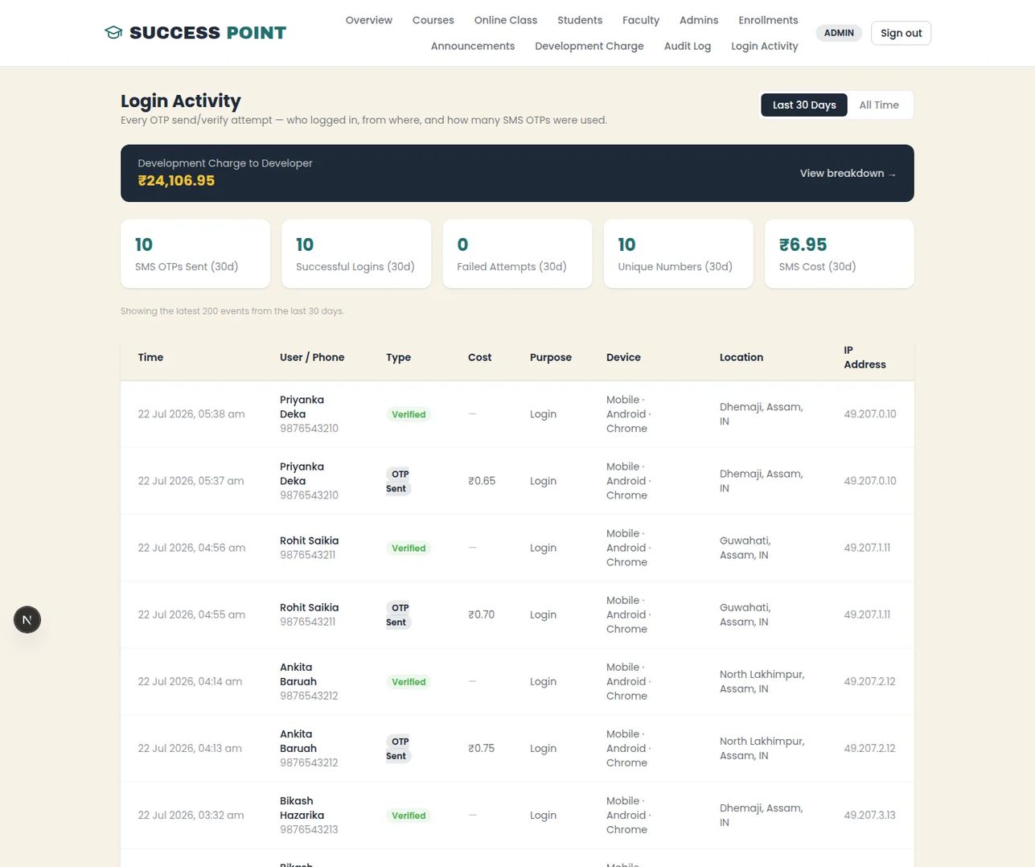
Every action, logged automatically
An immutable audit log of every price, faculty, and enrollment change
Login activity by device and location, for every OTP and password attempt
Phone number verified once, then a password — no SMS cost on every login
Self-service forgot-password, no admin has to get involved
10

Slide 11




Built around how you actually run
This isn't an off-the-shelf product you bend your institute around. Everything below has been built or can be — tell me how you work, and it gets built that way.
Complaints & grievances
Attendance & leave
Fees & installments
Students or parents raise an issue privately; staff track it through to resolution, with a record.
Mark attendance per class, flag shortfalls early, and let faculty apply for leave in the system.
Who has paid, who is due, automatic reminders — instead of a register and phone calls.
Tests & report cards
Parent access & alerts
Staff, roles & payroll
Record test scores, publish results to students, and show progress over the year.
A parent view of attendance, fees, and results, with SMS or push for anything urgent.
Salary records, staff attendance, and finer permissions than the four standard roles.
Anything specific to your institute — if you can describe it, it can be built in.
11

Slide 12
What this actually changes
Found by new families
Hours back every week
Nothing falls through the cracks
One system, four roles
Ranks and converts visitors who’d never have called otherwise.
Enrollments, pricing, and faculty changes take minutes, not phone calls.
Every login, price change, and doubt is tracked automatically.
Students, faculty, admins, and the owner each get their own view of it.
12

Slide 13



How we build it
A straight line from first call to a platform your students are actually using.
1
2
3
4
Discovery
Build
Launch
Support
One call to map your courses, batches, and what “done” looks like for you.
Your site, dashboards, and live-class flow, built against your real content.
Go live with your own domain, branding, and a working admissions funnel.
Direct access to the person who built it, not a ticket queue.
13

Slide 14

Choose how much you need
Your first year includes full setup — renewals cost less. Every tier is configured with your courses and branding.
MOST POPULAR
Website
Full Platform + Custom
Website + Dashboards
Get found, get called
Built to your workflow
₹20,000 first year
Run the whole operation
₹90,000 first year
₹60,000 first year
then ₹12,000 / year · ₹1,000 / month
then ₹54,000 / year · ₹4,500 / month
Public site with SEO
then ₹36,000 / year · ₹3,000 / month
Everything in Website + Dashboards
Every feature of the Website plan
Course catalog & search
Custom features built for you
Student / faculty / admin dashboards
WhatsApp + click-to-call
Complaints, attendance, fees, report cards
Live classes & recordings
Installable PWA
Your custom features maintained & supported
App Notifications, Ask Question & a homepage banner
Enrollment tracking, audit log & login activity
Every plan includes up to 150 active students — ₹150 per student / year beyond that.
Monthly payment available on any plan · Custom development quoted separately · ₹15 per SMS verification
14

Slide 15






Know the developer
You can read exactly how this platform was built and why, before you commit to anything.
Why It Matters to Digitalise Your Business, Entity, and Identity
Sourav Lahon
Why a signboard and word of mouth no longer win the batch — written for owners, not engineers.
Software Engineer
B.Tech — NIT Silchar
lahon.in/blog/why-digitalise-your-coaching-business
You work directly with the person who designs, builds, and runs your platform — no agency layer, no ticket queue.
A Complete Coaching Center Management System
Every feature and screen of this platform — website, dashboards, live classes, billing — explained end to end.
+91 60010 98923
lahon.in/blog/coaching-center-management-system
sourav@lahon.in
lahon.in
Success Point Gogamukh: The Full Technical Build
linkedin.com/in/lahoncs
The engineering behind it: Next.js, Prisma and PostgreSQL, OTP onboarding, and live classes.
github.com/lahonsourav
lahon.in/blog/building-success-point-gogamukh
15

Slide 16
Let's build your platform
One call to see if this fits your institute — no obligation, no generic sales pitch, just a straight look at what it'd take to get you live.
Would you like a live demo?
I'll walk you through the working platform end to end on a call — go live in a class, post an announcement, answer a doubt, and see the logs update.
+91 60010 98923
· WhatsApp
sourav@lahon.in
lahon.in
Success Point Gogamukh is live proof this works — yours could be next.

