Slide 1
Demo 1
Taras Lahotskyi
    LV-197 WebUI:Ruby

Slide 2
Abramov exercises
# 86a
Put the integer number n.
a) How many digits in the number.
# 86b
b) How much is the sum of its digits.
https://github.com/lahotskyy/abramov

Slide 3
Abramov exercises
# 544
Put the integer number n.
Find all Pythagorean triples of natural numbers,
each of which does not exceed n,
that is all three positive integers a, b, c,
where a**2 + b**2 = c**2 (a <= b <= c <= n).
https://github.com/lahotskyy/abramov/blob/master/tasks/554.rb

Slide 4
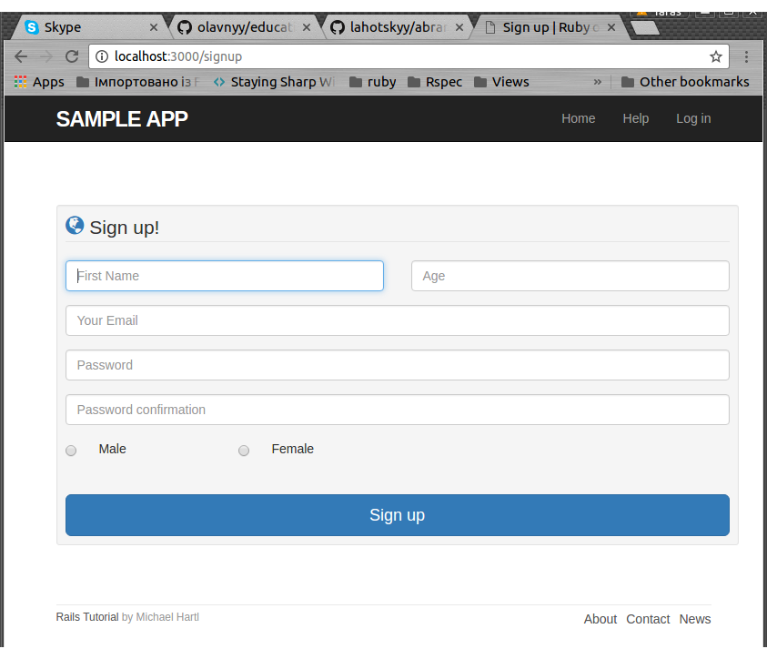
Signup Form
(by Michael Hartl)
https://github.com/lahotskyy/demo1/tree/master/demo_app

Slide 5
Primary School Report System
Task 1. Build Class model
Task 2. Add and configure CanCanCan gem
Task 3. Add permissions for different users with CanCan
and cover them tests
Task 4. Create Teachers controller
Task 5. Create Students controller
Task 6. Create Health_info model

Slide 6
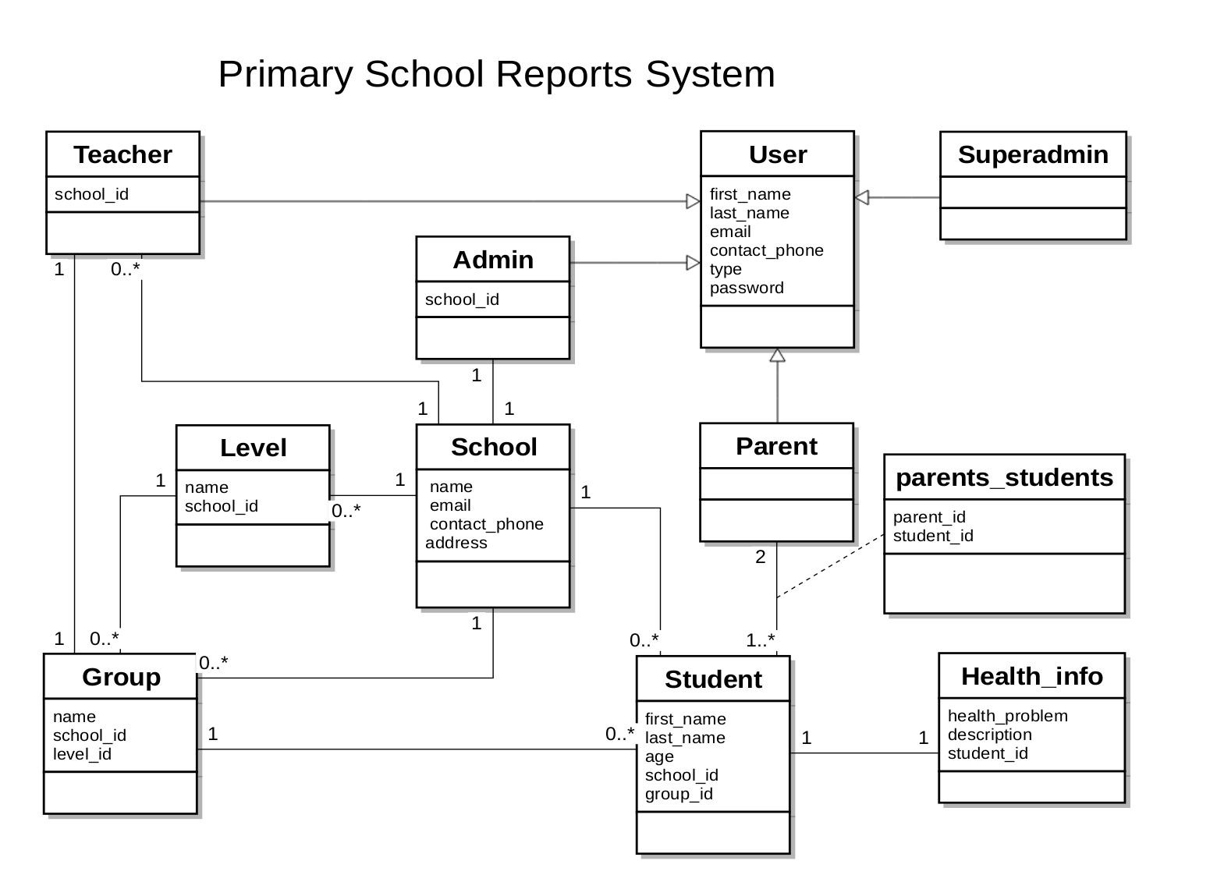
Class diagram PSRS

Slide 7
Permissions for Users
Create ability.rb
  rails generate cancan:ability
Create permissions for User
https://github.com/olavnyy/education_project/blob/development/app/models/ability.rb
Create tests for permissions
https://github.com/olavnyy/education_project/blob/development/spec/models/ability_spec.rb

Slide 8
Create Teachers and Students controllers
Create Teachers controller
https://github.com/olavnyy/education_project/blob/development/app/controllers/teachers_controller.rb
Create Students controller
https://github.com/olavnyy/education_project/blob/development/app/controllers/students_controller.rb

Slide 9
Create Health_info model
Students may have health problems that are entered in Health_info model
https://github.com/olavnyy/education_project/blob/development/app/models/health_info.rb
Update student.rb
https://github.com/olavnyy/education_project/blob/development/app/models/student.rb

Slide 10
Any questions?
???

