Slide 1




Sales Performance Analysis of Walmart Stores
Using Advanced MySQL Techniques

Slide 2

Overview
  Introduction
  Business Problem & Solutions
  Top Branch by Sales Growth
  Most Profitable Product Line
  Customer Segmentation by Spending
  Sales Anomaly Detection
  Popular Payment Method by City
  Monthly Sales by Gender
  Best Product Line by Customer Type
  Repeat Customer Identification
  Top 5 Customers by Sales
  Sales Trends by Day of Week
  Key Insights
  Recommendations
3
4
5
7
9
11
13
15
17
19
21
23
25
26

Slide 3


Introduction
Walmart is a global retail giant known for offering a wide range of products, including groceries, electronics, clothing, and household items, at affordable prices. With thousands of stores across multiple countries, Walmart strives to provide convenient shopping experiences through both physical locations and its online platform. The company focuses on delivering value to customers while maintaining operational efficiency and a strong supply chain.

Slide 4
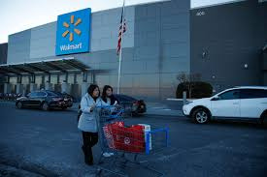

Business Problem
Walmart wants to optimize its sales strategies by analyzing historical transaction data across branches, customer types, payment methods, and product lines.
Solution
To accomplish this, advanced MySQL queries will be utilized to address complex business questions related to sales performance, customer segmentation, and product trends.
Save money. Live better

Slide 5
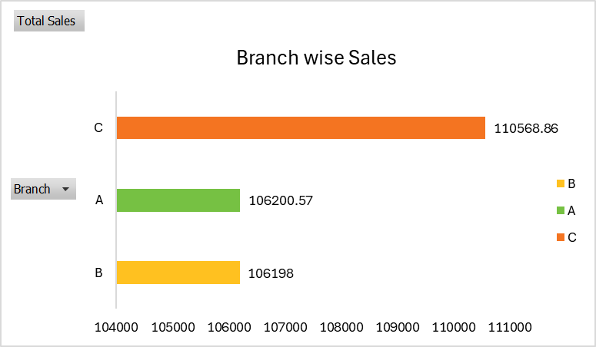
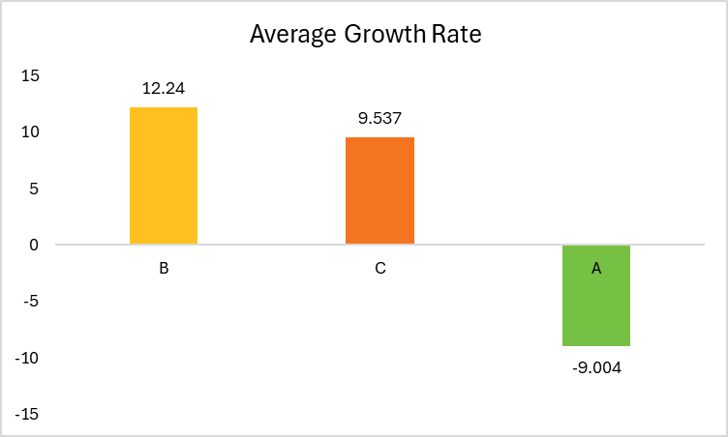
Top Branch by Sales Growth
Highest Sales
It was done by Product Line of Food and beverages with total sale of $56144.96
Branch wise Sales
Branch C has the highest total sales, followed by Branch A and Branch B.
Growth Rate
Branch B leads with an average growth rate of 12.24%, showing the highest growth despite having the lowest total sales.
Branch A experienced a negative growth rate of -9.004%, indicating a decline in sales over time.

Slide 6
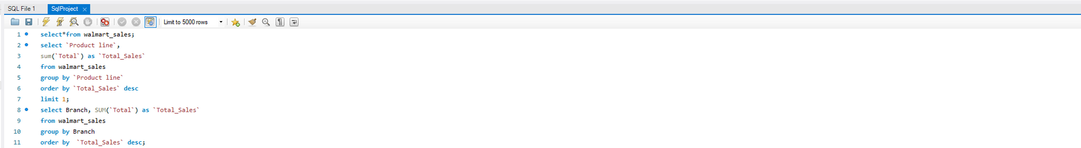

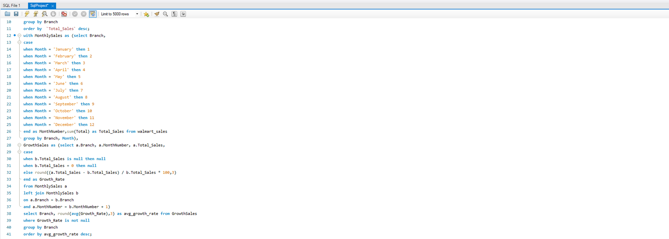

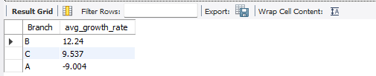
Task 1 : MySQL query and Output Table

Slide 7
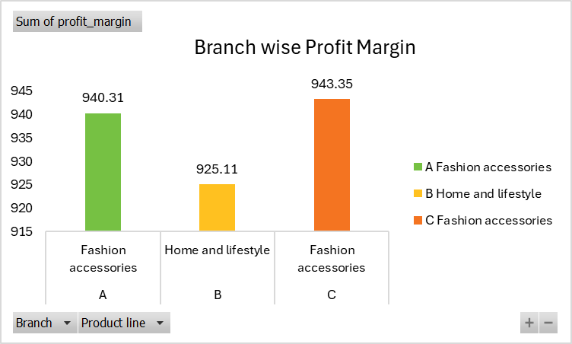
Most Profitable Product Line
Analysis
  Branch C: The most profitable product line is Fashion accessories, with a profit margin of $943.35.
  Branch A: The most profitable product line is Fashion accessories, with a profit margin of $940.31.
  Branch B: The most profitable product line is Home and lifestyle, with a profit margin of $925.11.
Conclusion
Fashion accessories is the top performer in branches A and C, while Home and lifestyle leads in branch B.

Slide 8
Task 2 : MySQL query and Output Table

Slide 9
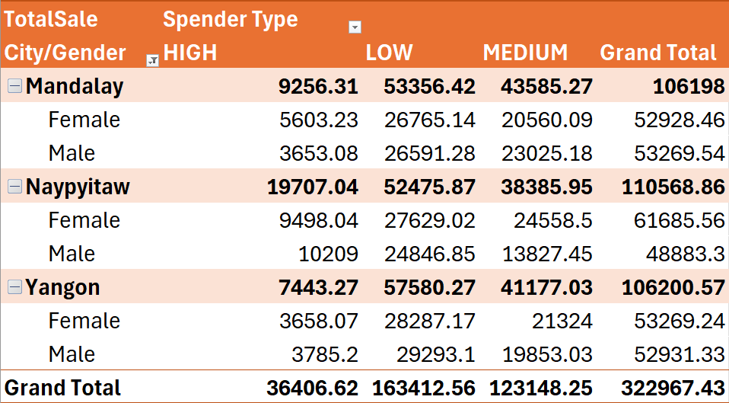
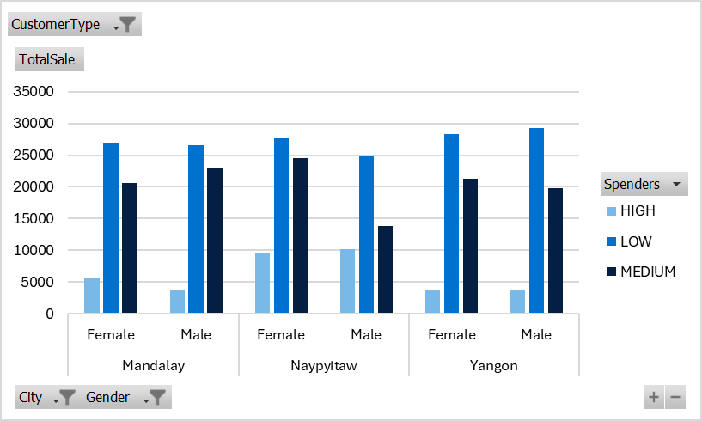
Customer Segmentation by Spending
Analysis
Conclusion
Low spenders contribute the highest total sales across all cities and genders, with a total of $163,412.56.
Medium spenders follow with $123,148.25 in total sales.
High spenders contribute the least, totaling $36,406.62.

Slide 10
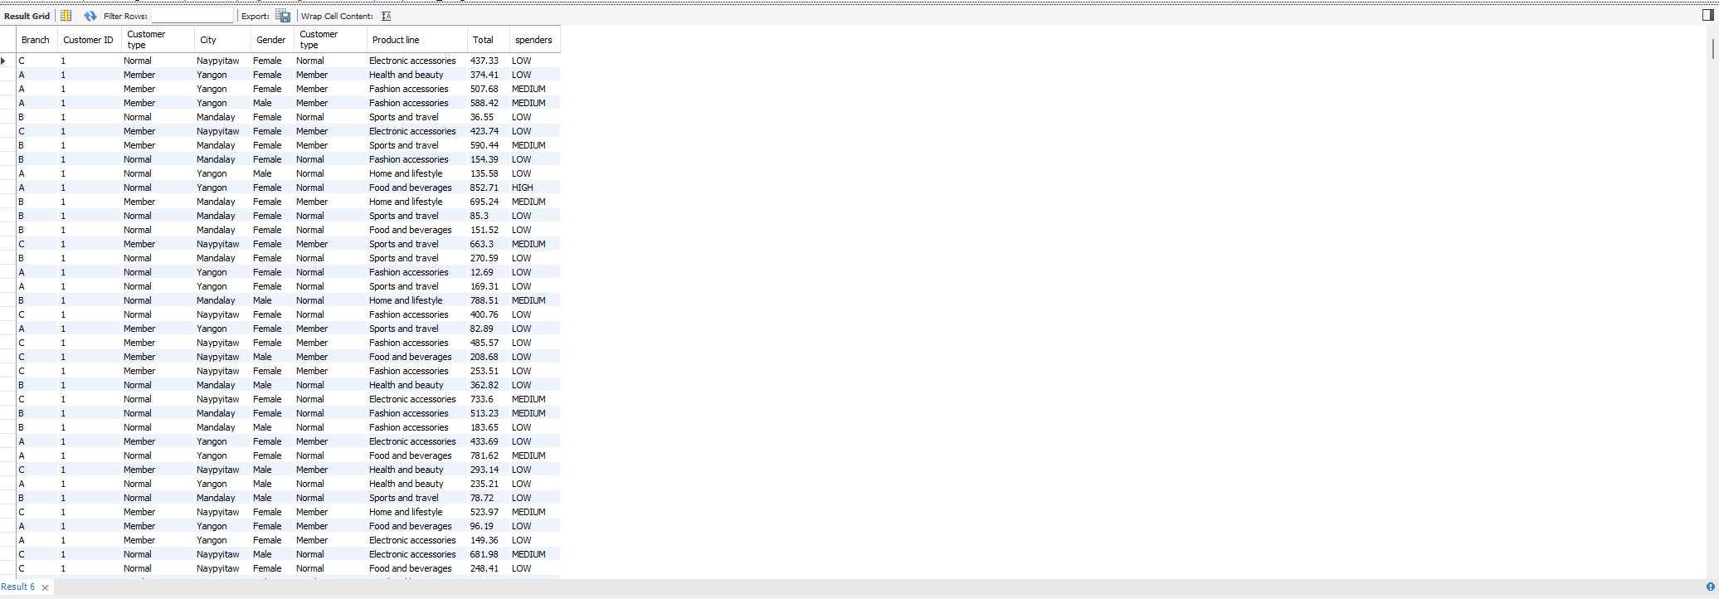
Task 3 : MySQL query and Output Table

Slide 11
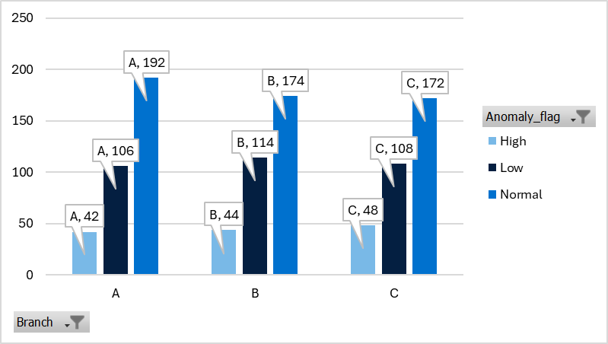
Sales Anomaly Detection
Interpretation
  Branch C has the highest number of high anomaly flags (48), indicating the largest number of transactions with unusually high sales compared to the average.
  Branch B has the most low anomaly flags (114), suggesting a higher number of transactions with unusually low sales.
  Branch A has the highest number of normal transactions (192), indicating the largest number of transactions that fall within the expected sales range.
Conclusion
Branch C may require attention to verify if its unusually high sales are justified, and Branch B should investigate the reasons for the unusually low sales in certain transactions.

Slide 12
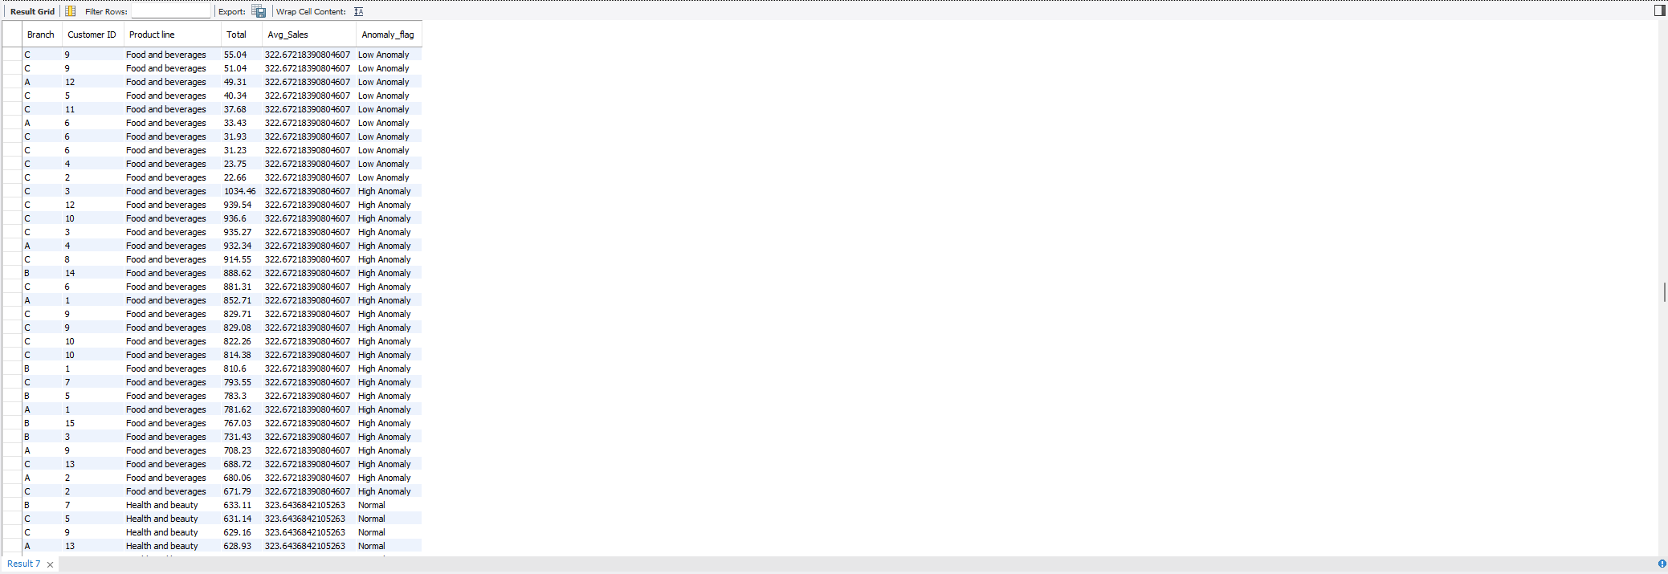
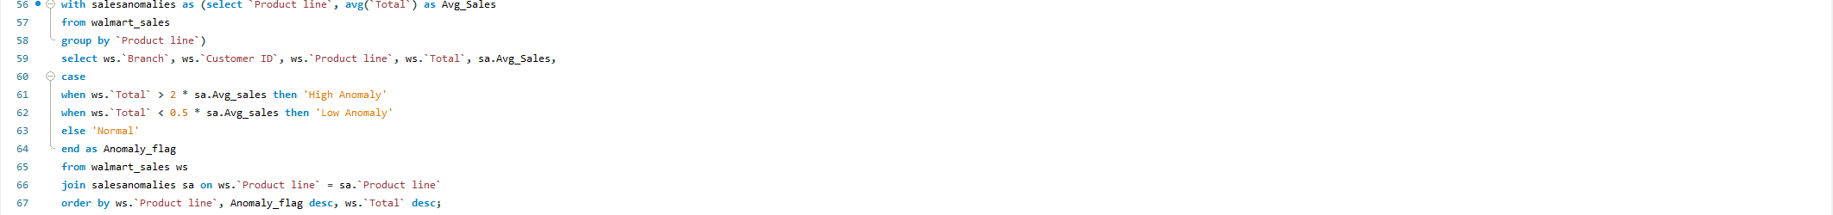
Task 4 : MySQL query and Output Table

Slide 13
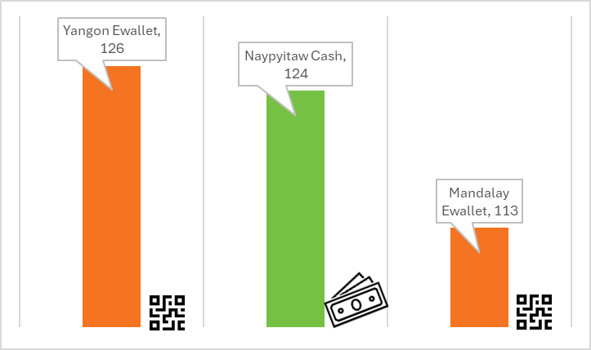
Popular Payment Method by City
Analysis
  Yangon and Mandalay prefer Ewallet as the most popular payment method.
  Naypyitaw prefers Cash as the most popular payment method.

Slide 14
Task 5 : MySQL query and Output Table

Slide 15
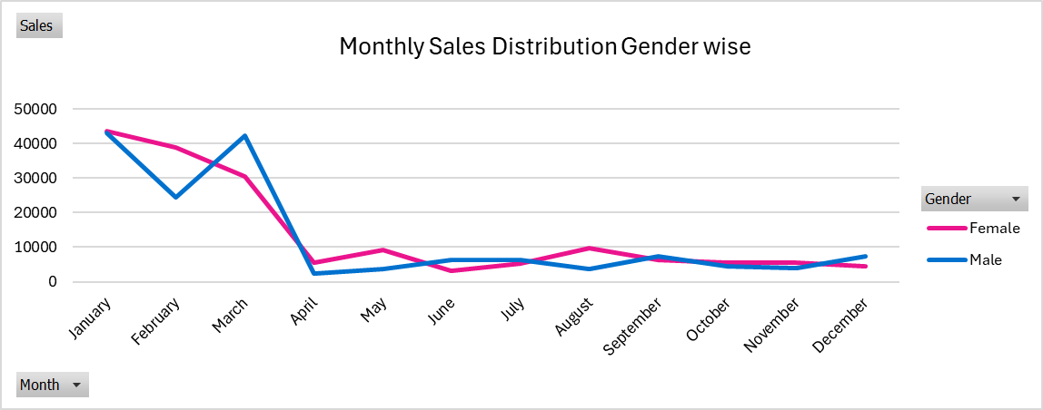
Monthly Sales Distribution by Gender
Highest Sales
Lowest Sales
  Female Sales: The highest female sales occurred in January with $43,624.80.
  Male Sales: The highest male sales occurred in March with $42,245.50.
  Female Sales: The lowest female sales occurred in June with $3,290.30.
  Male Sales: The lowest male sales occurred in April with $2,466.60.
Conclusion
January shows the highest overall sales, primarily driven by female customers.
Male sales peak in March and December, while female sales peak in January.

Slide 16
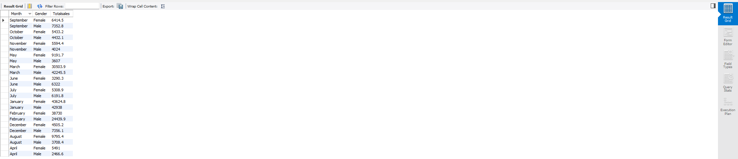
Task 6 : MySQL query and Output Table

Slide 17
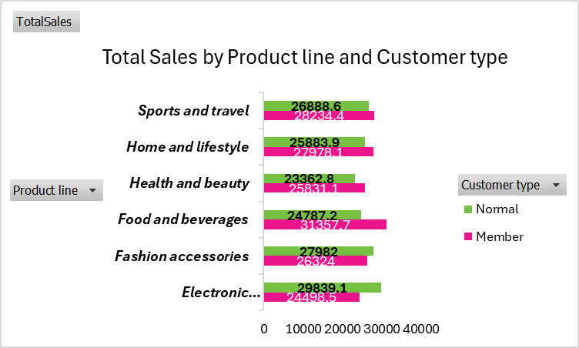
Best Product Line by Customer Type
Analysis
Highest Sales by Product Line for Normal Customers:
  Electronic accessories: $29,839.1
  Fashion accessories: $27,982
  Food and beverages: $24,787.2
Highest Sales by Product Line for Member Customers:
  Food and beverages: $31,357.7
  Sports and travel: $28,234.4
  Electronic accessories: $24,498.5
Conclusion
  For Normal customers, Electronic accessories is the top-performing product line with $29,839.1 in sales.
  For Member customers, Food and beverages is the most popular product line with $31,357.7 in sales.

Slide 18
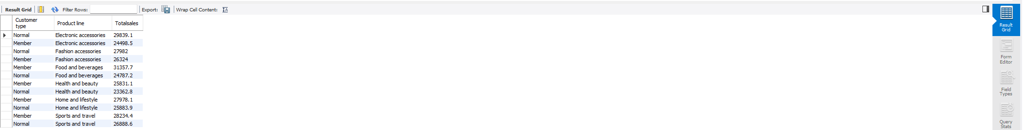
Task 7 : MySQL query and Output Table

Slide 19
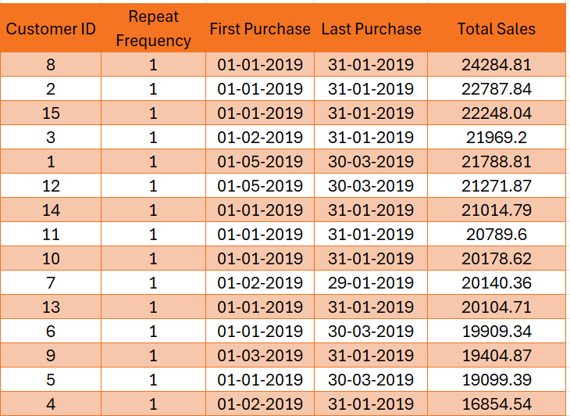
Repeat Customer Identification
Analysis
All customers have made repeat purchases within a specified timeframe (30 days). Each customer has a "Repeat Purchases" flag marked as 1, which indicates they are repeat customers.
Conclusion
  All customers have made repeat purchases, as indicated by the "Repeat Purchases" value of 1 for each.
  Purchase timeframes range between early January and March 2019, with most customers making their last purchase within January and March.

Slide 20
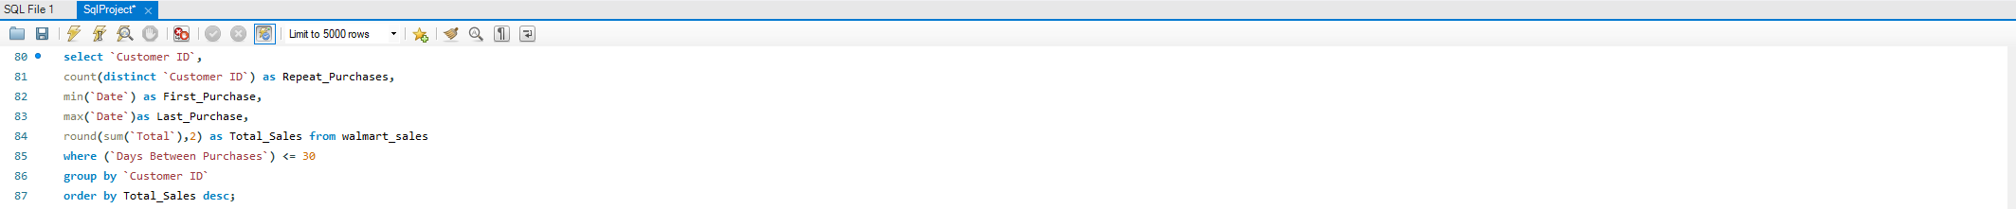
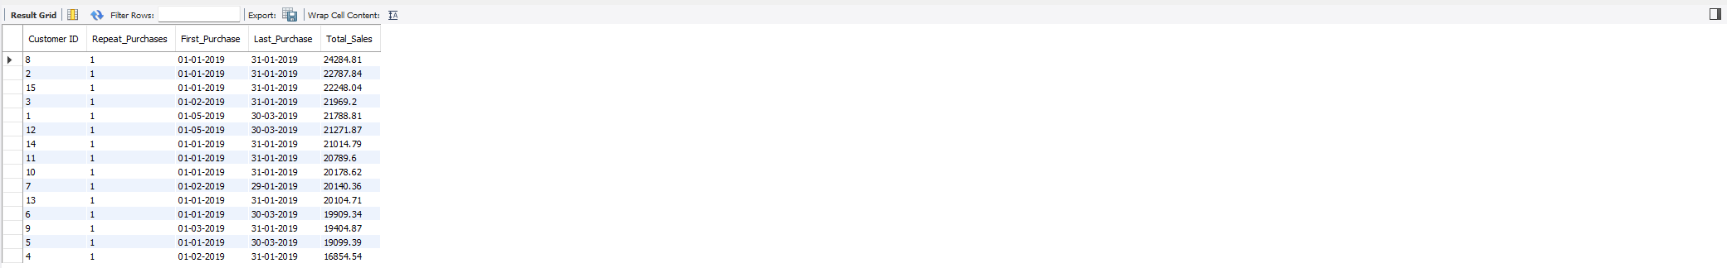
Task 8 : MySQL query and Output Table

Slide 21
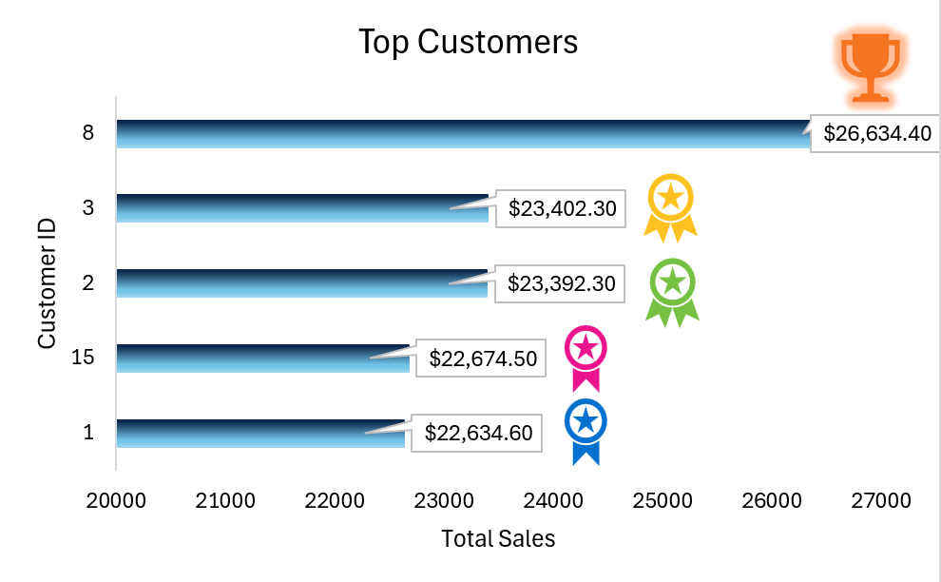
Top 5 Customers by Sales
Interpretation
Total Sales by Top 5 Performers: 113,078.70$
Total Contribution % by Top 5 Performers:
36.26%

Slide 22
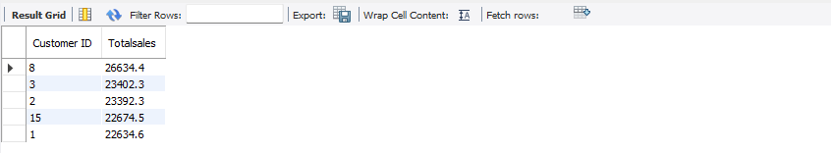
Task 9 : MySQL query and Output Table

Slide 23
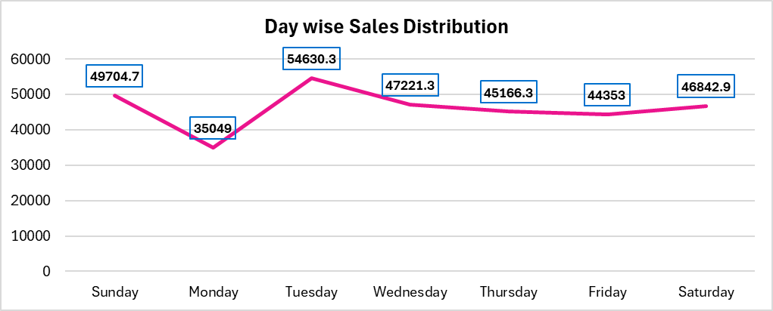
Sales Trends by Day of Week
Analysis
Highest Sales:
The highest sales occurred on Tuesday, with $54,630.30.
Lowest Sales:
The lowest sales occurred on Monday, with $35,049.
Conclusion
Tuesday brings the highest sales, while Monday experiences the lowest sales.

Slide 24
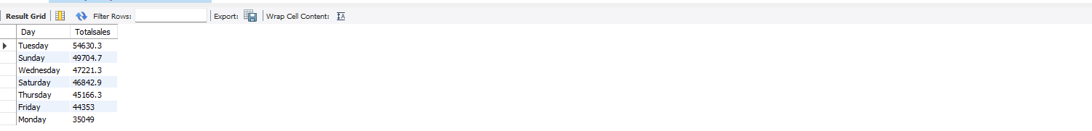
Task 10 : MySQL query and Output Table

Slide 25
Key Findings
1. Branch Performance:
  Branch B: Top performer in terms of growth rate.
  Branch C: Leads in total sales
2. Spending Patterns:
  Fashion Accessories: Top-performing product category in branches A and C.
  Home and Lifestyle: Leads in sales in Branch B.
  Mandalay: Highest sales from low spenders.
  Naypyitaw: Strong sales from high spenders.
  Yangon: Balanced but low-spenders dominate.
3. Gender-Based Spending Trends:
  Female Customers: Tend more in low and medium spender categories, with higher spending in January and February.
  Male Customers: Have a more balanced contribution across all tiers, with spikes in March and December.
4. Sales Performance Insights:
  January: Highest overall sales
  March and December: Peak sales for male customers
5. Payment Mode:
  Yangon and Mandalay: Prefer E-wallet.
  Naypyitaw: Prefers cash.
6. Product Line Preferences:
  Members: Prefer food and beverages.
  Normal Customers: Prefer electronic accessories.
7. Customer Behavior: All customers have made repeat purchases.
8. Top Performers: The Top 5 performers generated a total sales of 113,078.70$, contributing 36.26%.
9. Sales by Day: Tuesday saw highest sales while lowest sales were on Monday’s annually.

Slide 26
Business Recommendations
1. Branch Performance:
  Branch A: Investigate the decline in sales and implement strategies to improve, like promotions or customer service improvements.
  Branch B: Address low sales in certain transactions while maintaining growth rate.
  Branch C: Maintain the performance while verifying unusually high sales for consistency.
2. Spending Patterns:
  Fashion Accessories: Focus more on promotion in branches A and C.
  Home and Lifestyle: Continue focusing on this product line in Branch B.
  Mandalay: Highest sales from low spenders.
  Naypyitaw: Strong sales from high spenders.
  Yangon: Balanced but low-spenders dominate.
3. Gender-Based Spending Trends:
  Female Customers: Maintain sales in January and February by providing targeted promotions and special discount offers like wintersale20%.
  Male Customers: Boost sales by providing special offers in March and December.

Slide 27
Business Recommendations
4. Payment Modes:
  Yangon and Mandalay: Promote E-wallets further by giving reward points.
  Naypyitaw: Ensure smooth cash transactions and offer discounts to encourage E-wallet use.
5. Product Preferences:
  Members: Focus on food and beverages, offering loyalty programs or discounts.
  Normal Customers: Continue promoting electronic accessories.
6. Sales by Day:
  Tuesday: Replicate successful strategies to boost Monday sales.
  Monday: Investigate reasons for low sales and consider promotions to encourage shopping by giving discounts.
7. Customer Retention: Continue investing in loyalty programs to encourage repeat business and strong customer retention.
8. Trend Analysis: Tailor marketing campaigns to align with gender-based spending trends, particularly in January, March, and December.

Slide 28

THANK YOU
For watching this presentation
Made by : Saumya Lahri

