Slide 1
FINAL YEAR B.TECH PROJECT · IEEE-STYLE PROJECT DEMONSTRATION
Indian Institute of Computing & Technology (IICT), New Delhi
AI-Driven Phishing Email Detection
Using Natural Language Processing & Machine Learning
127,428
Emails Trained
6
Classifiers Benchmarked
99.31%
Best Accuracy (MLP)
Candidate: Lahya Sree Bollinkala · Academic Year 2026–2027 · Streamlit · FastAPI · Scikit-Learn · Docker
Notes:
Welcome the panel. Good morning/afternoon, respected judges, faculty members, and friends. I am Lahya Sree Bollinkala, and I present my final-year B.Tech project titled 'AI-Driven Phishing Email Detection Using NLP'. Today I will walk you through a production-grade machine-learning system that detects phishing emails by combining natural-language processing with engineered structural features, and ships as a Streamlit web application, a FastAPI REST service, and a Docker container. The system was developed at the Indian Institute of Computing & Technology, New Delhi for the academic year 2026-2027.

Slide 2
01 · OVERVIEW
Project Overview
Production-grade ML system for real-time email threat classification.
▪ Merges 7 public email datasets into one unified corpus.
▪ Hybrid features: 10,000 TF-IDF terms + 15 metadata features.
▪ 6 ML classifiers benchmarked on accuracy, precision, recall, F1, ROC & PR-AUC.
▪ Inference engine: verdict, confidence, risk score (0–100), explanation & report.
▪ Deployed as Streamlit UI + FastAPI REST API + Docker.
127,428
Emails trained
6
ML classifiers
Tech Stack
Python 3.14 · scikit-learn · NLTK · XGBoost · LightGBM · Streamlit · FastAPI · Plotly · Docker · pytest
99.31%
Best accuracy
10,015
Features
AI-Driven Phishing Email Detection Using NLP · IICT New Delhi
2
Notes:
Give the big picture before diving into detail. This is an end-to-end machine-learning project. We merged seven public email datasets into a corpus of roughly 165,000 emails, cleaned them with an NLP pipeline, engineered a hybrid feature set of 10,015 features, and benchmarked six classifiers. The best model - a Neural Network - reached 99.31% accuracy with a 99.34% F1 score. The system is deployed through a cyber-themed Streamlit dashboard, a FastAPI REST API, and is fully containerised with Docker. Four key numbers to remember: 127,428 emails trained on, 6 models compared, 99.31% accuracy, and a best-model prediction time of about 0.6 seconds per email.

Slide 3
02 · PROBLEM STATEMENT
The Problem
Why phishing remains the hardest email attack to stop
Phishing is a people problem
Attackers exploit urgency, fear and authority — not software vulnerabilities. A single click can compromise credentials.
Signature & blacklist filters are reactive
They only catch known patterns and already-reported URLs. Newly registered phishing domains evade them (zero-hour attacks).
!
Content is the untapped signal
Rule-based keyword filters are trivially bypassed by paraphrasing; they ignore structural cues like URL density and uppercase ratio.
The bar is rising
Generative AI now produces fluent, personalised phishing — static filters cannot keep pace with evolving language.
AI-Driven Phishing Email Detection Using NLP · IICT New Delhi
3
Notes:
Phishing remains one of the most effective attack vectors because it targets the human rather than the machine. Attackers craft emails that create urgency, impersonate trusted brands, and embed links to credential-harvesting pages. Traditional defenses have three weaknesses: rule-based keyword filters are trivial to bypass with paraphrasing; blacklists and URL reputation fail against newly registered domains, the so-called zero-hour attacks; and users cannot reliably detect socially engineered messages, especially now that generative AI produces near-perfect English. This creates a clear need for a detection system that analyses the actual content and structure of the email, which is exactly what this project implements.

Slide 4
03 · MOTIVATION
Motivation
1
Cybersecurity reality
Phishing drives credential theft, ransomware delivery and business-email-compromise; inbox filters cannot fully stop socially engineered mail.
2
Technical gap
Most filters use metadata and blacklists alone. Combining semantic content (TF-IDF) with structural features is under-used and harder to bypass.
3
Practical value
An explainable, real-time detector with risk scores and recommendations is directly deployable to end users and mail infrastructure.
4
Academic completeness
Demonstrates the full ML lifecycle — data engineering, NLP, feature engineering, benchmarking, evaluation and deployment.
AI-Driven Phishing Email Detection Using NLP · IICT New Delhi
4
Notes:
Motivation comes from three directions. First, the security reality - phishing drives credential theft and business-email-compromise, and spam filters alone cannot stop targeted attacks. Second, the technical gap - most existing filters rely on metadata and blacklists rather than semantic and structural content analysis; we combine both. Third, the academic opportunity - this project demonstrates a complete machine-learning lifecycle: data engineering, NLP, feature engineering, model comparison, evaluation, and deployment, which is precisely the skill set expected of a final-year B.Tech student in an IEEE-style demonstration.

Slide 5
04 · OBJECTIVES
Project Objectives
1
Multi-source corpus
Merge 7 public datasets (~165K emails) into one unified schema with provenance tracking.
2
NLP preprocessing
12-step cleaning pipeline: HTML strip, URL/email/signature removal, tokenize, stopword filter, WordNet lemmatize.
3
Hybrid feature engineering
10,000-term TF-IDF (uni+bigram) combined with 15 scaled metadata features.
4
Benchmark 6 classifiers
Logistic Regression, Naive Bayes, Random Forest, XGBoost, LightGBM, MLP — identical data and splits.
5
Production inference engine
Verdict, confidence, 0–100 risk score, keyword highlighting, URL extraction, explanation, report download.
6
Deployment
Streamlit dashboard, FastAPI REST API with Swagger docs, CLI pipeline, Docker one-command startup.
AI-Driven Phishing Email Detection Using NLP · IICT New Delhi
5
Notes:
The project has six concrete objectives, each mapped to a delivered module: one, build a multi-source corpus by merging seven datasets into a unified schema; two, design an NLP preprocessing pipeline for email text; three, engineer a hybrid feature set combining 10,000 TF-IDF terms with 15 metadata features; four, benchmark six machine-learning classifiers under identical conditions; five, build a production inference engine with confidence scores, risk scoring, and natural-language explanations; and six, deploy the system as a Streamlit UI, a FastAPI API, and a Docker image. Every objective corresponds to a working component you will see in the demo.

Slide 6
05 · EXISTING SYSTEMS
Existing System & Its Gaps
✕
✕
What is missing?
A detector that reads both what an email says and how it is written:
▪ Semantic content — cleaned, lemmatized tokens
▪ Structural signals — URLs, uppercase ratio, punctuation, subject
▪ Social-engineering lexicon — urgency and credential keywords
▪ Large multi-source training corpus
▪ Explainable output — confidence, risk score, reasons
Rule-based keyword filters
Match fixed word lists; instantly defeated by paraphrasing or obfuscated spelling.
Blacklist / URL reputation
Reactive; powerless against newly registered phishing domains and zero-hour campaigns.
✕
✕
Classic spam filters (Bayesian)
Bag-of-words only; ignore structure such as URL density, uppercase ratio and subject cues.
Metadata-only ML baselines
Use headers/sender data alone; miss the linguistic content that defines phishing.
Our system closes these gaps — combining NLP content analysis with engineered metadata in one hybrid model.
AI-Driven Phishing Email Detection Using NLP · IICT New Delhi
6
Notes:
To position the contribution, we analyse the limitations of existing systems. Rule-based systems match fixed keyword patterns and break immediately when wording changes. Blacklist and URL-reputation systems only detect previously reported infrastructure. Standard spam filters such as Bayesian classifiers treat the email as a bag of tokens and ignore structure like URL density and subject characteristics. Finally, a common problem in simple ML baselines is that they either use text features alone or metadata alone - never both. Our system is designed to close these gaps by using cleaned semantic content plus structural metadata together in one model, trained on a large multi-source corpus.

Slide 7
06 · PROPOSED SYSTEM
Proposed System
NLP Preprocessing
HTML strip · URL/email removal · signature strip · tokenize · stopword removal · lemmatize
Feature Engineering
TF-IDF 10,000 terms + 15 metadata features, standardized & stacked
Model Benchmarking
6 classifiers trained & evaluated; best selected by F1 score
Inference Engine
Verdict · confidence · risk score 0–100 · explanations · recommendations
Deployment
Streamlit UI · FastAPI REST · CLI pipeline · Docker
AI-Driven Phishing Email Detection Using NLP · IICT New Delhi
7
Notes:
Our proposed system is a modular pipeline. Raw email text first passes through NLP preprocessing - HTML stripping, URL and signature removal, tokenization, stopword removal, and WordNet lemmatization. Then feature engineering combines a 10,000-term TF-IDF representation with 15 scaled metadata features. Six classifiers are trained and the best is selected by F1 score. At inference time, the system returns a verdict, a confidence value, a 0-100 risk score, the suspicious keywords detected, extracted URLs, an explanation, and an actionable recommendation. The same engine is exposed through a web UI, a REST API, and a CLI training pipeline.

Slide 8
07 · DATASET
Dataset Description
Seven public email corpora merged into a single unified dataset
Source Dataset | Emails (merged) | Type / Origin
Phishing Email | 82,486 | Phishing corpus (labeled)
CEAS 08 | 39,154 | Spam / phishing benchmark
Enron | 29,767 | Corporate legitimate mail
SpamAssassin | 5,809 | Spam & ham corpus
Nigerian Fraud | 3,332 | 419 advance-fee fraud
Ling | 2,859 | Ling-spam corpus
Nazario | 1,565 | Phishing corpus
TOTAL | 164,972 | 7 sources
Unified Schema
text_combined · subject · body
sender · label (0/1)
source_dataset (provenance)
Heterogeneous schemas are normalised in DatasetLoader.
Why multi-source?
▪ Broad vocabulary coverage
▪ Real-world legitimate mail (Enron)
▪ Diverse attack templates (419 fraud, phishing kits)
▪ Reduced corpus bias
AI-Driven Phishing Email Detection Using NLP · IICT New Delhi
8
Notes:
The dataset layer merges seven public email corpora. The largest is the Phishing Email dataset with over 82,000 labeled phishing samples. CEAS-08 contributes roughly 39,000 spam and phishing messages from the 2008 CEAS challenge. Enron provides almost 30,000 genuine corporate emails, which anchors the legitimate class. SpamAssassin adds about 5,800 spam-and-ham messages, the Nigerian Fraud corpus captures 4-1-9 advance-fee scam templates, Ling and Nazario round out the spam and phishing coverage. The merging logic in DatasetLoader normalises each file's heterogeneous schema - some have subject and body, some only text - into one common schema with a source_dataset column for traceability.

Slide 9
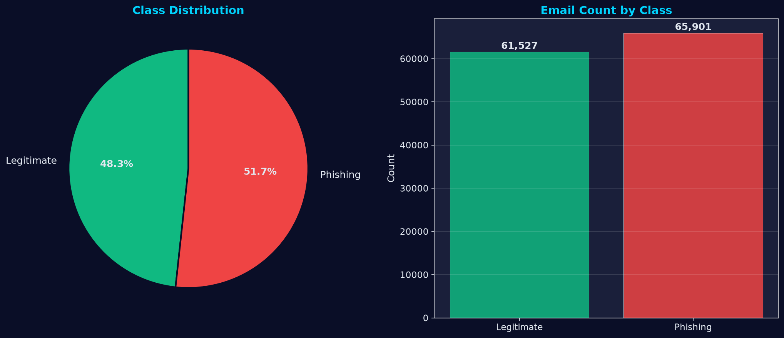
08 · DATASET
Dataset Statistics
After cleaning — the training corpus used for all six models
127,428
Total emails after cleaning
65,901
Phishing (51.7%)
61,527
Legitimate (48.3%)
101,942 / 25,486
Train / Test (80/20, seed 42)
Figure: class distribution (pie & bar) generated by evaluate_models.py
Class balance (mild imbalance)
Handled via class_weight=“balanced” (sklearn) and scale_pos_weight (boosted trees).
AI-Driven Phishing Email Detection Using NLP · IICT New Delhi
9
Notes:
After merging we obtained 164,972 emails. Cleaning and de-duplication left 127,428 usable samples, which were split 80/20 in a stratified fashion with a fixed random seed of 42, giving about 101,942 training and 25,486 test emails. The class distribution is nearly balanced - 51.7% phishing versus 48.3% legitimate - which is good for training, though the gradient-boosted models still received class weights. This pie and bar chart on the right is generated by our evaluation module. The final feature matrix has 10,015 dimensions.

Slide 10
09 · DATA PREPROCESSING
NLP Preprocessing Pipeline
12 deterministic cleaning steps applied to every email
Step 1
Lowercase
case folding
Step 2
Strip HTML
tags → text
Step 3
Remove URLs
http / www / ftp
Step 4
Remove emails
addresses
Step 5
Strip signatures
regards, ——, sent from
Step 6
Clean chars
punct, digits, emoji
Step 7
Tokenize
NLTK word_tokenize
Cleaned Text Output
Clean, token-joined text ready for TF-IDF vectorization — stored in cleaned_dataset.csv.
Quality Controls
▪ Truncate > 50,000 chars · drop duplicates
▪ Remove empty / < 10-char texts · cache cleaned data
Step 8
Stopwords
remove + 1-char
Step 9
Lemmatize
WordNet
AI-Driven Phishing Email Detection Using NLP · IICT New Delhi
10
Notes:
Preprocessing follows a strict 12-step order. We lowercase, strip HTML tags, remove URLs and email addresses, cut off signature blocks, remove punctuation, numbers and emoji, tokenize with NLTK, drop English stopwords and single-character tokens, and finally lemmatize every token using WordNet. Quality controls include truncating emails beyond 50,000 characters, removing duplicate cleaned texts, dropping empty rows, and discarding texts shorter than 10 characters. Each step is an isolated method in TextPreprocessor, so the pipeline is fully testable - and there are unit tests verifying it.

Slide 11
10 · FEATURE ENGINEERING
Feature Engineering
One sparse matrix — lexical content + structural metadata
TF-IDF Features
10,000 top terms
Unigrams + bigrams, min_df=3, max_df=0.95, sublinear TF
Vocabulary + bigram phrases from cleaned text — captures phishing phrasing.
Metadata Features (15)
Extracted from RAW text & subject
URL count · uppercase ratio · keyword score · subject stats · length & punctuation cues
Standardized with StandardScaler so gradients stay stable.
hstack → Combined Sparse Matrix
10,000 TF-IDF + 15 scaled metadata = 10,015 features
Fit on training data only — no data leakage · same transforms reused at test & inference
AI-Driven Phishing Email Detection Using NLP · IICT New Delhi
11
Notes:
Feature engineering produces a single sparse matrix by horizontally stacking two feature blocks. The first block is TF-IDF on the cleaned text, capped at 10,000 terms using unigrams and bigrams. The second block is 15 metadata features extracted from the ORIGINAL raw text - this matters because structural signals such as URL count and uppercase ratio would be destroyed by cleaning. Metadata is standardized with StandardScaler so gradients stay stable. The fit happens on training data only, which prevents data leakage, and the same transform is applied to test and inference time. Total: 10,015 features.

Slide 12
11 · TF-IDF VECTORIZATION
TF-IDF Vectorization
Parameter | Value
max_features | 10,000
ngram_range | (1, 2) — unigrams + bigrams
min_df | 3 documents
max_df | 0.95 (95%)
sublinear_tf | 1 + log(tf)
strip_accents | unicode
Concept
tf-idf(t, d) = tf(t, d) × idf(t)
idf(t) = log( N / df(t) )
Weights each term by how often it appears in a document, down-weighting terms common across the corpus — so distinctive phishing phrases earn high weights.
Terms that occur in almost every email (e.g. ‘the’, ‘and’) get near-zero weight; rare, telling terms carry the signal.
Sparse CSR matrix — memory-efficient at 127K × 10K dimensions.
10,000-term vocabulary
Unigrams + bigrams → phrases like ‘click here’ are captured as tokens.
AI-Driven Phishing Email Detection Using NLP · IICT New Delhi
12
Notes:
TF-IDF, or term frequency - inverse document frequency, weights each term by how often it appears in a document and down-weights terms that appear across most documents, so common words carry less signal. The TfidfVectorizer is configured with max_features 10,000, n-gram range (1,2) for unigrams and bigrams, minimum document frequency of 3, a maximum document frequency of 95%, sublinear term frequency scaling 1+log(tf) to tame very frequent terms, and unicode accent stripping. This gives the models a compact but expressive vocabulary of phishing and legitimate phrasing.

Slide 13
12 · METADATA FEATURES
15 Engineered Metadata Features
Structural & social-engineering signals extracted from the raw email
Why metadata?
Computed from the ORIGINAL text, before cleaning, so these cues survive.
Cleaning removes exactly the signals phishing emails use most — URLs, ALL-CAPS, punctuation bursts and urgent keywords. Metadata restores them alongside TF-IDF, making the models harder to fool by rephrasing.
Length & Content
▪ email_length
▪ word_count
▪ char_count
▪ avg_word_length
Structural Markers
▪ url_count
▪ digit_count
▪ special_char_count
▪ uppercase_word_count
▪ exclamation_count
▪ question_mark_count
Social-Engineering
▪ suspicious_keyword_score
Subject Analytics
▪ has_subject
▪ subject_length
Lexical Style
▪ unique_word_ratio
▪ uppercase_ratio
AI-Driven Phishing Email Detection Using NLP · IICT New Delhi
13
Notes:
Beyond the bag of words, the system engineers 15 hand-crafted metadata features from the raw email. Length and content features: email length, word count, character count, and average word length. Structural markers: URL count, digit count, special-character count, uppercase word count, and the number of exclamation and question marks. A social-engineering score counts how many curated suspicious keywords appear - words like 'urgent', 'verify', 'password', 'lottery', 'click here'. Subject analytics capture whether a subject exists and its length. Lexical style features include unique-word ratio and uppercase ratio. These 15 features are a major reason the models generalise beyond vocabulary.

Slide 14
13 · ML MODELS
Machine Learning Models
Six classifiers benchmarked under identical conditions
Logistic Regression
scikit-learn
C = 1.0 · lbfgs · max_iter 1000 · class_weight = balanced
Multinomial Naive Bayes
scikit-learn
alpha = 0.1
Random Forest
scikit-learn
200 trees · max_depth 50 · min_samples_split 5 · balanced
XGBoost
xgboost
200 trees · lr 0.1 · depth 6 · subsample 0.8 · scale_pos_weight
LightGBM
lightgbm
200 trees · lr 0.1 · leaves 31 · subsample 0.8 · scale_pos_weight
Neural Network (MLP)
scikit-learn
layers 256–128–64 · relu · adam · early stop · batch 256
Config-driven hyperparameters live in src/config.py — one source of truth, fully editable.
AI-Driven Phishing Email Detection Using NLP · IICT New Delhi
14
Notes:
We benchmark six distinct learning algorithms so the comparison is meaningful. Logistic Regression, a linear model with L2-style lbfgs optimisation and balanced class weights, trains in under 6 seconds. Multinomial Naive Bayes with alpha 0.1 is the baseline, running in 0.04 seconds. Random Forest uses 200 trees with depth limit 50. XGBoost and LightGBM are gradient-boosted learners with 200 trees, learning rate 0.1, and scale_pos_weight derived from the measured class ratio. Finally, a Neural Network MLP with three hidden layers of 256, 128 and 64 neurons, ReLU activation, Adam optimisation, early stopping and a batch size of 256 - this is our best performer. Configs live in one place, src/config.py.

Slide 15
14 · TRAINING PIPELINE
Model Training Pipeline
End-to-end orchestration in main.py (8 stages)
1 · Load & Merge
7 raw datasets
3 · Split
80/20 stratified, seed 42
5 · Train 6 Models
balanced weights
7 · Select Best
max F1 → save joblib
2 · Preprocess
NLP cleaning
4 · Fit Features
TF-IDF + scaler on train only
6 · Evaluate
test set, full metrics
8 · Reports & Charts
CSV, JSON, PNG
Class imbalance handled with class_weight=“balanced” (sklearn) and scale_pos_weight (XGBoost / LightGBM)
AI-Driven Phishing Email Detection Using NLP · IICT New Delhi
15
Notes:
The training pipeline is orchestrated by main.py in eight steps. We reuse cached cleaned data to avoid re-cleaning, split into train and test before fitting any feature - a crucial anti-leakage design - fit the vectorizer and scaler on training data only, train all six models, evaluate each on the held-out test set, choose the best model by F1 score with ROC-AUC as tiebreaker, save the best model plus metadata to joblib artifacts, and generate all reports and charts. Class imbalance is handled with class_weight balanced for sklearn models and scale_pos_weight for the boosted trees. A full run takes roughly 25-30 minutes on typical hardware, dominated by the neural network.

Slide 16
15 · MODEL COMPARISON
Model Comparison
Full benchmark from the latest run — sorted by F1 score (reports/model_comparison.csv)
Model | Acc | Prec | Rec | F1 | ROC-AUC | PR-AUC
Neural Network | 99.31 | 99.49 | 99.18 | 99.34 | 99.96 | 99.96
Logistic Regression | 98.89 | 98.89 | 98.96 | 98.93 | 99.92 | 99.92
LightGBM | 98.81 | 98.60 | 99.10 | 98.85 | 99.94 | 99.95
XGBoost | 97.90 | 97.19 | 98.79 | 97.99 | 99.81 | 99.82
Random Forest | 97.89 | 97.32 | 98.64 | 97.98 | 99.80 | 99.81
Naive Bayes | 96.30 | 98.83 | 93.95 | 96.33 | 99.57 | 99.58
Neural Network selected as production model: highest F1 (99.34%) with ROC-AUC 99.96%.
AI-Driven Phishing Email Detection Using NLP · IICT New Delhi
16
Notes:
This table is the complete benchmark from the latest run, sorted by F1 score. The Neural Network leads with 99.31% accuracy and a 99.34% F1, and effectively perfect ROC and PR AUC values of 99.96%. Logistic Regression is the surprise second - 98.89% accuracy trained in only 5.8 seconds, making it the best accuracy-to-cost trade-off. LightGBM is the best boosted tree at 98.81%. The full CSV is saved to reports/model_comparison.csv and is regenerated on every training run.

Slide 17
16 · EVALUATION METRICS
Evaluation Metrics
Accuracy
Correct predictions / total
Overall correctness
Precision
TP / (TP + FP)
How many flagged emails really are phishing — minimises false alarms
✓
Recall
TP / (TP + FN)
How many phishing emails we catch — minimises missed attacks
F1 Score
2·P·R / (P + R)
Harmonic mean of precision & recall — our model-selection metric
ROC-AUC
TPR vs FPR over thresholds
Threshold-independent ranking quality
PR-AUC
Precision vs recall over thresholds
Focuses on the positive (phishing) class — more honest under imbalance
!
AI-Driven Phishing Email Detection Using NLP · IICT New Delhi
17
Notes:
Before the results, a quick note on the metrics used. Accuracy is overall correctness. Precision measures how many emails flagged as phishing actually are phishing - it penalises false alarms. Recall measures what fraction of real phishing emails we catch - it penalises missed attacks. F1 is the harmonic mean of precision and recall, and because a missed phishing email is more harmful than a false alarm in this domain, we optimise model selection on F1. ROC-AUC and PR-AUC are threshold-independent; PR-AUC is especially informative here because the classes are mildly imbalanced.

Slide 18
17 · EXPERIMENTAL RESULTS
Experimental Results
Native editable chart — all models above 96% on every metric
Key findings
▪ Neural Network leads all four metrics.
▪ Naive Bayes trails on recall (93.95%) — misses more phishing.
▪ Logistic Regression: 98.89% accuracy in 5.8 s — best cost/accuracy.
Winner: Neural Network
Accuracy 99.31% · F1 99.34%
ROC-AUC 99.96% · PR-AUC 99.96%
Prediction ≈ 0.6 s per email
AI-Driven Phishing Email Detection Using NLP · IICT New Delhi
18
Notes:
This native PowerPoint chart, editable like any normal chart, plots Accuracy, Precision, Recall and F1 for all six models. Notice every model is above 96%, which confirms the feature set carries strong signal. The Neural Network leads across all four metrics, while Naive Bayes trails on recall at 93.95% - it is conservative and misses more genuine phishing messages. This consistency across metrics makes the Neural Network the clear production choice, despite its longer training time.

Slide 19
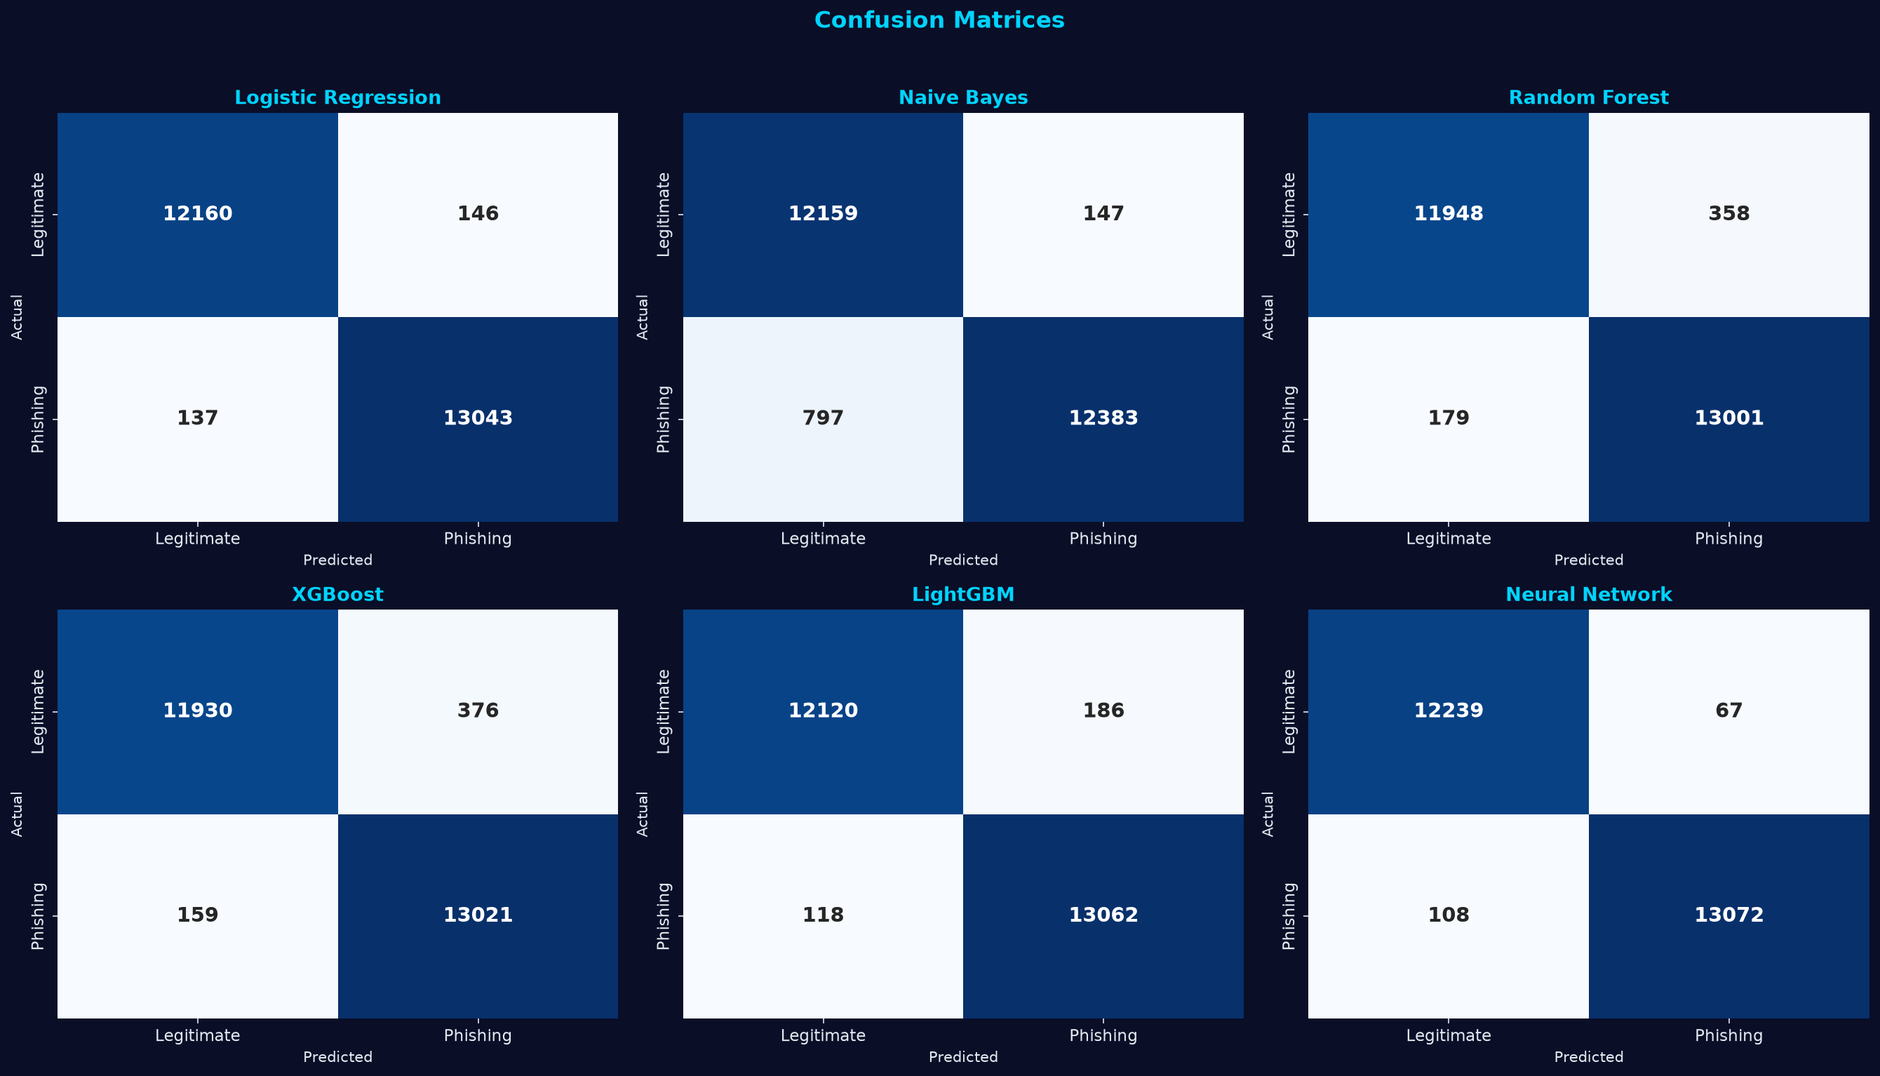
18 · CONFUSION MATRIX
Confusion Matrices
All six classifiers on the held-out test set (25,486 emails)
Reading a confusion matrix
Rows = actual · Columns = predicted
Diagonal = correct; off-diagonal = errors
Neural Network (best model)
▪ 12,239 legitimate correctly classified (TN)
▪ 67 legitimate falsely flagged (FP)
▪ 108 phishing missed (FN) — the dangerous cases
▪ 13,072 phishing correctly caught (TP)
Figure: generated by evaluate_models.py for every model
AI-Driven Phishing Email Detection Using NLP · IICT New Delhi
19
Notes:
A confusion matrix shows exactly where a model errs. This grid is generated for all six models. For the best model, the Neural Network: 12,239 legitimate emails correctly classified, 67 legitimate emails falsely flagged as phishing - these are false alarms; 108 phishing emails missed - these are the dangerous misses; and 13,072 phishing emails correctly caught. The asymmetric cost matters: missing a real phishing email (108 cases) is far more serious than a false alarm (67 cases), which is why we also inspect recall.

Slide 20
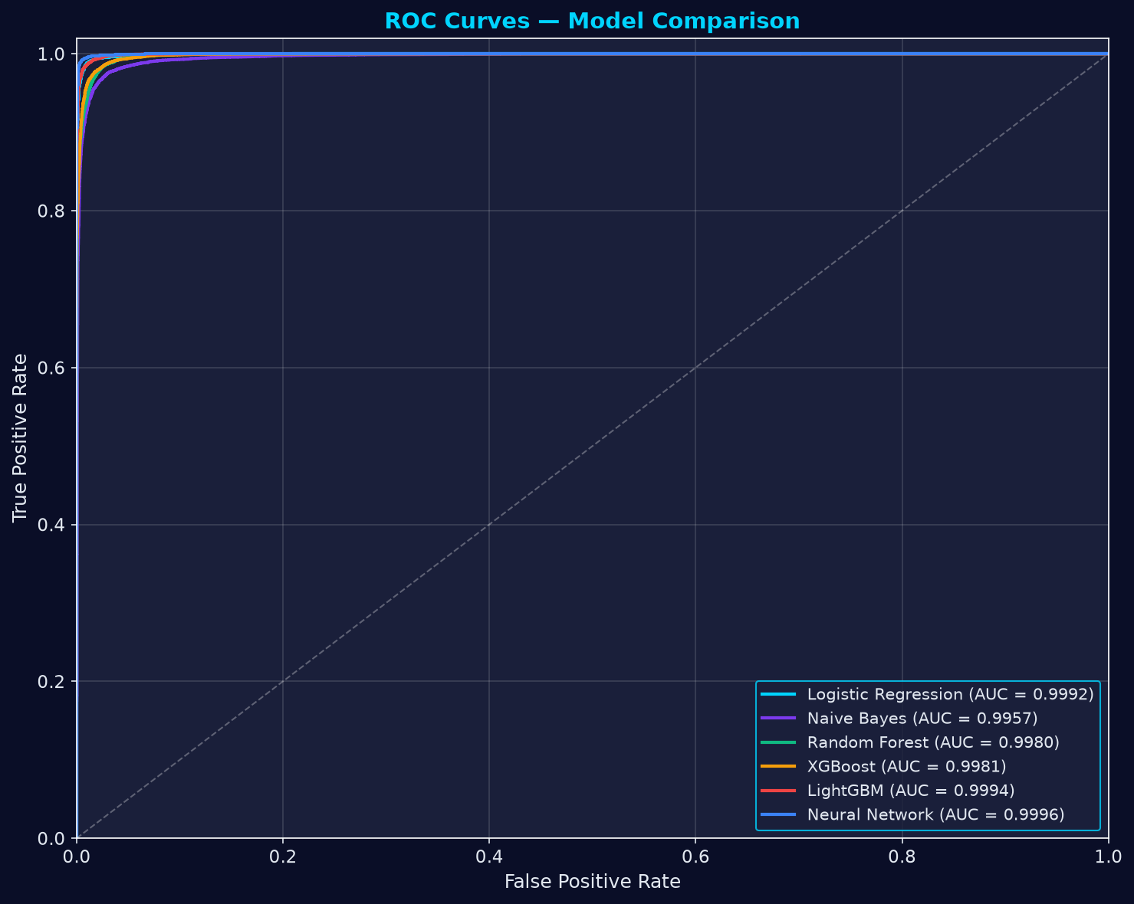
19 · ROC CURVE
ROC Curves — All Models
AUC 0.9957 → 0.9996 — all models near-perfect ranking
How to read it
TPR vs FPR across all thresholds — the higher the curve, the better.
AUC 1.0 = perfect · 0.5 = random.
Top AUC values
▪ Neural Network 0.9996
▪ LightGBM 0.9994
▪ Logistic Regr. 0.9992
AI-Driven Phishing Email Detection Using NLP · IICT New Delhi
20
Notes:
The ROC curve plots the true-positive rate against the false-positive rate across all thresholds. All six models sit near the top-left corner, with AUC values from 0.9957 for Naive Bayes up to 0.9996 for the Neural Network. An AUC of 1.0 is a perfect classifier, and 0.5 is random guessing - we are within striking distance of perfection. The curves are nearly overlapping at this scale, which is a strong visual argument for the quality of the feature engineering.

Slide 21
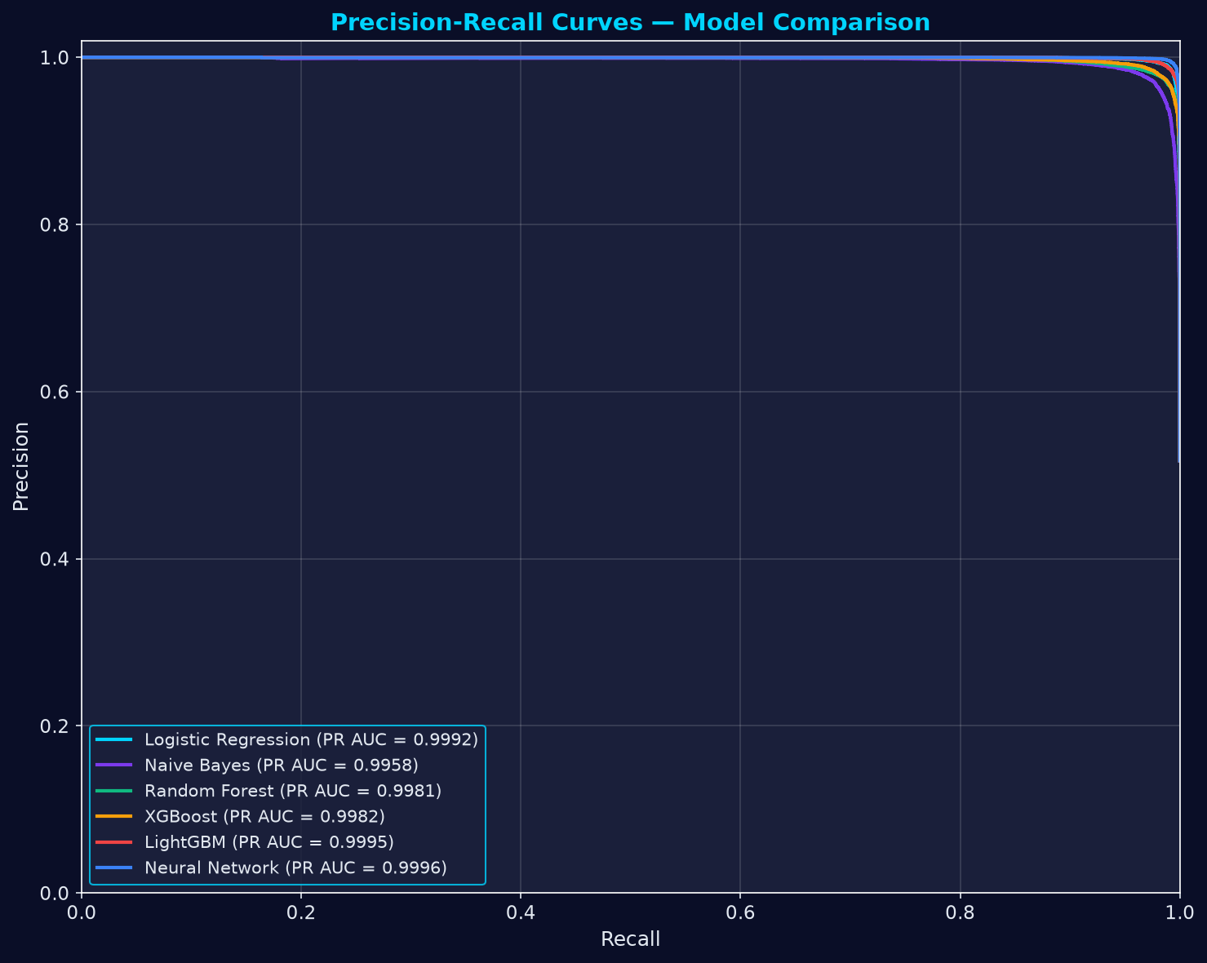
20 · PRECISION-RECALL
Precision-Recall Curves
PR-AUC 0.9958 → 0.9996 — the phishing-class view
Why PR over ROC?
Focuses on the positive (phishing) class only — more honest when classes are imbalanced.
High precision = few false alarms; high recall = few missed attacks.
Top PR-AUC values
▪ Neural Network 0.9996
▪ LightGBM 0.9995
▪ Logistic Regr. 0.9992
AI-Driven Phishing Email Detection Using NLP · IICT New Delhi
21
Notes:
The precision-recall curve is often more honest than ROC under class imbalance, because it focuses on the positive class we care about - phishing. Here again the Neural Network and Logistic Regression dominate the top-right corner, maintaining high precision even at high recall. PR-AUC values are all above 0.9958. A point worth mentioning in a viva: high precision keeps false alarms low for users, while high recall keeps missed attacks low - this curve shows both simultaneously.

Slide 22
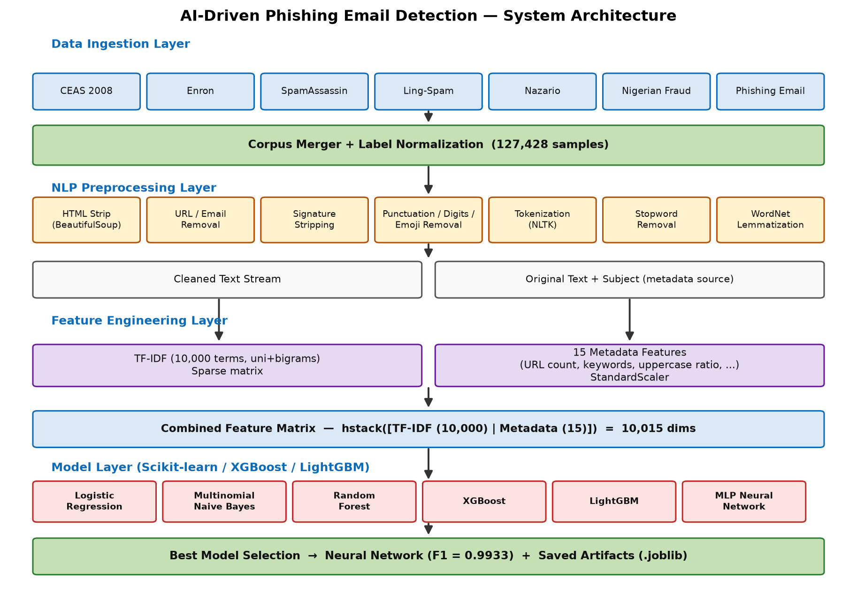
21 · ARCHITECTURE
System Architecture
Modular layers — data → ML → inference → interfaces
Layers
▪ dataset/ — raw + processed data
▪ src/ — pipeline, models, evaluation, API
▪ app/ — Streamlit multipage UI
▪ models/ · reports/ · images/ — artifacts
Design principles
▪ Config-driven (src/config.py) — no magic numbers
▪ Fit-on-train-only to prevent leakage
▪ Lazy artifact loading for fast startup
▪ Single code path for train & inference
AI-Driven Phishing Email Detection Using NLP · IICT New Delhi
22
Notes:
This is the full system architecture. Raw datasets live under dataset/raw and are merged by DatasetLoader in src/preprocessing.py. The NLP cleaning pipeline and feature engineering live in feature_engineering.py. Six models are trained and evaluated by train_models.py and evaluate_models.py, which also generate every chart you see in this deck. Trained artifacts - the best model, the TF-IDF vectorizer, and the metadata scaler - are persisted as joblib files under models/ and loaded lazily at startup by the PhishingDetector in src/predict.py. Two interfaces expose the engine: the Streamlit app in app/ and the FastAPI service in src/api.py. Docker wraps everything with one command.

Slide 23
22 · WORKFLOW
End-to-End Workflow
!
Ingest
7 datasets merged
Preprocess
NLP cleaning
Features
TF-IDF + metadata
Train
6 classifiers
Evaluate
metrics & charts
Deploy
UI + API + Docker
Infer
verdict + risk + explain
Artifacts: models/*.joblib · reports/*.csv & *.json · images/*.png
One command
python main.py
runs the full pipeline end-to-end and regenerates every artifact.
Two interfaces, one engine
Streamlit UI (port 8501) · FastAPI REST (port 8000)
Docker compose starts both services from one image.
AI-Driven Phishing Email Detection Using NLP · IICT New Delhi
23
Notes:
This workflow diagram shows the end-to-end flow at a glance. Seven datasets are ingested and merged; the NLP pipeline cleans the text; the feature engineer builds the 10,015-feature matrix; six models are trained and evaluated; the best model is saved; and it is deployed simultaneously to a Streamlit UI and a FastAPI API. At inference, new emails flow through the same cleaning and transform steps before the saved model returns a verdict. Everything below the fold - models, reports, images - is regenerated automatically by one command: python main.py.

Slide 24
23 · PREDICTION PIPELINE
Prediction Pipeline
Production inference — the same transforms used at training time
!
Input
paste · .txt · .eml · CSV batch
Clean
TextPreprocessor.clean_text()
Features
TF-IDF + scaled metadata → hstack
Predict
best model → phishing probability
Risk Score
0–100 weighted
Output
verdict · explain · recommend · report
Risk score — weighted formula
Score = 0.60·confidence + 0.25·keyword + 0.15·URL
keyword term = min(keywords × 3, 25)
URL term = min(urls × 5, 15)
Levels: 0–30 Low · 31–60 Medium · 61–80 High · 81–100 Critical
Per-email output
▪ Verdict + confidence (model probability)
▪ Suspicious keyword highlighting & detected URLs
▪ Natural-language explanation & safety recommendation
▪ Downloadable .txt security report
CSV batch scanning appends verdict · label · confidence · risk_score · risk_level to every row
AI-Driven Phishing Email Detection Using NLP · IICT New Delhi
24
Notes:
The prediction pipeline is where the project meets production. An email arrives by pasted text, an uploaded .txt or .eml file, or a CSV batch. It is cleaned by the exact same TextPreprocessor used in training. Features are built with the saved vectorizer and scaler - never refit - and passed to the model, which returns a probability. The risk score combines model confidence with 60% weight, suspicious keywords with 25% weight, and detected URLs with 15% weight, producing a 0-100 score with four risk levels. The system then emits a verdict, a confidence, an explanation, and a recommendation, and can generate a downloadable text report. Batch CSV scanning appends these columns per row.

Slide 25
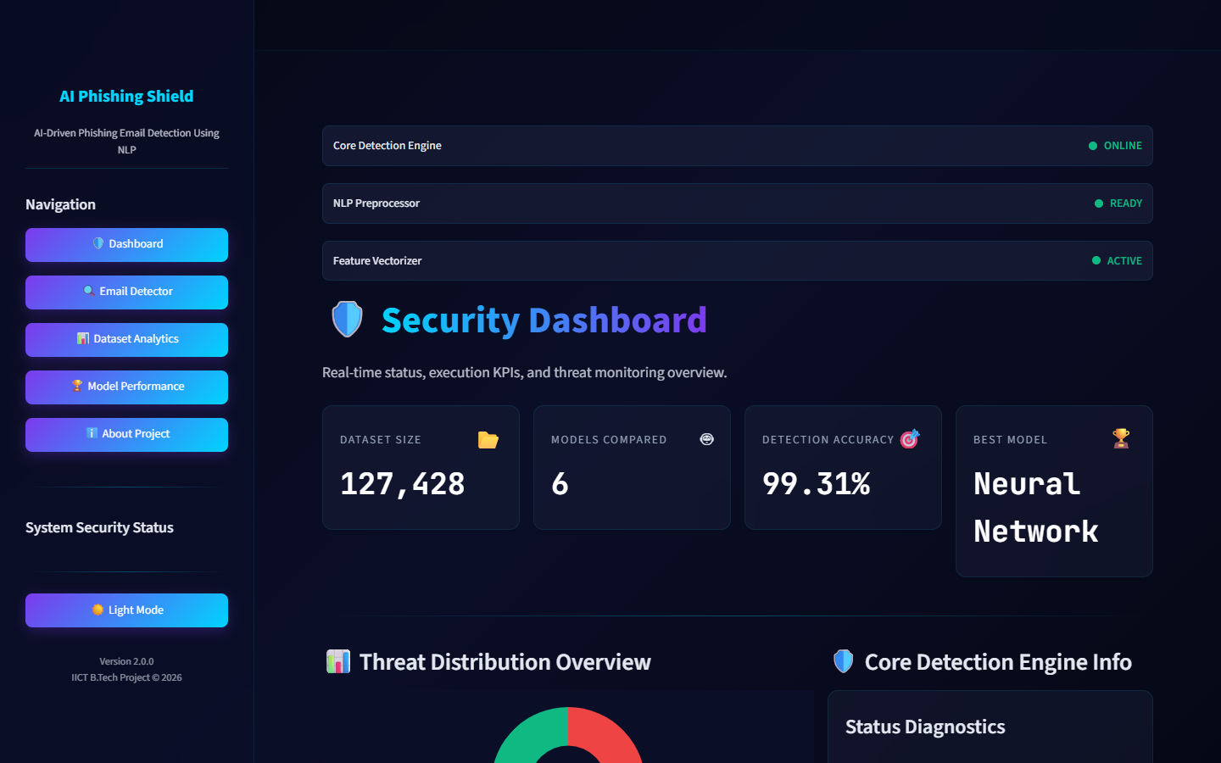
24 · STREAMLIT UI
Streamlit Application — “AI Phishing Shield”
Cyber-themed, multipage, light/dark themes
Dashboard
KPIs, threat donut, model leaderboard, prediction history
Email Detector
paste / file / CSV · live risk gauge · highlighted keywords
Dataset Analytics
class & source distribution, wordclouds, top words, heatmap
Model Performance
metrics table, ROC/PR curves, confusion matrices, feature importance
About Project
methodology, architecture map, tech stack, credits
Live status sidebar
Engine ONLINE · NLP READY · Vectorizer ACTIVE — theme toggle, v2.0.0
AI-Driven Phishing Email Detection Using NLP · IICT New Delhi
25
Notes:
The Streamlit dashboard, called AI Phishing Shield, has five pages. Dashboard shows KPIs, a threat distribution donut, a model leaderboard, and session prediction history. The Email Detector accepts paste, file upload, or batch CSV and renders a live cyber-risk gauge. Dataset Analytics shows class distribution, source datasets, wordclouds, top words, length histograms, and a correlation heatmap. Model Performance presents the metrics table, ROC and PR curves, confusion matrices, feature importance, and classification reports. The About page documents the architecture and tech stack. There is a light and dark theme toggle, and the entire theme is consistent with this presentation.

Slide 26
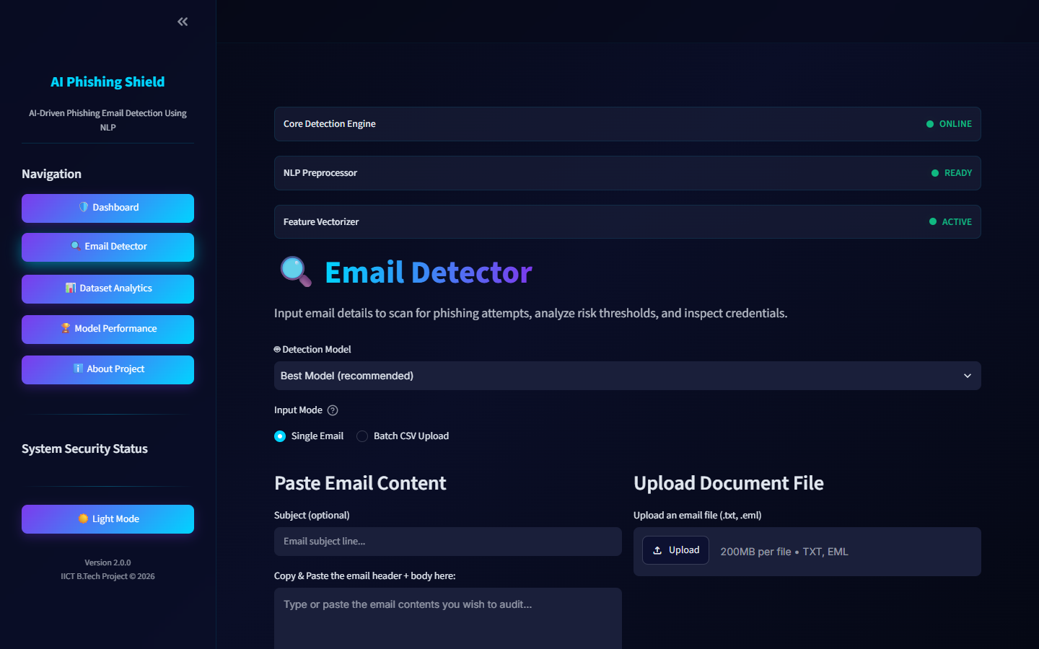
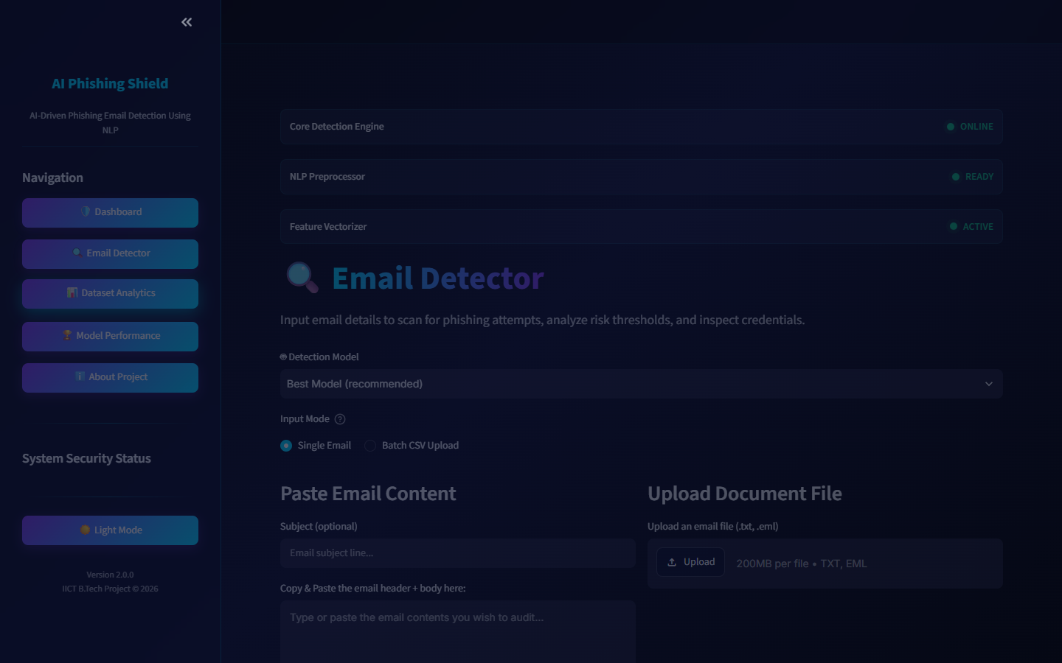
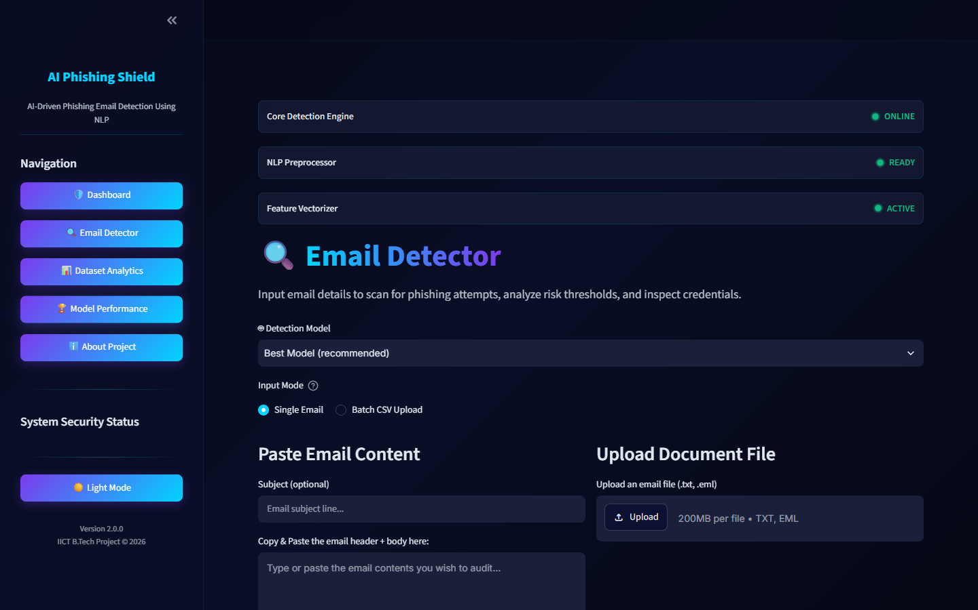
25 · DEMO SCREENSHOTS
Live Application Screenshots
Real captures from the running Streamlit dashboard
Security Dashboard
Email Detector
Dataset Analytics
Model Performance
AI-Driven Phishing Email Detection Using NLP · IICT New Delhi
26
Notes:
These are real screenshots of the running application. Top-left, the Security Dashboard with KPI cards, the threat distribution donut, and the model leaderboard. Top-right, the Email Detector page with the paste/upload interface and the interactive cyber-risk gauge. Bottom-left, Dataset Analytics showing class ratio and data-origin distribution. Bottom-right, the Model Performance page with the interactive metrics comparison. During the live demonstration I will run a phishing sample and show the highlighted keywords, the risk gauge, and the downloadable report.

Slide 27
26 · ADVANTAGES
Advantages
High accuracy
99.31% accuracy · 99.34% F1 on 25,486 held-out emails.
Hard to bypass
Hybrid features — semantic + structural — survive paraphrasing and obfuscation.
✓
✓
Explainable output
Every verdict ships with confidence, risk score, flagged keywords, URLs and reasons.
Multi-interface
Streamlit UI, FastAPI REST (+Swagger), CLI pipeline, Docker one-command startup.
✓
✓
Engineering quality
Unit-tested, config-driven hyperparameters, reproducible seeds, cached cleaning.
Self-documenting
Reports and all charts auto-generated to reports/ and images/ for audit.
✓
✓
AI-Driven Phishing Email Detection Using NLP · IICT New Delhi
27
Notes:
Summarise the advantages. First, accuracy: 99.31% with an F1 of 99.34% across a large, diverse corpus. Second, robustness: hybrid features combine semantic content with structural metadata, so the model is not fooled by merely rephrasing. Third, explainability: every prediction comes with confidence, a 0-100 risk score, flagged keywords, detected URLs, and a plain-English explanation. Fourth, multi-interface deployment: Streamlit UI, FastAPI REST API with auto-generated Swagger docs, CLI pipeline, and Docker. Fifth, engineering quality: unit tests, config-driven hyperparameters, reproducible random seeds, and cached cleaning for fast iteration. Sixth, transparency: reports and all charts are auto-generated for audit.

Slide 28
27 · LIMITATIONS
Limitations & Honest Assessment
English only
Corpus and NLP pipeline are English-centric; non-English phishing is out of scope.
No attachments / images
Analysis covers text and metadata, not attachment payloads or image content.
✕
✕
Adversarial text
Carefully rewritten messages avoiding typical phrasing may still evade detection, though metadata helps.
Memory & time
MLP training takes ≈13 min and several GB of RAM; full runs ≈25–30 min.
✕
✕
Static snapshot
Point-in-time model — periodic retraining is needed as attack language evolves.
AI-generated phishing
Fluent generative-AI phishing that mimics legitimate writing raises the detection ceiling.
✕
✕
AI-Driven Phishing Email Detection Using NLP · IICT New Delhi
28
Notes:
It is equally important to state limitations honestly. The dataset is English-only, so non-English phishing is out of scope. The system analyses text and metadata, not attachment payloads or image content, so image-only phishing emails can slip through. Crafted messages that deliberately avoid typical vocabulary may still evade detection, though metadata features reduce this. Training is memory-intensive - the neural network alone takes about 13 minutes and several GB of RAM. The model is a point-in-time snapshot; as attacker language evolves, periodic retraining is required. Finally, recent generative-AI phishing that imitates legitimate writing styles raises the detection ceiling.

Slide 29
28 · FUTURE SCOPE
Future Scope
Model architecture
Fine-tune transformer (BERT-family) models on the cleaned corpus for deeper semantics.
URL & domain intelligence
Lexical URL analysis, domain-age checks and URL reputation at inference time.
Header authentication
Inspect SPF / DKIM / DMARC records and sender reputation.
Real-time integration
Wire the FastAPI service into mail servers for inline quarantine decisions.
Continuous retraining
Online learning as newly labeled samples arrive to counter evolving attacks.
Research extensions
Adversarial robustness testing and SHAP-style explainability for stronger papers.
AI-Driven Phishing Email Detection Using NLP · IICT New Delhi
29
Notes:
Future work branches in several directions. Model-wise, we could add modern architectures such as transformers - fine-tuning BERT-style models on the cleaned corpus. Domain-wise, we could add URL lexical and reputational analysis, domain age checks, header authentication inspection such as SPF, DKIM, and DMARC, and attachment sandboxing. Deployment-wise, we could add real-time integration into mail servers through the FastAPI service, continuous retraining as new labeled samples arrive, and a multi-language corpus. For research, adversarial robustness testing and explainability methods such as SHAP could turn this into a stronger research paper.

Slide 30
29 · CONCLUSION
Conclusion
We designed, implemented, evaluated and deployed an end-to-end machine-learning system for phishing email detection.
7 datasets merged → 127,428-email corpus → 12-step NLP pipeline → 10,015 features → 6 models benchmarked → best model 99.31% accuracy / 99.34% F1.
The system is production-ready: Streamlit dashboard, FastAPI REST API, Docker, plus auto-generated reports and charts for full transparency.
99.31%
Best Accuracy
99.34%
Best F1 Score
0.9996
Best ROC-AUC
6
Models Compared
From raw data to a deployed, explainable product — the complete ML lifecycle in one project.
AI-Driven Phishing Email Detection Using NLP · IICT New Delhi
30
Notes:
To conclude: we designed, implemented, evaluated, and deployed an end-to-end machine-learning system for phishing email detection. We merged seven datasets into a 127,428-email training corpus, built a modular NLP and feature-engineering pipeline with 10,015 features, benchmarked six classifiers, and selected a Neural Network achieving 99.31% accuracy and 99.34% F1. The system ships as a Streamlit dashboard, a FastAPI API, and a Docker image, with full reports and visualizations generated automatically. The project demonstrates the entire ML lifecycle, from raw data to a deployed, explainable product.

Slide 31
30 · REFERENCES
References
Datasets
▪ Phishing Email dataset
▪ CEAS 2008 — spam benchmark
▪ Enron email corpus
▪ SpamAssassin corpus
▪ Ling-Spam · Nazario · Nigerian Fraud (419)
Libraries & Frameworks
▪ scikit-learn — preprocessing, models, metrics
▪ NLTK + WordNet — tokenization, lemmatization
▪ XGBoost · LightGBM — gradient-boosted trees
▪ Streamlit — web UI · FastAPI + Uvicorn — REST API
▪ Docker · Plotly · matplotlib · joblib · pytest
Reproducibility
Version pins in requirements.txt · Dockerfile mirrors the exact ML versions that trained the serialized models · seed 42 for all random operations · reports/ holds every number used in this deck.
AI-Driven Phishing Email Detection Using NLP · IICT New Delhi
31
Notes:
References include the public datasets: the Phishing Email dataset, CEAS-08, Enron, SpamAssassin, Ling-Spam, Nazario, and the Nigerian Fraud corpus. On the engineering side: scikit-learn for preprocessing, models and metrics; NLTK and WordNet for tokenization and lemmatization; XGBoost and LightGBM for the boosted learners; Streamlit for the UI; FastAPI and Uvicorn for the REST API; and Docker for packaging. For the slide deck itself we used python-pptx. Full version pins are in requirements.txt, and the Dockerfile mirrors the exact versions that trained the serialized models.

Slide 32
Thank You
Questions & Discussion Welcome
Lahya Sree Bollinkala · Indian Institute of Computing & Technology (IICT), New Delhi · 2026–2027
Notes:
Thank you for your time and attention. I am happy to take questions on any aspect - the NLP pipeline, feature engineering, model selection, the evaluation metrics, or the deployment architecture. The source code, trained artifacts, reports and this presentation are all part of the project deliverable for IICT New Delhi, academic year 2026-2027.

