Slide 1

The Impact of Lifestyle on Quality of Life
Final Project Presentation
Morjana Abu Saleh
Laia sweed
Tamir Fuaz
Data Analyst Course – 2025

Slide 2
Research Question & Goal
Research Question:
Which aspects of lifestyle influence Quality of Life?
Goal: To explore and predict how lifestyle factors affect Work-Life Balance.
Focus on health, productivity, and emotional well-being.

Slide 3
Dataset Overview
• 15,972 observations
• 24 initial features
• No missing values
• Numeric encoding for categorical variables
• Selected 11 features with Pearsoncorrelation ≥ 0.45

Slide 4
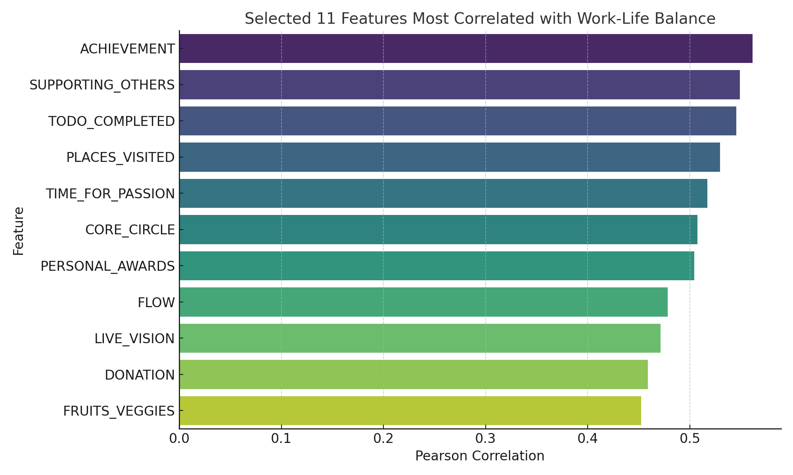

Slide 5
Literature Review Summary
5 research articles reviewed on lifestyle and quality of life.
Findings support strong links between physical/mental habits and well-being.
Limitations include narrow samples and subjective self-reports.
Articles reinforced importance of holistic health approaches.

Slide 6
Study | Focus | Main Finding
Zhang et al. (2021) – China, Retired Workers | Health-promoting lifestyle | Positive correlation between healthy habits and life satisfaction among retirees
González et al. (2022) – Spanish Youth | Lifestyle, Physical activity | Active lifestyle linked to better perceived quality of life in adolescents
Kumar & Sharma (2023) – ML Prediction | Machine learning & Work-Life Balance | Lifestyle data can predict WLB with high accuracy using ML models
Fernandez et al. (2020) – Serious Games Review | Emotional intelligence & balance | Serious games help develop emotional skills and improve inner balance
Al-Khalidi et al. (2021) – International Students | Sleep, mental health, physical activity | Strong link between sleep quality, mental health, activity, and QoL

Slide 7
Model Used
Regression:
• Linear Regression
• Random Forest Regressor
Classification:
• Random Forest Classifier
• XGBoost Classifier
Used cross-validation for tuning..
Data split: 70% training, 15% validation, 15% testing
Applied hyperparameter tuning with cross-validation

Slide 8
Key Findings
Work-Life Balance influenced by achievement, support, purpose, and health.
Healthy eating, sleep, and meaningful goals improve quality of life.
Data-driven insights align with findings from reviewed literature.

Slide 9
Regression Results
• Linear Regression:
R² = 0.824 , MAE = 15.13
• Random Forest:
R² = 0.814 , MAE = 15.50
• Linear model slightly outperformed RandomForest

Slide 10
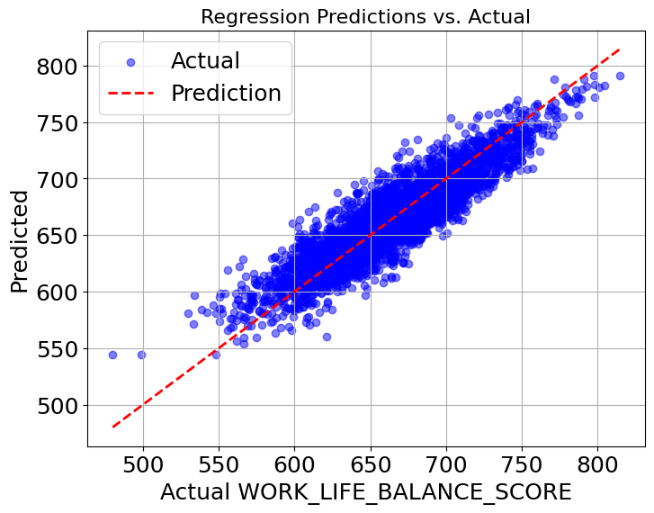

Slide 11
Classification Results
• Random Forest Classifier:
Accuracy = 0.885 ,F1 = 0.89
• XGBoost:
Accuracy = 0.871 , F1 = 0.87
• No significant class imbalance found (ratio =1.81)

Slide 12
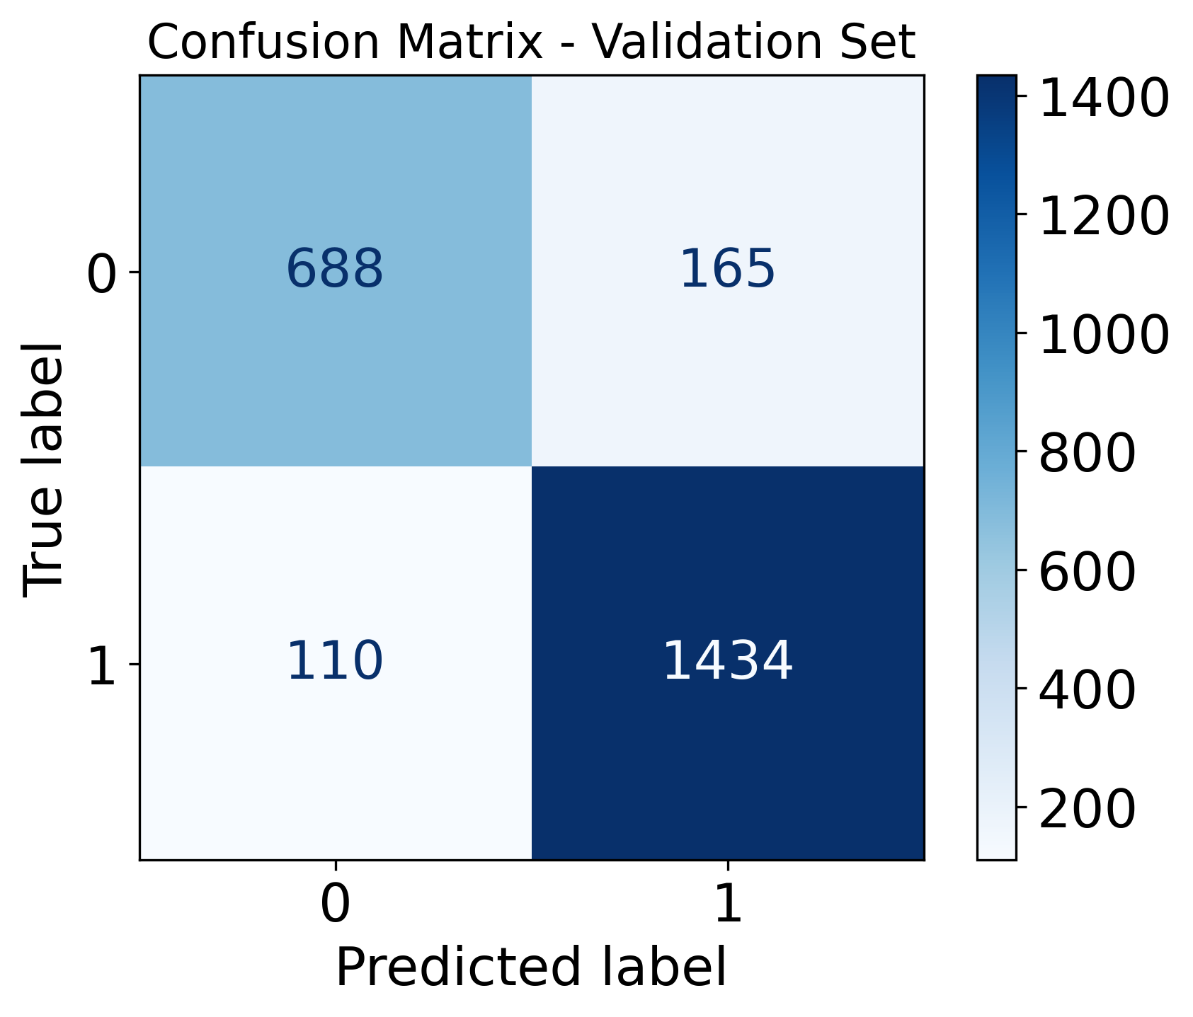

Slide 13
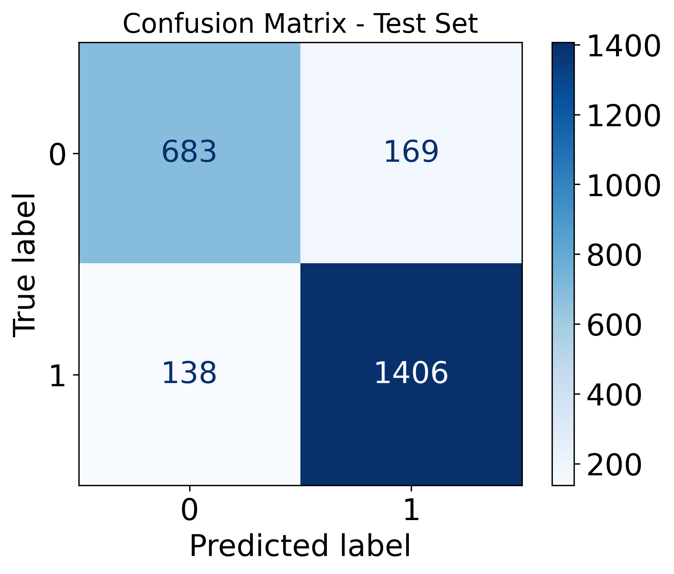

Slide 14
Conclusion
• Lifestyle habits can predict work-life balance
• Top performing models: Linear Regression &Random Forest Classifier
• Practical applications for individuals and organizations

Slide 15
Limitations
Potential bias in self-reported data.
Correlation does not imply causation.
Not all lifestyle aspects represented equally.
Some models are complex and less interpretable.

Slide 16
Recommendations
Collect more diverse and real-time data (e.g., wearables).
Explore deep learning or ensemble methods.
Build user-friendly dashboards for tracking well-being.
Use A/B testing to validate intervention effectiveness.

