Slide 1
Explainable
Data Science
Laia Domingo
2021

Slide 2
Outline
What is deep learning?
Examples of deep learning
Brief history of deep learning
How does deep learning work?
Examples

Slide 3
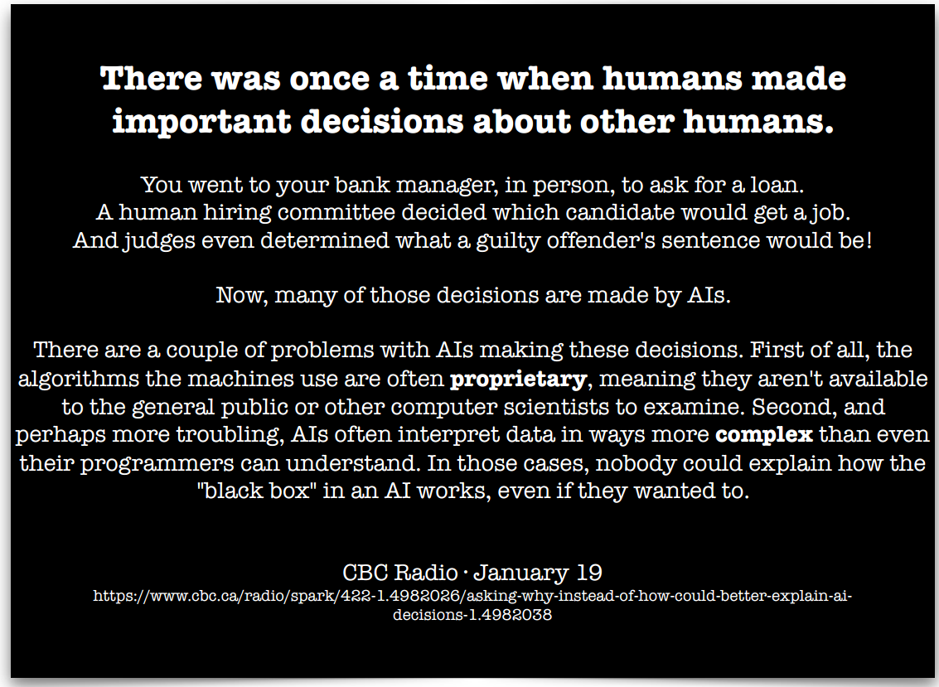

Slide 4
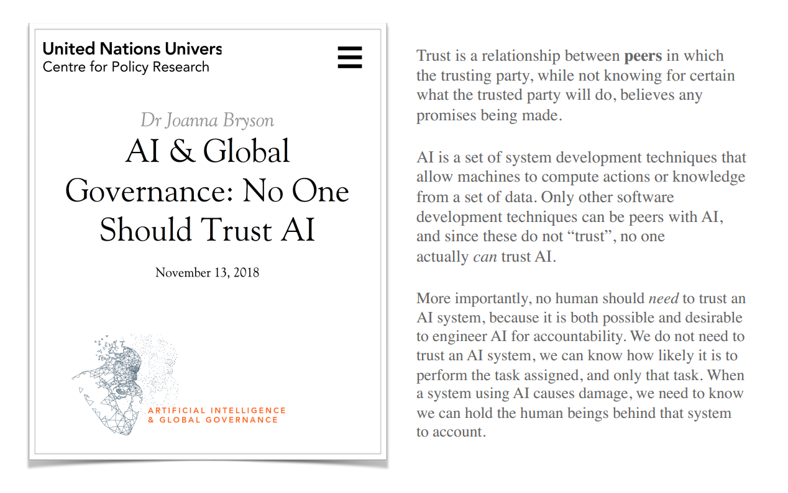

Slide 5
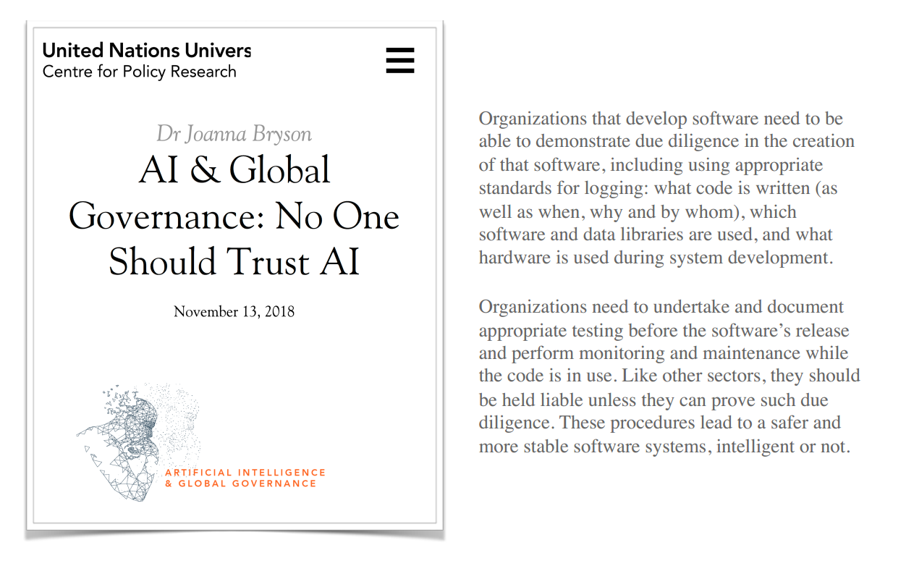

Slide 6
Scenario
Data science tasks:
Description is using data to provide a quantitative summary of certain features of the world.
→ What is the mean value of X?
Prediction is using data to map some features of the world (the inputs) to other features of the world (the outputs). → How would seeing X change my belief in Y?
Causation: Measuring the causal influence of a variable X in another variable Y, while excluding any influences on Y not actually due to the causal effect of X, and being able to guess what the effect will be if one performs an action. →How would my expected lifespan change if I become a vegetarian?
Correlation is not the same as causation!!
https://www.bbc.com/news/magazine-27537142
Counterfactual: Being able to reason about hypothetical situations, things that could happen.
→ Would my grandfather still be alive if he had not smoked?

Slide 7
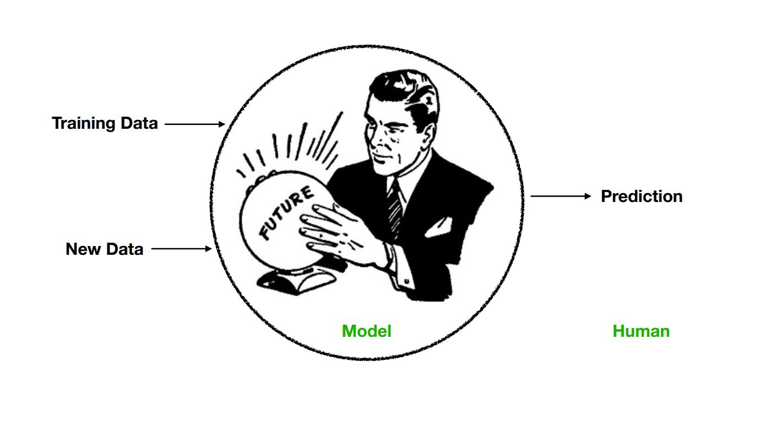
Scenario

Slide 8
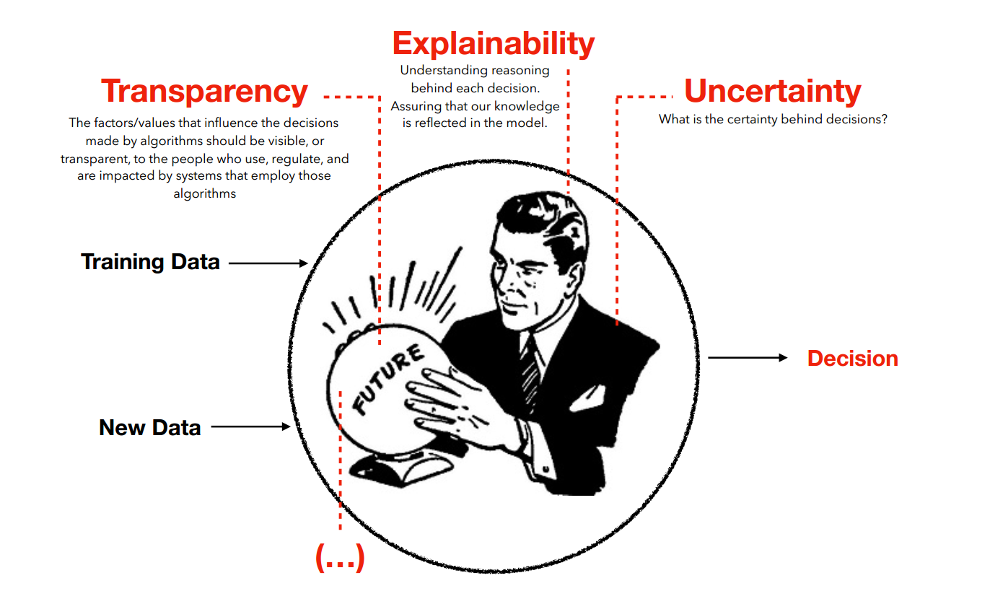
Why?

Slide 9
Why?
There are different reasons that drive the demand for interpretability and explanations:
Human curiosity and learning: Humans have a mental model of their environment that is updated when something unexpected happens. This update is performed by finding an explanation for the unexpected event.
The goal of science is to gain knowledge, but many problems are solved with big datasets and black box machine learning models. The model itself becomes the source of knowledge instead of the data. Interpretability makes it possible to extract this additional knowledge captured by the model.

Slide 10
Why?
Machine learning models take on real-world tasks that require safety measures and testing. Imagine a self-driving car automatically detects cyclists based on a deep learning system. You want to be 100% sure that the abstraction the system has learned is error-free, because running over cyclists is quite bad.
By default, machine learning models pick up biases from the training data. This can turn your machine learning models into racists that discriminate against protected groups. Interpretability is a useful debugging tool for detecting bias in machine learning models. It might happen that the machine learning model you have trained for automatic approval or rejection of credit applications discriminates against a minority.
The process of integrating machines and algorithms into our daily lives requires interpretability to increase social acceptance. People attribute beliefs, desires, intentions and so on to objects.

Slide 11
Why?
If you can ensure that the machine learning model can explain decisions, you can also check the following traits more easily:
• Fairness: Ensuring that predictions are unbiased and do not implicitly or explicitly discriminate against protected groups. An interpretable model can tell you why it has decided that a certain person should not get a loan, and it becomes easier for a human to judge whether the decision is based on a learned demographic (e.g. racial) bias.
• Privacy: Ensuring that sensitive information in the data is protected.
• Reliability or Robustness: Ensuring that small changes in the input do not lead to large changes in the prediction.
• Causality: Check that only causal relationships are picked up.
• Trust: It is easier for humans to trust a system that explains its decisions compared to a black box.

Slide 12

All the models need to be explained?
We don’t need interpretability if the model has no significant impact, the problem is well studied or if this enable people to manipulate or to game a critical system. Examples:
Handwritten digit recognition
Obtaining a loan from the bank

Slide 13

Our definition
Explainable data science
Using (or considering) our models as a black box and explaining it afterwards.

Slide 14
What is a Black Box?
By Black box we denote a predictive model which:
Has been pretrained
Can estimate the output given a set of input values
Whose internal details, such as algorithm of choice, or dataset used for training, are not accessible or
not even known.

Slide 15
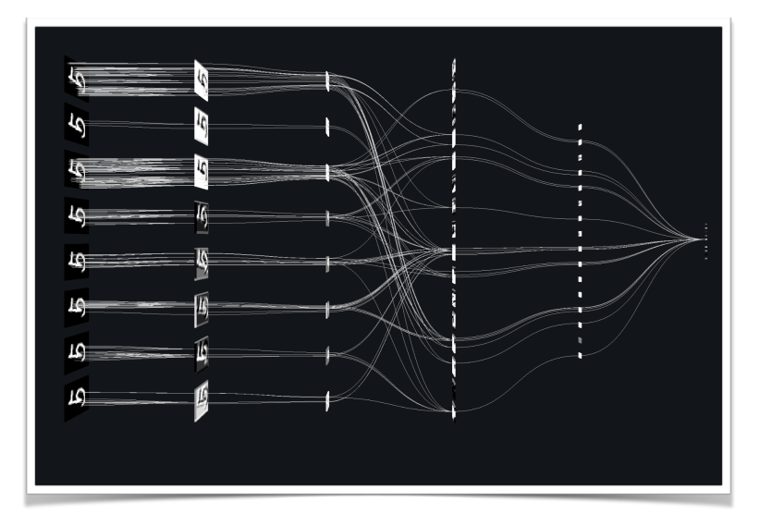
Our definition
Interpretable data science
Using a model that is not a black box.

Slide 16
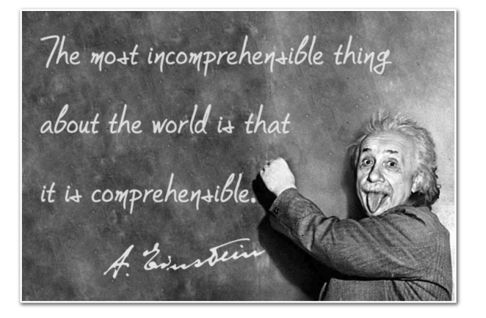
What is an explanation?
An explanation is the answer to a why-question:
Why is treatment not suitable for the patient?
Why was my loan rejected?

Slide 17
What is an explanation?
A good explanation is:
Contrastive. Humans usually do not ask why a certain prediction was made, but why this prediction was made instead of another prediction.
Selected. People do not expect explanations that cover the actual and complete list of causes of an event. We are used to selecting one or two causes from a variety of possible causes as THE explanation.
Consistent with prior beliefs of the customer. This is difficult to integrate into machine learning!
Focused on the abnormal. People focus more on causes that had a small probability but nevertheless happened.
General and probable. A cause that can explain many events is very general and could be considered a good explanation.

Slide 18
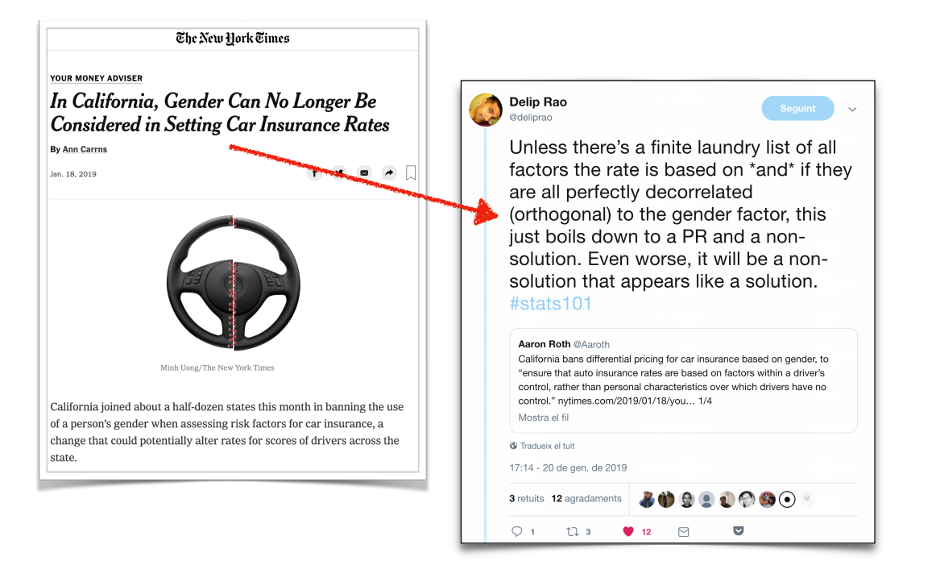
It is a difficult problem!

Slide 19
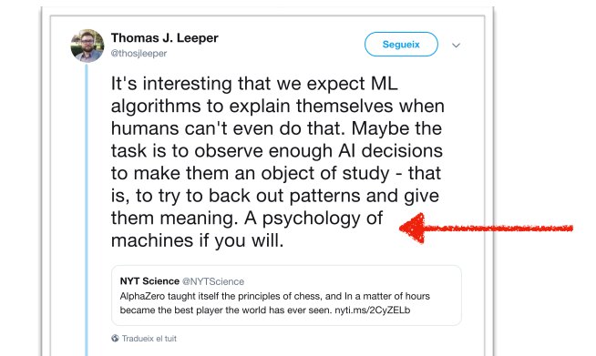
The skeptical point of view

