Slide 1
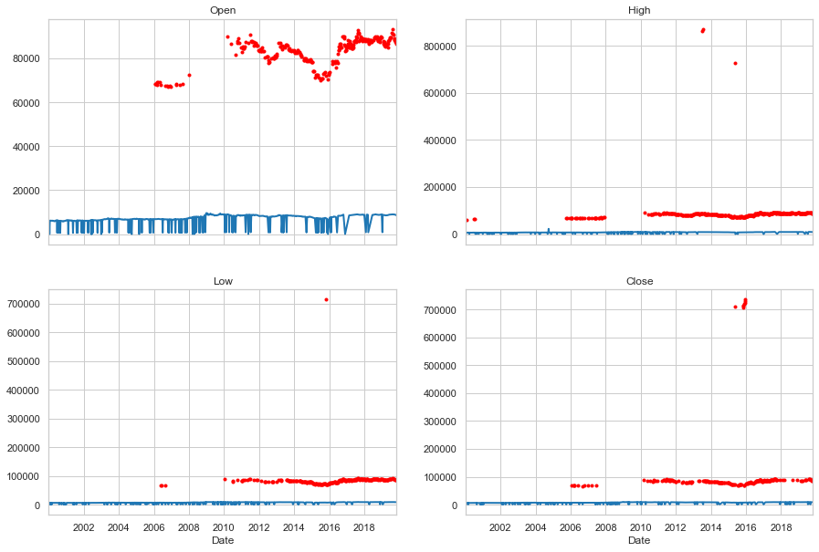
Open, High, Low, and Close values show some data anomalies that need cleaning

Slide 2
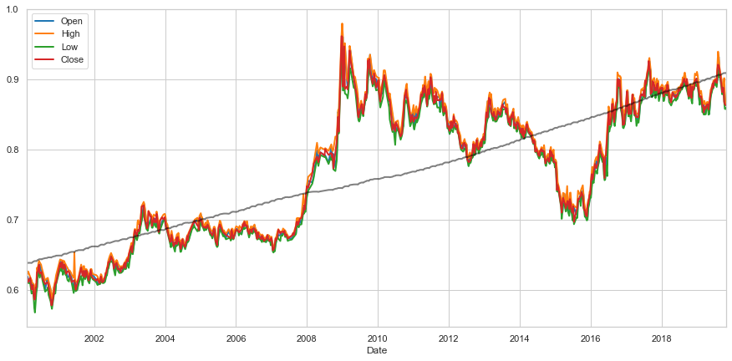
Clean data shows clear uplift of price pair at 2009 which is maintained until currently. Price pair dropped in 2015 but recovered on the following year Price stabilized since 2018

Slide 3
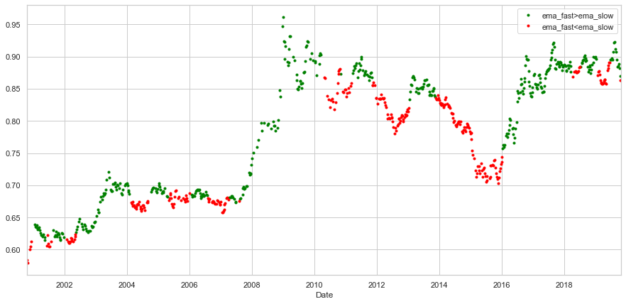
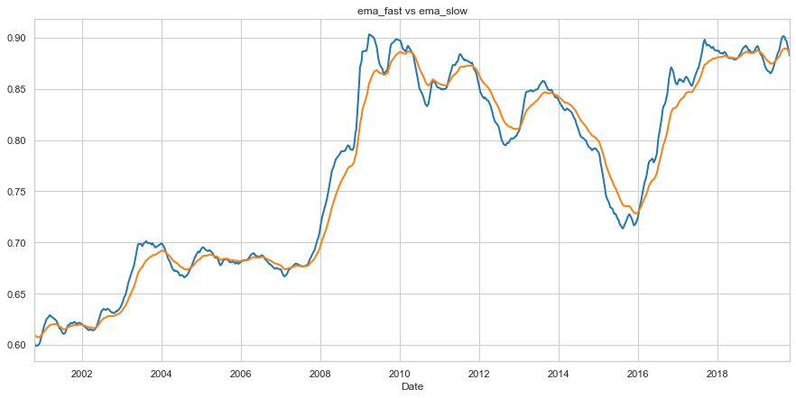
Observe correlation between ema fast being larger than ema slow and uplift trends on average price

Slide 4
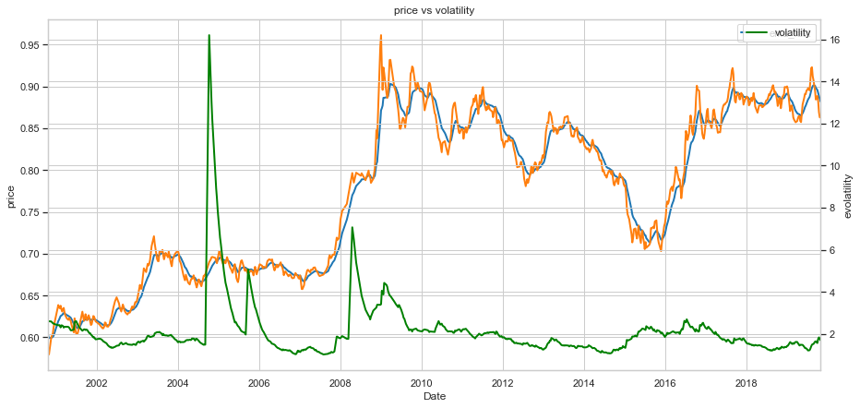
We can relate high volatility periods with variations on the price. Notice that the spike on volatility of 2008 preceded a high increase on the price. The spike on volatility in 2005, however, relates to variation on price which is not as high as the spike on volatility would suggest, so the relationship between changes in price and high volatilities are not unequivocal.

