Slide 1
Heat Shield Pakistan
Team ByteStorm | Climate & heat-health( urban heat vulnerability and outdoor labor)

Slide 2
Problem Statement
Who is affected?
1
THE PROBLEM
Outdoor workers (construction workers, delivery riders, traffic police)
Extreme summer heat in Karachi, Lahore and Jacobabad puts outdoor workers, such as construction workers, delivery riders and traffic police, at risk of heat stress and heatstroke. Officials need a reliable forecast of dangerous heat one to three days ahead, with a stated uncertainty, to decide when to issue advisories, shift working hours and prioritise cooling and hydration support.
Why does it matter?
2
Extreme heat can cause heatstroke, and officials currently lack a clear, uncertainty-aware forecast of dangerous heat to act on early.
Our goal
3
Forecast the daily maximum heat index 1 to 3 days ahead, with a stated range and cited official guidance, so officials can issue timely heat advisories.

Slide 3
Dataset Declaration
Dataset name | Historical & Forecast Weather Data with Official Heat-Safety Guidelines
Source / link | Open-Meteo, NASA POWER, Copernicus ERA5; NDMA, PDMA, PMD
Coverage | Karachi, Lahore & Jacobabad
Data Types | Historical weather, current forecasts & heat index
Format & license | CSV, JSON and PDF raw files, open licences.
Key features / target | Temp, humidity, wind; target: daily max heat index
Karachi
Lahore
Jacobabad

Slide 4
Pipeline Used
1
2
3
4
5
Data Collection
Data Cleaning
Analysis / EDA
Modeling
Dashboard / App
API + Official pdfs
Gates + quality agent
NWS heat index
Forecast + intervals
Dashboard + RAG
Raw weather and official guidance in -> cited heat-risk forecasts with ranges out

Slide 5
Pipeline Details & Tools
STAGE | TOOLS / LIBRARIES | WHAT WE DID
Collection | Python, Open-Meteo and NASA POWER APIs, GitHub Actions | Hourly fetch; each raw file SHA-256 hashed in a manifest
Preprocessing | Python, Parquet, Data Quality Agent | Two quality gates; fix, fill, flag or quarantine, all logged
Analysis / EDA | Python, NWS heat index | Daily max per city and PKT day; quality and data reports
Modeling | Python, bootstrap CIs | Chronological split; 1-3 day forecast with 80/90% intervals
Dashboard / App | Streamlit, Docker, Hugging Face Spaces | Freshness, quality, last run, forecasts, cited RAG assistant

Slide 6
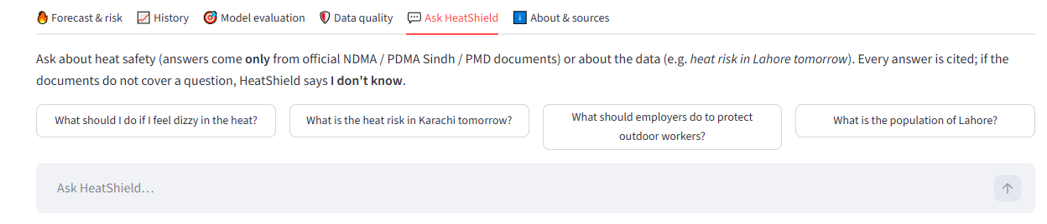
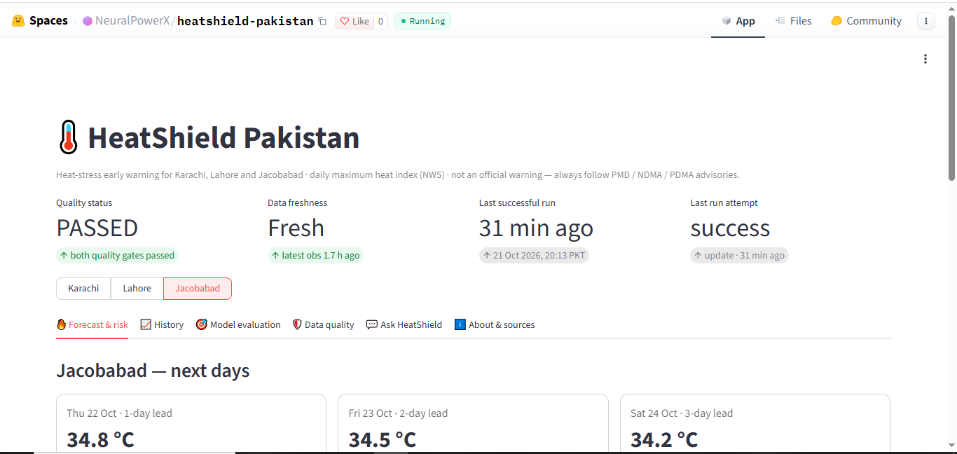
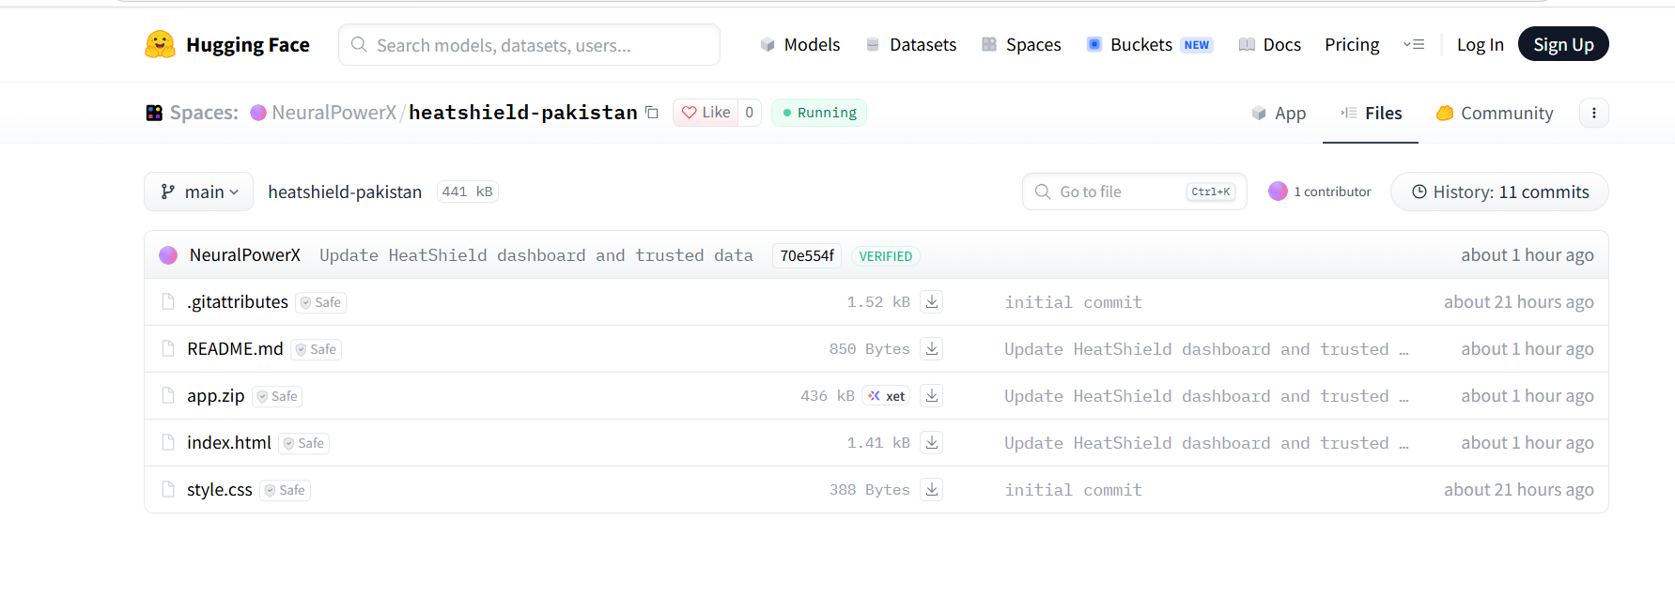
Dashboard / App Views
Page 2 - [Name]
Page 1 - [Overview]
Paste screenshot here
Paste screenshot here
https://huggingface.co/spaces/NeuralPowerX/heatshield-pakistan

Slide 7
Conclusion
Early Heat Warnings
IMPACT
1
Helps people prepare for extreme heat.
Officials get early, cited, uncertainty-aware heat warnings for outdoor workers
2
Data-Driven Insights
Uses historical data and current forecasts to predict heat conditions.
FUTURE WORK
Pakistan-specific thresholds, Urdu output, more cities
3
Safety Guidance
Provides useful precautions through an AI assistant using official guidance documents.

Slide 8
Team & Credits
[TEAM NAME]
AB
AB
AB
AB
AATIQA BATOOL
YUSRA NOOR
LAIBA
ABDULLAH
CT - 056
CT - 075
CT - 208
CT - 234
Mentor / Supervisor: Muhammad Taha Sharif
Thank you!

