Slide 1
Web Technologies
css
Cascading Style Sheets
Arfah Ali
FA21-BSE-080

Slide 2
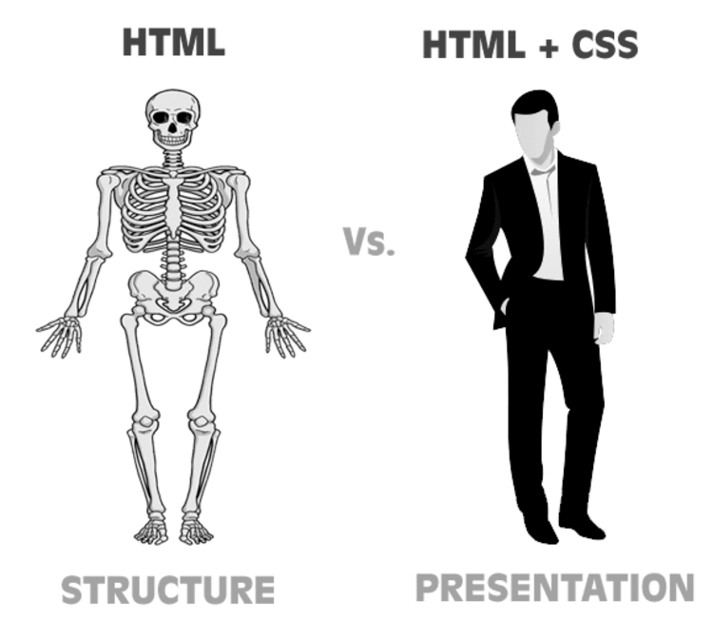
What is CSS?
CSS is used to style HTML.
HTML is a content and CSS is the presentation of the Content.
Example:
Consider HTML as a human skeleton which is used to structure the human body.
But does it look nice? Obviously No.
Here CSS is used to present the structure in the best possible way. It beautifies the HTML same as muscles do to skeleton.

Slide 3
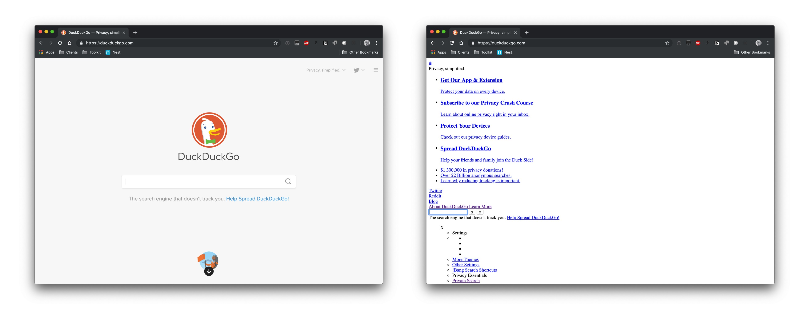
WHY CSS?
Website with CSS
Website without CSS

Slide 4
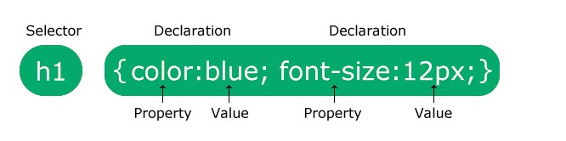
CSS Syntax
Property: value;
For example:
Color: red; //used to apply color on text
Background-color: blue; //used for background color
Border: 1px solid brown; // used for border
Z-index: 3; //used for overlaying mostly used on div

Slide 5
How to Apply
There are three ways of applying a style sheet:
Inline CSS
Internal CSS
External CSS

Slide 6
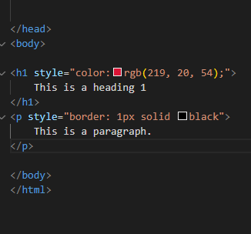
Inline CSS
An inline style is used to apply a style for a single element.
Use style attribute to where you want to style.
Always Style inside the opening tag.
<h6 Style=“color:red;”></h6>

Slide 7
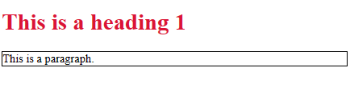
Output of Inline Styling
Use inline when want to edit a small particular element.
Inline css is prioritized to internal and external css as code runs from top to bottom.

Slide 8
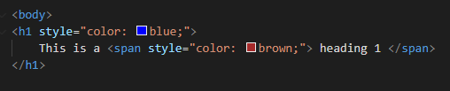

<Span> tag
Note:
We can use <Span> tag when want to edit a small portion.

Slide 9
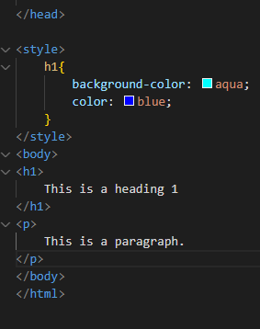
Internal CSS
An internal style sheet used if one single HTML page has a unique style.
The internal style is defined inside the <style> tag, before <body> and after
<head> tag.
<head>
<style>
</style>
<body>

Slide 10
Output of Internal Styling
Inside the <style> element we specify how HTML elements
should render in a browser.

Slide 11

External CSS
Change the look of an entire website by changing just one file.
Use <link> element, inside the head section to link HTML page to the .CSS sheet.
Link tag has 2 attributes.
rel: Relationship between the current document and the linked document.
href: Hypertext reference specify the location of the CSS file

Slide 12
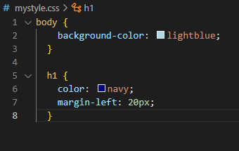
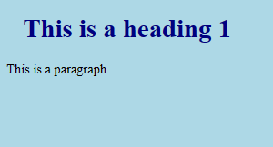
How the "mystyle.css" file looks:
Create External sheet using .css at the end of file name.
# shows it is a style sheet.
External styling
Output of External Styling

Slide 13
TASK:
Create an HTML file containing heading 3 (h3).
Apply blue color on h3 using Inline CSS.
Apply red color on h3 using Internal CSS.
Apply orange color on h3 using External CSS.
Write a conclusion, which color of h3 renders and why?.

Slide 14

TIPS
Try to use only a pair of fonts on one page of website.
Use margins for frame.
Use padding for space within boundary of something.
For large and complex websites External CSS works best.
When styling a very small element prefer inline.

Slide 15

Arfah Ali
arfahali994@gmail.com
https://medium.com/@arfahali994

