Slide 1
Web technologies
LAB 2

Slide 2
Topics
CSS Position
Bootstrap 5

Slide 3
CSS Position property
The CSS position property is used to specify the positioning method for an HTML element.
There are five different values for position property
static
relative
fixed
absolute
sticky

Slide 4
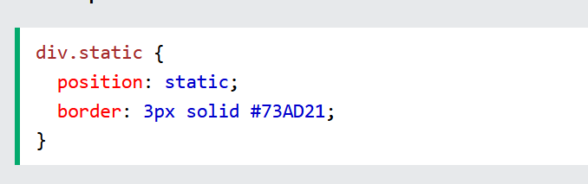
static
All HTML elements use static position by default.
Static positioned elements are not affected by the top, bottom, left, and right properties.
An element with static positioning is positioned according to the normal flow of the page

Slide 5
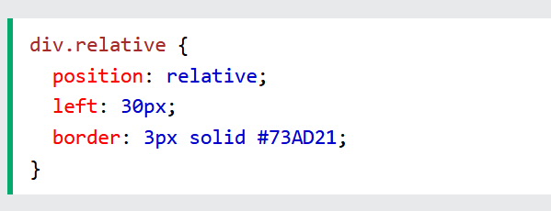
relative
An element using position: relative; is positioned relative to its normal position on the canvas.
Setting the top, right, bottom, and left properties of a relatively-positioned element will cause it to be adjusted away from its normal position.
Other content will not be adjusted to fit into any gap left by the element.

Slide 6
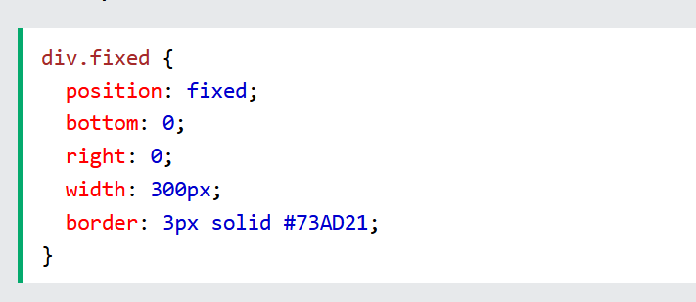
fixed
An element with position: fixed; is positioned relative to the viewport, which means it always stays in the same place even if the page is scrolled. The top, right, bottom, and left properties are used to position the element.
A fixed element does not leave a gap in the page where it would normally have been located.

Slide 7
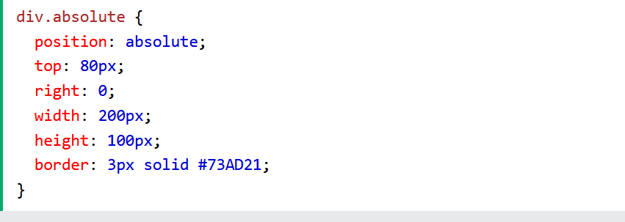
absolute
An element with position: absolute; is positioned relative to the nearest positioned ancestor (instead of positioned relative to the viewport, like fixed).
However; if an absolute positioned element has no positioned ancestors, it uses the document body, and moves along with page scrolling.
Absolute positioned elements are removed from the normal flow and can overlap other elements on the page.

Slide 8
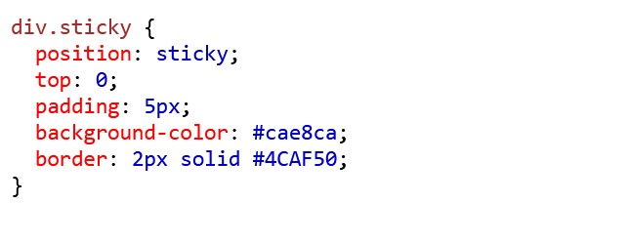
sticky
An element with position: sticky; is positioned based on the user's scroll position.
A sticky element toggles between relative and fixed, depending on the scroll position. It is positioned relative until a given offset position is met in the viewport – then it "sticks" in place (like position: fixed).

Slide 9
Bootstrap 5
Introduction
Bootstrap is a free and opensource CSS Framework for making and styling webapps.
It contains HTML, CSS and JavaScript-based design templates for typography, forms, buttons, navigation, and other interface components.
It was first developed at Twitter for consisting styling across the platform.

Slide 10
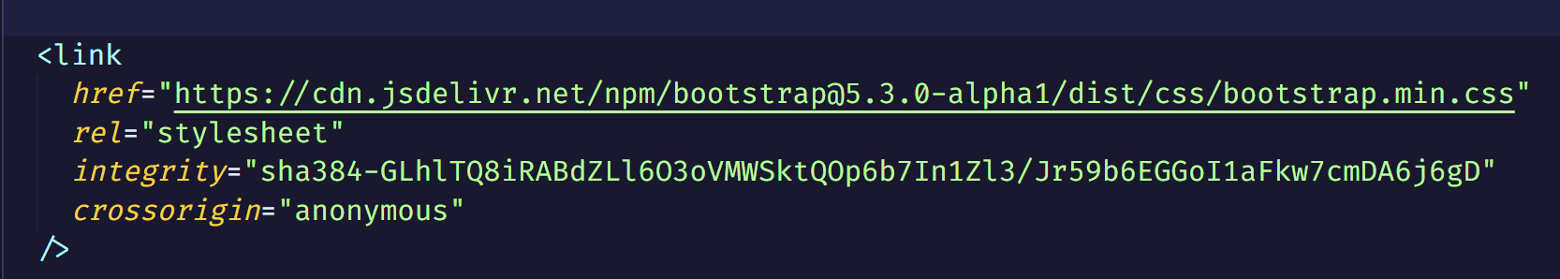
How to use bootstrap?
You can use Bootstrap in your webapp by using a link tag, like the one used to include a local css file. The link tag and the complete instructions are available at: https://getbootstrap.com/docs/5.3/getting-started/introduction/
Linking with the Bootstrap stylesheet enables you to use pre-defined styles using classes with HTML elements.

Slide 11
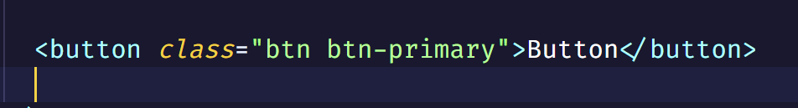
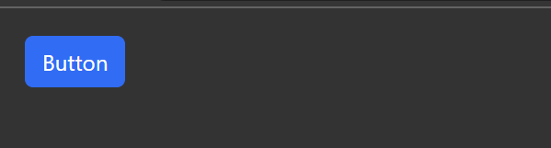
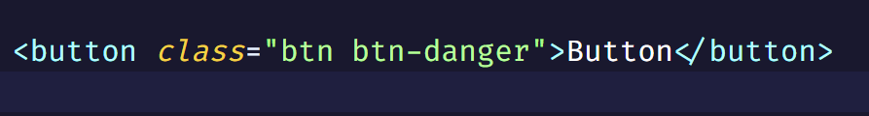
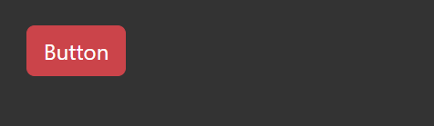
Bootstrap in use
Bootstrap’s predefined styles can be used by using class names when defining HTML elements on your web page.
In the given example, we can style a button without having to write any css, just by using desired bootstrap class.
You can checkout further styling options for HTML elements over at:
https://getbootstrap.com/docs/5.3/

Slide 12
Additional resources
https://developer.mozilla.org/en-US/docs/Web/CSS/position
https://www.w3schools.com/css/css_positioning.asp
https://getbootstrap.com/docs/5.3/getting-started/introduction/

Slide 13
THANK YOU
Hanzla Nouman
hanzlanouman@gmail.com

