Slide 1
REACT JAVASCRIPT
WEB DOCUMENTS

Slide 2
REACT STATE
React components has a built-in state object.
The state object is where you store property values that belongs to the component.
When the state object changes, the component re-renders.
The state object can contain as many properties as you like.

Slide 3
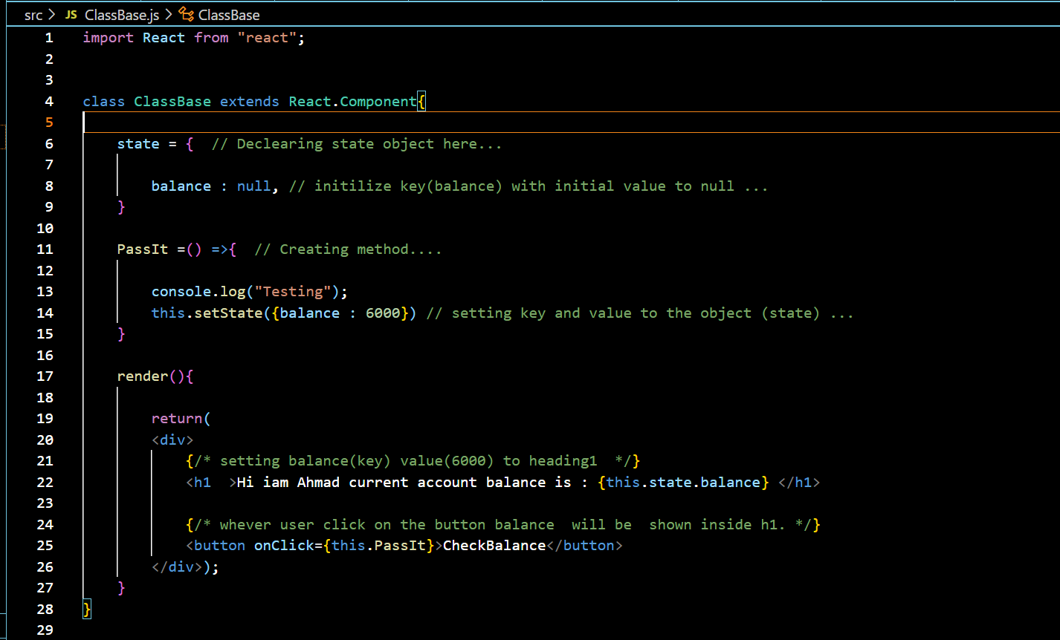
Example:

Slide 4
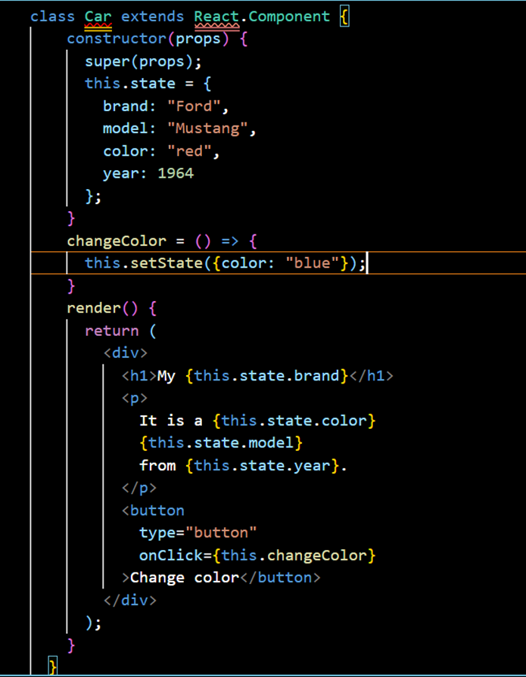
Changing the state of object
To change a value in the state object
use of set.State() method.
When a value in the state object changes, the component will re-render, meaning that the output will change according to the new value(s)

Slide 5
Onclick():
The onClick handler in React enables you to call a function and performs an action when an element is clicked in your app. It is the cornerstone of any React app.

Slide 6
Setstate():
To change a value in the state object
we use setState() method.
When a value in the state object changes, the component will re-render, meaning that the output will change according to the new value(s).

Slide 7
What is React Hooks ?
Hooks were added to React in version 16.8.
Hooks allow function components to have access to state and other React features. Because of this, class components are generally no longer needed.
Although Hooks generally replace class components, there are no plans to remove classes from React.
Hooks allow us to "hook" into React features such as state and lifecycle methods.

Slide 8
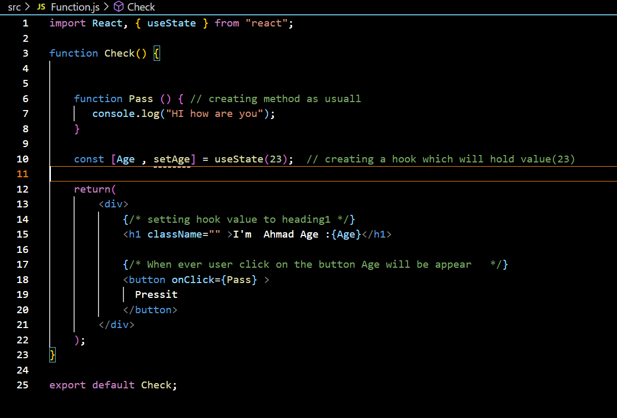
Example:

Slide 9
HOOK RULES:
There are 3 rules for hooks:
Hooks can only be called inside React function components.
Hooks can only be called at the top level of a component.
Hooks cannot be conditional.
You must import hook from React.
THANK YOU

