Slide 1


BY
WAQAS

Slide 2

Lecture # 3:
In this lecture we are studying about
ID
Class

Slide 3

Now the question is that what is meant by id and class?
ID : The id attribute is used by CSS and JavaScript to style/select a specific element. The value of the id attribute is case sensitive(unique).
id is denoted by # symbol
Class : The HTML class attribute specifies one or more class names for an element. Classes are used by CSS and JavaScript to select and access specific elements. The class attribute can be used on any HTML element. Different HTML elements can point to the same class name.
class is denoted by (.) symbol

Slide 4

Difference between Id and Class
Remember the difference between Class and ID: A Class name can be used by multiple HTML elements, while an ID name must only be used by one HTML element within the page.

Slide 5

Some important points you must know about id
ID’s are unique
Each element can have only one ID.
Each ID can have an unlimited amount of Styles applied to it.
Each page can have only one element with that ID.
IDs use “#” in the CSS which can also be used as an identifier for HTML “Jump Links” (hyperlinks). This allows you to jump from one place to another on the same web page and can also be used in creating a well-designed Table of Contents.

Slide 6

Some important points you must know about class
Classes are not unique
You can use the same Class on multiple elements.
Class naming is case sensitive.
Classes use a “.” in front of the name in the CSS as seen in the illustration below.
Each Class can have an unlimited amount of Styles applied to it.
You can use multiple classes on the same element.

Slide 7
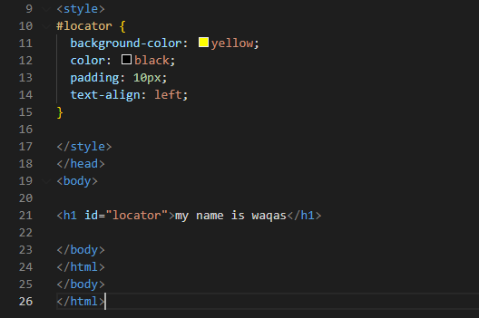
Example of id

Slide 8

.
Here simple we can write a heading h1 in body and give him a unique id #locator. And simple in head with the help of style tag we are target the heading h1 by its unique id name #locator and give it the background color, color and padding etc.

Slide 9
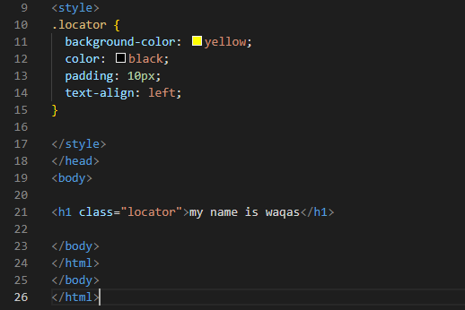
Example of Class

Slide 10

.
Here simple we can write a heading h1 in body and give him a unique id .locator . And simple in head with the help of style tag we are target the heading h1 by its unique id name .locator and give it the background color, color and padding etc.

Slide 11

.
Thanks

