Slide 1
Content Generation Engine (CGE) for AI-Assisted LMS
Version: 1.0

Slide 2
01
Introduction

Slide 3
What is CGE?
What is CGE?
A core module of the AI-Assisted LMS leveraging AI for educational content creation.
Purpose:
Automate and enhance content creation for educators.
Improve learning experiences for students.
Challenges Addressed:
Time and effort in manual content creation.
Adaptability for diverse teaching styles and student needs.

Slide 4
Stakeholders
Student
Enhance learning experiences with personalized, interactive, and evaluative tools.
Teacher
Simplify content creation, improve instruction with insights, and automate assessments.
Admin
Maintain system integrity, monitor user performance, and manage operational workflows.

Slide 5
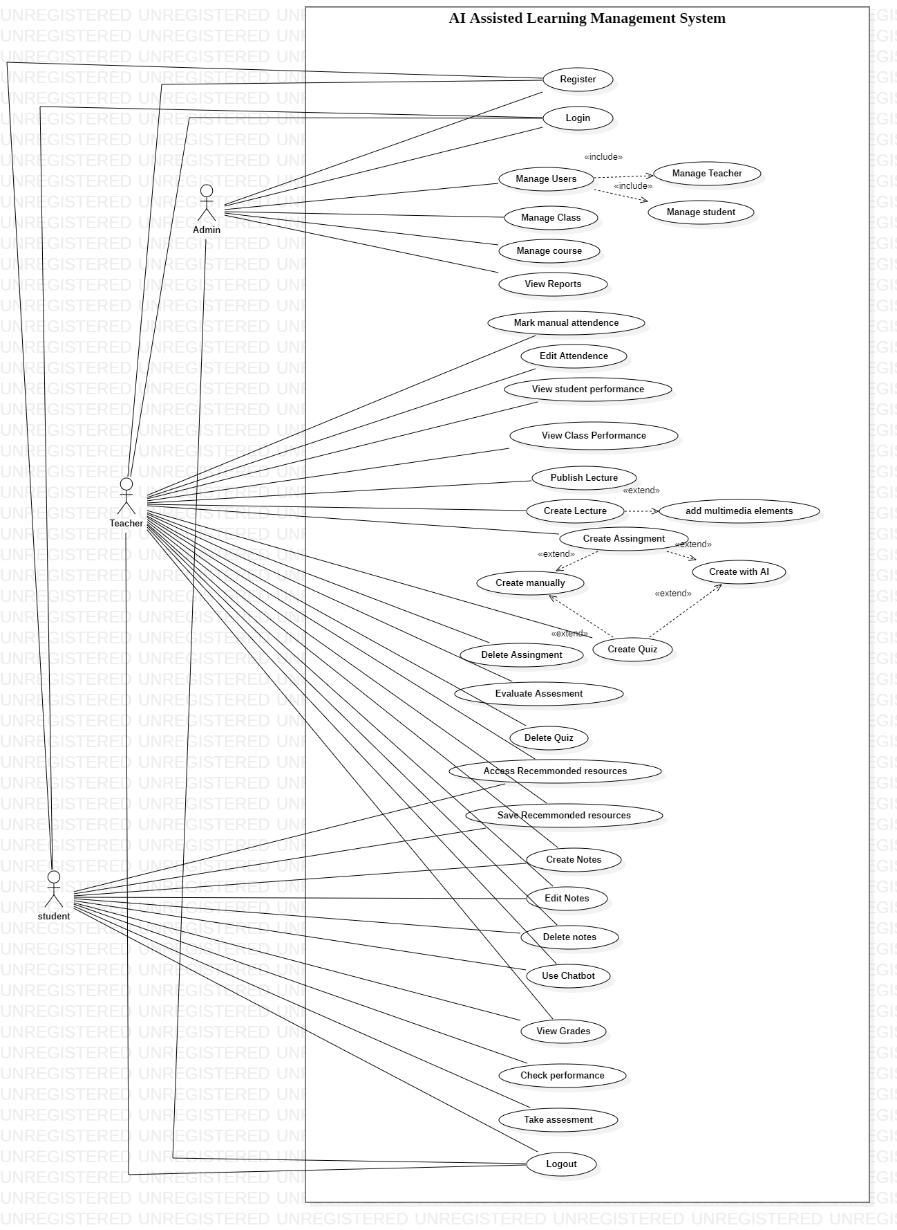
Use Case diagram

Slide 6
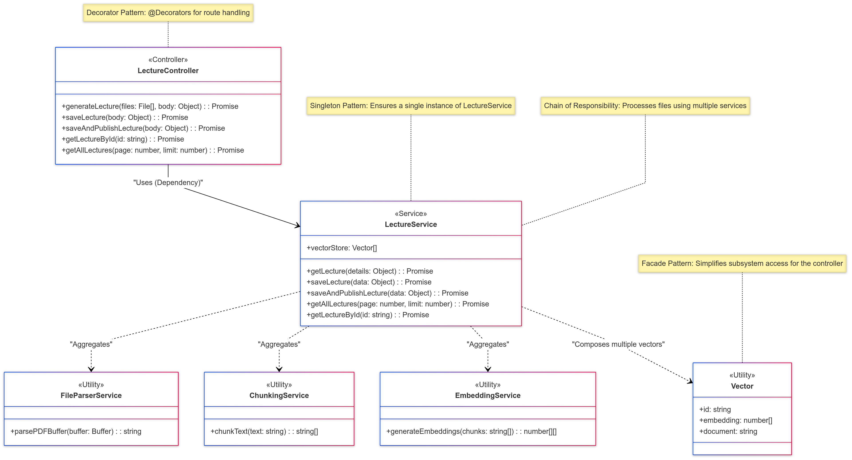

Slide 7
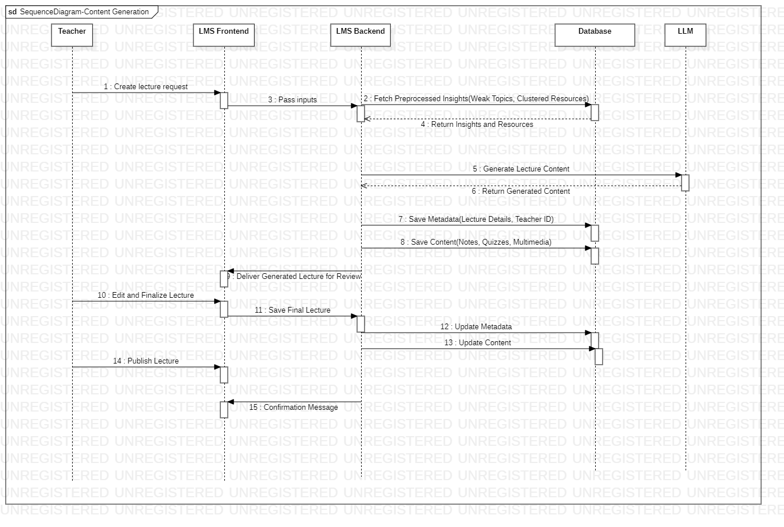
Sequence Diagram

Slide 8
02
Core Functionalities - Overview

Slide 9
Core Functionalities - Overview
Create Lecture
01
Build and structure lecture content seamlessly.
Integrate text, images, videos, and interactive quizzes.
AI Generated Lecture
02
Suggestions for topics, objectives, and resources.
Auto-generated outlines for creativity and efficiency.
Save and Publish
03
Save drafts and publish finalized content directly.

Slide 10
03
Core Functionalities - Advanced Features

Slide 11
Core Functionalities
1
2
3
4
Add Multimedia Elements
Personal Notetaking
Edit and Update Content
Content Templates
Allow students to create personalized notes linked to lecture content.
Enable modifications for relevance and clarity.
Pre-designed templates for lectures and guides to ensure consistency.
Embed images, videos, and diagrams for enhanced engagement.

Slide 12
04
Proposed Design Patterns and Principles

Slide 13
Design Patterns
GRASP Principles
Factory Pattern
Observer Pattern
Decorator Pattern
Chain Of Responsibility
Adapter Pattern
Facade Pattern
Command Pattern
Controller: Centralized control of user interactions.
High Cohesion: Components focus on specific tasks.

Slide 14
SOLID Principles
SRP: Separate logic for content creation, AI, and multimedia.
OCP: Add features without modifying existing code.

Slide 15
05
Code Implementation

Slide 16
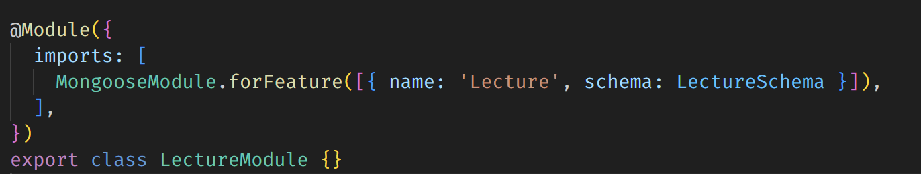
Factory Pattern

Slide 17
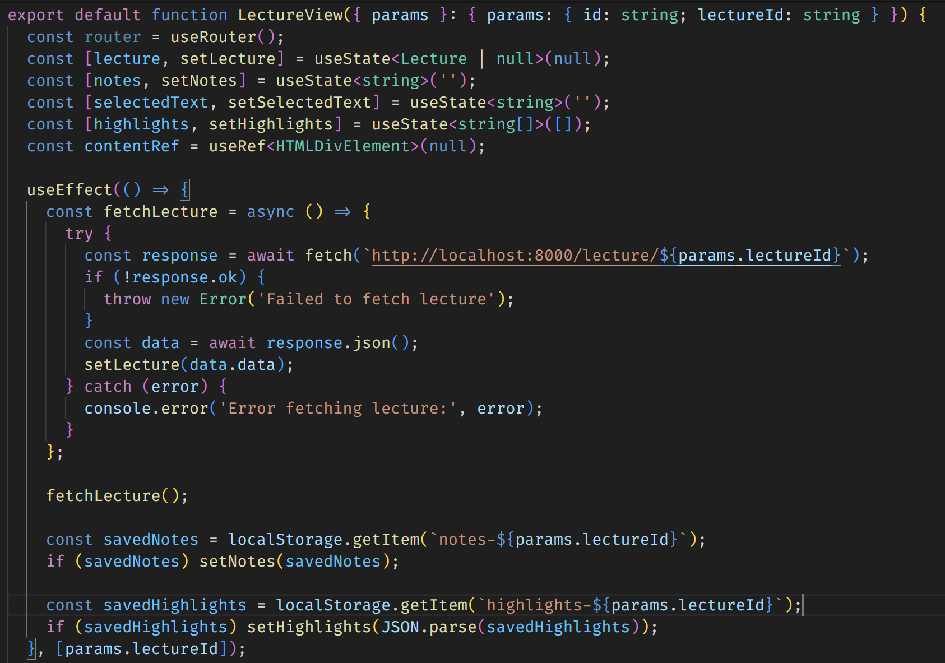
Observer Pattern
Anywhere where useState and useEffect Hook is used

Slide 18
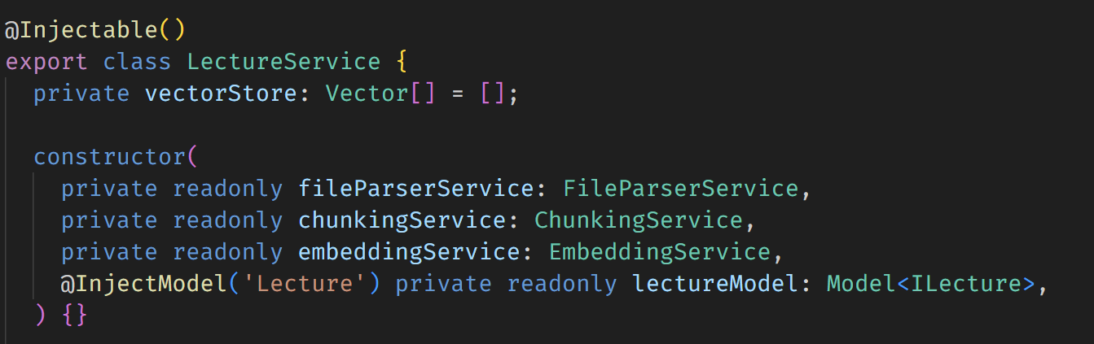
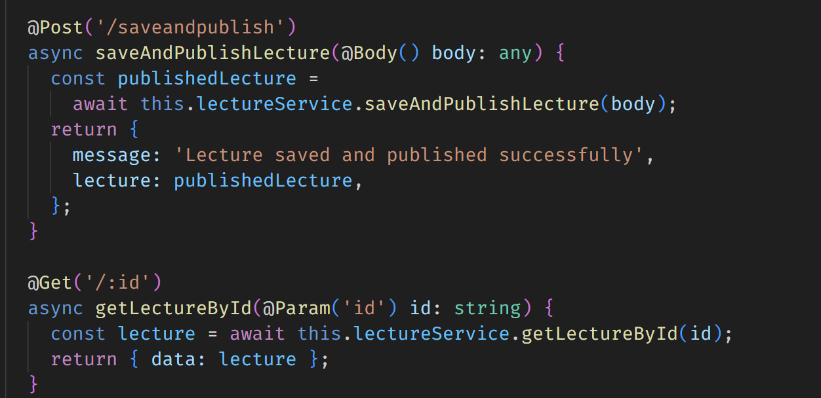
Decorator Pattern
Used with NestJS Decorators

Slide 19
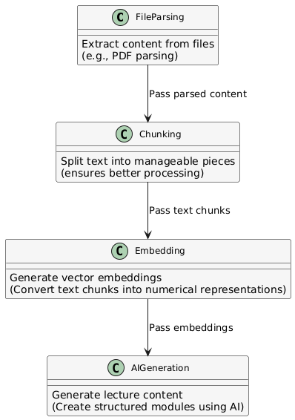
Chain of Responsibility Pattern
The pipeline for generating lecture content (file parsing → chunking → embedding → AI generation) resembles a chain of responsibility.

Slide 20
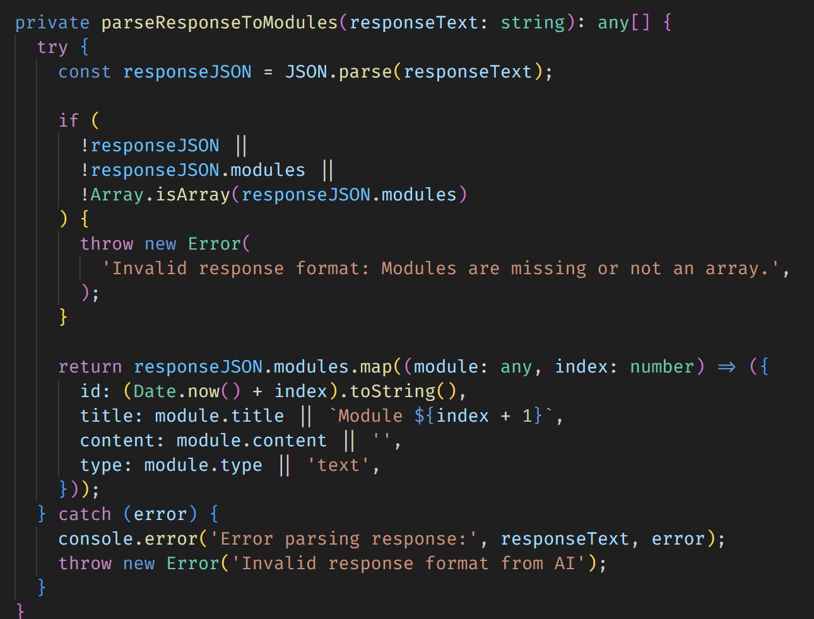
Adapter Pattern
Converts AI response format into a structure usable by the application.

Slide 21
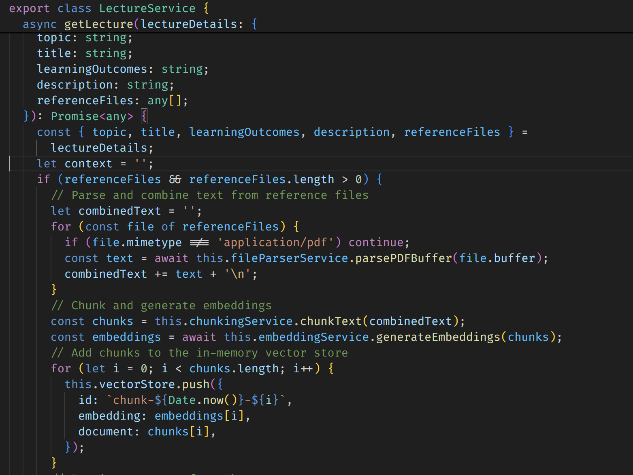
Façade Pattern
The LectureService simplifies complex workflows like file parsing, embedding generation, and AI integration into a single method.

Slide 22
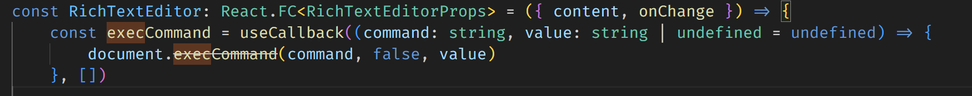
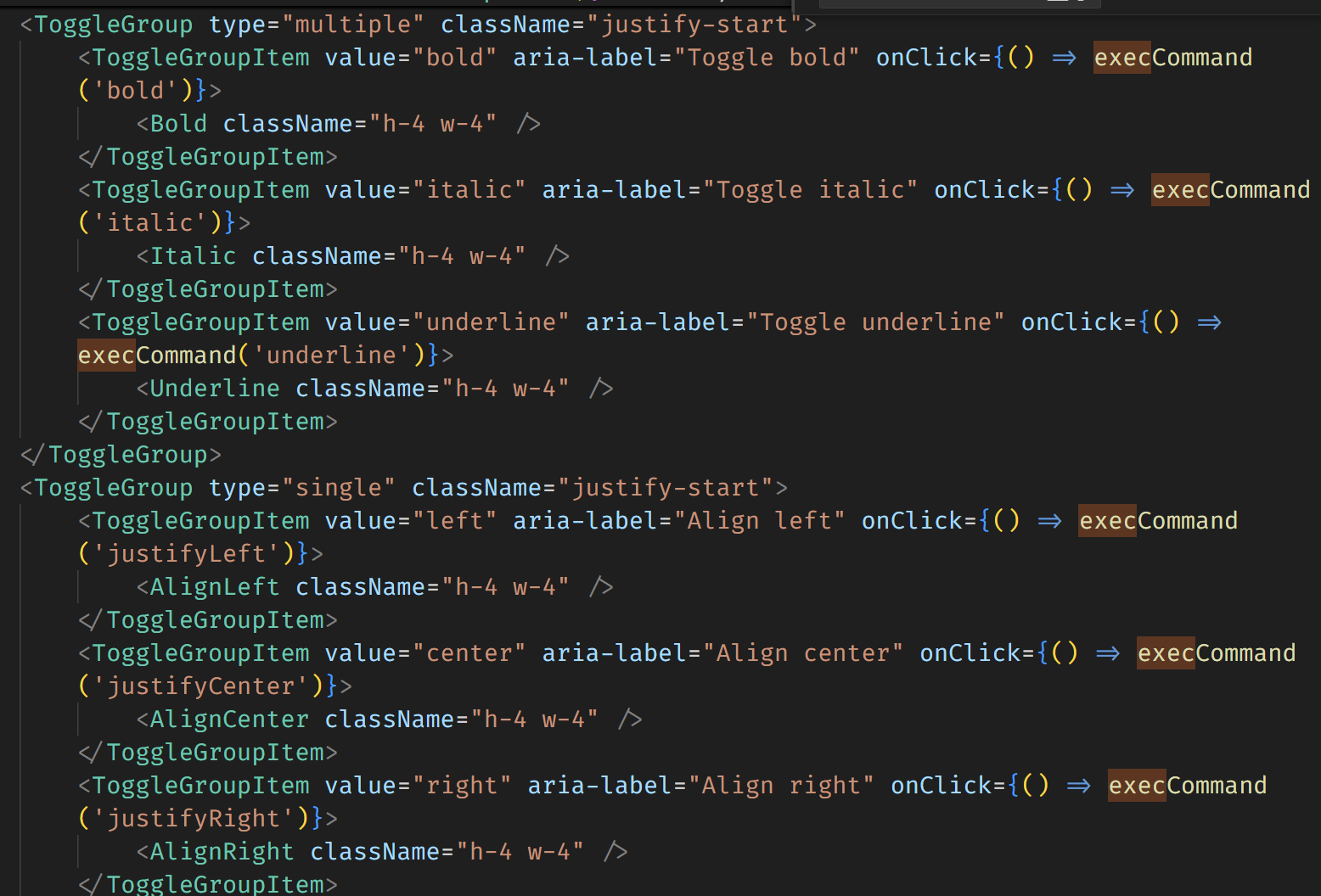
Command Pattern
Used in the RichTextEditor for executing browser commands like bold, italic, or justifyLeft

Slide 23
Thanks!
Hanzla Nouman (FA21-BSE-015)
Laiba Binta Tahir (FA21-BSE-019)
Arfah Ali (FA21-BSE-080)
Abdul Rehman (FA21-BSE-062)
No Questions Please!

