Slide 1
Installation & Setup

Slide 2
Download and Install
Install Unity Hub
Start Your Creative Projects and Download the Unity Hub | Unity
Install Unity 2022 LTS
Install .NET SDK
Download .NET 7.0 SDK (v7.0.401) - Windows x64 Installer (microsoft.com)
Install Visual Studio Code OR Visual Studio Community
Visual Studio Community can be installed as a module in Unity
Visual Studio Code - Code Editing. Redefined
Install Unity Extension (VS Code)

Slide 3
Unity Hub
The Unity Hub is an essential tool for managing the projects you build, and ever-improving versions of the Unity Editor.
The Hub brings together several Unity tools and resources that will keep you organized and up to date.

Slide 4
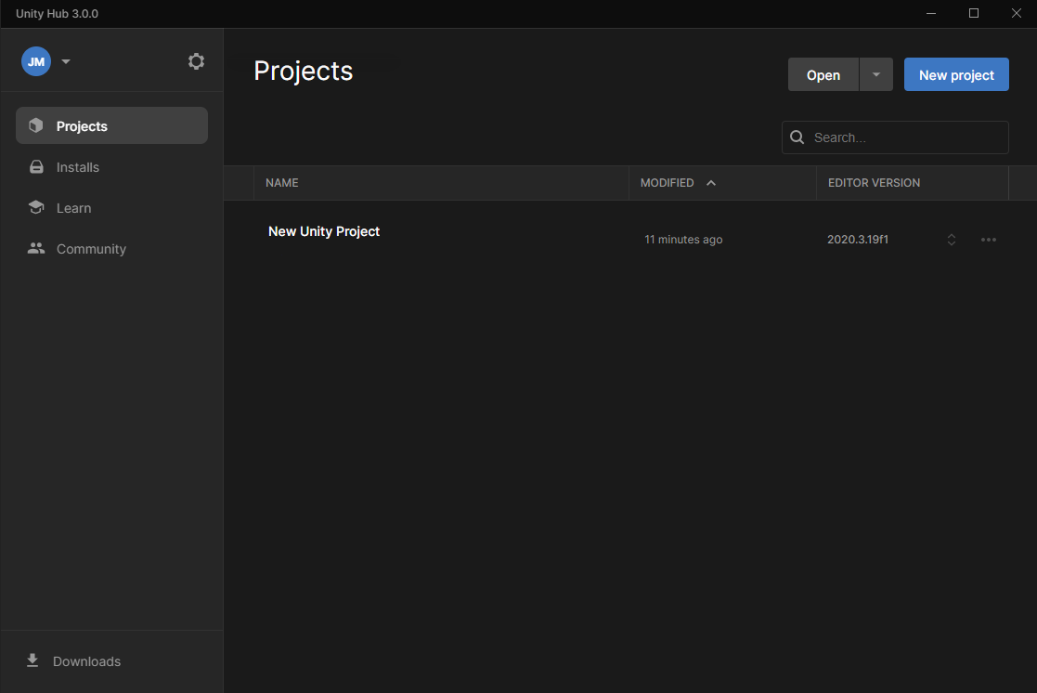
Explore Unity Hub
Open the Unity Hub if it isn’t open already. You will see the main menu of the Unity Hub. Take a quick look at each of the tabs described below.

Slide 5
Explore Unity Hub
Projects tab
In Unity, you will work in multiple projects, just like you work in multiple documents using office applications, or multiple images using graphics software. The Projects tab is where you’ll create and import new projects and manage existing ones.
Learn tab
The Learn tab is your instant connection to resources for learning Unity. Check the Learn tab for featured learning experiences and tutorials on specific skills.

Slide 6
Explore Unity Hub
Community tab
The Community tab is a quick reference resource that lists various places you can engage and connect with the wider Unity community.
Installs tab
You’ll be installing new versions of Unity as the engine evolves. The Installs tab is where you’ll manage and configure these installs in the Hub.
Hub preferences and account settings
There are two additional controls on the Hub’s main screen:
Selecting the settings (gear icon) opens your Preference settings for the Unity Hub.
Selecting your initials opens an account menu for your Unity ID.

Slide 7
Identify Unity Version
In the Unity Hub, you can manage many versions of the Editor. There are two different types of Unity releases:
Long-Term Support (LTS) releases
TECH Stream releases, including alpha and beta releases
As a general rule, you should use the latest LTS version for your Unity project.

Slide 8
Identify Unity Version
In the Unity Hub, you will see release numbers with a build number, such as 2021.2.6f1.
The letters in the build number indicate the following:
Alpha (a)
Beta (b)
A candidate for final release (rc)
A final release (f)

Slide 9
Install a new version of Unity from the Hub
When you first installed Unity, you were probably guided to install the latest LTS version.
There are typically two LTS versions available at a time.
Go to the Installs tab. (Notice which version you already have installed.)
Select Install Editor (Button), and browse the available “Official Releases.”
Select an LTS version and install it.

Slide 10
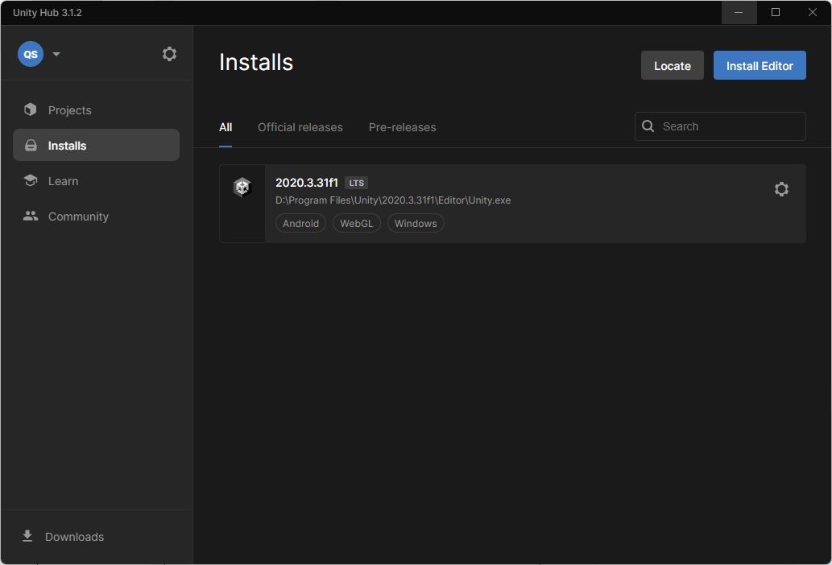
Install a new version of Unity from the Hub
Open the Unity Hub and select the Installs tab.

Slide 11
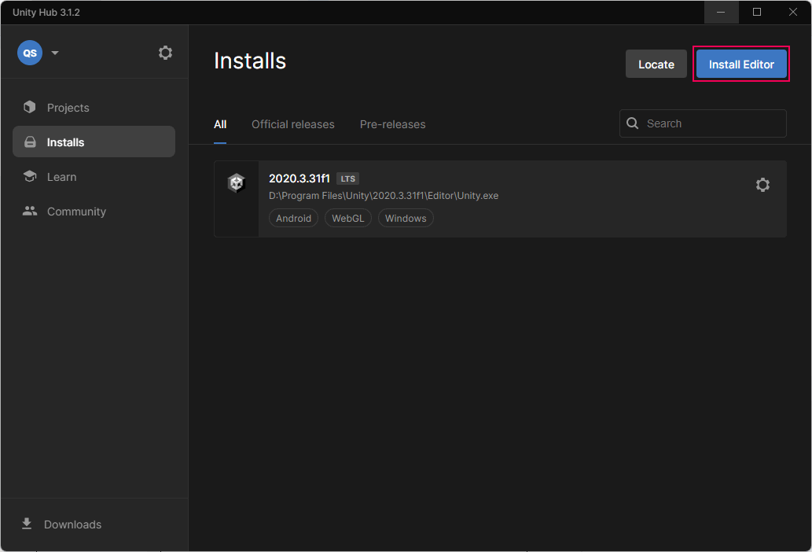
Install a new version of Unity from the Hub
Select Install Editor to install a new version.

Slide 12
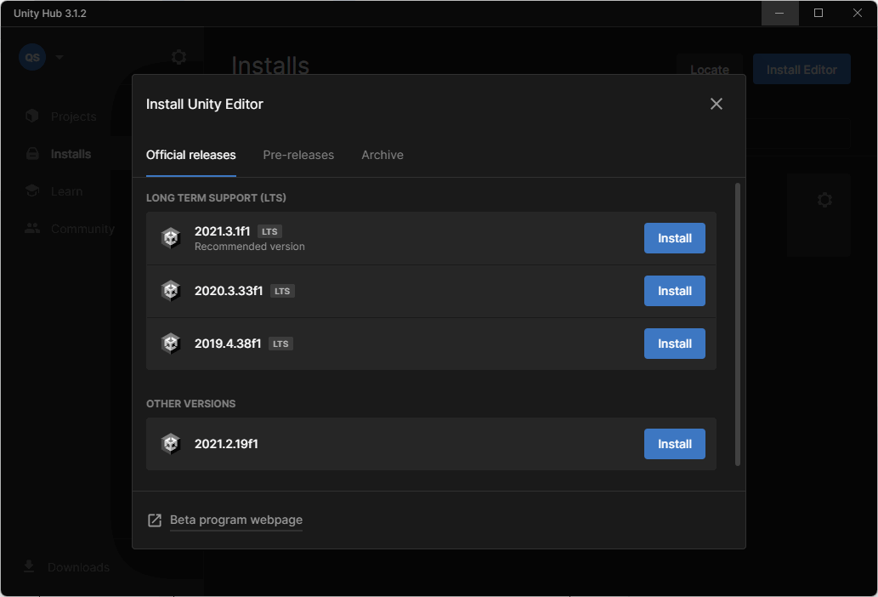
Install a new version of Unity from the Hub
Find the version you need and select Install. (Preferably LTS)

Slide 13
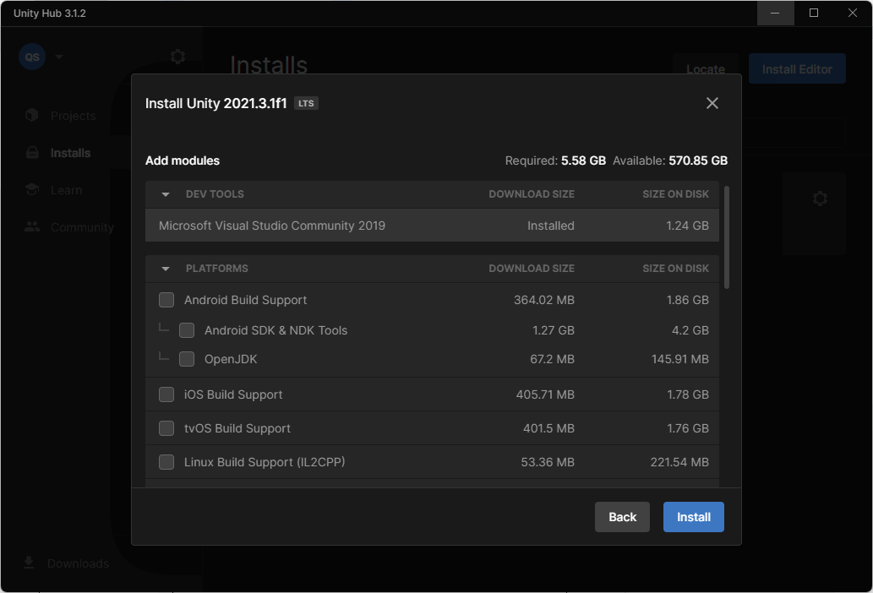
Install a new version of Unity from the Hub
Select any modules that you want to add. You may want to consider:
Build support, so that the experiences you create can be played on different platforms (WebGL, Windows, Mac and Linux)
Language packs
Documentation will be selected by default.
Select Install to complete the installation.

Slide 14



Game Engine & IDE
Game Engine
IDE
Scripts
Visual interface for creating games
Systems of existing code we can use (physics, rendering, audio, etc)
Helps us write code to tell the game engine what to do
Auto-complete, colour coding, syntax error checking
Code we write is saved in “Scripts” which are .cs files

Slide 15
Unity Project

Slide 16
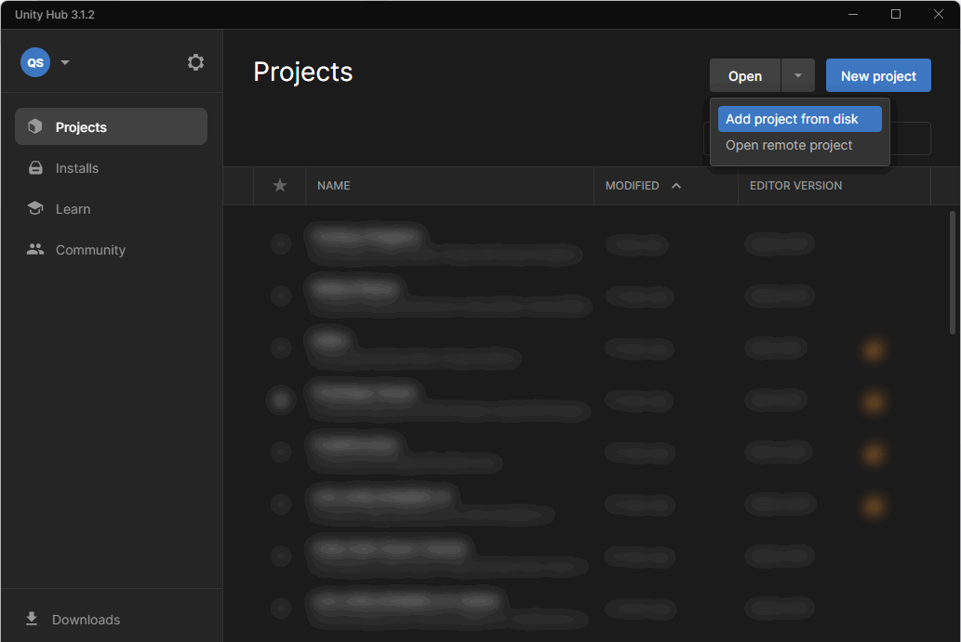
Add a project to the Unity Hub
In the Projects tab, select the Open options dropdown, and select Add project from disk
Navigate to the root folder for the Unity project and then Select Folder. The project will appear in the list available on your Projects tab.

Slide 17
Add a project to the Unity Hub
If the project uses a Unity version that you don’t have installed, you’ll see a warning icon next to the Unity Version field in its listing. You can either:
Go to the Unity Download Archive and install the missing Unity version.
Select Choose another Editor version and open the Project using a version that you have installed previously. Note: If you do this and the versions do not match, when you try to open the project a dialog window will open asking you to confirm that you want to upgrade the project.
Important: Don’t open any Unity project with an older Unity version — this is known as downgrading.

Slide 18
Create a new Unity project
Important: If the filepath to a project on your computer is more than 260 characters or there are spaces in that filepath, you may encounter errors when initially opening your project from Unity Hub. This is due to operating system restrictions.
To avoid encountering these errors, we recommend that you:
Check that the folder you are organizing your Unity projects in isn’t at the end of a long filepath.
Remove any spaces from the folder names in the filepath to your Unity projects.
Name your project without spaces. You can use underscores (_) if this is helpful.

Slide 19
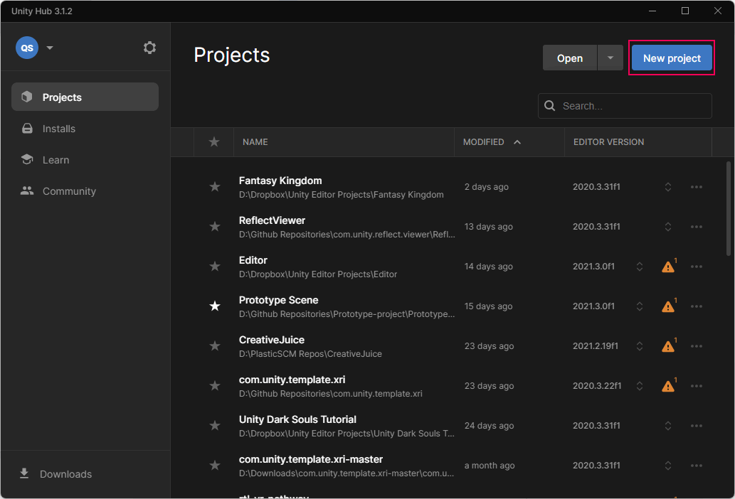
Create a new Unity Project
Open the Unity Hub.
In the Projects tab, select New project.

Slide 20
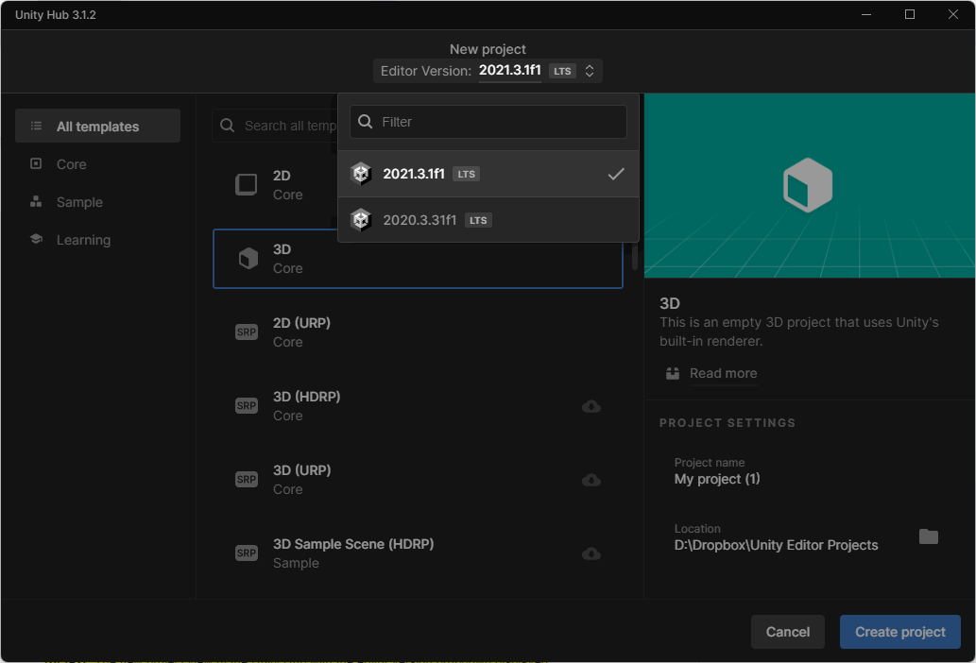
Create a new Unity Project
Select the Unity version you’d like to use with the Editor Version dropdown (If you have multiple installs).

Slide 21
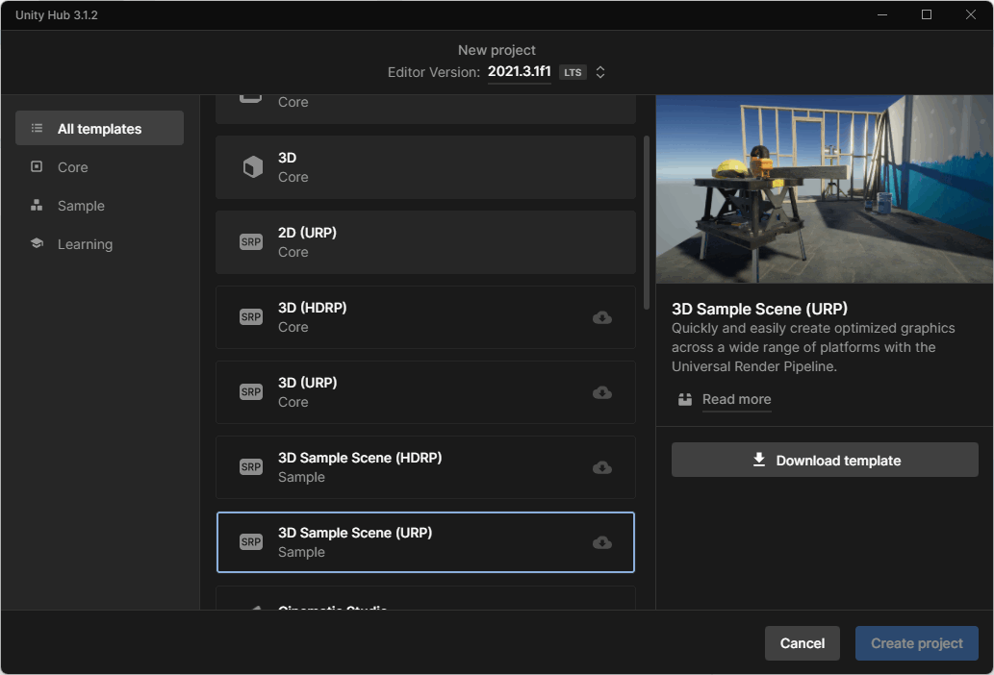
Create a new Unity Project
Select the Template that you want to use. (Your specific learning experience will include the required Template.)
Note: It may take a few moments for all the Templates to become visible in the available list. If a Template has a download icon (cloud with a down arrow), you’ll need to select this and download the Template or update it before you can use it.

Slide 22
Create a new Unity Project
Name your project and set the location.
Select Create Project. Your project will open in Unity Editor — don’t worry if this takes a few minutes.
Depending on the Template you select, you might see sample content.
If you don’t want to use this content, you can create a new Scene that only contains a Directional Light and Main Camera.
To create the new Scene, start at the Unity Editor’s main menu and select Assets > Create > Scene. Give your new Scene a name.

Slide 23
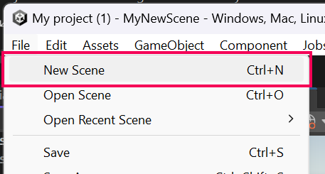
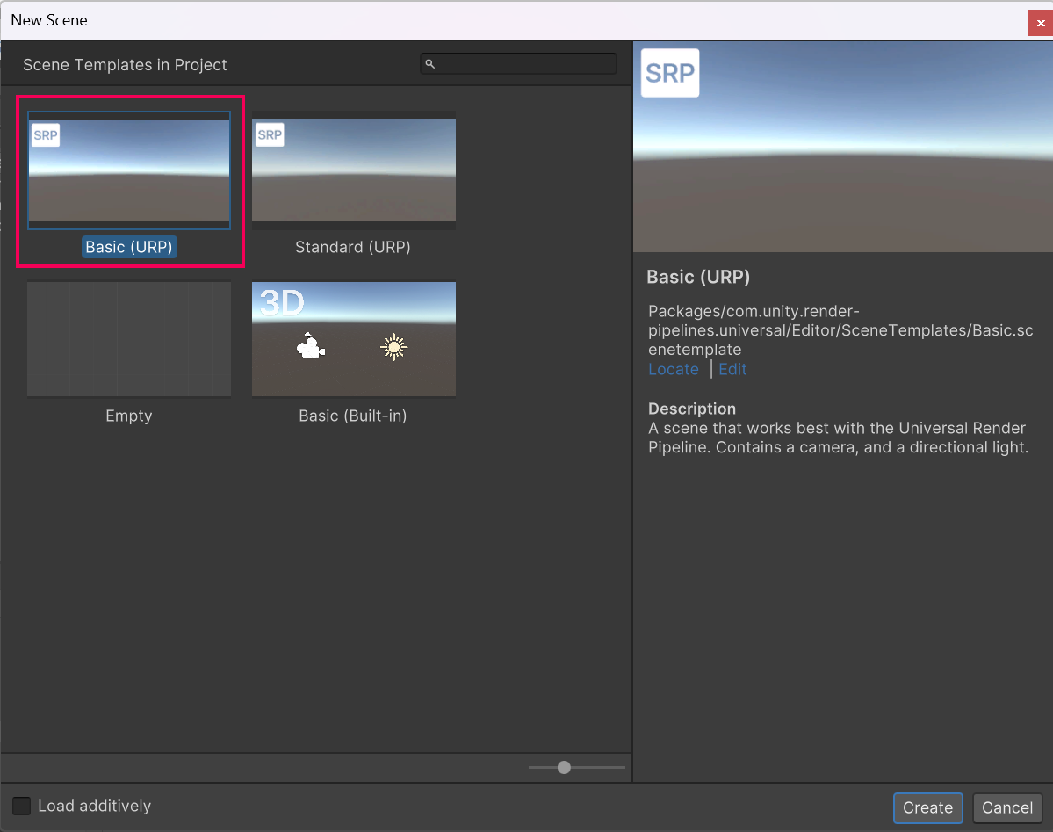
Create a new Scene
In the Unity Editor main menu, go to File > New Scene.
Select your preferred scene template. Select Basic (URP) if you are unsure which one to use.

Slide 24
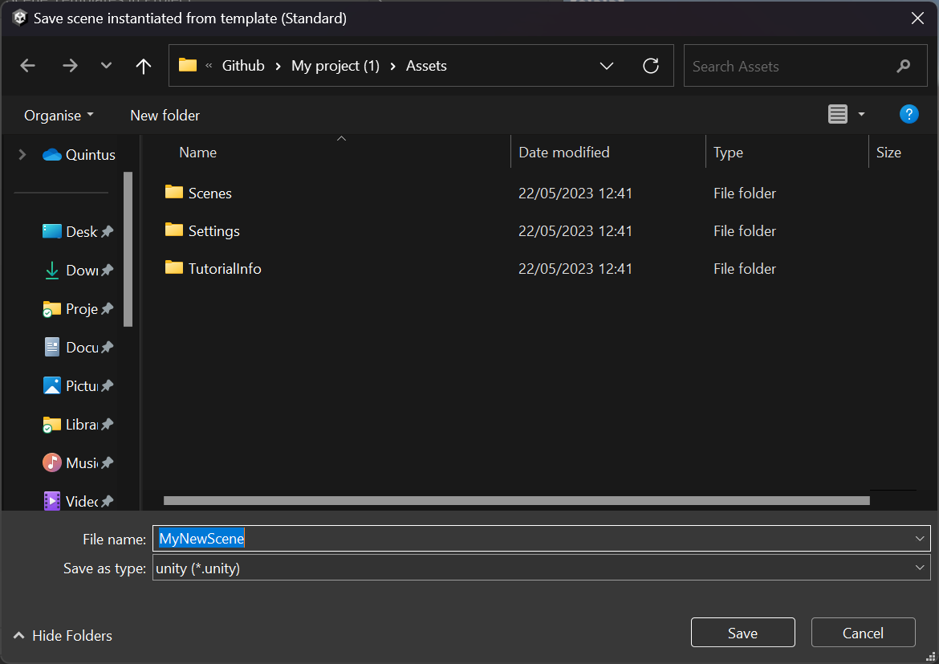
Create a new Scene
Give your new scene a name and select a location to save it. The Scenes folder inside your project is the best option to keep everything neat and easy to manage.

Slide 25
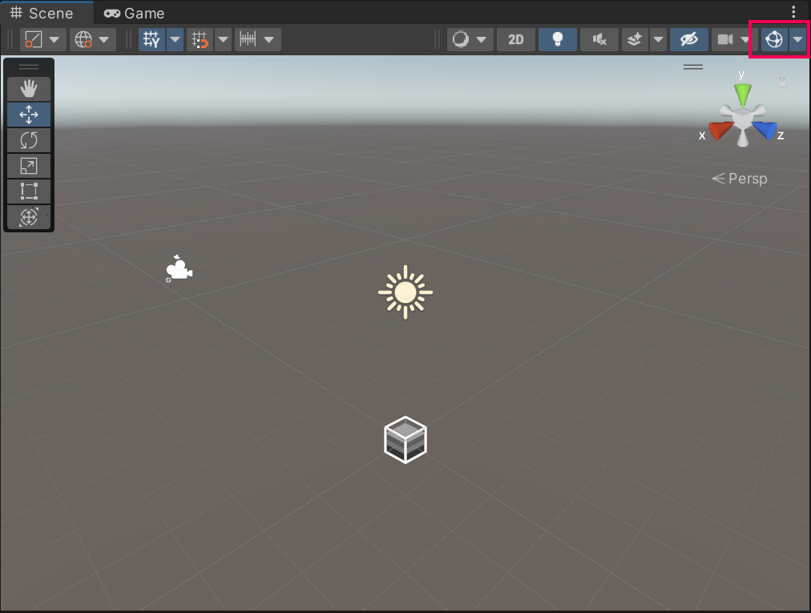
Create a new Scene
Your new scene contains a camera (Main Camera) and a default sun (Directional Light) in the Hierarchy.
Both these GameObjects also have icons that represent them in the scene.
You can adjust the size of the icons or switch them off by using the Gizmo visibility toggle at the top right of the Scene view window.

Slide 26
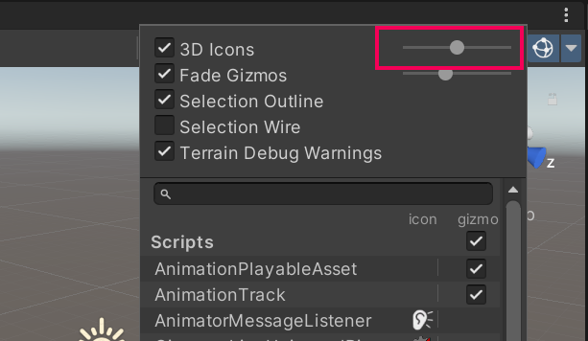
Create a new Scene
If you wish to keep the Gizmos but adjust their size, use the slider under the dropdown option on the Gizmo visibility toggle.

Slide 27
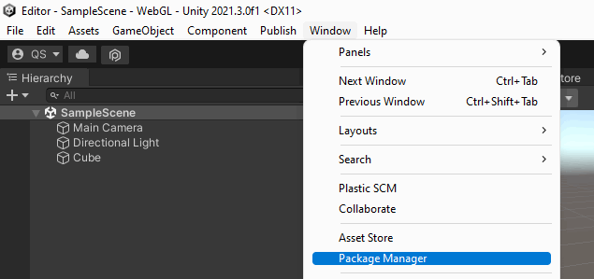
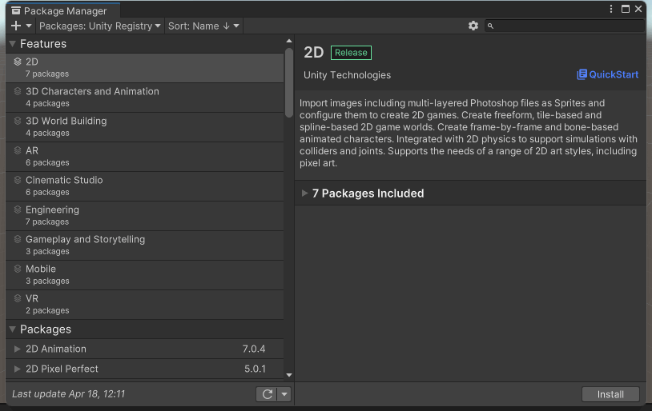
Install Packages via Package Manager
Open Unity Editor, if you haven’t already done so.
In the top menu, go to Window > Package Manager.
Browse the Unity Registry (default view) or use the search bar to find the package that you want to install.
When you’ve found your required package, select Install to install it in your Unity project.

Slide 28
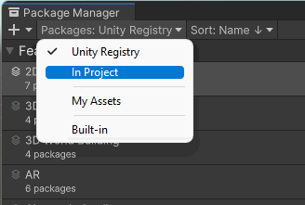
Update a package in your Unity project
Open Unity Editor, if you haven’t already done so.
In the top menu, go to Window > Package Manager.
In the left-hand corner of the window, select the package scope drop-down menu and choose In Project.
This view lists all the packages that are currently in your Unity project.

Slide 29
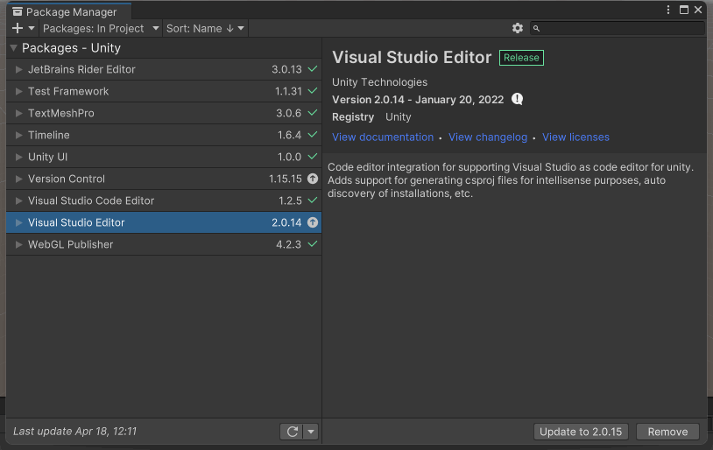
Update a package in your Unity project
Select the relevant package from the list available. Tip: An arrow icon indicates packages with an update available.
Select Update to [version number].

Slide 30
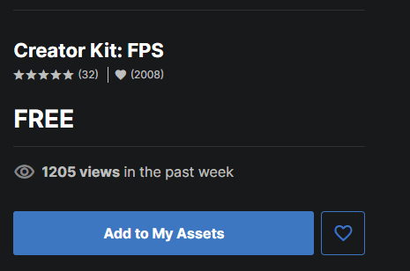
Import assets from the Asset Store
Open the project in Unity Editor.
In your internet browser, go to the Asset Store and find the package you want to download.
Select Add to My Assets.
When the completion dialog window opens, select Open in Unity.

Slide 31
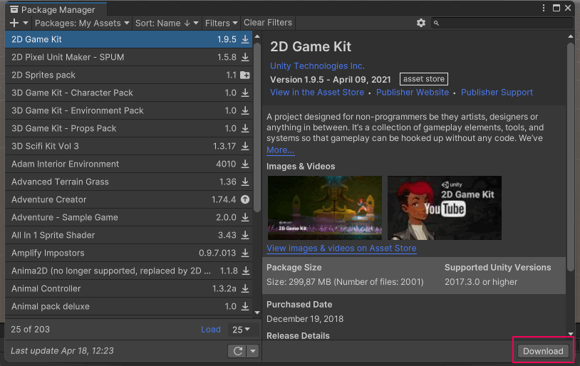
Import assets from the Asset Store
The package will open in the Package Manager window.
Select Download. If you previously downloaded the assets, you will go straight to the next step in this process.

Slide 32
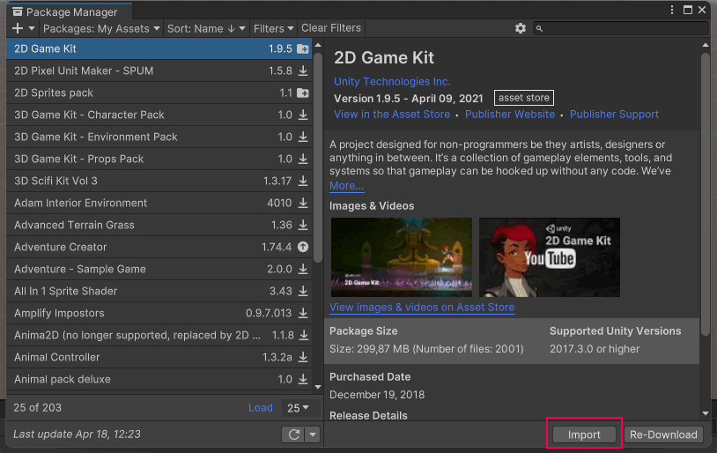
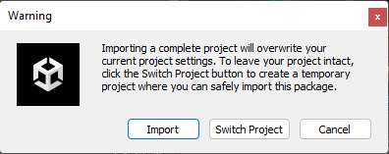
Import assets from the Asset Store
Select Import.
A dialog window will warn you about overwriting your project settings — if you haven't customized your project settings, you can ignore this warning. To proceed, select Import.

Slide 33
Import assets from the Asset Store
Another dialog window may warn you that there are Package Manager dependencies — if so, select Install/Upgrade.
The Import Unity Package window will open, listing the contents of the package. In most cases, you will want to keep all of the contents of the asset package selected. In the lower right corner of the window, select Import.
The assets will be added to the Assets folder of your Unity project. When this process is completed, close the Package Manager window and return to your learning experience.

Slide 34
Import a local asset package
Open the project in the Unity Editor.
In the top menu, go to Assets > Import Package > Custom Package.
In the file browser window, navigate to the .unitypackage file you want to import and select Open.
Select Import to import the assets to your project. You can find them by going to the Project window and opening the Assets folder.

Slide 35
Import individual assets from your computer
In your file browser window, navigate to the file that you want to import.
Open your project in Unity Editor.
Drag the file from the file browser into the Project window in the Editor. This will copy the file into the Unity project’s Assets folder.

Slide 36
Introduction to Unity

Slide 37
GameObject & Components
They are the fundamental objects in Unity that represent characters, props and scenery.
They do not accomplish much in themselves, but they act as containers for Components, which implement the functionality.
To give a GameObject the properties it needs to become a light, or a tree, or a camera, you need to add components to it.
Depending on what kind of object you want to create, you add different combinations of components to a GameObject.

Slide 38
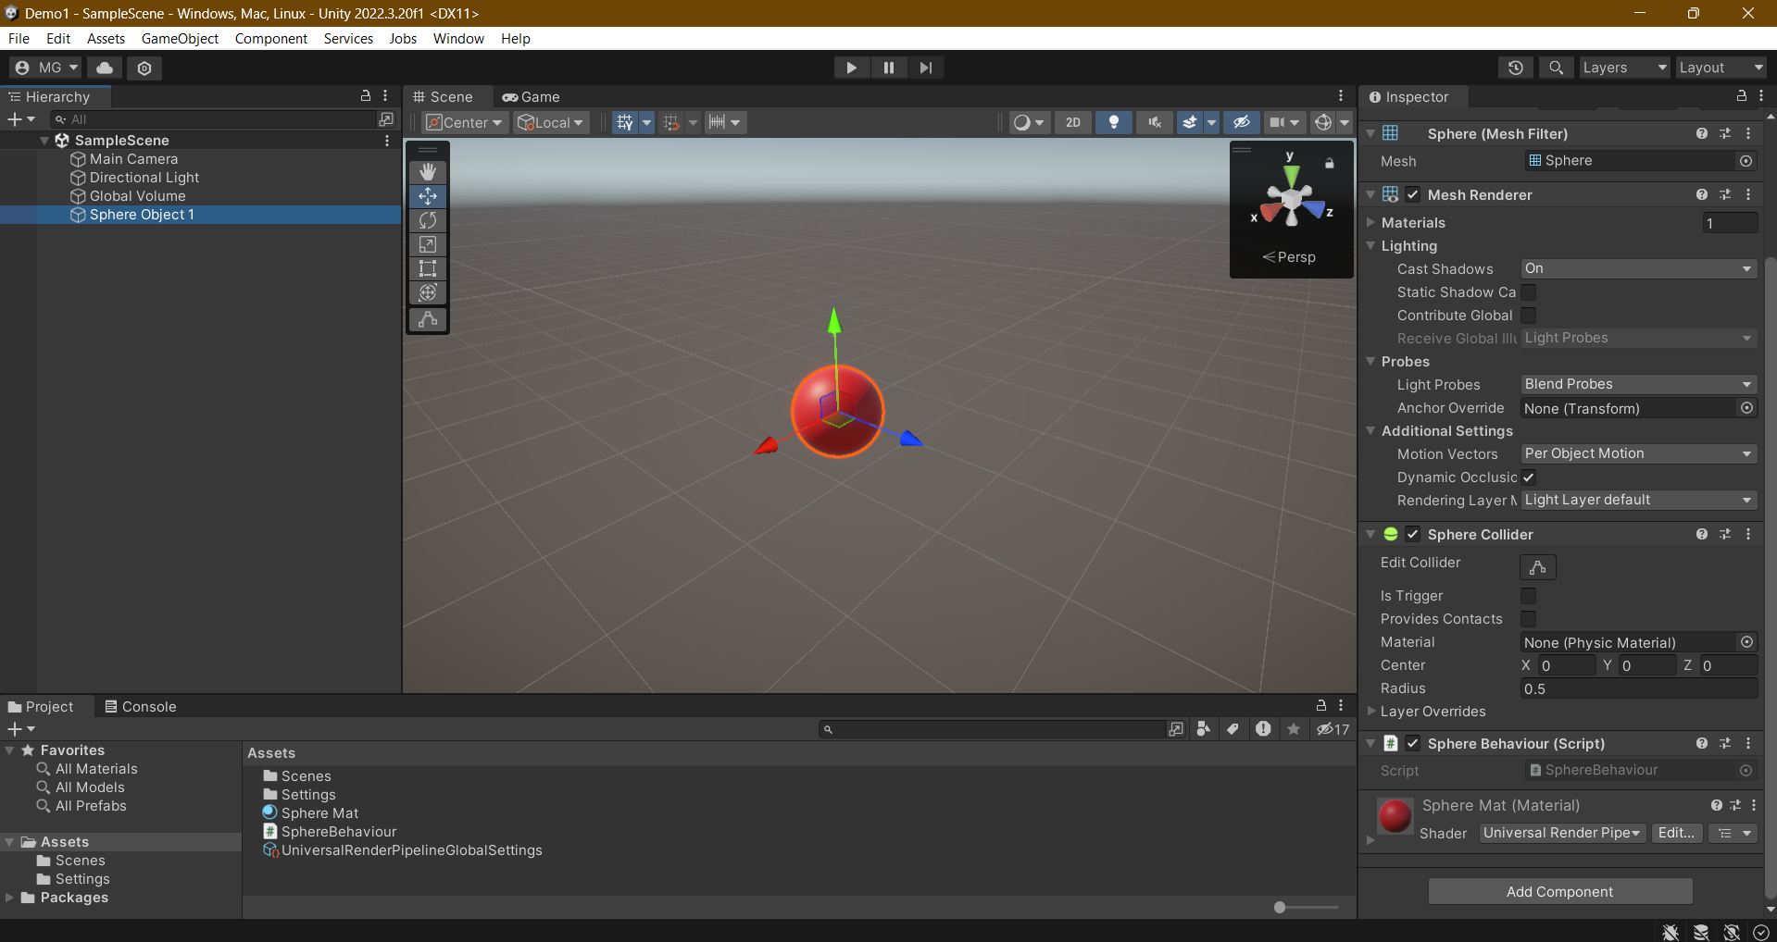
Menu
GameObject Visual
Inspector
Tools
GameObject
Component
Hierarchy
Assets Folder
Script
Button to add new component

Slide 39
Asset Workflow
An asset is any item that you use in your Unity project to create your game or app.
Assets can represent visual or audio elements in your project, such as 3D models, textures, sprites, sound effects, or music.
Assets can also represent more abstract items such as color gradients, animation masks, or arbitrary text or numeric data for any use.

Slide 40
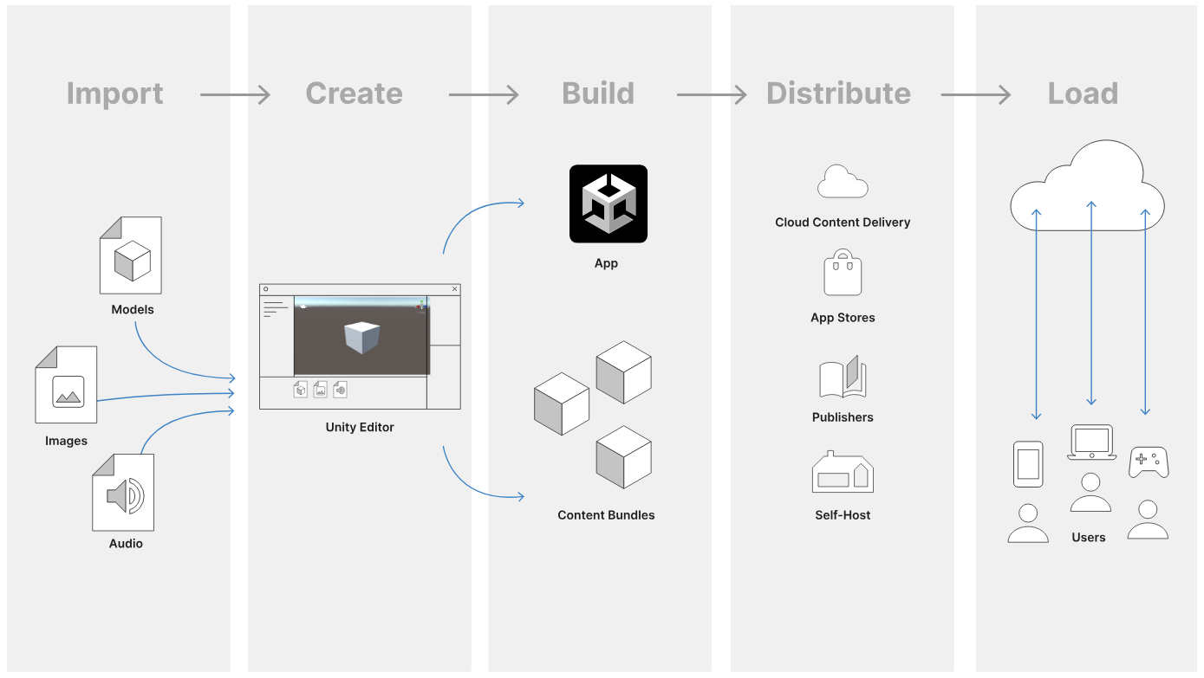

Slide 41
Import, Create, Build, Distribute, Load
The diagram shows the typical workflow when you work with assets in Unity. Each column represents a separate step and is described below:
Import assets into the Unity Editor
Create content using the Unity Editor with those assets.
Build your app or game file, and optionally its accompanying content bundles
Distribute the built files so that your users can access them, via a publisher, or an app store
Load further updates as necessary at runtime, depending on your user’s behavior, and how you have grouped and bundled your content.

Slide 42
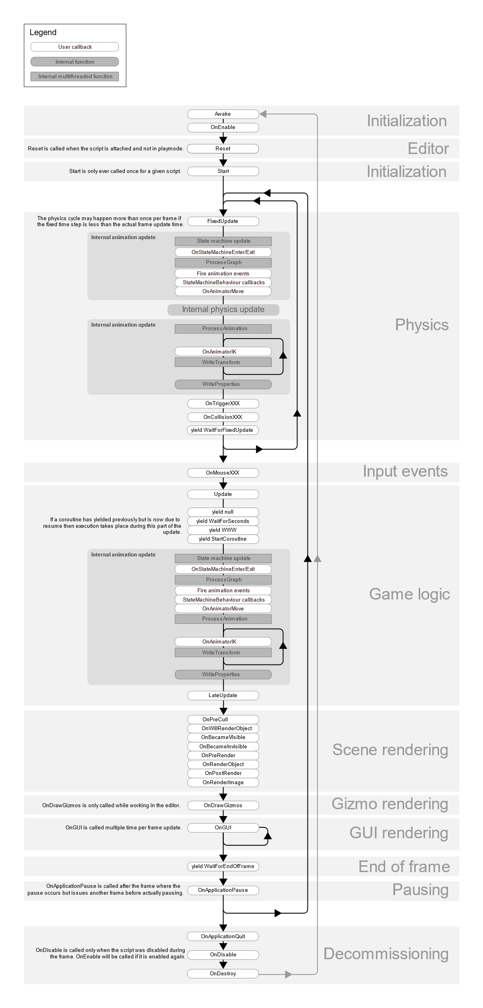
Unity Order of Execution
Awake
Called when a scene starts.
Start
Called before the first frame update
FixedUpdate
Called more frequently then Update
Can be called multiple times per frame
All physics calculations are made after Fixed Update
Update
Called per frame
Main workhorse of a frame
LateUpdate
Called once per frame after Update has finished.

Slide 43
Create a Basic 3D Scene

Slide 44
Modify a Scene
Create a 3D URP Project
Add some basic 3D Objects to create a game scene.
Manage the game object by creating parent and child game objects.
Create a new Material and add it to the 3D object.
Modify the color of the material.

Slide 45
Create a Script
Create a new C# script.
Print a message on Console.
Attach the script to game object.

Slide 46
References
Start Your Creative Projects and Download the Unity Hub | Unity
Unity Asset Store - The Best Assets for Game Making
Unity Documentation
Unity - Manual: GameObjects (unity3d.com)
Visual Studio Code - Code Editing. Redefined
Download .NET (Linux, macOS, and Windows) (microsoft.com)
Download .NET Framework 4.7.1 | Free official downloads (microsoft.com)
Unity - Manual: Order of execution for event functions (unity3d.com)
Unity - Manual: 2D (unity3d.com)

