Slide 1
Advanced Python Programming
Topic: Introduction To Operator In Python
Presenter: Laiba Arshad Kiyani

Slide 2
Operator
In programming and mathematics, an operator is a symbol or keyword that tells the computer to perform a specific operation on values or variables.

Slide 3
Types of operators
Arithmetic Operators
Comparison (Relational) Operators
Logical Operators
Assignment Operators

Slide 4
Arithmetic Operators
Name | Operator | Function | Example (a=10, b=3) | Result
Addition | + | Two or more numbers are combined to make a total (sum). | a+b | 13
Subtraction) | - | To find the difference. | a-b | 7
Multiplication | * | Product of two or more numbers. | a*b | 30
Division | / | Splitting a number into equal parts . | a/b | 3.3333…
Floor division | // | Divides one number by another and returns the quotient without the decimal part. | a//b | 3
Modulus | % | Returns the remainder after dividing one number by another. | a%b | 1
Exponentiation | ** | Raises one number (the base) to the power of another number | a**b | 1000

Slide 5
Comparison Operators
Name | Operator | Functions | Example | Result
equal to) | == | Checks if two values are equal. | print(5 == 5) print(5 == 3) | True False
not equal to | != | Checks if two values are not equal. | print(5 != 3) print(5 != 5) | True False
Greater than | > | Checks if the value on the left is greater than the value on the right. | print(7 > 3) print(2 > 9) | True False
Less than | < | Checks if the value on the left is less than the value on the right. | print(3 < 8) print(9 < 4 | True False
Greater than or equal to | >= | Checks if the value on the left is greater than or equal to the value on the right. | print(5 >= 5) print(10 >= 3) print(2 >= 6) | True True False
Less than or equal to | <= | Checks if the value on the left is less than or equal to the value on the right. | print(4 <= 4) print(3 <= 9) print(7 <= 2) | True True False

Slide 6
Logic Operators
Operator | Functions | Example | Result
And | Returns True if both conditions are True. | print(5 > 3 and 10 > 7) print(5 > 3 and 2 > 7) | True (both are True) False (second is False)
Or | Returns True if at least one condition is True. | print(5 > 3 or 2 > 7) print(1 > 5 or 2 > 7) | True (first is True) False (both are False)
not | Reverses the result (True becomes False, False becomes True). | print(not(5 > 3)) print(not(2 > 7)) | False (because 5 > 3 is True, but `not` reverses it) True (because 2 > 7 is False, and `not` makes it True)

Slide 7
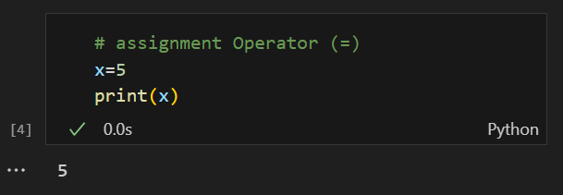
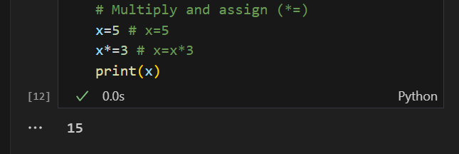
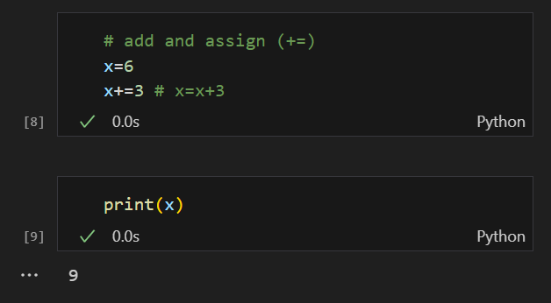
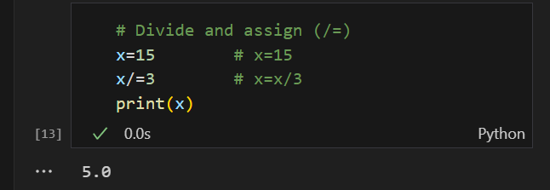
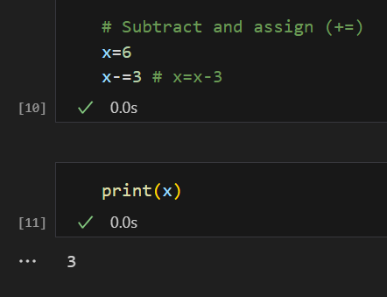
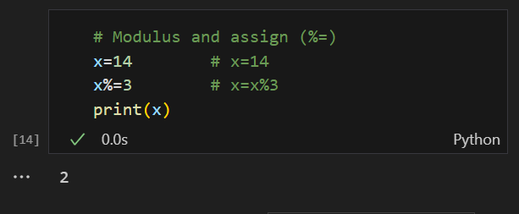
Assignment Operators

Slide 8
Quiz
Q#1 What will be the output of this code? x = 5 y = 2 print(x ** y)
a) 25 | b) 7 | c) 2.5 | d) 1o
Q#2 Which of the following is the floor division operator in Python?
a) / | b) // | c) \ | d) \\
Q#3 . What is the result of: print(10 % 3)
a) 3 | b) 1 | c) 0 | d) 10
Q4. Which operator is used to check equality in Python?
a) = | b) == | c) != | d) <=, >=
Q#5. What will this code print? a = True b = False print(a and not b)
a) True | b) False | c) 0 | d) None

Slide 9


